Slide 1

Basic Functionality in Linux (With credit to M. Lunacek at CU Research Computing)
Linux is the operating system that controls the hardware of a computer. The computers in the scorpius lab run Linux (Debian to be exact).
Other examples of operating systems are OSX and Windows.
You will use a terminal on scorpius to type in commands (input) and get output (usually to the screen).

Slide 2
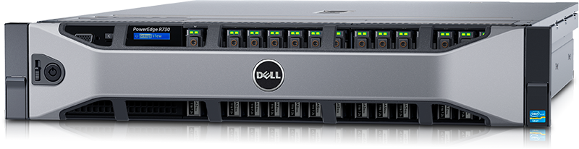
Login
Enter username (identikey) and password
Authentication
Desktop/Shell starts
Environment is set up
With a shell, you get a prompt: “$”
A remote server usually allows multiple logins

Slide 3
Navigating in your directory structure
You have a home directory (think of it as a folder) in which you can put subdirectories and files.
ls lists directory contents
ls –l long listing (info on files)
cd <path> change directory
cd .. move up one directory
pwd print working directory
clear clear the screen
arrow-up previous command
arrow-down next command
man <cmd> command (user) manual

Slide 4
man example: I’m logged on remotely to scorpius from my Mac laptop:
dawe1428@scorpiusprime:~$ man ls
LS(1) User Commands LS(1)
NAME
ls - list directory contents
SYNOPSIS
ls [OPTION]... [FILE]...
DESCRIPTION
List information about the FILEs (the current directory by default).
Sort entries alphabetically if none of -cftuvSUX nor --sort.
Mandatory arguments to long options are mandatory for short options
too.
-a, --all
do not ignore entries starting with .
:q will quit

Slide 5
Creating directory structure, manipulating directories and files
mkdir <dirname> make a directory
rmdir <dirname> remove the directory
rm <filename> remove a file
cp <src> <dest> copy a file from src to
dest
scp secure copy: see tutorial
mv <src> <dest> move a file (including the
path) to a new location (including the path)
Ex:> cp testfile ../testfile
Q. What does this do?

Slide 6
Creating directory structure, manipulating directories and files
mkdir <dirname> make a directory
rmdir <dirname> remove the directory
rm <filename> remove a file
cp <src> <dest> copy a file from src to
dest
scp secure copy: see tutorial
mv <src> <dest> move a file (including the
path) to a new location (including the path)
Q. How would I create a subdirectory homework and move the file HW1.ipnyb into it?

Slide 7
Creating directory structure, manipulating directories and files
mkdir <dirname> make a directory
rmdir <dirname> remove the directory
rm <filename> remove a file
cp <src> <dest> copy a file from src to
dest
mv <src> <dest> move a file (including the
path) to a new location (including the path)
mkdir homework
mv HW1.ipynb homework/HW1.ipynb
Any other way?

Slide 8
Creating directory structure, manipulating directories and files
mkdir <dirname> make a directory
rmdir <dirname> remove the directory
rm <filename> remove a file
cp <src> <dest> copy a file from src to
dest
mv <src> <dest> move a file (including the
path) to a new location (including the path)
OR
mkdir homework
cd homework
mv ../HW1.ipynb HW1.ipynb
Which would make homework the working directory

Slide 9
Creating directory structure, manipulating directories and files
mkdir <dirname> make a directory
rmdir <dirname> remove the directory
rm <filename> remove a file
cp <src> <dest> copy a file from src to
dest
mv <src> <dest> move a file (including the
path) to a new location (including the path)
OR
mkdir homework ; mv HW1.ipynb homework/HW1.ipynb
Which executes both commands in one line

Slide 10
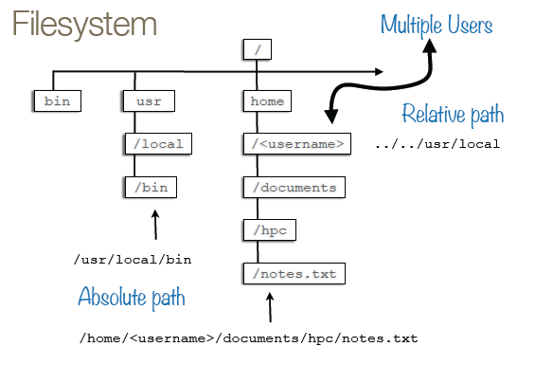
File System (M. Lunacek)
home directory
This is close to, but not exactly, our directory structure on scorpius – see tutorial.

Slide 11
The home directory and $HOME variable
$HOME is an environment variable that holds the full path of the home directory
echo is a command that reports what a variable holds
Q. What should echo $HOME report for me if my username (and the name of my home directory) is dawe1428?
dawe1428@scorpiusprime:~$ echo $HOME

Slide 12
The home directory and HOME variable
$HOME is an environment variable that holds the full path of the home directory
echo is a command that reports what a variable holds
Q. What should echo $HOME report for me if my username (and the name of my home directory) is dawe1428?
dawe1428@scorpiusprime:~$ echo $HOME
/home/dawe1428

Slide 13
The $PATH variable
When you type a command the shell looks in the current directory for the program, then in other directories in the $PATH environment variable:
dawe1428@scorpiusprime:~$ echo $PATH
/opt/anaconda/bin:/usr/local/bin:/usr/bin:/bin:/usr/local/games:/usr/games

Slide 14
The $PATH variable
We can append to $PATH with a new directory where we put our programs. For example:
Q. Why would we want to append to our path variable?
dawe1428@scorpiusprime:~$ PATH=$PATH:/home/dawe1428/homework
And then:
dawe1428@scorpiusprime:~$ echo $PATH
/opt/anaconda/bin:/usr/local/bin:/usr/bin:/bin:/usr/local/games:/usr/games:/home/dawe1428/homework

Slide 15
Creating a simple program
In /home/dawe1428/homework, I created test1, which contains:
#/bin/sh
echo ‘hello world’
I can run the shell program test1 by specifying its exact location:
dawe1428@scorpiusprime:~$ ~/homework/test1
hello world

Slide 16
Creating a simple program
In /home/dawe1428/homework, I created test1, which contains:
#/bin/sh
echo ‘hello world’
I can run the shell program using the command sh. ~/homework/test1 is an input to sh:
dawe1428@scorpiusprime:~$ sh ~/homework/test1
hello world

Slide 17
Creating a simple program
In /home/dawe1428/homework, I created test1, which contains:
#/bin/sh
echo ‘hello world’
I can run the shell program test1 by changing to the directory it is in and then executing test1:
dawe1428@scorpiusprime:~$ cd homework
dawe1428@scorpiusprime:~/homework$ ./test1
hello world

Slide 18
Creating a simple program
And to run it from any directory:
dawe1428@scorpiusprime:~$ PATH=$PATH:/home/dawe1428/homework
Then, from my home directory without specifying any directory:
dawe1428@scorpiusprime:~$ test1
hello world
Note: You must append to the path every time you log in.

Slide 19
King of commands: grep
”grep” is used to find content inside text files (there is a pdfgrep, but needs to be installed extra).
Try it with your .bashrc file:
dawe1428@scorpiusprime:~$ grep HISTSIZE .bashrc
Or, you maybe don’t know which of dot-files contains HISTSIZE:
dawe1428@scorpiusprime:~$ grep HISTSIZE .*
You can also only list the matching files with the –l option.
I can seriously say, without “grep” there’d be much less science

