Slide 1
etwork mation
N
Auto
HUB
1
Ashwin Chandrasekaran

Slide 2
etwork mation
N
Auto
HUB
Ashwin Chandrasekaran
1

Slide 3










Auto
N
HUB
1
Ashwin Chandrasekaran
SNMP

Slide 4
Auto
N
HUB
SNMP
2
Network Management and Automation System
Network Source Of Truth
AI Assitant

Slide 5
Auto
N
HUB
Network Management and Automation System
SNMP
Network Source Of Truth
AI Assitant

Slide 6
Auto
N
HUB
Network Management and Automation System
Network Source Of Truth
SNMP
2
AI Assitant

Slide 7
Auto
N
HUB
Network Management and Automation System
Network Source Of Truth
SNMP
AI Assitant
2
NMAS

Slide 8

Auto
N
HUB
Main Components
Additional Features
Edge Devices
Show Commands
Network Management and Automation System
Auto
N
Config Download
Core Devices
Network Source Of Truth
NMAS
Difference Comparator
SNMP
Server Devices
IP Validation
AI Assitant
Ping Test
3

Slide 9






Main Components
Additional Features
Edge Devices
Show Commands
Config Download
Core Devices
NMAS
Difference Comparator
Server Devices
IP Validation
Ping Test
SNMP
3

Slide 10


SNMP
4
Front End

Slide 11
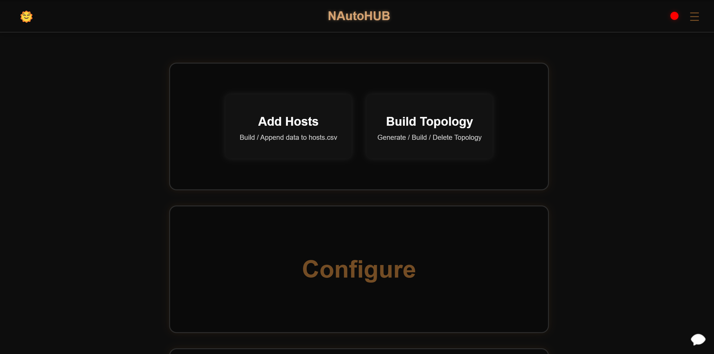
5
SNMP

Slide 12
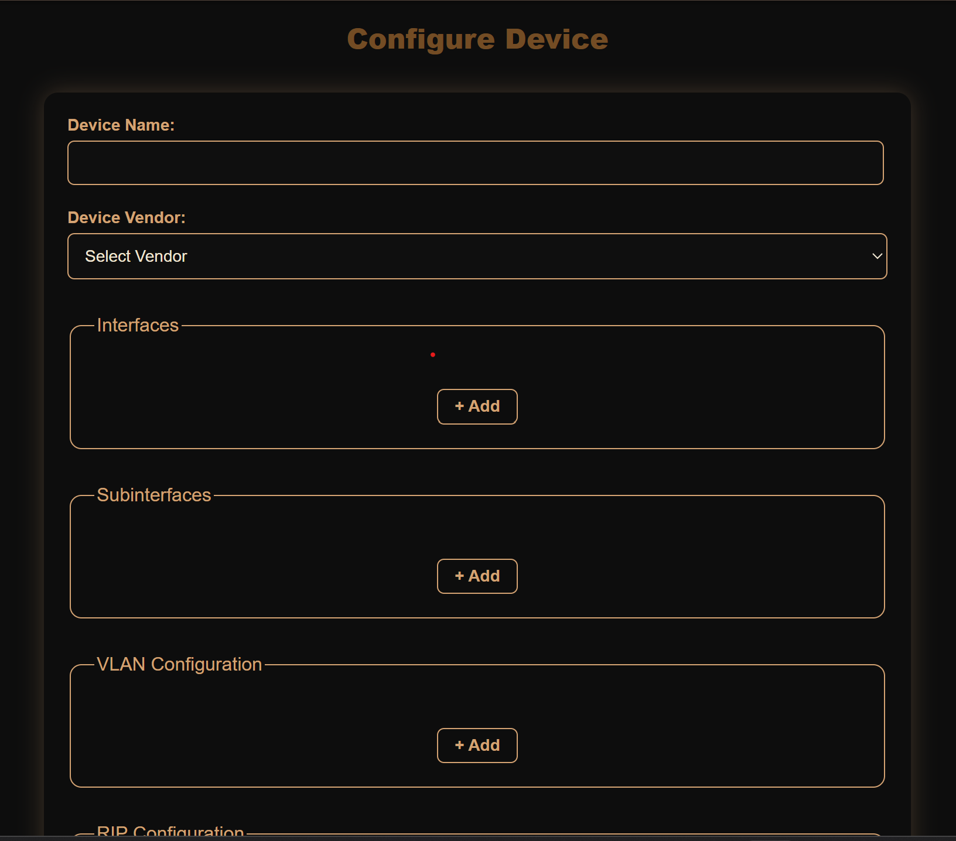
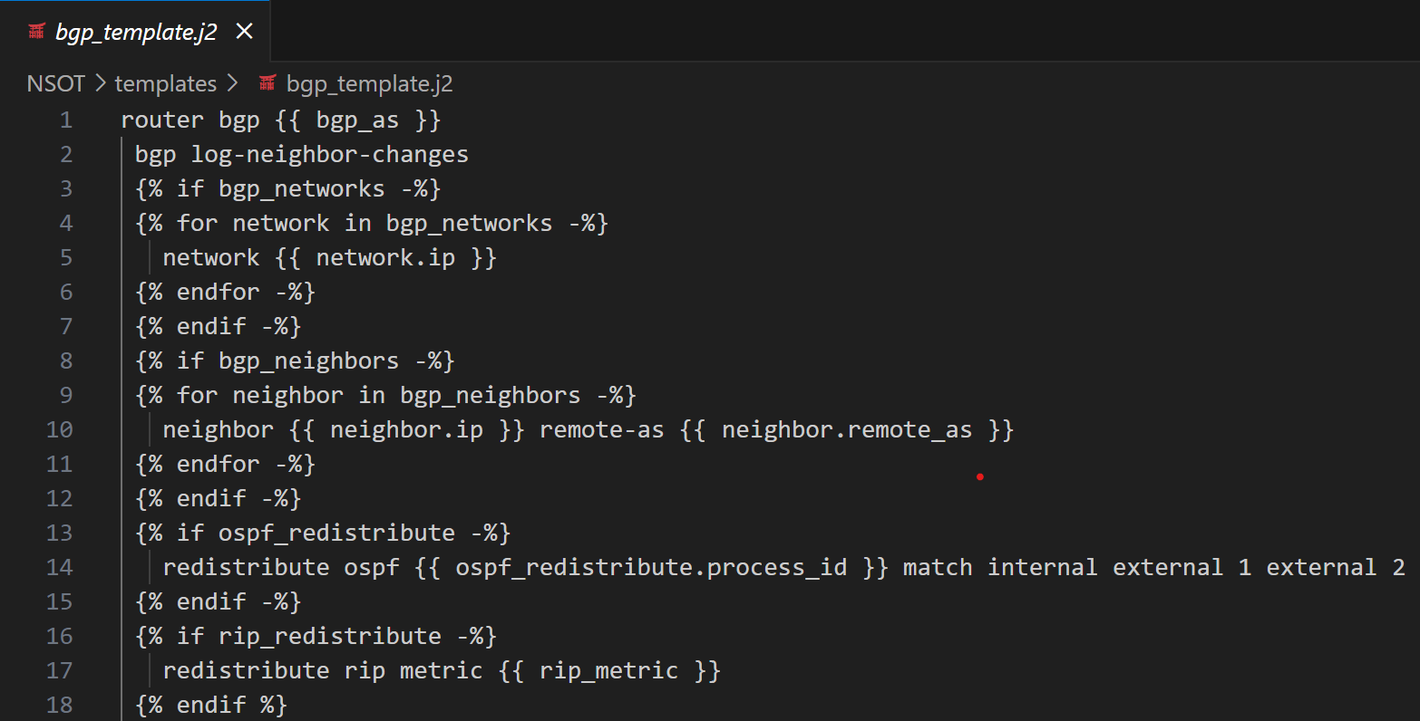
6
SNMP

Slide 13
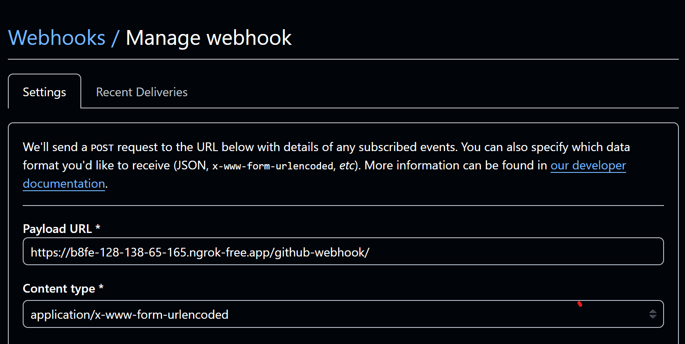
SNMP
7

Slide 14
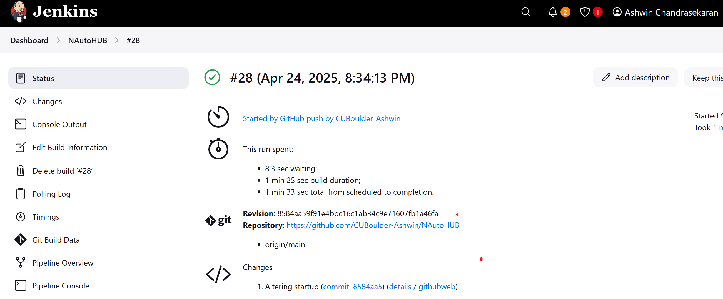
SNMP
8

Slide 15
SNMP
9

Slide 16
10
SNMP

Slide 17
11
SNMP

Slide 18
SNMP
DEMO
12

Slide 19
SNMP
DEMO
13

