Slide 1
ODE to Joy: Neural ODEs and a Surprising Simplification of Neural Networks
Olivier B. Simon
Ghosh Lab
Machine Learning Reading Group, CU Anschutz
March 5, 2019

Slide 2
Artificial Neural Networks (ANNs)
Current state-of-the-art for many AI problems, particularly in visual processing
Based on a gross analogy to the structure of biological brains: neocortical layers, neurons with firing thresholds, etc.
Not a really new idea at all (McCullough and Pitts, 1940s; perceptrons, 1950s)
Really only caught on post-2012 (AlexNet) due to availability of brute-force computing power (GPUs)
Still sort of tricky to train; hyperparameter choice is more art than science
lots of memory, hardware needed

Slide 3
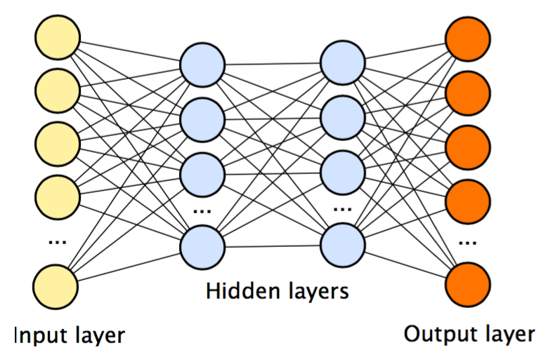
Your Basic ANN
(Loads of) training information is propagated through successive layers, input to output, often in batches, to get an output
This is compared with the ground truth, and backpropagation then goes the opposite direction, again layer-by-layer, updating the gradients
Result, if successful: often >tens of millions of trained parameters, representing biases and weights of the nodes and connections of this notional “network”

Slide 4
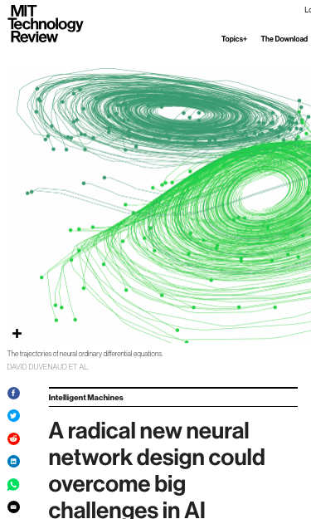
A New Way? Neural ODEs: the Paper
“Neural Ordinary Differential Equations”
by Ricky T. Q. Chen, Yulia Rubanova, Jesse Bettencourt, & David Duvenaud
Received “best paper” at Neural Information Processing Systems conference (NIPS) last year (with four others)
Already making a stir: featured in MIT Tech Review!

Slide 5
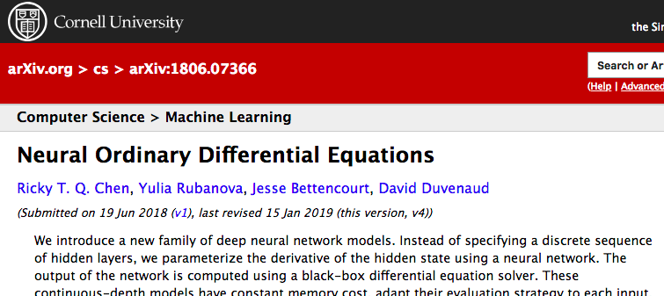
A new way? Neural ODEs: the paper
Basic idea: replace the discrete, finite-numbered “layers” and “nodes” of an NN with “layers” of infinitesimal/differential thickness, all governed by a single big ordinary differential equation (ODE)
So we not only have calculus being done within each layer (i.e. the chain rule for backpropagation updates) but now in the succession of “layers”
In this way, NN “classification” and “training” are re-conceptualized as the continuous evolution of the ODE in the forward or reverse time, respectively

Slide 6
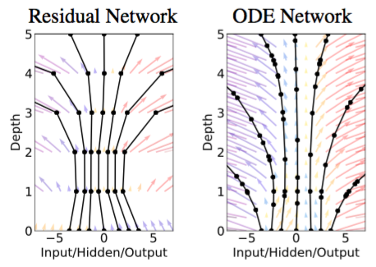
Figure 1: Discrete vs. continuous NN
The discrete-layered NN is like a step-wise approximation to a trajectory in the vector field defined by the underlying ODE
Layers thus are reconceptualized as equally-spaced “timepoints”; in the case of a recurrent NN, they literally are the timepoints.
Neural ODE replaces this stepwise evolution with a smooth path

Slide 7
By the way... what’s an ODE?
Ordinary Differential Equation
A specific but very common/useful kind of differential equation
Any combination of different functions (often linear, as above), and/or their n-th order derivatives
Essential distinguishing feature: all these functions and derivatives are in terms of a single independent variable, so no partial derivatives (contrast with partial differential equation)
Goal is to solve for this variable, which will have the form of a function or trajectory.

Slide 8
Neural ODEs: sounds nice but... why?
Constant memory cost w.r.t. NN depth (fewer parameters needed).
In effect, you can make the “network” as deep as you want it to be, just by running the solver for longer—which does not take more memory since all that matters is the current state of the ODE.
Adaptable for trade-offs at different levels of accuracy, allowing more efficient usage of compute
Continuous transformation, rather than layer-by-layer, makes change-of-variables (for density estimation) remarkably easier mathematically.
Unlike RNNs, which are clock-like, Neural ODEs can train on data gathered at arbitrary time-points, rather than requiring imputation or otherwise suffering from ill-synchronized data.

Slide 9
Key Mathematical Aspects

Slide 10
The three most distinctive math concepts used in neural ODEs
Besides ODEs themselves, three pieces of math in the paper stand out as most critical to carrying out this shift from discrete to continous solutions:
Adjoint state method
(Continuous) normalizing flows
Instantaneous change-of-variable theorem
The first and last are described in the paper and are also given proofs in the appendices
Second one is probably the most abstruse (and least clearly explained)

Slide 11
1. Adjoint method (continuous backpropagation)
"...a well-known method in the numerical community for computing the gradient of a functional with respect to the model parameters when this functional depends on those model parameters through state variables, which are solutions of the forward problem.” (R. E. Plessix et al, 2006)
A bit more simply: the adjoint method is a way of getting the derivatives of a continuous, many-valued function—particularly in an inverse direction—without having to compute the Jacobian matrix, which is computationally nasty.
Authors call it an “instantaneous analog of the chain rule”
Backpropagation surely can’t happen without derivatives. So this is indeed useful to our quest to recast NNs as continuous functions.

Slide 12

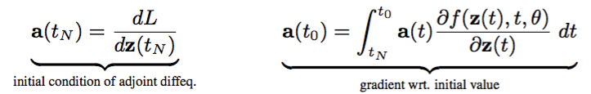
1. Adjoint method (continuous backpropagation)
Adjoint Method used for recreating back-propagation in an ODE setting. (Proof given in Appendix B)
a(t) is the “adjoint state”; z(t), the “hidden state”
We can integrate this backwards through time to decrease the loss through each successive timepoint, at which we “update” by calculating a new initial condition (see Figure 2)

Slide 13
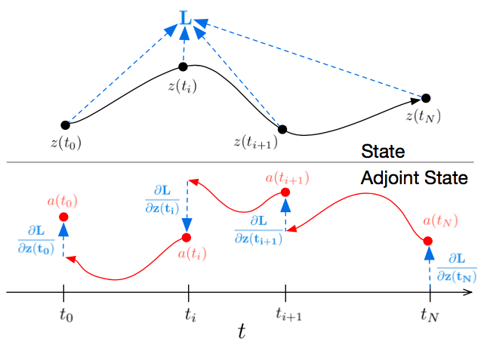
Figure 2: Adjoint method in action
Red arrows: use the adjoint method to track the ODE dynamics smoothly back through time/layer-space
Blue arrows: when a timepoint is reached, use adjoint method to get the resulting change in gradient and “update” the dynamics
Repeat till you reach t=0
This is oversimplifying: three different integrals being calculated (t, z, and theta)

Slide 14
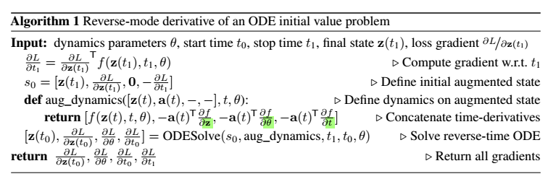
NN ODEs: Backpropagation algorithm

Slide 15
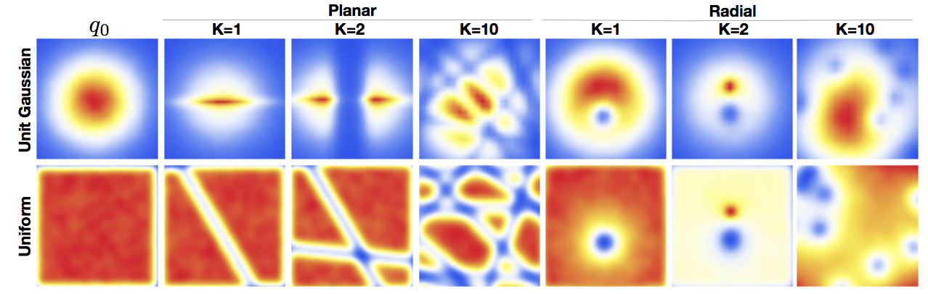
2. Normalizing flows
Normalizing flows (NFs) are a tool of variational inference: they are invertible transformations that can progressively generate reasonably tractable posterior distributions, to approximate the oft-intractable real-life ones.
As the name suggests, the trick is keeping the distribution normalized through these transformations.

Slide 16

2. Normalizing flows
NFs normally use the discrete change-of-variable theorem (above) to update the distributions with time evolution/new data and stay normalized
But: using the continuous change-of-variable makes NFs into something mathematically more economical and yet more robust, and particularly well-suited for ODEs: Continuous Normalizing Flows (CNFs)

Slide 17
3. Instantaneous change-of-variable
The original “change of variables theorem” is:
“A theorem which effectively describes how lengths, areas, volumes, and generalized n-dimensional volumes (contents) are distorted by differentiable functions. In particular, the change of variables theorem reduces the whole problem of figuring out the distortion of the content to understanding the infinitesimal distortion, i.e., the distortion of the derivative (a linear map), which is given by the linear map's determinant.” (Wolfram Mathworld)
This idea also can be applied to distortions of probability distributions.

Slide 18
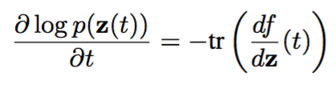
3. Instantaneous change-of-variable
Generalization of the change-of-variable equation to infinitesimal cases
The authors “use it to construct a new class of invertible density models that avoids the single-unit bottleneck of normalizing flows, and can be trained directly by maximum likelihood.”
Used for updating the underlying posterior distributions/probabilities within the NN in continuous rather than discrete time (?)

Slide 19
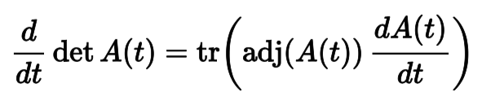
3. Instantaneous change-of-variable
Key step in the proof (Appendix A): Jacobi’s formula
Note that by changing to instantaneous, a determinant computation (left side; computationally hard) is converted into a trace computation (right side; not very hard)
Thus, continuous change-of-variable makes normalizing flows into continuous normalizing flows, AND makes them much easier to handle
The continuousness of neural ODEs makes them a perfect fit for this
Notes:
“adj()” is the adjugate operator, basically like the adjoint. It’s the transpose of the cofactor matrix.

Slide 20
General Results and Figures

Slide 21
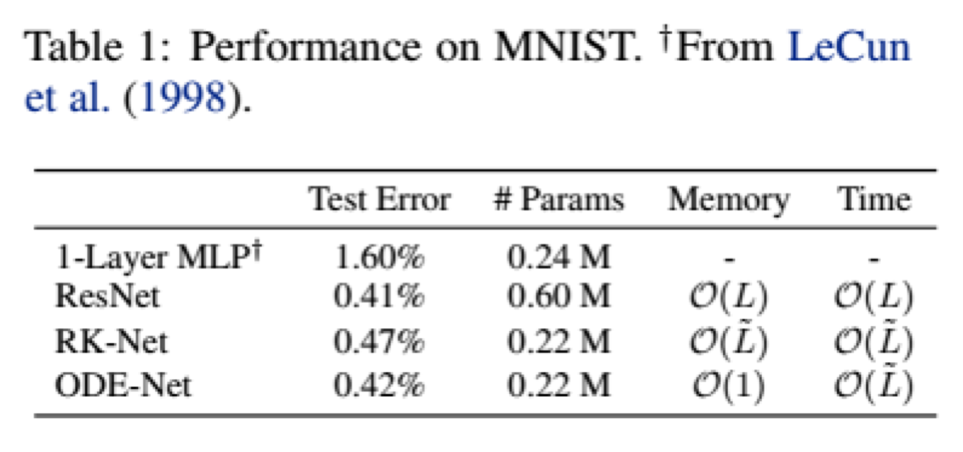
Table 1: Neural ODE is as accurate, but more efficient than discrete NN
First test: authors train an ODE model derived from ResNet architecture, dubbed “ODE-Net”, on MNIST
ODE-Net achieves the same test error as ResNet, but with 1/3 the parameters!
L = number of layers in the ResNet; L ̃ = number of function evaluations by the ODE solver per forward pass
Note also that it is constant in memory usage
“RK-Net”: not sure

Slide 22
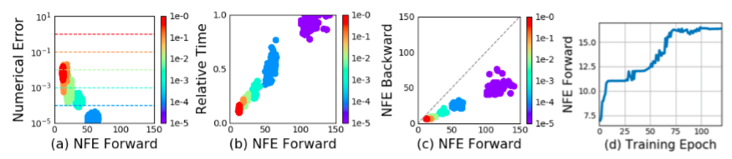
Figure 3: Neural ODE depth and precision can be traded for speed
Computational time demands go down as the neural ODE runs with less precision (~ less “deep”)
Also, backprop using the adjoint method is actually about half as compute-intensive

Slide 23
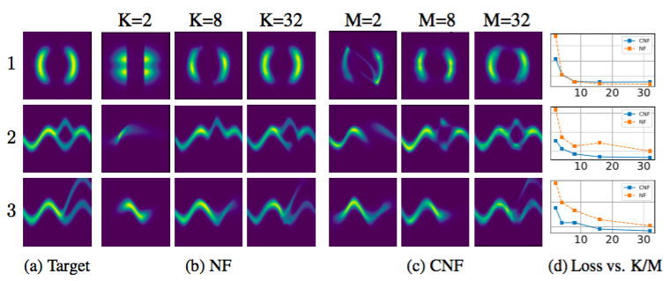
Figure 4: NFs vs CNFs
Comparison of NFs versus CNFs.
CNFs converge to the true distribution more quickly than NFs
CNFs can be adjusted by width (M) as well as depth (K)

Slide 24
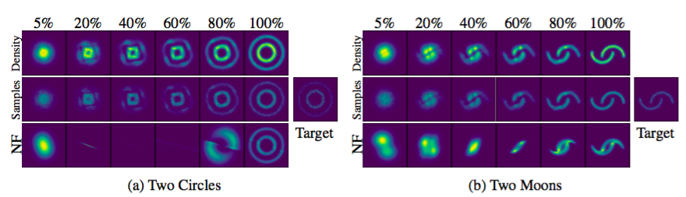
Figure 5: CNFs learn distributions smoothly
Comparison of the time progression of NFs and CNFs in learning a given “target” distribution
CNF’s progression is smooth, reversible and visually makes sense; NF much less so
NF does a poor job estimating the “two moons”
Notes:
CNF is the upper 2 rows. Trained using maximum likelihood. Samples are taken from the model run in reverse after training.

Slide 25
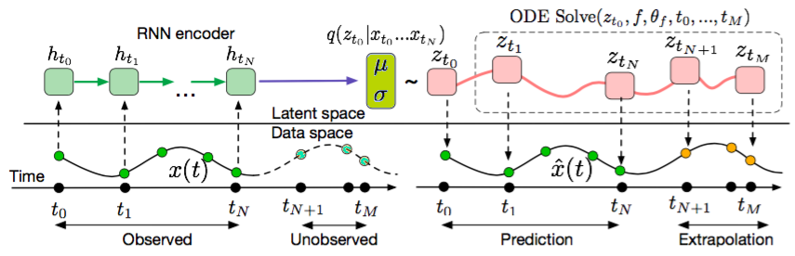
Figure 6: Neural ODE can make predictions, even at unevenly-spaced timepoints
Caption: “Computation graph of the latent ODE model”
Oddly, there is no mention of this figure in the body of the paper
Seems to show the neural ODE’s ability to use irregular timepoints, and then to function as a generative model
Notes:
Maybe the most confusing figure in the whole paper. So you train an RNN on an autoencoder, and then train ODEsolve on the RNN, and then run the ODEsolve forward to make predictions?? (TowardsDataScience says: “The model is a variational autoencoder which encodes the past trajectory (green in the figure below) in the initial latent state z[sub]₀ using an RNN.”)

Slide 26
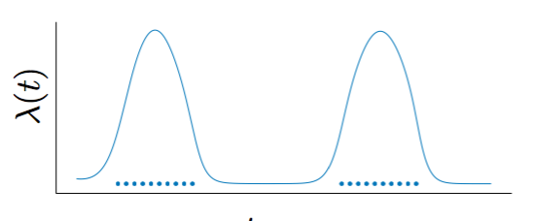
Figure 7: On-the-fly adaptation to time-varying statistics in the data
“The rate of events can be parameterized by a function of the latent state: p(event at time t| z(t)) = (z(t)). Given this rate function, the likelihood of a set of independent observation times in the interval [tstart , tend ] is given by an inhomogeneous Poisson process”
Another way of dealing with clumped, temporally irregular data
Notes:
Caption is: Figure 7: Fitting a latent ODE dy- namics model with a Poisson pro- cess likelihood. Dots show event times. The line is the learned inten- sity (t) of the Poisson process.

Slide 27
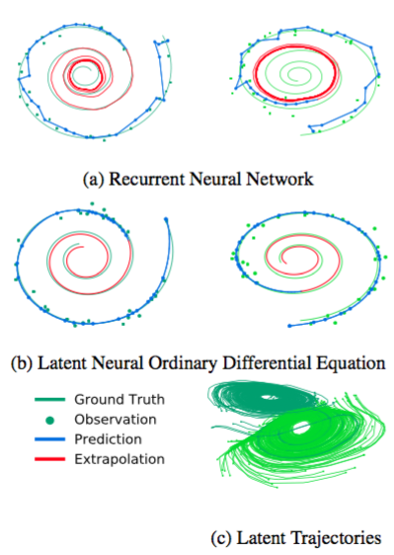
Figure 8: RNNs vs. neural ODEs
a) demonstrates the superior ability of the neural ODE to generate the underlying spiral shape from which the data points were generated
b) is a 2D projection of the 4D latent space in which the spirals are embedded in the ODE (left-handed and right-handed spirals are in two adjacent families)

Slide 28
Final Questions/Thoughts

Slide 29
Downsides of Neural ODEs
Minibatching is more complicated: may have to combine multiple ODEs together (“...concatenating the states of each batch element”)
Unique ODE solutions depend on the NN having finite weights and Lipschitz nonlinearity
Reversibility accrues errors in the forward and reverse passes, and from “multiple initial values mapping to the same final state”

Slide 30
How to train differing “layers”?
In the case of an RNN, the network architecture is often thought of as a single layer repeated over and over.
For larger networks, it appears the authors just train the ODE on the whole network as a block.
How would we simulate successive layers that are of different types?
In general, it also appears possible to adjust the CNFs on-the-fly: “We can specify the parameters of a flow as a function of t, making the differential equation f(z(t), t) change with t. This parameterization is a kind of hypernetwork”
Similarly with inhomogeneous Poisson: can train on changing likelihoods
So, it looks like with neural ODEs you can actually shift from not only one “layer type”, but one NN architecture to another
Cool

Slide 31
Other Questions
Still don’t really understand how a simple ODE solver manages to efficiently encapsulate all of the potential dynamics of an “explicit” neural network architecture, with its tens/hundreds of millions of parameters...
...unless, as some have suggested (Chaudhari & Soatto, 2018), the vast majority of the variables in the trained net carry little information (low-rank).
Does the “vanishing gradient” issue simply itself vanish entirely once we give up on simulating as nodes, discrete layers etc.? Or is there a continuous-valued analogue of it?
Is there any analogue of “dropout” in a Neural ODE?
What determines “divergence” or “convergence” in training? (Imagine a case where solution of the Neural ODE could be unique and yet zigzags wildly or perhaps is even chaotic, thus not very useful as a model.)

Slide 32
Summary/Conclusion
An unusually simple, intuitive, and elegant re-conceptualization of NNs
Possibility of much more efficient use of computing power
Interesting insight: seemingly intractably complex NN architectures can be, in effect, “bottled” by an ODE solver.

Slide 33
Thanks

