Slide 1
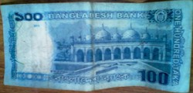
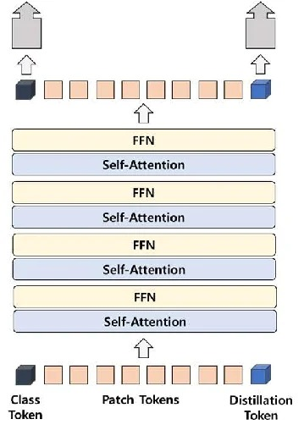
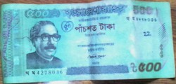
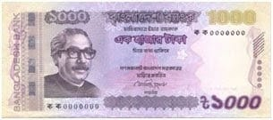


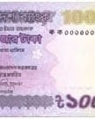

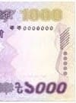
Banknote Dataset
Prediction
Preprocessing
Resize 224×224
Augmentation
Normalization
i. Genuine
ii.Counterfeit
Data Collection and Preprocessing
DeiT-Tiny Vision Transformer
Prediction

