Slide 1

Abstrax
®
Issues and Opportunities With Commercial Grade Scheme
John LaLonde
September 18, 2004

Slide 2
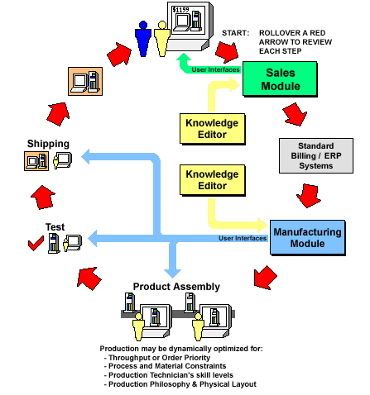
Abstrax automates the order fulfillment loop for build-to-order manufacturers.

Slide 3
Abstrax’s Software Entails
  Custom Product Configuration & Validation
  Product Modeling
  Scheduling (NP)
  Automatic Program Generation (source code)
  Automatic Human/Robotic Process Instruction Generation
  Multi-Platform

Slide 4
Benefits of Functional Languages
  Flexibility
    Hybrid Paradigm Architectures
    Extend / Create Languages
  Automatic Memory Management
  Reduced Prototyping / Development Time
  Performance

Slide 5
Our Issues With Functional Languages
  Windows Platform
    Look & Feel
    Build Environments & Tools
    Utility Integration
  Internet Application Support
  Trained Talent
  Sole Source Compiler
  Fortune 500 Hesitance

Slide 6
Opportunities For Wide Spread Use
  Powerful Internet Applications
    Single Flag To Create Internet App
    Optional Native / VM Runtime
  Mircrosoft Adoption
  New Wave of AI Apps
  CUFP Inertia ?

Slide 7
Thanks to John Launchbury for getting
CUFP started .
Where do we all take it from here?

Slide 8
Abstrax
®
Issues and Opportunities With Commercial Grade Scheme
John LaLonde
September 18, 2004

