Slide 1


Productivity Gains in Erlang
A Heriot-Watt and Motorola Production
Commercial Users of Functional Programming Freiburg, Germany, October 4th 2007
Jan Henry Nyström
jann@macs.hw.ac.uk jan@erlang-consulting.com
Phil Trinder
trinder@macs.hw.ac.uk
David King
david.king@praxis-his.com

Slide 2
Project
Project
High-Level Techniques for Distributed Telecoms Software
EPSRC (UK Govt) Project, Dec 2002 – Feb 2006
Collaboration between
  Motorola UK Labs
  Heriot-Watt University

Slide 3
Project
High-Level Techniques for Distributed Telecoms Software
EPSRC (UK Govt) Project, Dec 2002 – Feb 2006
Collaboration between
  Motorola UK Labs
  Heriot-Watt University
Aim: Produce scientific evidence that high-level distributed languages like Erlang or Glasgow distributed Haskell (GdH) can improve distributed software robustness and productivity.

Slide 4
Erlang Comparisons
A number of sequential comparisons
  Computer Language Shootout
Very few distributed system comparisons published!
Ulf Wiger [Wiger01] reports
  Erlang systems have between 4 and 10 times less code than C/C++/Java/PLEX systems
  Similar error rates/line of code, similar productivity rates
  No direct comparative measurements

Slide 5
Research Questions: Potential Benefits
RQ1: Can robust, configurable systems be readily developed?
Resilience to extreme loads
Availability in the face of hardware & software failures
Dynamic reconfigurability on available hardware
RQ2: Can productivity and maintainability be improved?
How do the sizes of the C++ and Erlang components compare & what language features contribute to size differential?

Slide 6
Research Questions: Feasibility
High-level distributed languages:
Abrogate control of low-level coordination aspects, so
  RQ3: can the required functionality be specified?
typically pay space and time penalties for their automatic coordination management.
  RQ4: can acceptable performance be achieved?
RQ5: What are the costs of interoperating with conventional technology?
RQ6: Is the technology practical?

Slide 7
Research Strategy
Reengineer telecoms applications in GdH and Erlang
  Dispatch Call Controller [NTK04,NTK05]
  Data Mobility component
Compare high-level and Java/C++ implementations for
  Performance
  Robustness
  Productivity
  Impact of programming language constructs

Slide 8
Data Mobility Component (DM)
First Product Application
Communicates with Motorola mobile devices
3000 lines of C++
Uses 18,000 lines of Motorola C library functions
Has a transmitter, a receiver and 2 message types
Interacts with 5 other components of the system

Slide 9
Despatch Call Controller (DCC)
Second Application
Handles mobile phone calls
A process manages each call
Scalable with multiple servers

Slide 10
Two Erlang DM Implementations
Pure Erlang DM
Erlang / C DM
  Reuses some C DM libraries & drivers
Both interoperate with a test harness
Combines
  Unix Processes
  Erlang processes
  C Threads (Erlang/C DM)

Slide 11
RQ3 Performance 1: Throughput
Platform: 167MHz, 128Mb Sun Ultra 1, SunOS 5.8
C++ DM | Erlang/C DM | Pure Erlang DM
480 | 230 | 940
Maximum DM Throughput at 100% QoS
Pure Erlang DM is twice as fast as C++ DM
  Better process management and marshalling
Erlang/C DM is ½ speed of C++ DM
  Still meets nominal throughput

Slide 12
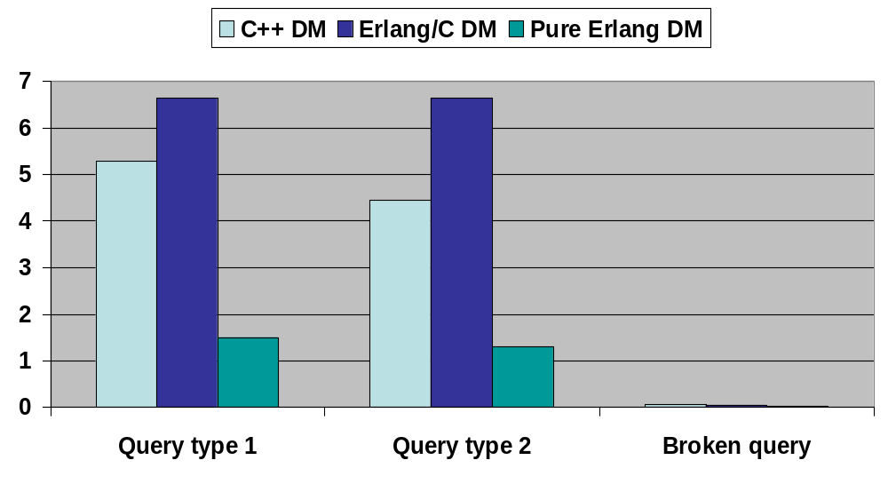
RQ3 Performance 2: Roundtrip Times
ms
Pure Erlang is approximately 3 times faster
Erlang/C is 26% - 50% slower

Slide 13
Performance Analysis
Pure Erlang DM is faster due to fast lightweight process management
Erlang/C is slower due to additional communication to C components

Slide 14
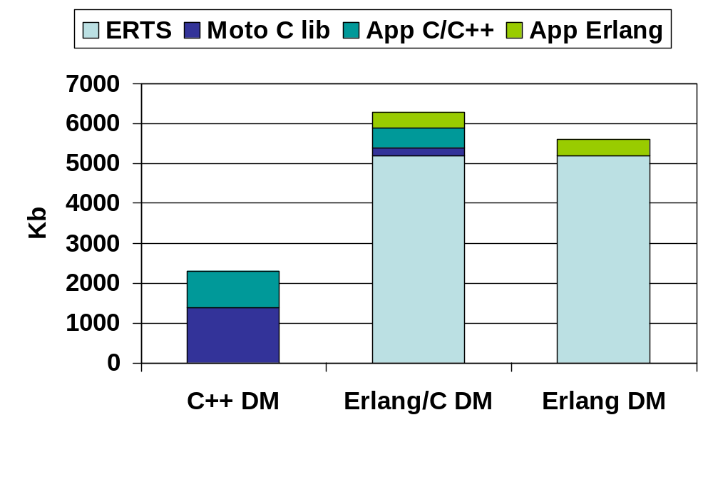
Performance 3: Memory Residence
Erlang DMs use 170% more memory
Erlang runtime sys (ERTS) has a fixed size
  Would be a smaller % of a larger application

Slide 15
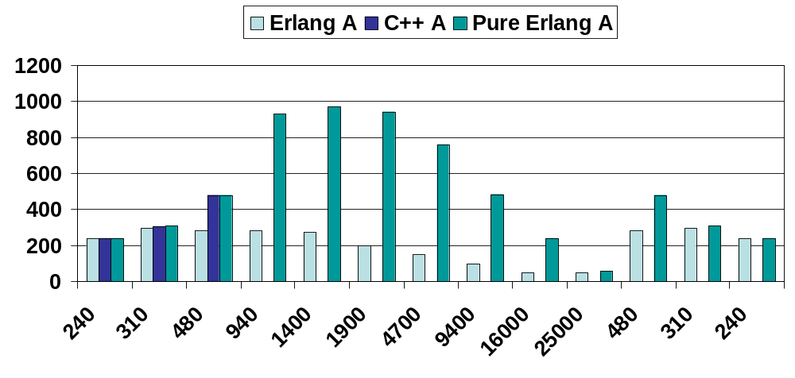
RQ1 Robustness 1: Resilience
Throughput
(queries/s)
Load (queries/s)

Slide 16
RQ1 Robustness 1: Resilience
When overloaded:
C++ DM fails catastrophically
Pure Erlang & Erlang/C DMs:
Throughput degrades
  Never completely fails
  Handling 48 q/s at peak load (25000q/s)
  Recovers automatically after load drops

Slide 17
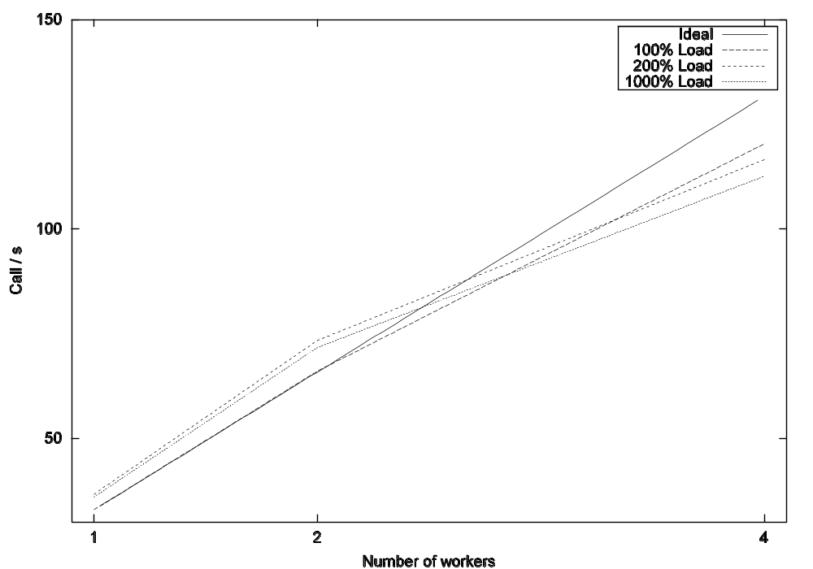
DCC Resilience

Slide 18
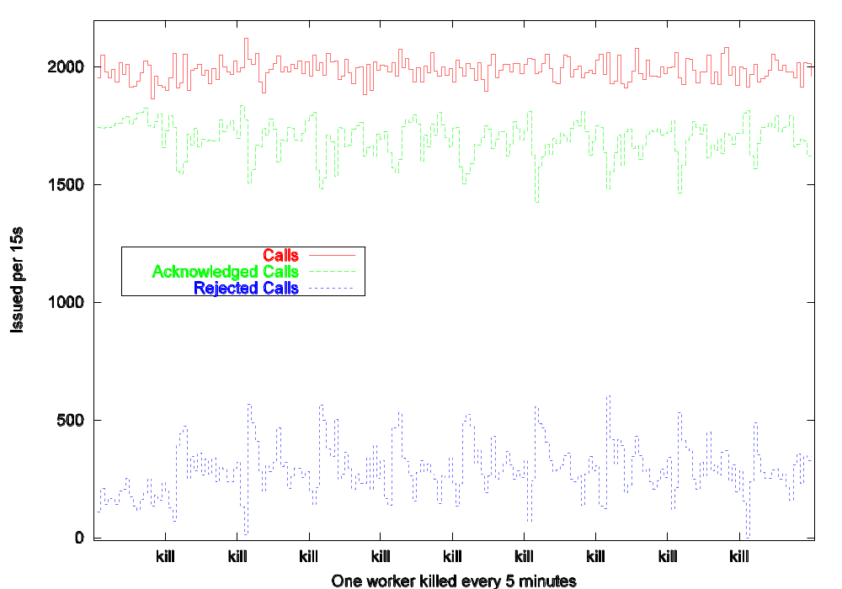
Robustness 2: Availability
Erlang DCC system:
Remains available despite repeated hardware and software failures
Performance doesn’t degrade with repeated failures
DCC Throughput with Repeated Failures

Slide 19
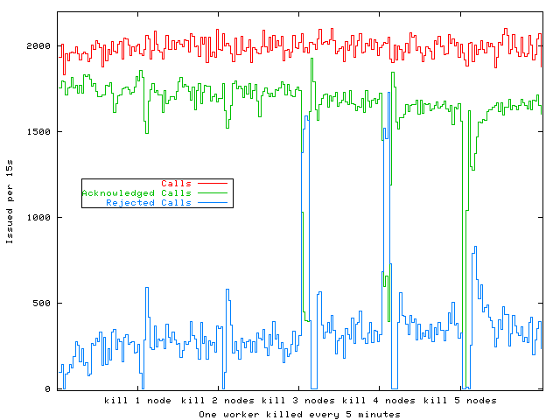
Robustness 2: Availability
Erlang DCC system:
Resists the simultaneous failure of multiple components
When more components fail throughput drops lower & recovery takes longer
5-processor DCC with Multiple Failures

Slide 20
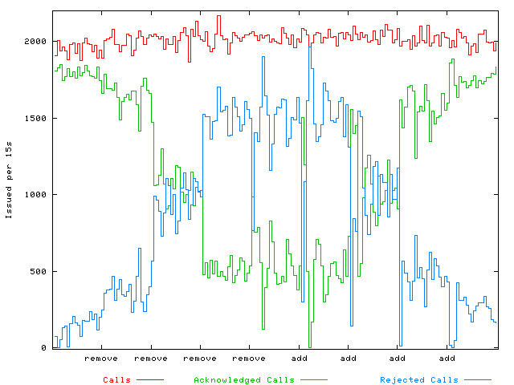
Robustness 3: Dynamic Configurability
Erlang DCC system:
Dynamically adapt to the available hardware resources
5 processor system
  Remove a processor 4 times
  Add a processor 4 times
DCC Throughput
with Varying Numbers of Processors

Slide 21
RQ2: Productivity & Maintainability
Shorter programs are
Faster to develop
Contain fewer errors [Wiger01]
Easier to maintain
The metric we use is Source Lines Of Code (SLOC)

Slide 22
Productivity: Source Code Sizes
Lang. | C/C++ | Erlang | Total
C++ | 3101 |  | 3101
Erl./C | 247 | 616 | 863
Erlang |  | 398 | 398
Lang. | C++ | IDL | Erlang | Total
C++ | 14.8K | 83 |  | 14.9K
Erlang |  |  | 4882 | 4882
DCC Implementations
DM Implementations
Erlang DCC & DM are less than 1/3rd of size of C++ version
Consistent with Wiger & folklore

Slide 23
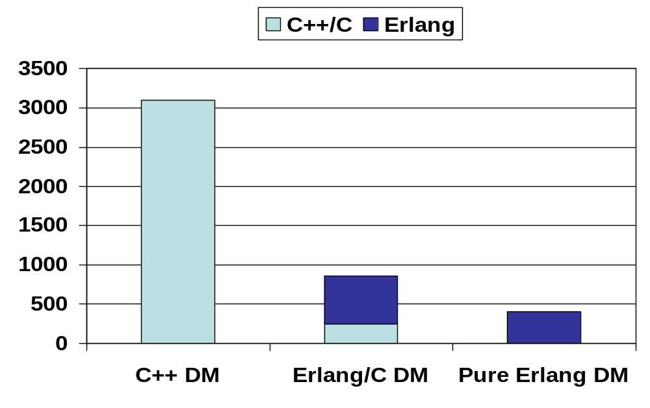
Productivity: DM Source Code Sizes
Erlang/C DM is 1/3rd of the size of the C++ DM
Pure Erlang DM is 1/7th of the size of the C++ DM
Erlang/C DM is 1/18th of the size of the C++ DM + libraries

Slide 24
Reasons for difference in Code Size
Erlang programmers can
  Rely on fault tolerance and code for the successful case
  27% of C++ DM code is defensive
And have to their use
  Automatic memory management (11% of C++ DM code)
  High-level communication (23% of C++ DM code)
  Telecom design pattern libraries

Slide 25
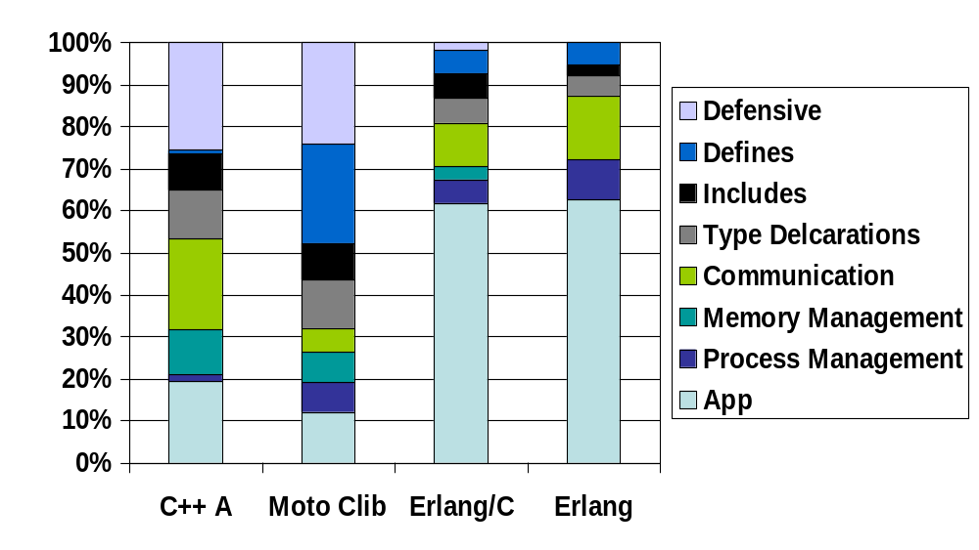
DM Code Breakdown

Slide 26
Code Difference Example
void DataMobilityRxProcessor::processUnsupVer(void)
{
MSG_PTR msg_buf_ptr;
MM_DEVICE_INFO_MSG *msg_ptr;
RETURN_STATUS ret_status;
UINT16 msg_size;
// Determine size of ici message
msg_size = sizeof( MM_DEVICE_INFO_MSG);
// Create ICI message object to send to DMTX so it sends a Device Info
// message to VLR and HLR clients
IciMsg ici_msg_object( MM_DEVICE_INFO_OPC, ICI_DMTX_TASK_ID, msg_size);
// Retrieve ICI message buffer pointer
msg_buf_ptr = ici_msg_object.getIciMsgBufPtr();
// Typecast pointer from (void *) to (MM_DEVICE_INFO_MSG *)
msg_ptr = (MM_DEVICE_INFO_MSG *)msg_buf_ptr;
// Populate message buffer
SET_MM_DEVICE_INFO_DEVICE_TYPE( msg_ptr, SERVER);
SET_MM_DEVICE_INFO_NUM_VER_SUPPORTED( msg_ptr, NUM_VER_SUPPORTED);
SET_MM_DEVICE_INFO_FIRST_SUP_PROTO_VERS( msg_ptr, PROTO_VERSION_ONE);
// Send message to the DMTX task
ret_status = m_ici_io_ptr->send(&ici_msg_object);
// Check that message was sent successfully
if (ret_status != SUCCESS)
{
// Report problem when sending ICI message
sz_err_msg( MAJOR, SZ_ERR_MSG_ERR_OPCODE, __FILE__, __LINE__,
"DataMobilityRxProcessor processUnsupVer: failure sending "
" device info message to DMTX");
}
C++
Erlang
sz_dme_dmtx:cast(device_info)

Slide 27
Erlang DCC Reusability
Part | SLOC | No. Modules | Percentage
Reusable Platform | 2994 | 26 | 61%
Specific Services | 147 | 1 | 3%
Testing & Statistics | 1741 | 11 | 36%
Considerable potential for reuse

Slide 28
Summary
Investigated high-level distributed language technology for telecoms software
Reengineered two telecoms components in Erlang
Measured & compared the Erlang & C++ components

Slide 29
RQ1:Robust and Configurable Systems
Improved resilience:
  Erlang DM and DCC sustain throughput at extreme loads
  Automatically recover when load drops
  C++ DM fails catastrophically (predict C++/CORBA DCC would)
Improved availability:
  Erlang DCC recovers from repeated & multiple failures
  Predict C++/CORBA DCC would fail catastrophically
Dynamic Reconfiguration
  Erlang DCC can be dynamically reconfigured to available hardware
  C++/CORBA DCC can also be dynamically reconfigured using CORBA
Potential for hot-code loading (not demonstrated)

Slide 30
RQ2:Productivity and Maintainability
Erlang DM and DCC:
  Less than 1/3rd size of C++ implementation
  Erlang DM 1/18th size of C++ DM with libraries
  Good reusability
Reasons:
  Code for successful case – saves 27%
  Automatic memory management – saves 11%
  High-level communications – saves 23%
  Telecom design pattern libraries

Slide 31
Distributed Functionality
Even though Erlang abstracts over low-level coordination, the required DM and DCC functionality is readily specified.

Slide 32
RQ4: Performance
Time:
Max. throughput at 100% QoS:
  Pure Erlang DM is twice as fast as C++ DM
  Erlang/C is ½ as fast as C++ DM , but still exceeds throughput requirements
Roundtrip times
  Pure Erlang DM is three times as fast as C++ DM
  Erlang/C is between 26% and 50% slower as C++ DM
Space:
Pure Erlang and Erlang/C both have 170% greater memory residency due to (fixed size) 5Mb runtime system

Slide 33
RQ5: Interoperation Costs
Erlang DMs interoperate with a C test harness, and Erlang/C DM incorporates C drivers & library functions
Costs
  Low space cost: an additional 15% residency
  High time cost:
    Erlang/C roundtrip times up to 6 times pure Erlang
    Erlang/C max. throughput ¼ of pure Erlang
Potential for incremental re-engineering of large systems

Slide 34
RQ6: Pragmatics
Erlang is available on several HW/OS platforms, including the Sun/Solaris DM product platform
Is supported with training, consultancy, libraries etc.

Slide 35
Conclusions
Erlang offers robustness & productivity benefits for distributed telecoms software (RQs 1 & 2)
High-level distributed languages like Erlang can deliver the required telecoms functionality and performance (RQs 3 & 4)
Erlang can interoperate with existing technologies and meets pragmatic requirements (RQs 5 and 6)

Slide 36
Further Information
Web sites/Seminars
  Project Site: www.macs.hw.ac.uk/~dsg/telecoms/
References
  [NTK04] Nystrom J.H. Trinder P.W. King D.J. Evaluating Erlang for Robust
  Telecoms Software S3S’04, Chicago, July 2004.
  [NTK05] Nystrom J.H. Trinder P.W. King D.J. Are High-Level languages suitable for
  Robust Telecoms Software? SafeComp’05, Fredrikstad, Norway, Sept. 2005.
  [Wiger01] Ulf Wiger, Workshop on Formal Design of Safety Critical Embedded
  Systems, Munich, March 2001 http://www.erlang.se/publications/Ulf_Wiger.pdf

