Slide 1
Learning with F#
Phillip Trelford, Applied Games, Microsoft Research

Slide 2
Overview
Learning Probabilistic Models
Factor Graphs
Inference in Factor Graphs
Projects
TrueSkill Analysis
Internal adCenter competition
Benefits of F#

Slide 3
Overview
Learning Probabilistic Models
Factor Graphs
Inference in Factor Graphs
Projects
TrueSkill Analysis
Internal adCenter competition
Benefits of F#

Slide 4
Factor Graphs
Bi-partite graphs
Random variables
Factors
Two purposes:
Representation of the structure of a probability distribution (more fine grained than Bayes Nets)
Represent an algorithm where computations are performed along the edges (schedules)

Slide 5
TrueSkill™ Factor Graph
s₁
s₂
s₃
s₄
t₁
t₂
t₃
y₁₂
y₂₃

Slide 6
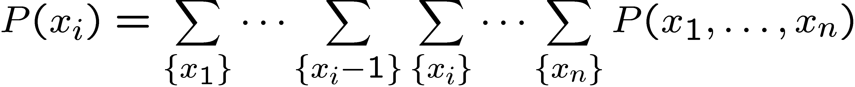
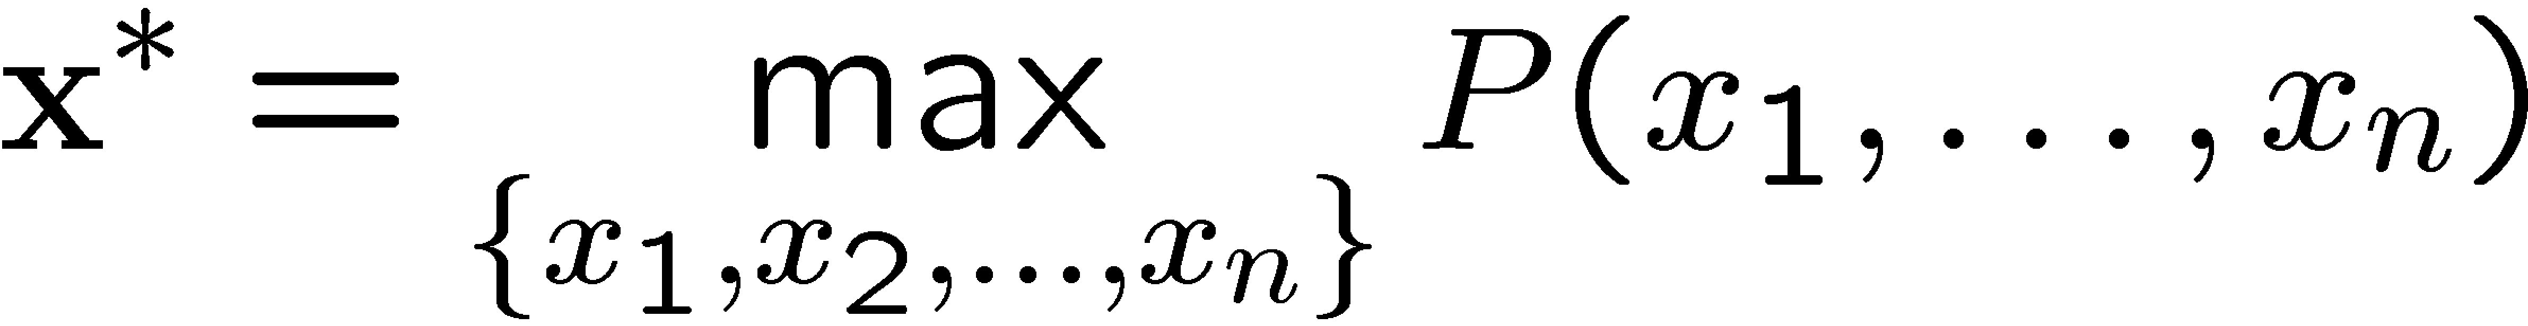
Inference in Factor Graphs
Computational question:
What are the marginals of the joint probability?
What is the mode of the joint probability?
Naive approach require exponential run-time:
Marginals:
Mode:

Slide 7
Message Passing in Factor Graphs
w₁
+
w₂
s
c
No Click
Click

Slide 8
Overview
Learning Probabilistic Models
Factor Graphs
Inference in Factor Graphs
Projects
TrueSkill Analysis
Internal adCenter competition
Benefits of F#

Slide 9
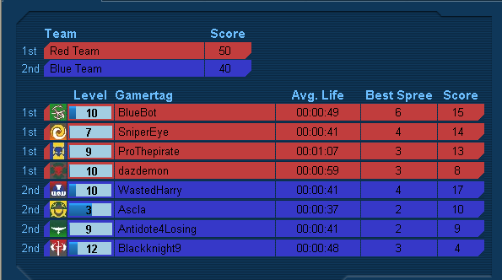
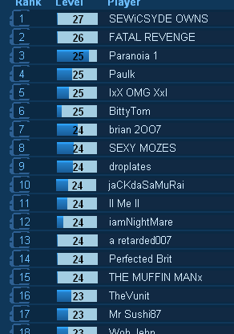
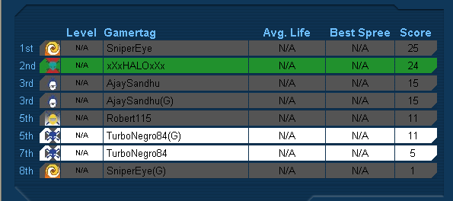
TrueSkill Rating Problem
Given:
Match outcomes: Orderings among k teams consisting of n₁, n₂ , ..., n_{k} players, respectively
Questions:
Skill s_{i} for each player such that
Global ranking among all players
Fair matches between teams of players

Slide 10

Xbox 360 Live
Launched in September 2005
Every game uses TrueSkill™ to match players
> 6 million players
> 1 million matches per day
> 2 billion hours of gameplay

Slide 11
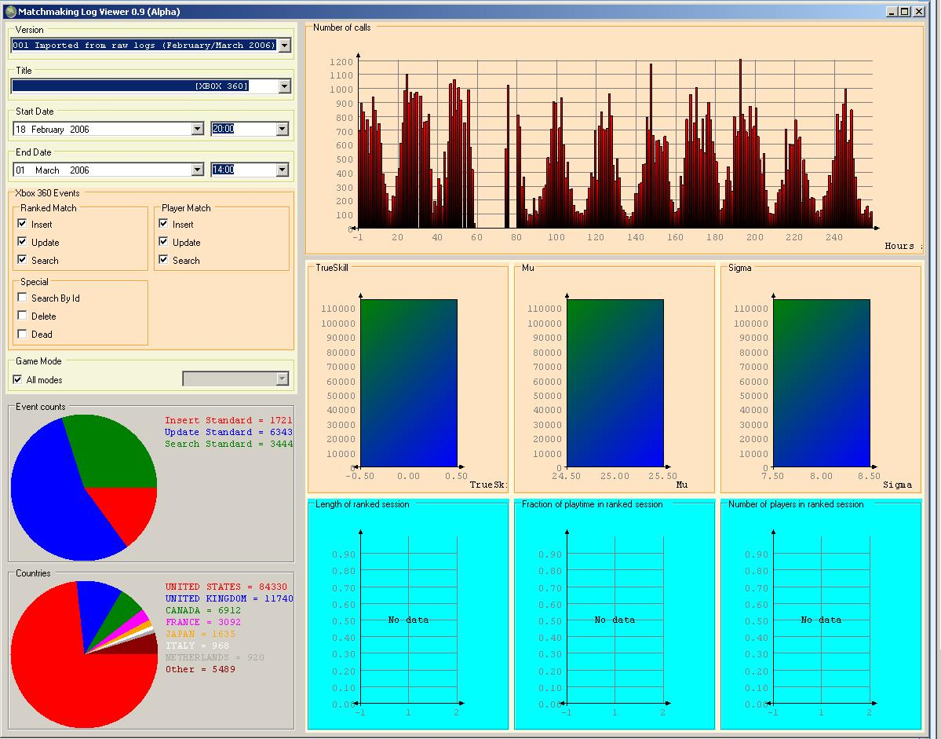
Xbox Live Activity viewer
Code size: 1400 LOC + 1400 LOC
Project size: 2 project / 21 files
Development time: 2 month
Features
Parser: High performance (> 2GB logs in 1 hour)
Parser: Recreation of matchmaking server status
Viewer: SQL database integration (deep schema)

Slide 12

Xbox 360 & Halo 3
Xbox 360 Live
Launched in September 2005
Every game uses TrueSkill™ to match players
> 6 million players
> 1 million matches per day
> 2 billion hours of gameplay
Halo 3
Launched on 25th September 2007
Largest entertainment launch in history
> 500,000 player concurrently playing

Slide 13
F# Tools for Halo 3
Questions
Controllable player skill progression (slow-down!)
Controllable skill distributions (re-ordering)
Simulations
Large scale simulation of > 8,000,000,000 matches
Distributed application written in C# using .Net remoting
Tools
Result viewer (Logged results: 52 GB of data)
Real-time simulator of partial update

Slide 14
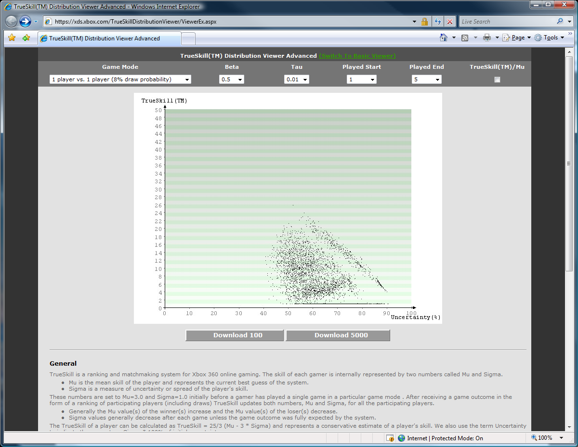
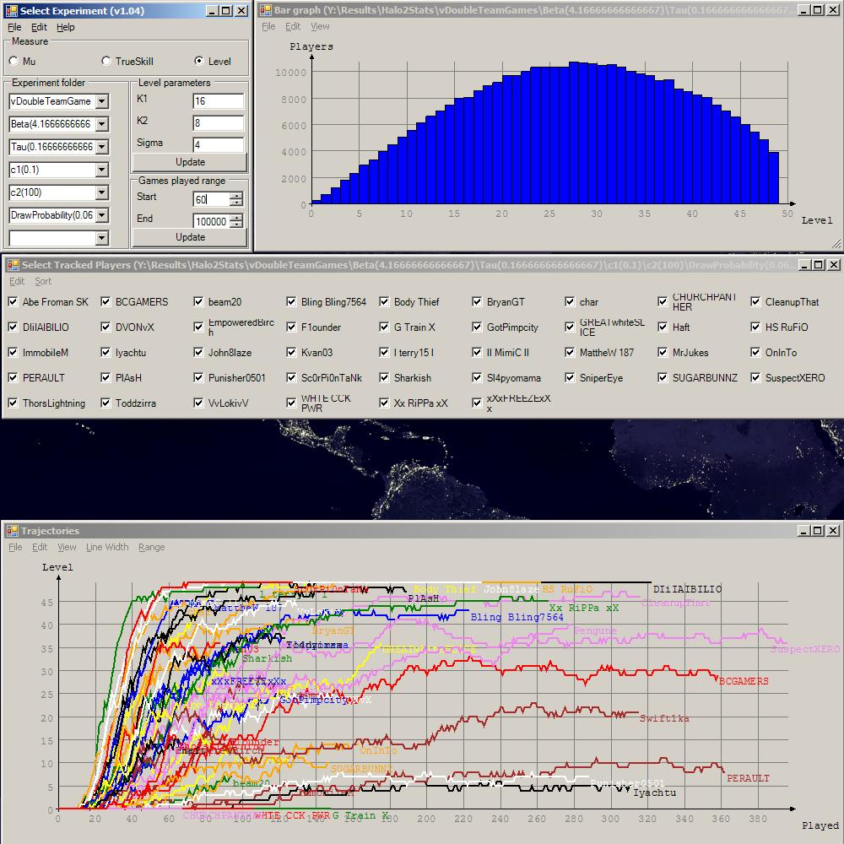
Halo 3 Simulation Result Viewer
Code size: 1800 LOC
Project size: 11 files
Development time: 2 month
Features
Multithreaded histogram viewer (due to file size)
Real-time spline editor (monotonically increasing)
Based on WinForms (compatability)

Slide 15
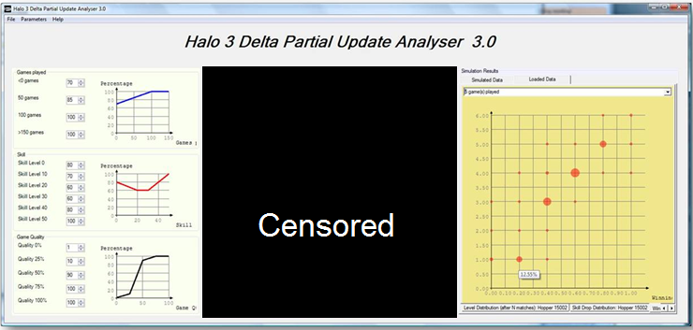
Halo 3 Partial Update Analyser
Code size: 2600 LOC
Project size: 10 files
Development time: 1 month
Features
SQL database integration (analysis of beta test data)
Full integration of C# TrueSkill code (.Net library)
Real time changes

Slide 16
Overview
Learning Probabilistic Models
Factor Graphs
Inference in Factor Graphs
Projects
TrueSkill Analysis
Internal adCenter competition
Benefits of F#

Slide 17
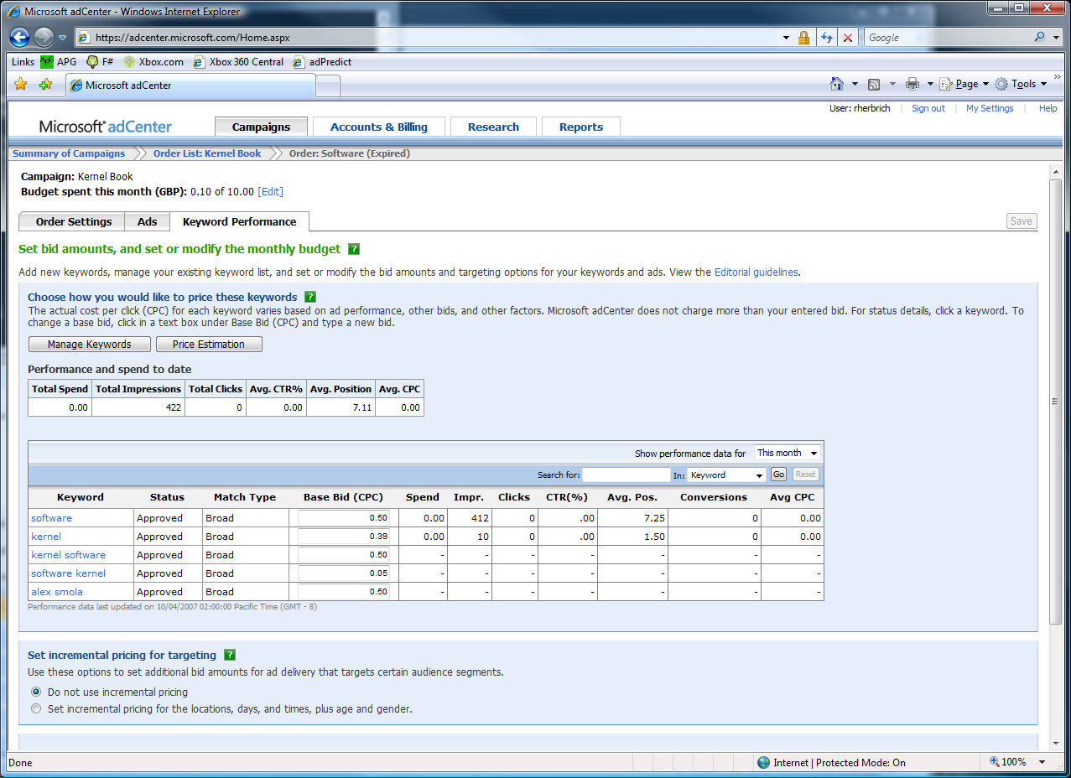
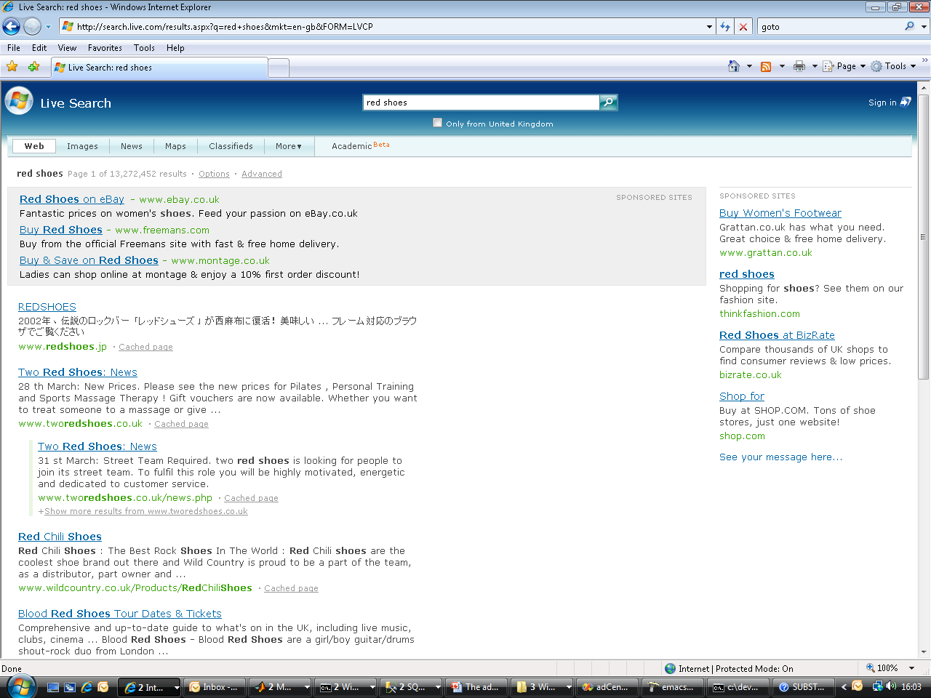
The adCenter Problem
Cash-cow of Search
Selling “web space” at www.live.com and www.msn.com.
“Paid Search” (prices by auctions)
The internal competition focuses on Paid Search.

Slide 18
The Internal adCenter Competition
Start of competition: February 2007
Start of training phase: May 2007
End of training phase: June 2007
Task:
Predict the probability of click of a few days of real data from several weeks of training data (logged page views)
Resources:
4 (2 x 2) 64-bit CPU machine
16 GB of RAM
200 GB HD

Slide 19
The Scale of Things
Weeks of data in training:
7,000,000,000 impressions
2 weeks of CPU time during training:
2 wks × 7 days × 86,400 sec/day =
1,209,600 seconds
Learning algorithm speed requirement:
5,787 impression updates / sec
172.8 μs per impression update

Slide 20
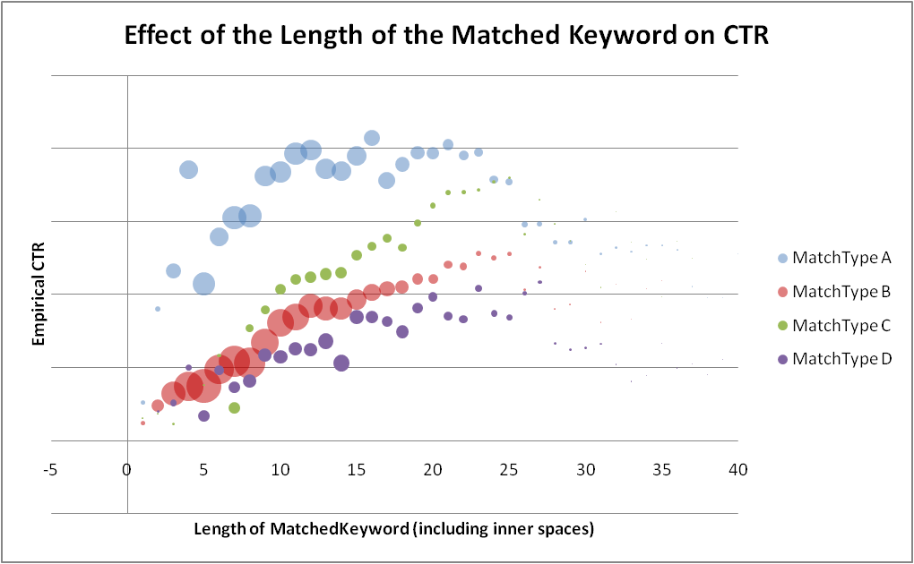
Tool Chain: Existing Tools
Excel 2007
Scientific Visualisation
Small Scale Simulations
SQL Server 2005
1.6 TB of “active” data (for 2 weeks of data + indices)
Ad-Hoc Queries and Stored Procedures
Visual Studio 2005 & F#
54 projects solution (many small tools)
FSI for rapid development and code testing
Strong typing as a surrogate for correctness

Slide 21
SQL Schema Generator
Code size: 500 LOC
Project size: 1 file
Development time: 2 weeks
Features
Code defines the schema (unlike LINQ)!
High-performance insertion via computed bulk-insertion with automated key propagation
Code sample is now part of the F# distribution

Slide 22
Strong Typing and SQL Datastores
/// A single page-view
type PageView =
{
ClientDateTime : DateTime
GmtSeconds : int
TargetDomainId : int16
Medium : MediumType option
StartPosition : int
PageNum : byte
[<SqlStringLengthAttribute(256)>]
Query : string
Gender : Gender option
AgeBucket : AgeGroup option
ReturnedAdCnt : byte
AbTestingType : byte option
AlgorithmId : int option
ANID : int128 option
GUID : int128 option
[<SqlStringLengthAttribute(15)>]
PassportZipCode : string option
[<SqlStringLengthAttribute(2)>]
PassportCountry : string option
PassportRegion : int
[<SqlStringLengthAttribute(2)>]
PassportOccupation : char
LocationCountry : int
LocationState : int
LocationMetroArea : int
CategoryId : int16
SubCategoryId : int16
FormCode : int16
ReturnedAds : Advertisement array
}
/// Different types of media
type MediumType =
| PaidSearch
| ContextualSearch
/// A single displayed advertisement
type Advertisement =
{
AdId : int
OrderItemId : int
CampDayId : int16
CampHourNum : byte
ProductId : ProductType
MatchType : MatchType
AdLayoutId : AdLayout
RelativePosition : byte
DeliveryEngineRank : int16
ActualBid : int
ProbabilityOfClick : int16
MatchScore : int
ImpressionCnt : int
ClickCnt : int
ConversionCnt : int
TotalCost : int
}
/// Create the SQL schema
let schema = bulkBuild ("cpidssdm18", “Cambridge", “June10")
/// Try to open the CSV file and read it pageview by pageview
File.OpenTextReader “HourlyRelevanceFeed.csv"
|> Seq.map (fun s -> s.Split [|','|])
|> Seq.chunkBy (fun xs -> xs.[0])
|> Seq.iteri (fun i (rguid,xss) ->
/// Write the current in-memory bulk to the Sql database
if i % 10000 = 0 then
schema.Flush ()
/// Get the strongly typed object from the list of CSV file lines
let pageView = PageView.Parse xss
/// Insert it
pageView |> schema.Insert
)
/// One final flush
schema.Flush ()

Slide 23
Overview
Learning Probabilistic Models
Factor Graphs
Inference in Factor Graphs
Projects
TrueSkill Analysis
Internal adCenter competition
Benefits of F#

Slide 24
Overview
Learning Probabilistic Models
Factor Graphs
Inference in Factor Graphs
Projects
TrueSkill Analysis
Internal adCenter competition
Benefits of F#

Slide 25
Benefits of F#
Four main reasons:
A language that both developers and researchers speak!
It leads to
“Correct” programs
Succinct programs
Highly performant code
Interoperability with .NET
It’s fun to program!

