Slide 1
Why is Microsoft investing in Functional Programming?
Don Syme
With thanks to Leon Bambrick, Chris Smith and the puppies
All opinions are those of the author and not necessarily those of Microsoft

Slide 2
Simplicity

Slide 3
Economics

Slide 4
Fun

Slide 5
What Investments?
C#
C# 2.0 (generics)
C# 3.0 (Language Integrated Queries - LINQ)
These represent a major industry shift towards functional programming
F#
Bringing F# to product quality
Haskell
Strongly supporting Haskell research
VB, Python, Ruby
These incorporate many functional features and overlap with the functional programming ethos

Slide 6
Who?
Microsoft Research (“MSR”)
F#
Haskell
Microsoft Developer Division (“DevDiv”), Visual Studio Languages Group
C#
Visual Basic
F#
Python
Ruby

Slide 7
F#: Influences
OCaml
C#/.NET
F#
Similar core
language
Similar object
model

Slide 8
Simplicity

Slide 9
Code!
//F#
open System
let a = 2
Console.WriteLine a
//C#
using System;
namespace ConsoleApplication1
{
class Program
{
static int a()
{
return 2;
}
static void Main(string[] args)
{
Console.WriteLine(a);
}
}
}

Slide 10
More Code!
//F#
open System
let a = 2
Console.WriteLine a
//C#
using System;
namespace ConsoleApplication1
{
class Program
{
static nt a()
{
return 2;
}
static void Main(string[] args)
{
Console.WriteLine(a);
}
}
}
More Noise
Than Signal!

Slide 11
Pleasure
Pain
abstract class Command
{
public virtual void Execute();
}
abstract class MarsRoverCommand : Command
{
protected MarsRover Rover { get; private set; }
public MarsRoverCommand(MarsRover rover)
{
this.Rover = rover;
}
}
class BreakCommand : MarsRoverCommand
{
public BreakCommand(MarsRover rover)
: base(rover)
{
}
public override void Execute()
{
Rover.Rotate(-5.0);
}
}
class TurnLeftCommand : MarsRoverCommand
{
public TurnLeftCommand(MarsRover rover)
: base(rover)
{
}
public override void Execute()
{
Rover.Rotate(-5.0);
}
}
// Use first-order functions as commands
type Command = Command of (Rover -> unit)
let BreakCommand = Command(fun rover -> rover.Accelerate(-1.0))
let TurnLeftCommand = Command(fun rover -> rover.Rotate(-5.0<degs>))

Slide 12
Pleasure
Pain
Tuple<V,T,U> Rotate(Tuple<T,U,V> t)
{
return new Tuple<V,T,U>(t.Item3,t.Item1,t.Item2);
}
int Reduce(Func<T,int> f,Tuple<T,T,T> t)
{
return f(t.Item1) + f(t.Item2) + f (t.Item3);
}
let rotate(x,y,z) = (z,x,y)
let reduce f (x,y,z) = f x + f y + f z

Slide 13
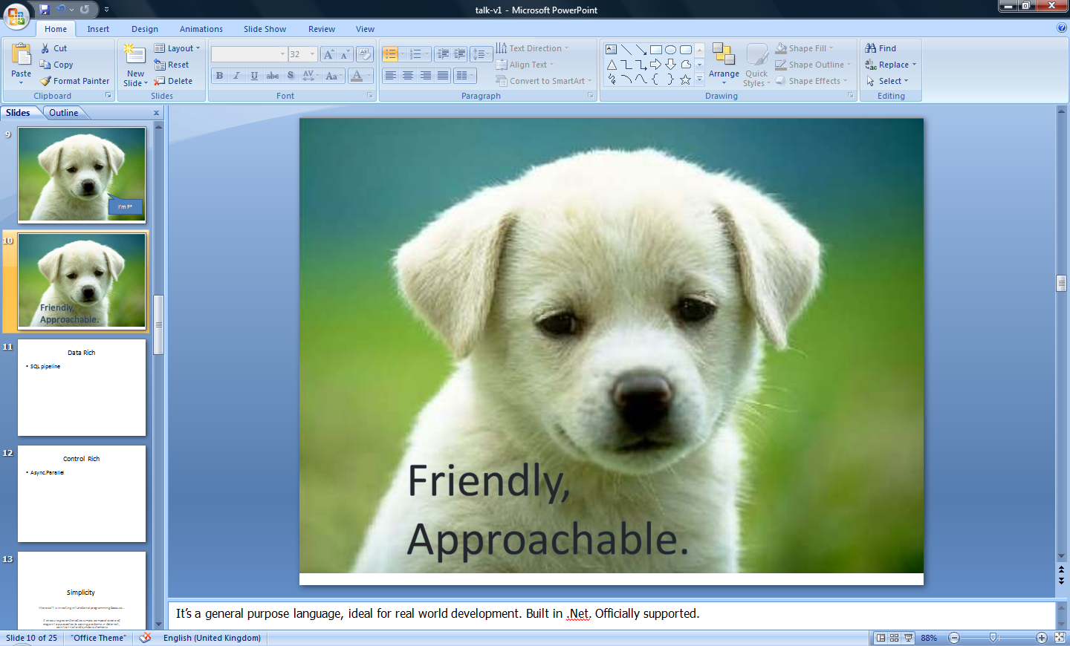


Slide 14
Orthogonal & Unified Constructs
Type inference. The safety of C# with the succinctness of a scripting language
Let “let” simplify your life…
Bind a static value
let data = (1,2,3)
let f(a,b,c) =
let sum = a + b + c
let g(x) = sum + x*x
g(a), g(b), g(c)
Bind a static function
Bind a local value
Bind a local function

Slide 15
Simplicity
using System;
using System.IO;
using System.Threading;
public class BulkImageProcAsync
{
public const String ImageBaseName = "tmpImage-";
public const int numImages = 200;
public const int numPixels = 512 * 512;
// ProcessImage has a simple O(N) loop, and you can vary the number
// of times you repeat that loop to make the application more CPU-
// bound or more IO-bound.
public static int processImageRepeats = 20;
// Threads must decrement NumImagesToFinish, and protect
// their access to it through a mutex.
public static int NumImagesToFinish = numImages;
public static Object[] NumImagesMutex = new Object[0];
// WaitObject is signalled when all image processing is done.
public static Object[] WaitObject = new Object[0];
public class ImageStateObject
{
public byte[] pixels;
public int imageNum;
public FileStream fs;
}
public static void ReadInImageCallback(IAsyncResult asyncResult)
{
ImageStateObject state = (ImageStateObject)asyncResult.AsyncState;
Stream stream = state.fs;
int bytesRead = stream.EndRead(asyncResult);
if (bytesRead != numPixels)
throw new Exception(String.Format
("In ReadInImageCallback, got the wrong number of " +
"bytes from the image: {0}.", bytesRead));
ProcessImage(state.pixels, state.imageNum);
stream.Close();
// Now write out the image.
// Using asynchronous I/O here appears not to be best practice.
// It ends up swamping the threadpool, because the threadpool
// threads are blocked on I/O requests that were just queued to
// the threadpool.
FileStream fs = new FileStream(ImageBaseName + state.imageNum +
".done", FileMode.Create, FileAccess.Write, FileShare.None,
4096, false);
fs.Write(state.pixels, 0, numPixels);
fs.Close();
// This application model uses too much memory.
// Releasing memory as soon as possible is a good idea,
// especially global state.
state.pixels = null;
fs = null;
// Record that an image is finished now.
lock (NumImagesMutex)
{
NumImagesToFinish--;
if (NumImagesToFinish == 0)
{
Monitor.Enter(WaitObject);
Monitor.Pulse(WaitObject);
Monitor.Exit(WaitObject);
}
}
}
public static void ProcessImagesInBulk()
{
Console.WriteLine("Processing images... ");
long t0 = Environment.TickCount;
NumImagesToFinish = numImages;
AsyncCallback readImageCallback = new
AsyncCallback(ReadInImageCallback);
for (int i = 0; i < numImages; i++)
{
ImageStateObject state = new ImageStateObject();
state.pixels = new byte[numPixels];
state.imageNum = i;
// Very large items are read only once, so you can make the
// buffer on the FileStream very small to save memory.
FileStream fs = new FileStream(ImageBaseName + i + ".tmp",
FileMode.Open, FileAccess.Read, FileShare.Read, 1, true);
state.fs = fs;
fs.BeginRead(state.pixels, 0, numPixels, readImageCallback,
state);
}
// Determine whether all images are done being processed.
// If not, block until all are finished.
bool mustBlock = false;
lock (NumImagesMutex)
{
if (NumImagesToFinish > 0)
mustBlock = true;
}
if (mustBlock)
{
Console.WriteLine("All worker threads are queued. " +
" Blocking until they complete. numLeft: {0}",
NumImagesToFinish);
Monitor.Enter(WaitObject);
Monitor.Wait(WaitObject);
Monitor.Exit(WaitObject);
}
long t1 = Environment.TickCount;
Console.WriteLine("Total time processing images: {0}ms",
(t1 - t0));
}
}
let ProcessImageAsync () =
async { let inStream = File.OpenRead(sprintf "Image%d.tmp" i)
let! pixels = inStream.ReadAsync(numPixels)
let pixels' = TransformImage(pixels,i)
let outStream = File.OpenWrite(sprintf "Image%d.done" i)
do! outStream.WriteAsync(pixels')
do Console.WriteLine "done!" }
let ProcessImagesAsyncWorkflow() =
Async.Run (Async.Parallel
[ for i in 1 .. numImages -> ProcessImageAsync i ])
Processing 200 images in parallel

Slide 16
Simplicity
Microsoft is investing in functional programming because....
It enables simple, compositional and elegant problem solving in data-rich, control-rich and symbolic domains

Slide 17
Case Study
Ad Ranking,
MSR Cambridge Online Services and Advertising Group

Slide 18
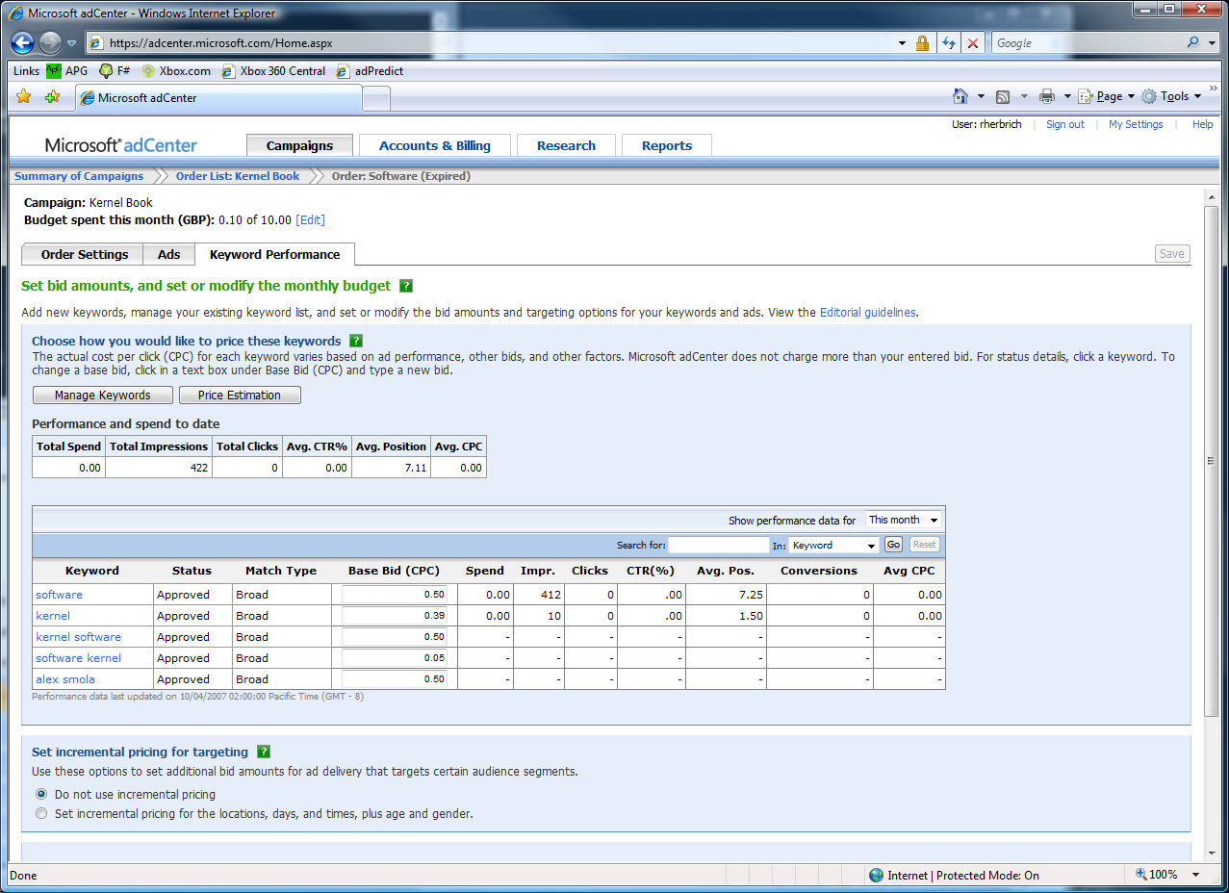

The adCenter Problem
Selling “web space” at www.live.com and www.msn.com.
“Paid Search” (prices by auctions)
The internal competition focuses on Paid Search.

Slide 19
OSA Machine Learning
Internal Competition
Use F# for major adCenter and Xbox Live projects
4 week project, 4 machine learning experts
100million probabilistic variables
Processes 6TB of training data
Real time processing
“F# was absolutely integral to our success”
“We delivered a robust, high-performance solution on-time.”
“We couldn’t have achieved this with any other tool given the constraints of the task”
“F# programming is fun – I feel like I learn more about programming every day”

Slide 20
OSA Machine Learning
F#’s type inference means less typing, more thinking
Observations
Quick Coding
Agile Coding
Scripting
Performance
Memory-Faithful
Succinct
Symbolic
.NET Integration
Type-inferred functional/ OO code is easily factored and re-used
Interactive “hands-on” exploration of algorithms and data over smaller data sets. Used in combination with Excel
Immediate scaling to massive data sets
mega-data structures, 16GB machines
Live in the domain, not the language
Schema compilation and efficient “Schedule” representations key to success
Especially Excel, SQL Server

Slide 21
The Team’s Summary
“F# was absolutely integral to our success”
“We delivered a robust, high-performance solution on-time.”
“We couldn’t have achieved this with any other tool given the constraints of the task”
“F# programming is fun – I feel like I learn more about programming every day”

Slide 22
Some Code Highlights
Type-safe Schema Bulk Import
High performance Bulk Insert Tool
Written as part of the team’s toolchain
Schema in F# types
Compiled using F# “schema compilation” techniques
800 lines
Enabled team to clean and insert entire data set over 3 day period
BulkImporter<'Schema>:
database:string * prefix:string -> BulkImport<'Schema>

Slide 23
Some Code Highlights
The essence of their
data import line
/// Create the SQL schema
let schema = BulkImporter<PageView> ("cpidssdm18", “Cambridge", “June10")
/// Try to open the CSV file and read it pageview by pageview
File.OpenTextReader “HourlyRelevanceFeed.csv"
|> Seq.map (fun s -> s.Split [|','|])
|> Seq.chunkBy (fun xs -> xs.[0])
|> Seq.iteri (fun i (rguid,xss) ->
/// Write the current in-memory bulk to the Sql database
if i % 10000 = 0 then
schema.Flush ()
/// Get the strongly typed object from the list of CSV file lines
let pageView = PageView.Parse xss
/// Insert it
pageView |> schema.Insert
)
/// One final flush
schema.Flush ()

Slide 24
Some Code Highlights
Expressing and evaluating “Approximation Schedules” was crucial to this work.
/// A schedule of computation in a factor graph
/// (i.e., a series of update functions
/// and variables that should be updated)
type Schedule =
| ScheduleStep of (IFactor * int)
| ScheduleSeq of Schedule[]
| ScheduleLoop of Schedule * float
/// Runs a schedule
member schedule.Run() =
match schedule with
| ScheduleStep (fac,idx) ->
fac.UpdateMessage idx
| ScheduleSeq sseq ->
sseq |> Seq.maxOn (fun s -> s.Run())
| ScheduleLoop (s,maxDelta) ->
let delta = s.Run()
if delta > maxDelta then schedule.Run() else delta
Functional programming made this beautiful

Slide 25
(Aside: Units Of Measure)
The F# September CTP includes
“units of measure”
Inference and checking
type acceleration = float<m / s^2>
let fast = 3.0e6<m/s>
let gravity = -9.81<m/s^2)
/// Computes the absolute difference between two Gaussians
let AbsoluteDifference (a:Gaussian) (b:Gaussian) =
max (abs(a.PrecisionMean - b.PrecisionMean))
(abs(a.Precision - b.Precision))
/// Computes the absolute difference between two Gaussians
let AbsoluteDifference (a:Gaussian<‘u>,b:Gaussian<‘u>) =
max (abs(a.PrecisionMean - b.PrecisionMean))
(abs(a.Precision - b.Precision))
/// Computes the absolute difference between two Gaussians
let AbsoluteDifference (a:Gaussian<‘u>,b:Gaussian<‘u>) =
max (abs(a.PrecisionMean - b.PrecisionMean))
(sqrt(abs(a.Precision - b.Precision)))

Slide 26
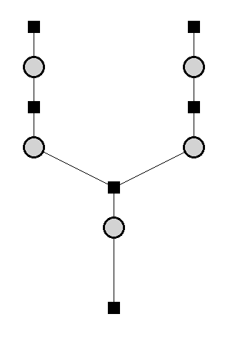
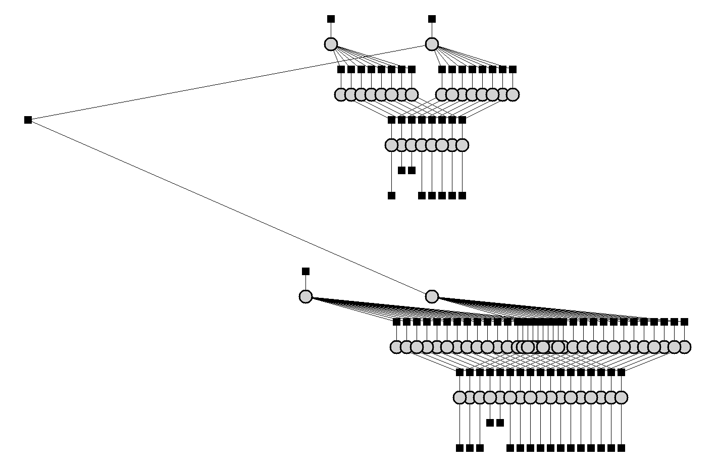
Re-Ranking the History of Chess
Search for “TrueSkill Through Time” (MSR Cambridge Online Services and Advertising Group)
Model time-series of skills by smoothing across time
Analyse history of chess based on 3.5M game outcomes
1857
s₁
s₂
Dynamics noise
Performance noise
p₁
p₂
d = p₁ - p₂
d > ε
1858
Single Game Outcome

Slide 27
Control Rich
Async.Run
(Async.Parallel
[ Async.GetHttp "www.google.com";
Async.GetHttp "www.live.com";
Async.GetHttp "www.yahoo.com"; ]

Slide 28
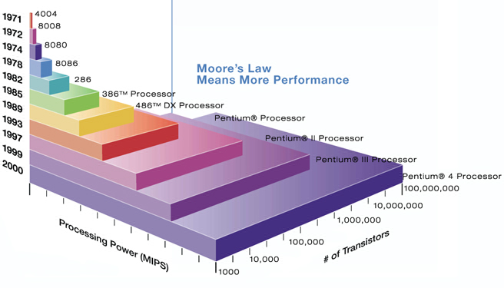
Why learn F#?
Moore’s Law, but no speed increase

Slide 29
Parallelism
The Economics of the Hardware Industry are Changing
Functional programming is a crucial tool in parallel and asynchronous programming
For architecture
For implementation
Good synergies, e.g. with Parallel Extensions for .NET

Slide 30
Economics

Slide 31
Economies of Scale at Microsoft
Have .NET
Have .NET Libraries
Have Visual Studio, Silverlight, .NET CF, ASP.NET, XNA GameStudio, RoboticsStudio
Have Tools (profilers, debuggers, designers)
Given this basis, the opportunities for low-cost, value-add investments are enormous:
Dynamic Languages
Functional Languages
Web programming (client, server, services)
Business programming
Parallel programming
Game programming
Data mining programming
Cost: low, Value: high

Slide 32
Economics for Users
Learn .NET
Can use the tools right for the job
Can reuse much knowledge from tool to tool

Slide 33
Economics
Microsoft is investing in functional programming because....
It is a sensible, relatively low-cost investment that adds real value to Visual Studio and the .NET Framework

Slide 34
Fun

Slide 35
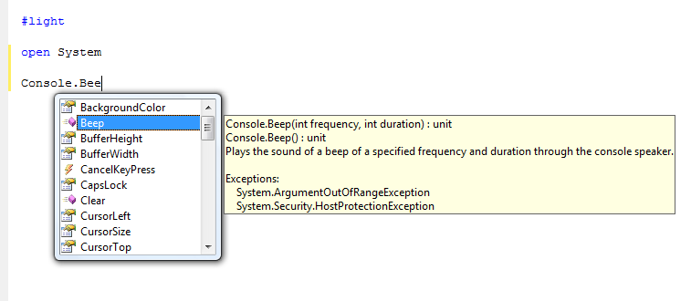
This is fun

Slide 36
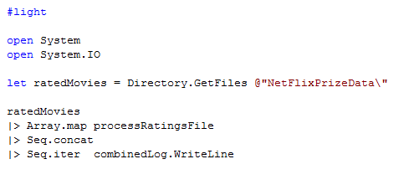
This is fun

Slide 37
This is not fun
using System;
using System.IO;
using System.Threading;
public class BulkImageProcAsync
{
public const String ImageBaseName = "tmpImage-";
public const int numImages = 200;
public const int numPixels = 512 * 512;
// ProcessImage has a simple O(N) loop, and you can vary the number
// of times you repeat that loop to make the application more CPU-
// bound or more IO-bound.
public static int processImageRepeats = 20;
// Threads must decrement NumImagesToFinish, and protect
// their access to it through a mutex.
public static int NumImagesToFinish = numImages;
public static Object[] NumImagesMutex = new Object[0];
// WaitObject is signalled when all image processing is done.
public static Object[] WaitObject = new Object[0];
public class ImageStateObject
{
public byte[] pixels;
public int imageNum;
public FileStream fs;
}
public static void ReadInImageCallback(IAsyncResult asyncResult)
{
ImageStateObject state = (ImageStateObject)asyncResult.AsyncState;
Stream stream = state.fs;
int bytesRead = stream.EndRead(asyncResult);
if (bytesRead != numPixels)
throw new Exception(String.Format
("In ReadInImageCallback, got the wrong number of " +
"bytes from the image: {0}.", bytesRead));
ProcessImage(state.pixels, state.imageNum);
stream.Close();
// Now write out the image.
// Using asynchronous I/O here appears not to be best practice.
// It ends up swamping the threadpool, because the threadpool
// threads are blocked on I/O requests that were just queued to
// the threadpool.
FileStream fs = new FileStream(ImageBaseName + state.imageNum +
".done", FileMode.Create, FileAccess.Write, FileShare.None,
4096, false);
fs.Write(state.pixels, 0, numPixels);
fs.Close();
// This application model uses too much memory.
// Releasing memory as soon as possible is a good idea,
// especially global state.
state.pixels = null;
fs = null;
// Record that an image is finished now.
lock (NumImagesMutex)
{
NumImagesToFinish--;
if (NumImagesToFinish == 0)
{
Monitor.Enter(WaitObject);
Monitor.Pulse(WaitObject);
Monitor.Exit(WaitObject);
}
}
}
public static void ProcessImagesInBulk()
{
Console.WriteLine("Processing images... ");
long t0 = Environment.TickCount;
NumImagesToFinish = numImages;
AsyncCallback readImageCallback = new
AsyncCallback(ReadInImageCallback);
for (int i = 0; i < numImages; i++)
{
ImageStateObject state = new ImageStateObject();
state.pixels = new byte[numPixels];
state.imageNum = i;
// Very large items are read only once, so you can make the
// buffer on the FileStream very small to save memory.
FileStream fs = new FileStream(ImageBaseName + i + ".tmp",
FileMode.Open, FileAccess.Read, FileShare.Read, 1, true);
state.fs = fs;
fs.BeginRead(state.pixels, 0, numPixels, readImageCallback,
state);
}
// Determine whether all images are done being processed.
// If not, block until all are finished.
bool mustBlock = false;
lock (NumImagesMutex)
{
if (NumImagesToFinish > 0)
mustBlock = true;
}
if (mustBlock)
{
Console.WriteLine("All worker threads are queued. " +
" Blocking until they complete. numLeft: {0}",
NumImagesToFinish);
Monitor.Enter(WaitObject);
Monitor.Wait(WaitObject);
Monitor.Exit(WaitObject);
}
long t1 = Environment.TickCount;
Console.WriteLine("Total time processing images: {0}ms",
(t1 - t0));
}
}

Slide 38
This is fun
using System;
using System.IO;
using System.Threading;
public class BulkImageProcAsync
{
public const String ImageBaseName = "tmpImage-";
public const int numImages = 200;
public const int numPixels = 512 * 512;
// ProcessImage has a simple O(N) loop, and you can vary the number
// of times you repeat that loop to make the application more CPU-
// bound or more IO-bound.
public static int processImageRepeats = 20;
// Threads must decrement NumImagesToFinish, and protect
// their access to it through a mutex.
public static int NumImagesToFinish = numImages;
public static Object[] NumImagesMutex = new Object[0];
// WaitObject is signalled when all image processing is done.
public static Object[] WaitObject = new Object[0];
public class ImageStateObject
{
public byte[] pixels;
public int imageNum;
public FileStream fs;
}
public static void ReadInImageCallback(IAsyncResult asyncResult)
{
ImageStateObject state = (ImageStateObject)asyncResult.AsyncState;
Stream stream = state.fs;
int bytesRead = stream.EndRead(asyncResult);
if (bytesRead != numPixels)
throw new Exception(String.Format
("In ReadInImageCallback, got the wrong number of " +
"bytes from the image: {0}.", bytesRead));
ProcessImage(state.pixels, state.imageNum);
stream.Close();
// Now write out the image.
// Using asynchronous I/O here appears not to be best practice.
// It ends up swamping the threadpool, because the threadpool
// threads are blocked on I/O requests that were just queued to
// the threadpool.
FileStream fs = new FileStream(ImageBaseName + state.imageNum +
".done", FileMode.Create, FileAccess.Write, FileShare.None,
4096, false);
fs.Write(state.pixels, 0, numPixels);
fs.Close();
// This application model uses too much memory.
// Releasing memory as soon as possible is a good idea,
// especially global state.
state.pixels = null;
fs = null;
// Record that an image is finished now.
lock (NumImagesMutex)
{
NumImagesToFinish--;
if (NumImagesToFinish == 0)
{
Monitor.Enter(WaitObject);
Monitor.Pulse(WaitObject);
Monitor.Exit(WaitObject);
}
}
}
public static void ProcessImagesInBulk()
{
Console.WriteLine("Processing images... ");
long t0 = Environment.TickCount;
NumImagesToFinish = numImages;
AsyncCallback readImageCallback = new
AsyncCallback(ReadInImageCallback);
for (int i = 0; i < numImages; i++)
{
ImageStateObject state = new ImageStateObject();
state.pixels = new byte[numPixels];
state.imageNum = i;
// Very large items are read only once, so you can make the
// buffer on the FileStream very small to save memory.
FileStream fs = new FileStream(ImageBaseName + i + ".tmp",
FileMode.Open, FileAccess.Read, FileShare.Read, 1, true);
state.fs = fs;
fs.BeginRead(state.pixels, 0, numPixels, readImageCallback,
state);
}
// Determine whether all images are done being processed.
// If not, block until all are finished.
bool mustBlock = false;
lock (NumImagesMutex)
{
if (NumImagesToFinish > 0)
mustBlock = true;
}
if (mustBlock)
{
Console.WriteLine("All worker threads are queued. " +
" Blocking until they complete. numLeft: {0}",
NumImagesToFinish);
Monitor.Enter(WaitObject);
Monitor.Wait(WaitObject);
Monitor.Exit(WaitObject);
}
long t1 = Environment.TickCount;
Console.WriteLine("Total time processing images: {0}ms",
(t1 - t0));
}
}
let ProcessImageAsync () =
async { let inStream = File.OpenRead(sprintf "Image%d.tmp" i)
let! pixels = inStream.ReadAsync(numPixels)
let pixels' = TransformImage(pixels,i)
let outStream = File.OpenWrite(sprintf "Image%d.done" i)
do! outStream.WriteAsync(pixels')
do Console.WriteLine "done!" }
let ProcessImagesAsyncWorkflow() =
Async.Run (Async.Parallel
[ for i in 1 .. numImages -> ProcessImageAsync i ])

Slide 39
This is fun!
Async.Run
(Async.Parallel
[ GetWebPage "http://www.google.com";
GetWebPage "http://www.live.com";
GetWebPage "http://www.yahoo.com"; ]
Async.Run
(Async.Parallel
[ for i in 1 .. numImages -> ProcessImage(i) ])

Slide 40
This is fun too!
#r "Microsoft.ManagedDirectX.dll"
#r "System.Xml.dll"
#r "System.Parallel.dll"
#r "NUnit.Framework.dll"
#r "Xceed.Charting.dll"
#r "ExtremeOptimization.Math.dll"

Slide 41
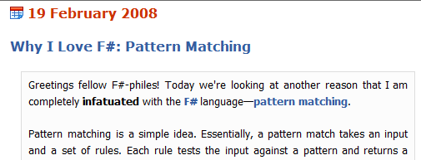
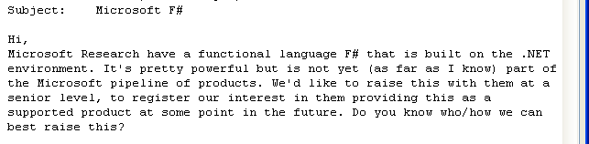
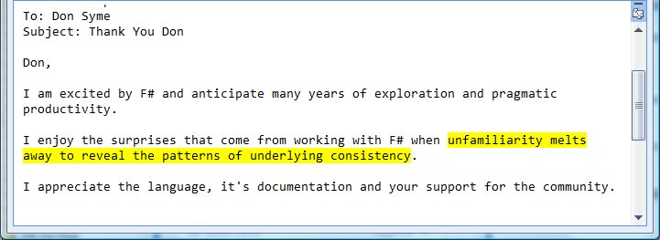

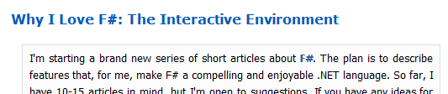
Community fun
It's the fastest genome assembly viewer I've ever seen and only 500 lines of F#. It's really an incredible language...

Slide 42






A Fantastic Team
Developers
QA
Research/Architecture
Program Managers
Oversight
+Joe,+Santosh,+James,+Baofa,+Sean,+Luca,+Tim,+Mike+Matteo
The decision to bring F# to product quality was made and informed by a collective process involving:
Vice Presidents, Research leaders, Architects, Technical fellows, CTOs, Product Unit Managers, Developers, Testers, Researchers...

Slide 43
Team skills
Ocaml/F#
C#/Linq
OO
Haskell
C/C++

Slide 44
Fun
Microsoft is investing in functional programming because....
People want it
People like it
People are (in certain important domains) more productive with it

Slide 45
Summary
Functional Programming Brings Simplicity
Functional Programming with .NET makes Business Sense
And it’s fun!
Notes:
“Functional Programming with .NET” also covers C#/Python/Ruby as well as F#

