Slide 1

FMD
Functional Development in Excel
Lee Benfield
Barclays Capital
Quantitative Analytics Group
CUFP - 4 September 2009
Notes:
[ commentary removed – please see video ]

Slide 2
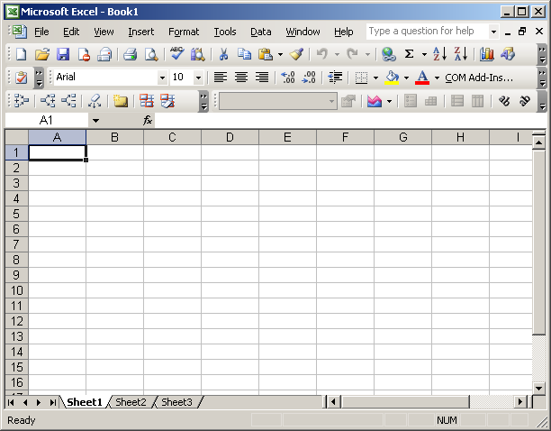
One of the most popular software tools in investment banking? The World?
Notes:
[ commentary removed – please see video ]

Slide 3
Why?!
Visibility
Immediacy
Flexibility
Control
Notes:
[ commentary removed – please see video ]

Slide 4
What’s missing?
Object support – pretty standard, and easy
to add.
Library functions – but we can write addins.
Notes:
What building blocks do we need?
‘Naked’ excel is a useful starting point, but doesn’t really provide any useful financial modelling features – we need to link in a custom Quantative Analytics library (ours is written in C++, fwiw), and some other things, such as support for passing objects around (this is a fairly common bolt on to excel)
However, it provides a reasonably decent API for users to provide plugins (addins in Excel parlance) of their own, either by implementing a given DLL api (usually in C), or by writing custom functions in VBA, so we can link in our Quant library...
(except of course that it’s never quite that simple).
Our Quant Library provides objects for modelling option pricing, but these are fairly fine grained, and need to be glued together in a higher level language in the appropriate way for whatever’s being done – and this is typically where things get a bit ugly....

Slide 5
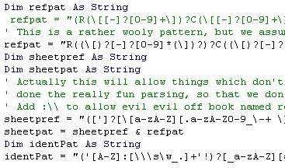
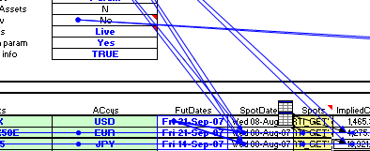
VBA....
Used as glue inside a sheet, around lower level libraries.
Used to implement things you just can’t do in a spreadsheet – functions, looping, interacting with object libraries
But....
Orthogonal models:
Spreadsheet DAG
VBA
Notes:
[ commentary removed – please see video ]

Slide 6
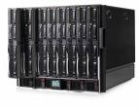
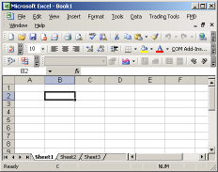
.... problems
‘Risking’
application.
Excel
VBA Wrapper
Model
Reimplementation
IT Team –
propagating new functionality
Quant Library
Quant Library
Notes:
[ commentary removed – please see video ]

Slide 7
So?
Without VBA we’ve got a 0th order functional environment
We need to drop into VBA when we can’t represent what we need to do. (which is quite a lot!)
But dropping into VBA brings a bunch of issues.
Notes:
[ commentary removed – please see video ]

Slide 8
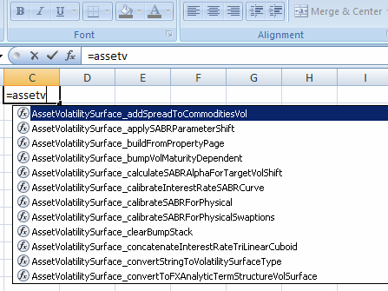
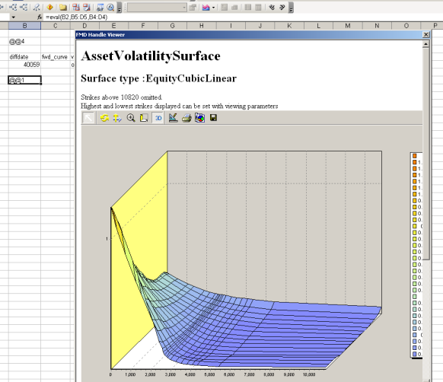
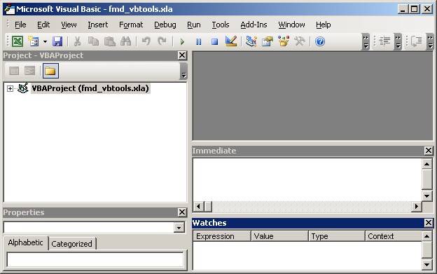
So, what can we do?
Excel
FMD
Generate boilerplate
‘wrapping’ on the fly
And No VBA
(other than a little for menus ☺ )
Quant Library
Other Libraries
Notes:
[ commentary removed – please see video ]

Slide 9
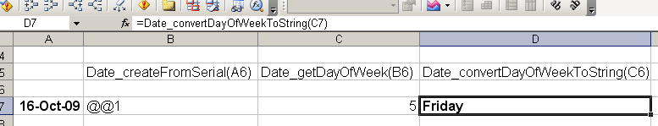
Getting somewhere (slowly!)
We chain a couple of functions to convert a date to an object,
extract the day, and get the day of week....
Date_CreateFromSerial ( date -> dateObject )
Date_GetDayOfWeek ( dateObject -> int )
Date_ConvertDayOfWeekToString
( int -> String )
Notes:
[ commentary removed – please see video ]

Slide 10
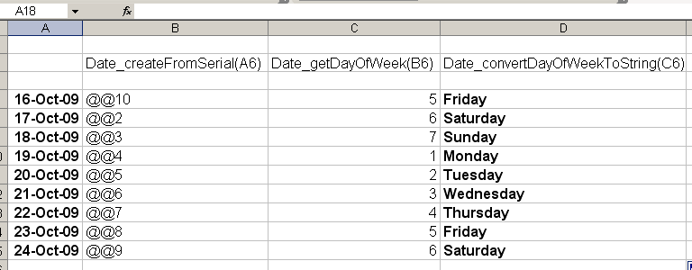
“Copydowns”
Notes:
[ commentary removed – please see video ]

Slide 11
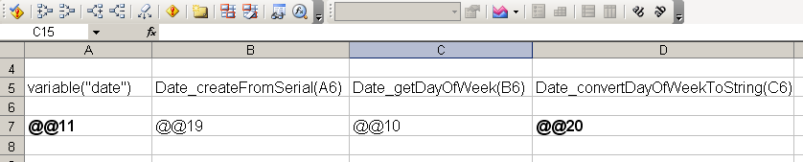
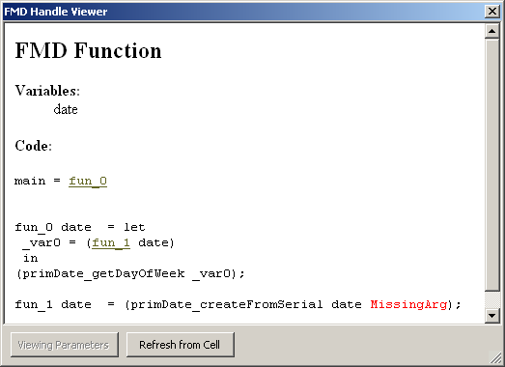
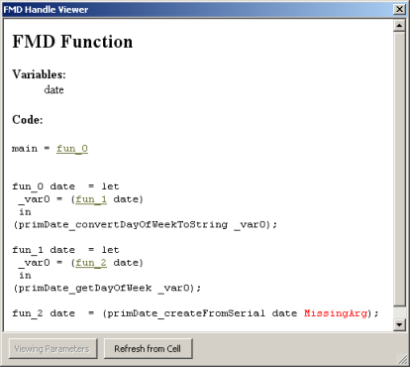
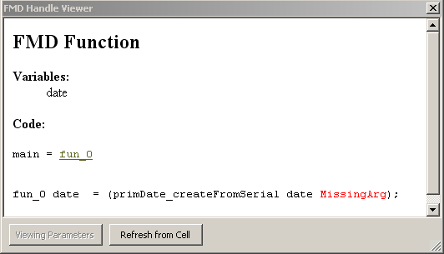
A different way..
Add a ‘variable’
Notes:
[ commentary removed – please see video ]

Slide 12
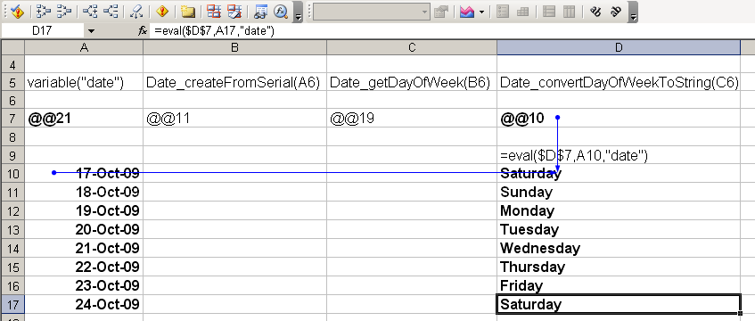
using this ‘function’...
Add another function ‘eval’, which will take a function and bind arguments.
Notes:
[ commentary removed – please see video ]

Slide 13
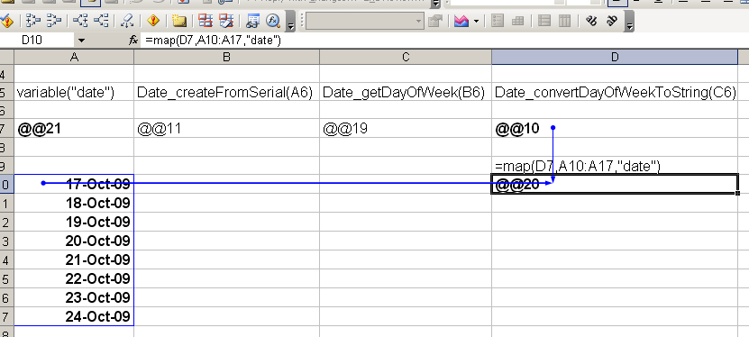
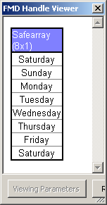
Mapping over functions
Notes:
[ commentary removed – please see video ]

Slide 14
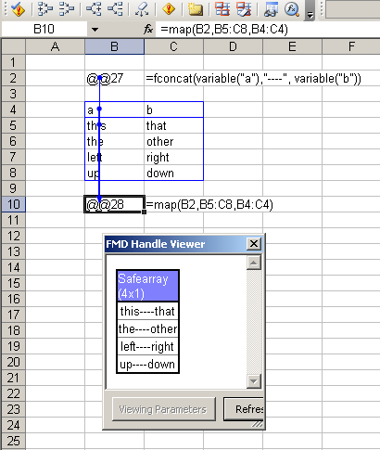
Mapping with more variables
Causes generation of function
taking 2-tuple instead, and maps
over that...
Notes:
[ commentary removed – please see video ]

Slide 15
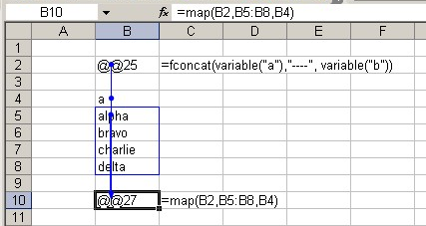
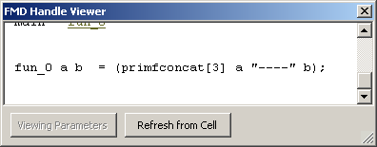
Sometimes need help for ambiguity...
..Do we want to create:
... a list of functions (eg):
... or another function:
fun_2 b =
map (fun_0’ b) [“alpha”, “bravo”, “charlie”]
fun_0’ b a = fun_0 a b
map fun_0 [“alpha”, “bravo”, “charlie”]
Instinctively we lean to the former, but in practice creating the latter is usually
what the user means... provide a 4th argument to ‘map’ to allow override.
Notes:
[ commentary removed – please see video ]

Slide 16
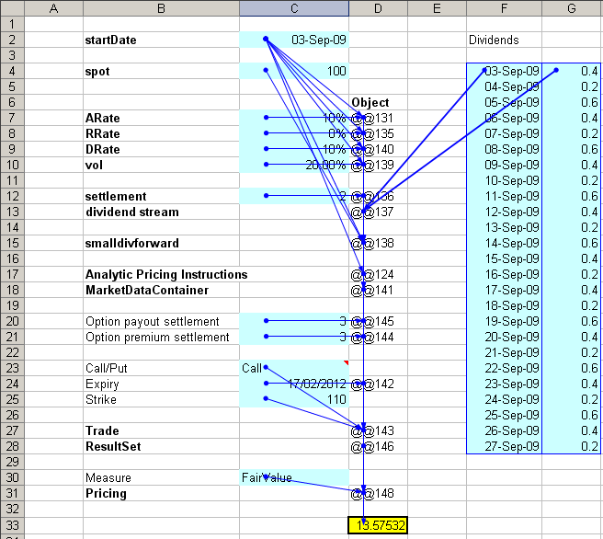
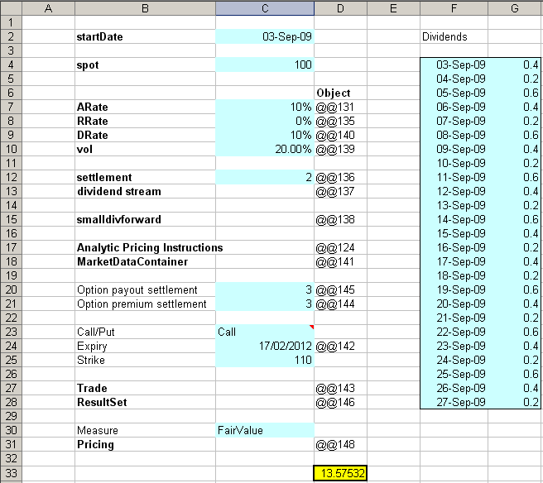
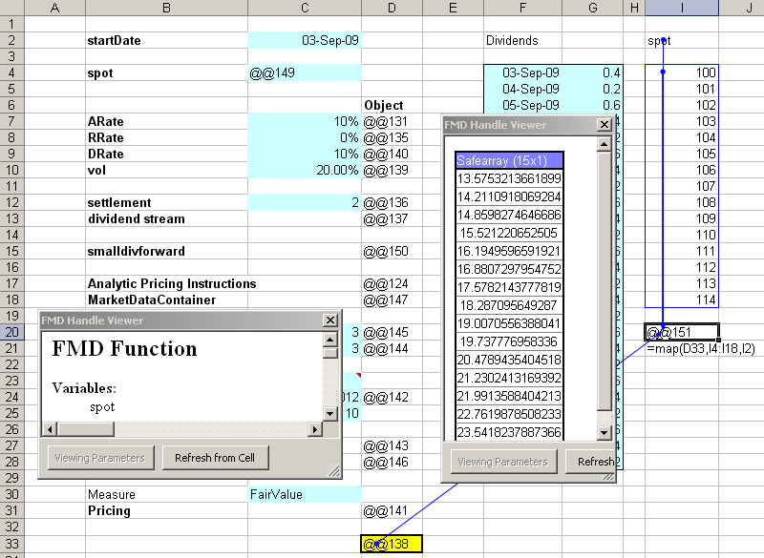
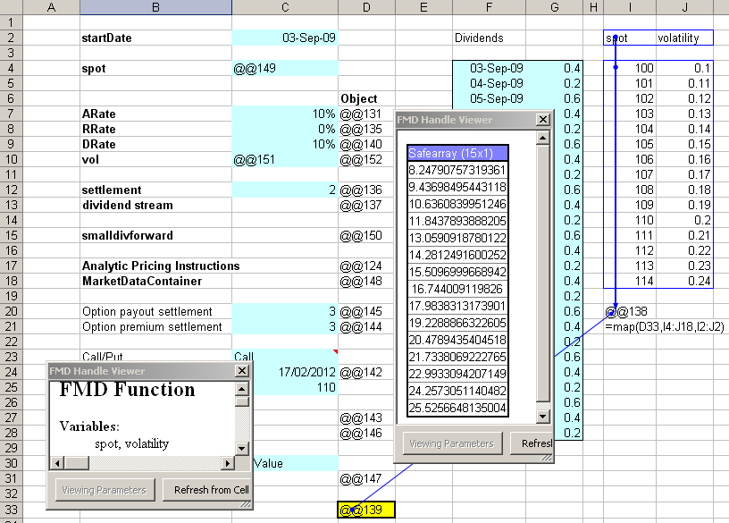
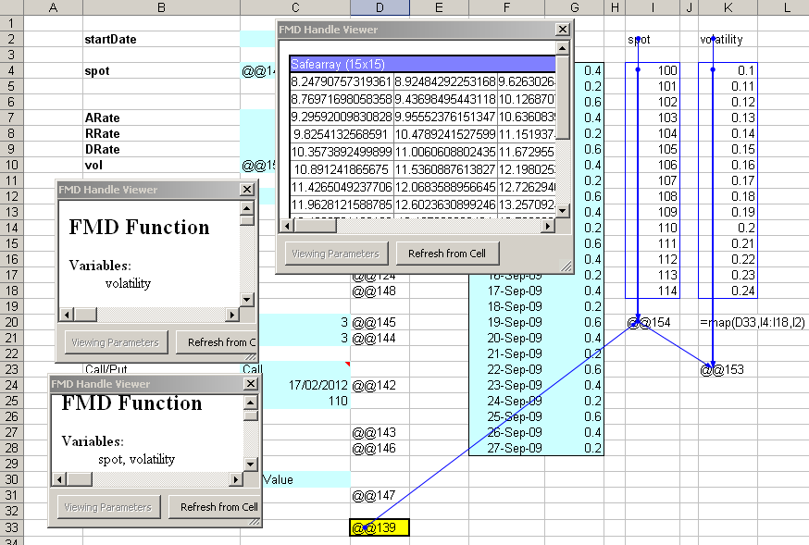
An (almost) real example!
Notes:
[ commentary removed – please see video ]

Slide 17
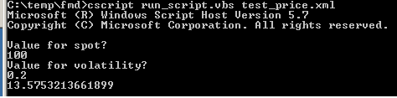
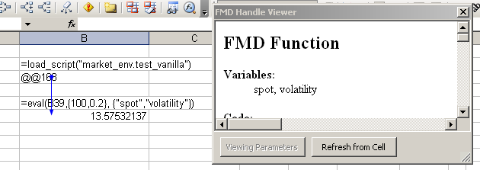
And finally, losing Excel altogether.
We can take the function we just created, extract its’ graph from the sheet, and
evaluate it anywhere.
... or load it into another spreadsheet...
Notes:
[ commentary removed – please see video ]

Slide 18
Who’s using FMD, for what?
FMD is in live use by multiple asset classes (equities, fixed income, funds, etc)
Model development & deployment – cuts TTM, Cost, Operational risk of transliteration drastically.
Ad hoc reporting tools – as a powerful extension to Excel, our traders find it useful for arbitrary data manipulation!
Higher order functionality is used by risk management to provide arbitrary risk measurements, which can be defined on the fly.
And lots of other uses I don’t know about ;)
Currently approx 250 active users internally.
Notes:
[ commentary removed – please see video ]

Slide 19
Some implementation observations
Memoization
Typing
Non-pure functions in scraped libaries
Custom engine vs standard FL.
Notes:
[ commentary removed – please see video ]

