Slide 1
Scala at EDF Trading
Implementing a domain-specific language
for derivative pricing with Scala

Slide 2
Overview
Background
Why EDFT is using Scala
EDFT’s domain-specific language for energy derivatives
  What it does
  How it works
  Why Scala was helpful
Experiences
Conclusion

Slide 3
Background
EDF Trading is EDF’s interface to the electricity, gas, emissions, & freight markets
Bluebird is EDFT’s system used to trade/hedge/risk-manage all non-linear deals
  7 years in production
  Currently ~6 developers
  ~300k lines of Java
  Various components
    Read/write market and trade data from external systems
    Pricing models/analytics
    Reports (aggregation of analytics across a whole portfolio)
    GUI
    Grid service
  Since September 08 we decided to start using Scala
    Most new classes developed in Scala

Slide 4
Why did we choose Scala?
Integration with existing code base
  300k lines of Java
Ability to concisely express mathematical concepts (code is like ‘the model’)
  Infix operators
  Pattern matching
  Closures
Plenty of libraries available
  Implicit conversions e.g. to give matrix library infix operators when used from Scala
Also..
  Some developers already familiar with functional programming
  Runs on JVM
    Low deployment overhead
    JVM-level tools e.g. profilers
    Reflection

Slide 5
DIESEL: EDFT’s domain-specific language
We would like to trade physical and financial swaps and options
  Where strike price is an arithmetic formula based on commodities and FX indexes
The business needs a fast turnaround of analytics for these custom derivatives structures
Rather than writing custom code for each derivative structure we decided to implement a DSL in Scala

Slide 7
Representation in DIESEL
:DELIVERY = Oct06..Sep09;
:POWER = 500000.0 thm/day;
:P0 = 13.20EUR/MWH;
:G0 = 185.000EUR/TONNE;
:F0 = 110.000EUR/TONNE;
:G = AVE(GAS_OIL_0_2PCT_FOB_ARA_BARGES,[9,0,1,:DELIVERY],Monthly) * AVE(1/ECB_USD_EUR,[1,0,1,:DELIVERY],Monthly);
:F = AVE(FUEL_OIL_1PCT_FOB_ARA_BARGES, [6,0,1,:DELIVERY],Monthly) * AVE(1/ECB_USD_EUR,[1,0,1,:DELIVERY],Monthly);
:PTFG = 0.7*(:G-:G0) + (0.1*(:G-:G0))^+;
:PTFF = 0.7*(:F-:F0) + (0.1*(:F-:F0))^+;
:P1_EUR_TON = :P0 + 0.55*0.007595*10TONNE/MWH*:PTFG + 0.45*0.007825*10TONNE/MWH *:PTFF;
:P1 = :P1_EUR_TON*29.3071MWH/1000THM;
:P2 = AVE(HEREN_ZEEHUB_GAS,[1,0,1,:DELIVERY],Monthly) * AVE(1/ECB_GBP_EUR,[1,0,1,:DELIVERY],Monthly);
:P= 0.75*:P1 + 0.25*:P2 ;
SWAP(ZEEHUB,:DELIVERY,:P)*:POWER

Slide 8
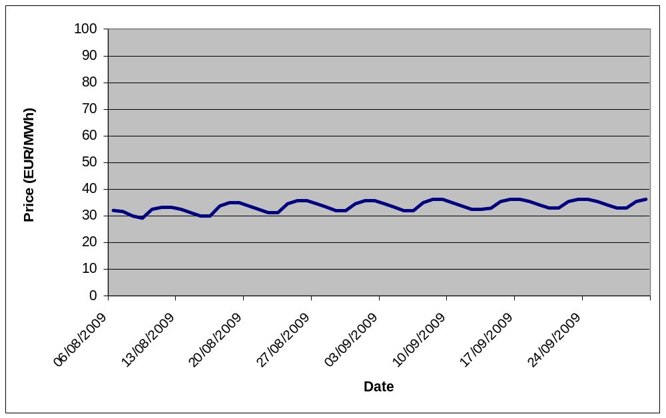
Monte Carlo simulation: Forward Curve

Slide 9
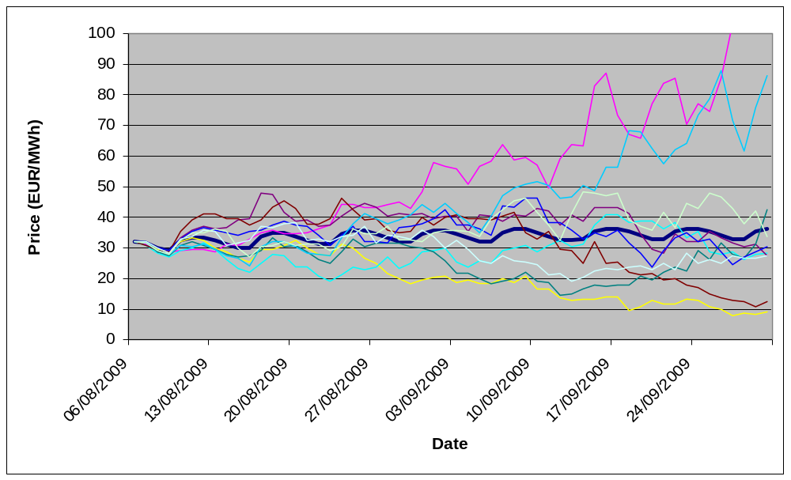
Monte Carlo simulation: Price Trajectories

Slide 10
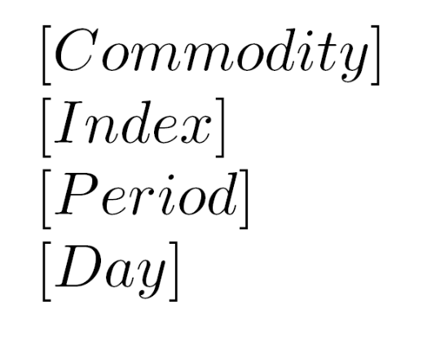
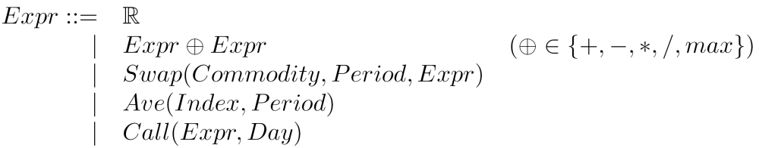
Sketch of syntax

Slide 11
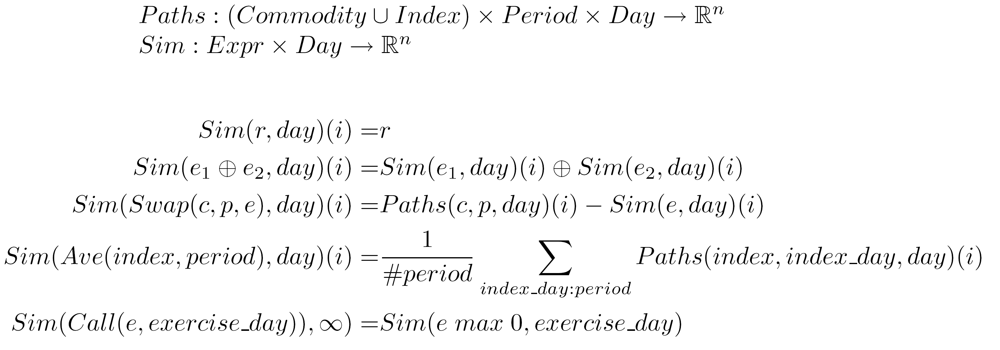
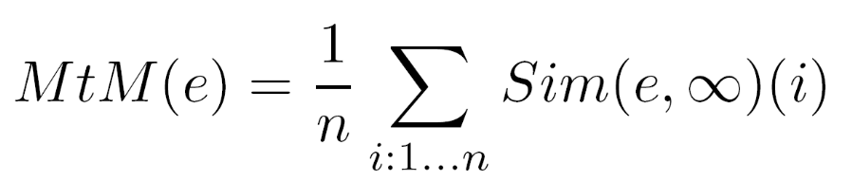
Sketch of semantics

Slide 12
Use of OO-functional paradigm
Combinator Parser Library
  Macro/variable feature added to DSL with parser side-effect:
val varBindings = scala.collection.mutable.Map.empty[String, EXPR]
def exprMacroDef:Parser[Unit] = ":"~>ident~"="~expr ^^
{case name~"="~exprValue => varBindings(name) = exprValue}
def variable: Parser[EXPR] = makeParser(varBindings)
Algebraic data types via case classes
  Some semantic functions implemented with methods on the classes
  Others by using pattern matching:
object linearVisitor extends GenericVisitor[Boolean](booleanOperations) {
override def apply (expr:EXPR): Boolean =
expr match { case m: MAX => false
case _ => super.apply(expr) }
}
object booleanOperations extends Operations[Boolean] {
def +(v1: Boolean, v2: Boolean) = v1 && v2
def zero = true
}

Slide 13
DIESEL experiences
DSLs are great when you want to span a space of concerns rather just cover a few points
I produced about 2kLoC of Scala in 6 months (~20LoC/day). I expect this is because
  Writing a DSL reduces the LoC needed
  Scala is very concise, particularly for expressing DSLs
    Combinator Parser library
The performance of the Monte Carlo is comparable to custom C++ code
  Much of the work is vector arithmetic; CERN’s Colt library makes this fast in Java
We have succeeded in reducing the turnaround time of analytics for custom derivative structures
  Still early days and some deals need extra language features
I also want to look at pricing derivatives with ‘state’ e.g. American options
  Considering writing an embedded DSL for this purpose

Slide 14
Overall experience of writing Scala code
Removes a lot of boiler plate
It seems to fit our domain of mathematics & finance well
  Easy to express ourselves in Scala
Code smells/duplication easy to eliminate
Code tends have a better design/be more reusable
  One is not distracted by language limitations/annoyances c.f. Java/C++
Code is ~2-3 times less LoC
  Easier to read
  Less buggy
Indeed: some concepts best expressed with a functional style, others, an imperative style

Slide 15
What about the practicalities of using Scala?
IDE support has come on well in the last 12 months
  Eclipse & IntelliJ/IDEA
  Some gotchas if using Java debugger
  More needed to get to Java level (e.g. refactoring support)
Compiler performance acceptable
  But could be improved for clean builds
We found a small number of bugs in the compiler and libraries
Developers took to Scala quickly and appreciated it
  Even those unfamiliar with functional programming
  Gentle learning curve
‘ecosystem’ still favours C++ or Java
  Most quants know C++
  There is MUCH inertia!

Slide 16
Conclusion
Scala is currently being used in a business-critical context at EDFT
Although there are risks associated with using a non-mainstream language our experience so far has been that they are outweighed by productivity benefits
We hope to take advantage of continued language/library improvements made by the Scala community

