Slide 1
Galois:
High Assurance Software
John Launchbury
ICFP 2004

Slide 2
Outline
A history of Galois
Some technology
Looking forward

Slide 3

In the beginning…
1999/2000
Service focus
Customers
  Government
  Local industry
Have FP,
Can program

Slide 4
Making a Business out of FP
Build cool things that people should want
  Find sales people to sell it
Sales is always the business
  Technology is a support department for sales
Marketing identifies the right
product for Technology to build
so that Sales will be able to sell

Slide 5
Sales 101
Rapport
Believability
Earn the right
Develop the need
Salesman aware
Customer aware
Offer solutions
Close
Open ended questions
Most urgent problems?
Listen.
Wait to see if bigger issues
are around the corner
Restate the problem.
Don’t assume the customer
sees it clearly.
What we can provide.
How valuable?
More analysis?
When should we start?
When would you pay us?
What are the barriers?

Slide 6

Automated Test Equipment
Customer’s
chip-specific
testing code
ATE vendor needs to provide backwards compatibility
Translation task
  Code cleaning to upgrade language
  OS migration
  API discovery & modification
Problem: testing code contains IP
Requirement: the code look-and-feel to remain unchanged
Chip
Tester

Slide 7
Partial Change List
Insert missing headers (#includes)
Change/add prototypes to match definition
Add prototype declaration instead of implicit forward declaration
Remove syntactic clutter
Remove/change ill-behaved declarations (e.g., static struct, static char *)
Make type casts explicit (i.e. double as case scrutinee; cast to int)
Change now illegal identifier names (forced by ANSI changes)
Change return statements for functions that now return void
Make implicit variable declarations explicit (i.e., to int)
Type changes (explicate CONN equivalences)
Introduction & initialization of global and /or local variables
Type changes/initialization of struct members
Aggregate initialization (where array is given all its values at once; need to translate to explicit bit setting)
Removal of redundant checks (no need to check for end of array; done inside API)
Flag deprecated API elements
Replacing malloc/free with API create/destroy
API function name/type changes

Slide 8
API Discovery
Old machine
  Test programs use arrays as connection lists
  b1 = *c; /* set b1 to current bit */
  b2 = *(c++); /* set b2 to next bit, move focus */
  *(c + 1) = b3; /* set next bit to b3 */
New machine
  Requires use of API for building connection lists
  b1 = conn_getbit(c, c_current);
  b2 = conn_getbit(c, c_current++);
  conn_setbit(c, c_current + 1, b3);

Slide 9
/* 1. BEFORE */
debug_printf("**** DSP error in test %s,
occurred on bit # %d -->",
test_name (NULL),
(*plist & ~LASTBIT) + 1);
if ((log_ptr->vector >= f_scan_st[u])
&& (log_ptr->vector < f_scan_sp[u]))
{
if ((log_ptr->fail_bits[0]
== *even_ram)
|| (log_ptr->fail_bits[1]
== *even_ram))
{
ficm_write(even_ram, log_ptr->vector,
log_ptr->vector,
"H", UNSPECIFIED, UNSPECIFIED);
rep_str[2*u][log_ptr->vector - f_scan_st[u]] = '1';
}

Slide 10
/* 1. AFTER */
debug_printf("**** DSP error in test %s,
occurred on bit # %d -->",
test_name (NULL),
conn_getbit(plist, plist_local_counter) + 1);
if ((log_ptr->vector >= f_scan_st[u])
&& (log_ptr->vector < f_scan_sp[u]))
{
if ((log_ptr->fail_bits[0]
== conn_getbit(even_ram, even_ram_global_counter))
|| (log_ptr->fail_bits[1]
== conn_getbit(even_ram, even_ram_global_counter)))
{
ficm_write(even_ram, log_ptr->vector,
log_ptr->vector,
"H", UNSPECIFIED, UNSPECIFIED);
rep_str[2*u][log_ptr->vector - f_scan_st[u]] = '1';
}

Slide 11
/* 2. BEFORE */
for( pbl = 0; pbl < S_parConnPointer->nrbitl;
pbl++ )
{
close_mba_relays
( S_parConnPointer->bitl[pbl] );
open_io_relays
( S_parConnPointer->bitl[pbl] );
prim_wait( 3 MS );
if ( MbaTest( S_parConnPointer->bitl[pbl],
SREXPD, SRESPD, DontDoMbaRly )
== FAIL )
goto finish;
close_io_relays
( S_parConnPointer->bitl[pbl] );
open_mba_relays
( S_parConnPointer->bitl[pbl] );
if ( theSiteCount > 1 && aSiteFailed )
update_parconn ( &S_tmpParConn, &p_sdbit );
}

Slide 12
/* 2. AFTER */
for( pbl = 0; pbl < parconn_getcount(S_parConnPointer);
pbl++ )
{
close_mba_relays
( parconn_getconn(S_parConnPointer, pbl) );
open_io_relays
( parconn_getconn(S_parConnPointer, pbl) );
prim_wait( 3 MS );
if ( MbaTest( parconn_getconn(S_parConnPointer, pbl),
SREXPD, SRESPD, DontDoMbaRly )
== FAIL )
goto finish;
close_io_relays
( parconn_getconn(S_parConnPointer, pbl) );
open_mba_relays
( parconn_getconn(S_parConnPointer, pbl) );
if ( theSiteCount > 1 && aSiteFailed )
parconn_update ( S_tmpParConn, p_sdbit );
}

Slide 13
Building the translator
C-Kit in ML
Tight schedule
Lesson 1
FP technology covers over a multitude of sins

Slide 14
Translators!!!
C
Business
legacy code
ATE market
IDEAL
COBOL
Build demos
Visit potential customers
Align with channel partners

Slide 15
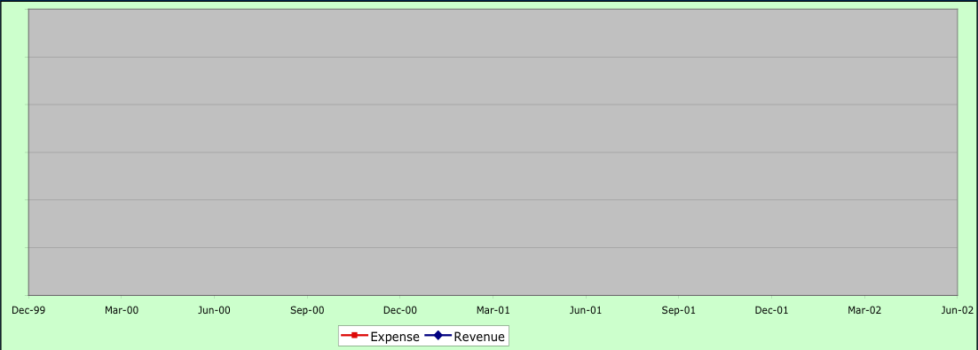
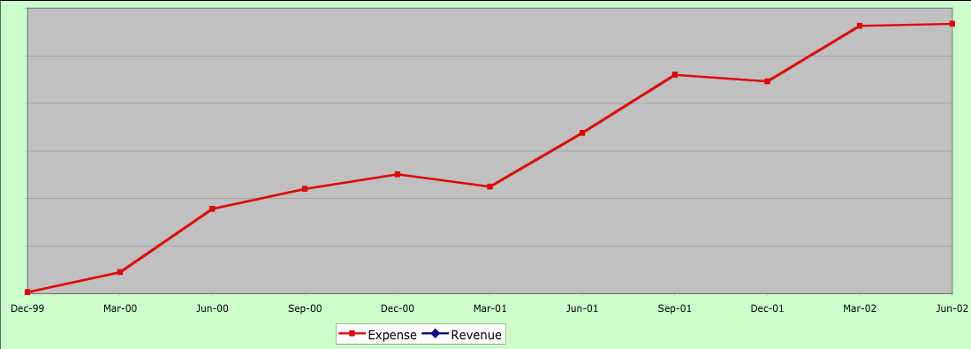
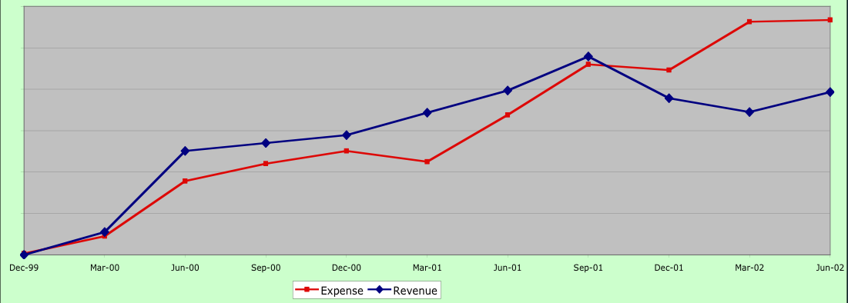
Market issues
Lesson 2
Keep the blue line above the red line

Slide 16
Analysis
Didn’t read the market properly
  References
  Budgets
Lost focus on our core business
Needed to re-invent Galois
  Very challenging times
Lesson 3
It’s not about technology, it’s about relationships

Slide 17
Who are we?
Examination
  Look at what we’ve been successful at
  Look at our skill sets
  Ask our clients
Synthesize
Define the brand
Lesson 4
If you don’t know who you are,
then neither does anyone else

Slide 18
Challenge: Correctness of Implementations of Crypto-algorithms
Crypto-algorithm V&V critical in crypto-modernization programs
Must manage assurance in face of exploding complexity and demands
Not just the DoD
  “25% of algorithms submitted for FIPS validation had security flaws”
    Director NIST CMVP, March 26, 2002
Notes:
CMVP - cryptographic module verification program

Slide 19
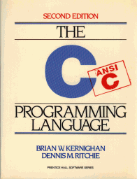
Contributing Factors
Variety of target
architectures
Requires skills in math
AND programming
Variety of requirements
Validation is complex
and tedious

Slide 20
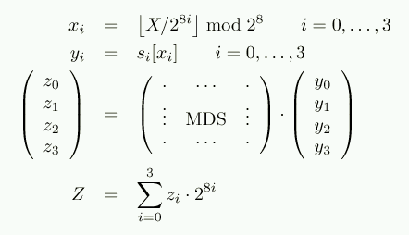
Lack of clear reference implementations
#define MDS_GF_FDBK 0x169
#define LFSR1(x) ( ((x) >> 1) ^ (((x) & 0x01) ? MDS_GF_FDBK/2 : 0))
#define LFSR2(x) ( ((x) >> 2) ^ (((x) & 0x02) ?
MDS_GF_FDBK/2 : 0) ^ (((x) & 0x01) ?
MDS_GF_FDBK/4 : 0))
#define Mx_1(x) ((DWORD) (x))
#define Mx_X(x) ((DWORD) ((x) ^ LFSR2(x)))
#define Mx_Y(x) ((DWORD) ((x) ^ LFSR1(x) ^ LFSR2(x)))
#define M00 Mul_1
#define M01 Mul_Y
return ((M00(b[0]) ^ M01(b[1]) ^
M02(b[2]) ^ M03(b[3])) ) ^
((M10(b[0]) ^ M11(b[1]) ^
M12(b[2])^ M13(b[3])) << 8)^
((M20(b[0]) ^ M21(b[1]) ^
M22(b[2])^ M23(b[3])) <<16)^
((M30(b[0]) ^ M31(b[1]) ^
M32(b[2])^ M33(b[3])) <<24);
It’s hard to relate implementations to the underlying math
Notes:
So, why is Crypto difficult to get right?
No clear unambiguous reference implementations
Papers are high level, but you can’t get test vectors from them
“reference impls” are written in a highly architecture dependent fashion
Implicit endian assumptions
Legacy crypto hard to understand

Slide 21
Specifications and Formal Tools
Declarative specification language
  Language tailored to the crypto domain
  Designed with feedback from cryptographers
Execution and Validation Tools
  Tool suite for different implementation and verification applications
  In use by crypto-implementers
Cryptol
The Language of Cryptography
Notes:
The NSA identified this problem, and decided that they needed a solution

Slide 22
One Specification — Many Uses
Domain-Specific Design Capture
Assured Implementation
Validate
Design
Models and test cases
Verify crypto implementations
Cryptol
Interpreter
w0=u-I*I modp + u-I*wl mod p
s=f*(w0 +pw2) (mod q)
Cryptol
Tools
Build
Target HW code
FPGA(s)
C or Java
Special purpose processor

Slide 23
Domain-Specific Design Capture
Design
Validate
Cryptol
Interpreter
w0=u-I*I modp + u-I*wl mod p
s=f*(w0 +pw2) (mod q)
Build
rc6ks : {a} (w >= width a) =>
[a][8] -> [r+2][2][w];
rc6ks key = split (rs >>> (v - 3 * nk))
where {
c = max (1, (width key + 3) / (w / 8));
v = 3 * max (c, nk);
initS = [pw (pw+qw) ..]@@[0 .. (nk-1)];
padKey : [4*c][8];
padKey = key # zero;
initL : [c][w];
initL = split (join padKey);
ss = [| (s+a+b) <<< 3
|| s <- initS # ss
|| a <- [0] # ss
|| b <- [0] # ls |];
ls = [| (l+a+b) <<< (a+b)
|| l <- initL # ls
|| a <- ss
|| b <- [0] # ls |];
rs = ss @@ [(v-nk) .. (v-1)];
};
Models crypto-algorithm
Natural expression
Clear and unambiguous
Structure and guide an implementation

Slide 24
Usage: Testing
Test cases
Cryptol
Tools
Cryptol Reference
Spec
Hand coded Implementation
Generates “known good tests”
Capture of intermediate vectors simplifies debugging
Easy to generate new intermediate vectors as needed
Reference Test Cases
Interpret and Validate
Validated Implementation

Slide 25
Technology Services
Operations &
Maintenance
O&M.
Advanced technology development
  Applied research to bring new technologies to bear
  Demonstration & validation to ensure successful deployment
Market
  Government
  Industry selling to government
  Other industry
Business model
  Services and product licenses
Seek partnerships elsewhere
  Critical for client success
  Outside of Galois’ core competency
Operational Systems
Development
6.7
Management Support
6.6
Engineering Mfg
Development
6.5
RDT&E
Demonstration
& Validation
6.4
Adv. Technology Dev.
6.3
Applied Research
6.2
Basic Research
6.1

Slide 26
High Assurance Software
Information Assurance
Cross
Domain
Security
Crypto
Devel. &
Validation
Secure
Middleware
Abstract Modeling
Prototype Development
High Assurance Engineering
Domain-Specific Language Design
Mission: Advanced technology development
for Information Assurance

Slide 27
NSTISSP 11
Effective 1 Jan 2001
  Preference given to evaluated Information Assurance (IA) products
Effective 1 Jul 2002
  Acquisition of COTS IA products limited to
    NIAP validated Products, or
    NIST validated Crypto Modules
  Acquisition of GOTS IA products limited to NSA approved

Slide 28
Evaluated Assurance Levels (EAL)
EAL1 | Functionally tested
EAL2 | Structurally tested
EAL3 | Methodically tested and checked
EAL4 | Methodically designed, tested & reviewed
COTS
EAL5 | Semi-formally designed and tested
EAL6 | Semi-formally verified design and tested
Galois Focus
EAL7 | Formally verified design and tested

Slide 29
Security Assurance Requirements
INFORMATION VALUE
V1 | negligible adverse effects or consequences
V4 | serious damage to the security, safety, financial posture, or infrastructure…
V5 | exceptionally grave damage to the security, safety, financial posture, or infrastructure…
THREAT LEVEL
T1 | inadvertent or accidental events
T5 | Sophisticated adversary with moderate resources who is willing to take significant risk (e.g. international terrorists)
T7 | Extremely sophisticated adversary with abundant resources who is willing to take extreme risk (e.g. nation-states in time of crisis)
Assurance at V4/T7, V5/T5 require EAL 6…
(excerpted from IATF Release 3.1)

Slide 30
High Assurance Development
Non-functional, non-technical requirements
  Documented software process
  Physical security of code
Verification and validation
  Traditional testing
  Formal and semi-formal designs and models
  Protection Profile (PP)
    User statement of security requirements
  Security Target (ST)
    Developer statement of the security functionality of a product

Slide 31
High Assurance ASN.1 Compiler
ASN.1
  Data description language
  Very large, obscure semantics
  Implementations have been error-prone
  Widely used
Designed for manifest correctness
  Parser grammar almost identical to ASN.1 definition
  Sequence of intermediate languages
Designed for robustness
  Each C construct considered in isolation
  All buffers, mallocs, pointer dereferences are guarded
ECU code
X.509
ASN.1 Compiler

Slide 32
Trusted Web Server
Clients
Network Services
Active Directory Server
- Authentication (KDC)
- Directory (LDAP)
.
.
.
Same
KDC
LDAP
TCP/IP
HTTPS
WebDAV
File
Control
Integrity
Checker
IPSec/SSL
TCP/IP
HTTPS
WebDAV
Read
Down
File
Control
TCP/IP
HTTPS
WebDAV
Read
Down
File
Control
IPSec/SSL
Integrity
Checker
MILS Separation Kernel
KDC
LDAP
.
.
.
Active Directory Server
- Authentication (KDC)
- Directory (LDAP)
Notes:
The diagram shows the external networks attached to the TSE on the left, and the internal software architecture within the TSE box on the right.
External networks:
Each must provide authentication, directory, and content checking services. As these are ‘single-level’ services, their assurance is not as critical as the assurance of the TSE.
Initially, the TSE is designed to interoperate with Microsoft Active Directory Server, which is commonly used for network authentication. Other authentication services could be used, provided they implement the protocols used by the TSE.
The content checking service provides a check of the data files uploaded from low to high to ensure that all possible malicious code is stripped to prevent virus incursion up. The TSE project is exploring the use of an NSA project (OWFiT) to provide this service. The TSE would guarantee that integrity checking was performed for every uploaded file.
Within the TSE:
There are separated processes as indicated on the diagram.
The underlying separation kernel ensures that data cannot move between processes except through explicitly defined channels.
The kernel provides strong timing guarantees so that activity at one level is not observable from another level. This protects against a denial-of-service attack at low from affecting the use of the high system on the TSE.
There are separate disks to hold data at separate security levels. From the user’s view, however, the file system looks like a single disk.
HTTPS/WebDAV are the standard protocols used to interface to the TSE and provide the file and web server capabilities.
Assurance work is focused on the critical read-down components that handle multiple levels of data.

Slide 33
Deploying Haskell
Minimize size of system underneath
  Extend RTS slightly
  Host directly on separation layer
  Formal model for RTS
High assurance platform
  Separation kernel provides coarse-grained security constraints
  Haskell types provide fine-grained security assurances
Evaluation
  Evaluate RTS system once
  Evaluation focuses on application, not infrastructure
Haskell
Haskell
Runtime
Runtime
OS
Haskell
Haskell
Runtime+
Runtime+
Separation layer

Slide 34
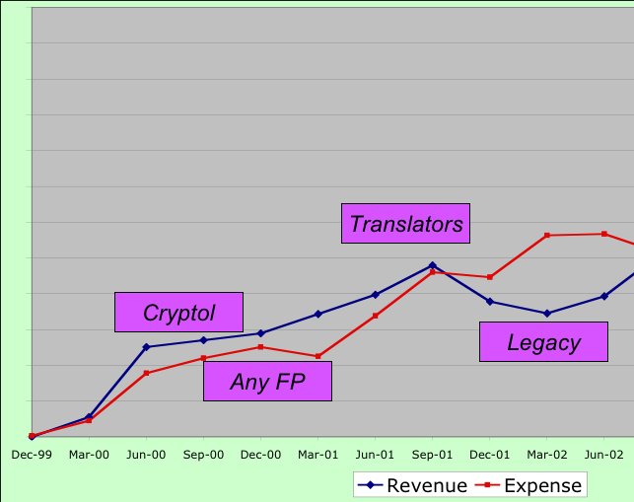
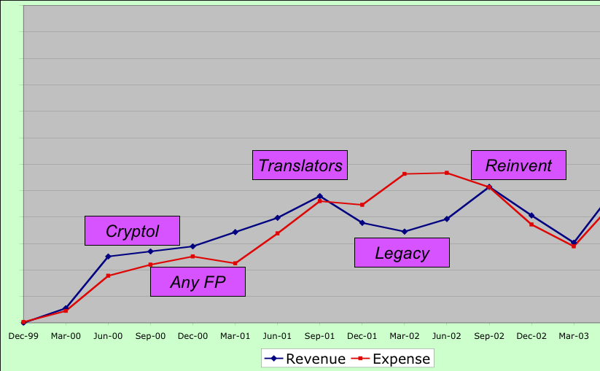
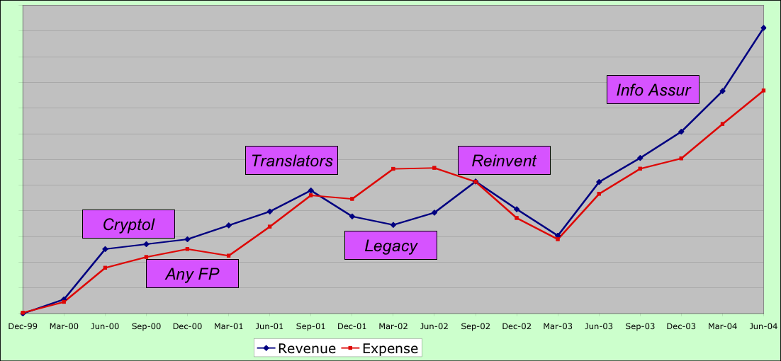
Focus, focus, focus

Slide 35
Business Benefits of Haskell
Executable
(semi)-formal
method
High
Productivity
Unique
niche
Quality of
engineers

Slide 36
Business Issues of Haskell
Debugging
Libraries
Government
requirements
Support
Abstraction
addiction

Slide 37
To the future
What is the most critical
question that the FP
community faces?

Slide 38
What is FP’s Brand?
Assurance
Types
Values
Cool
Abstraction
Expressive
Rapid Dev
Monads
Correctness

Slide 39
Technology directions
Spectrum from Haskell—HOL
Control over sensitive values in the heap

Slide 40
Conclusions
It’s been an incredible experience
FP languages are as good as we hoped
Business and Technology can go hand in hand

