Slide 1
Ispit: Java Microservices
Nikola Jovanovic

Slide 2
Uvod
2 Servisa ( Department & User )
Api Gateway
Klijentska Aplikacija

Slide 3
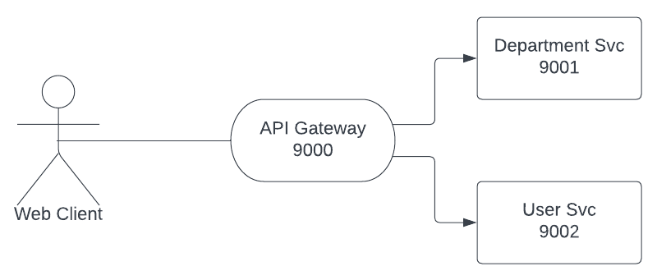
Graph

Slide 4
Opis Spring servisa
Controller ( GET, POST, PUT, DELETE )
Service
Repository ( JPA + psql )
Entity
Config

Slide 5
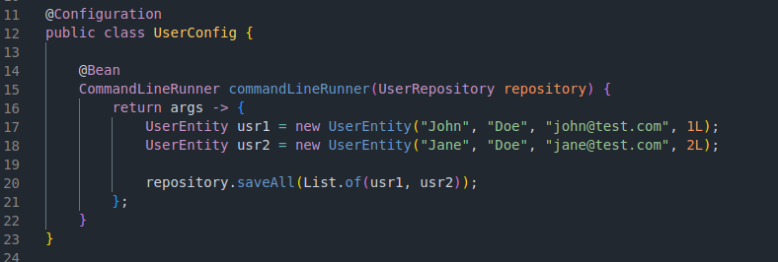
Config

Slide 6
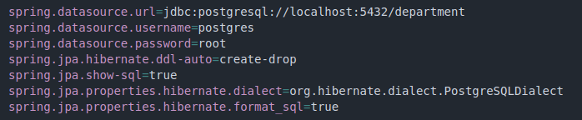
Baza podataka

Slide 7
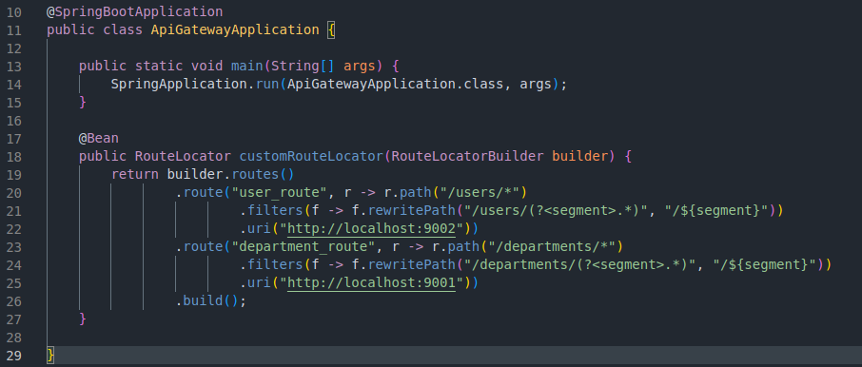
Api Gateway
http://localhost:9000/users === http://localhost:9002/

Slide 8
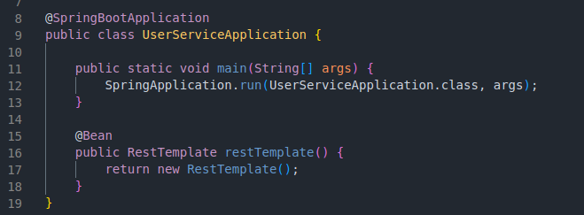
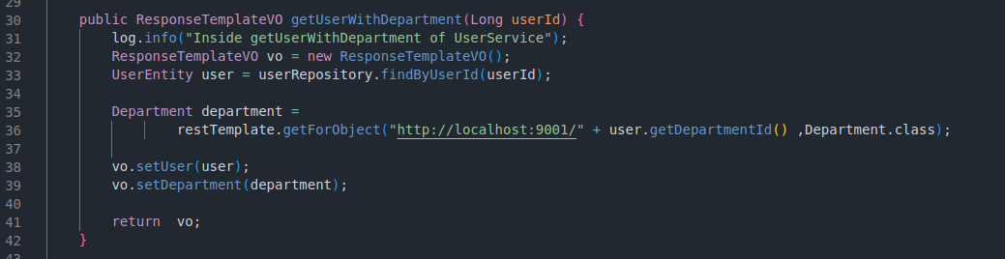
Komunikacija izmedju servisa

