Slide 1
SC10 Student Cluster Competition
Yeh-Ching Chung
National Tsing Hua University
Taiwan, ROC

Slide 2
Outline
HPC Education in Taiwan
Prepare for SCC
Conclusions

Slide 3
HPC Education in Taiwan
National Center for High-Performance Computing (NCHC) is the only HPC center and research institute in Taiwan
NCHC provides many HPC services to the public
All HPC related courses offered in the universities are for graduate students
Overall, HPC related courses are difficult for undergraduate students to learn

Slide 4
Prepare for SCC (1)
Some important rules make SCC unique
  Undergraduate students
  26-amp power limitation
  HPCC benchmarks
  HPC applications (this year)
    NAMD
    WRF
    FLASH
    Distributed Password Auditing/Cracking

Slide 5
Prepare for SCC (2)
Student recruiting
  In my department, undergraduate students are required to take 1-year hands on lab course
    The course starts in Spring semester and ends in Fall semester
  There is a demo show for undergraduate students to present their results at the end of each year
  It is easier to recruit students to take part in SCC during or after the demo show

Slide 6
Prepare for SCC (3)
Team member
  Advisor : Professor Yeh-Ching Chung
  Coaches
    Xuan-Yi Lin (PhD candidate)
    Chung-Yu Huang (master student)
    Yu-Ming Huang (master)
  Team members
    Yu-Cheng Chen (senior, captain)
    Yi-Man Ma (senior)
    Yi-Chun Chen (senior)
    Yu-Chun Hsueh (senior)
    Cheng-Wei Huang (Senior)
    Meng-Kai Liao (junior)

Slide 7
Prepare for SCC (4)
Skill trained and task assignment
  Parallel programming (MPI, Pthread)
  System software (Linux, PVFS, IB, Cluster management, etc.)
  HPCC (Meng-Kai Liao)
  NAMD (Yi-Man Ma, Yi-Chun Chen)
  WRF (Yi-Chun Chen, Yu-Chun Hsueh)
  FLASH (Yu-Chun Hsueh, Yi-Man Ma)
  Distributed Password Auditing/Cracking (Yu-Cheng Chen, Cheng-Wei Huang)

Slide 8
Prepare for SCC (5)
Vendor partners
  Acer
    Cluster sponsor
    Travel expenses sponsor
  Tatung and NCHC
    Travel expenses sponsors

Slide 9
Prepare for SCC (6)
Hardware configuration
  8 Acer AR360 servers
    Each Acer AR360 Server
      CPU: 2 Intel Xeon 5670 @ 2.93 GHz
      Memory: 24 GB
  Storage: 4.8TB
  Interconnection networks
    1 QLogic InfiniBand Edge Switch 12300-BS18
    8 Qlogic 40 Gb/s InfiniBand PCI-E cards
    1 Broadcom Coporation NetXtreme II BCM5708S Gigabit Ethernet

Slide 10
Performance of HPCC Benchmarks
 | InfiniBand | Gb Ethernet
Linpack | 994 GFLOPS | 872 GFLOPS
MPI-RandomAccess | 5.89x | 1x
MPI-FFT | 7.68x | 1x
PTRANS | 16.74x | 1x
EP-RandomAccess | 1x | 1x
EP-FFT | 1x | 1x
EP-DGEMM | 1x | 1x
EP-STREAM | 1x | 1x

Slide 11
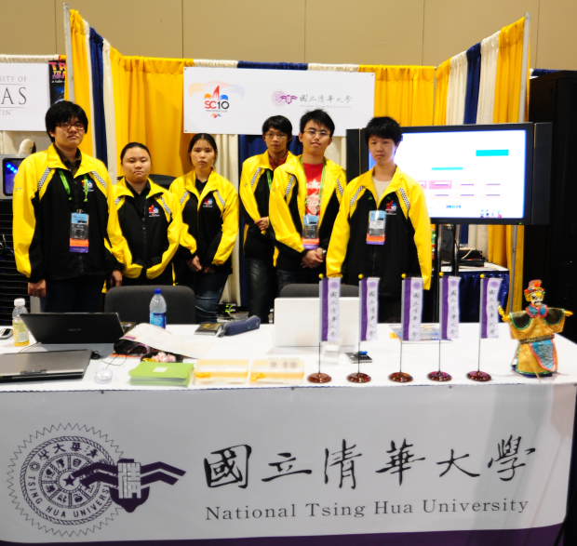
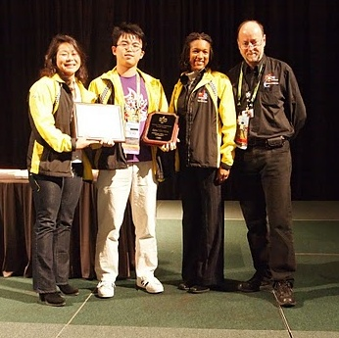
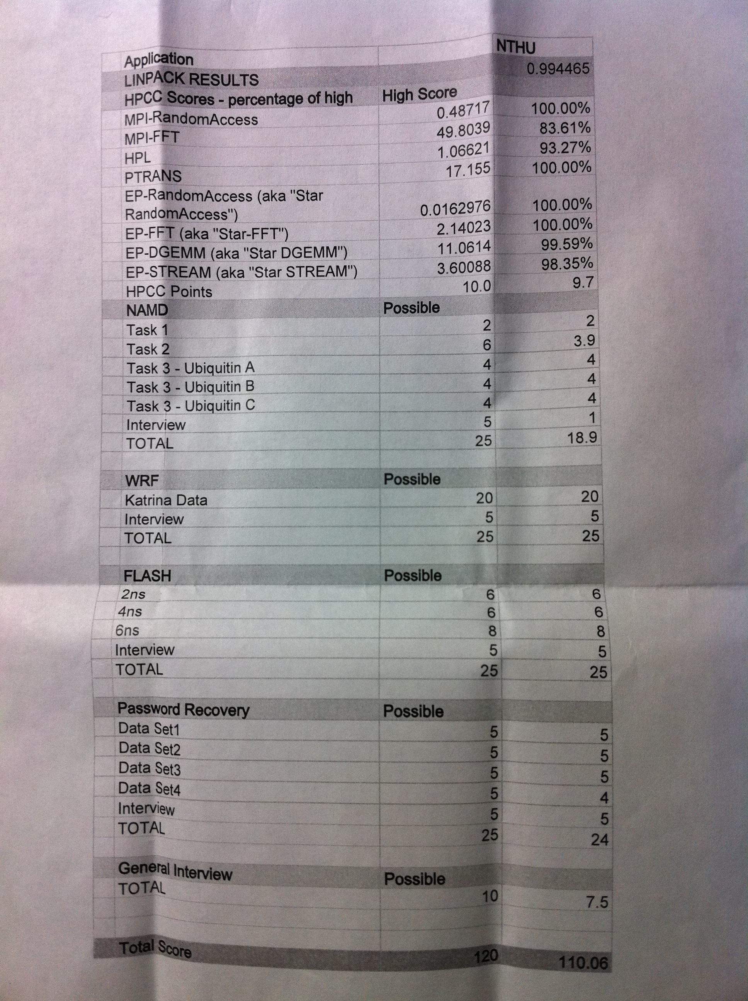
SC10 NTHU-Score

Slide 12
Conclusions
SCC is difficult for undergraduate students to prepare for
  No HPC background at all since no HPC related courses offered at undergraduate level
  The training period is long (almost a year)
  Students need to find extra time to learn HPC related skills
Experiences of SCC can help the preparation
Vendor partners are important for a SCC team

