Slide 1
Know about C&Cpp
——based on CSC3002

Slide 2
Array compare with List(python)

Slide 3
Array compare with List(python)
To use array, you need to:
declare data type
all the data should be one type
declare the length of the array
int array[10];
int array[] = {0, 0, 0, 0, 0}

Slide 4
IO and String difference in C&CPP

Slide 5
library in C
stdio.h
string.h
library in C++
iostream
string

Slide 6
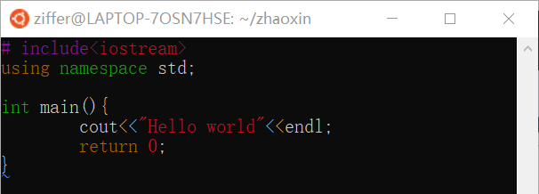
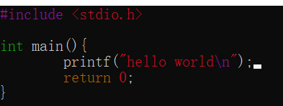
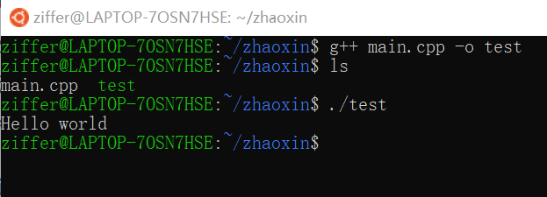

stdio.h C & iostream C++

Slide 7
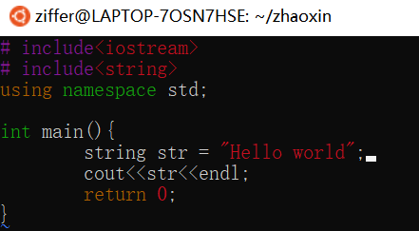
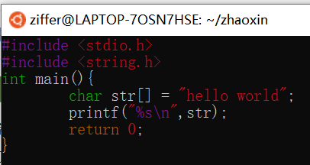
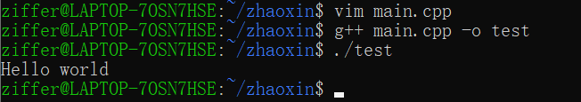
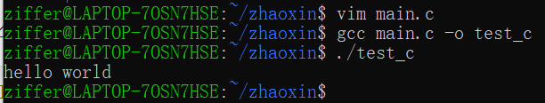
string.h in c & string in cpp

Slide 8
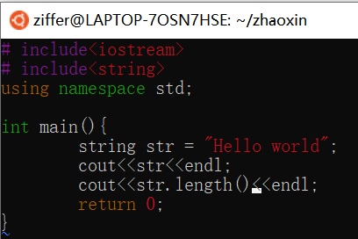
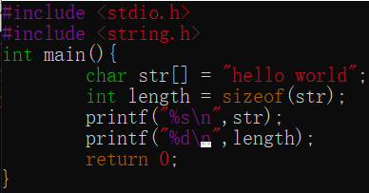
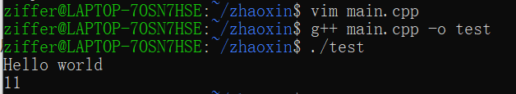
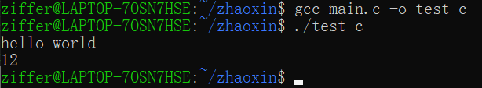
string.h in c & string in cpp
Why?

Slide 9
Struct in C & Class in Cpp

Slide 10
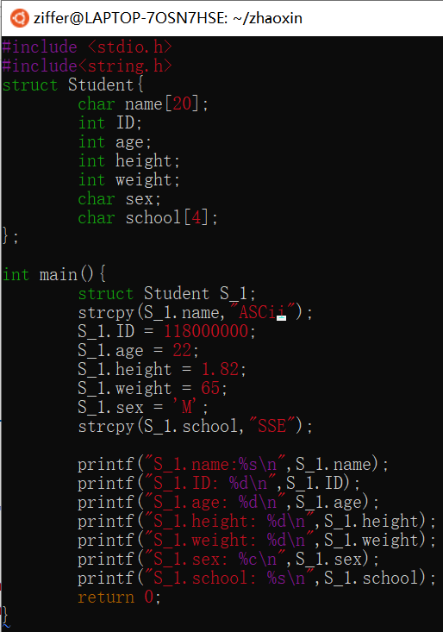
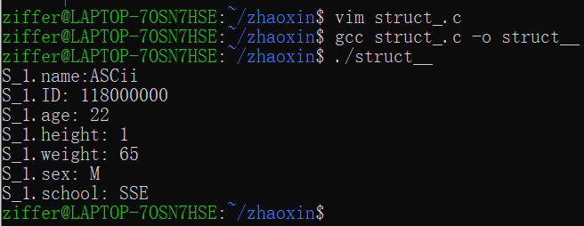
Struct in C & Class in Cpp

Slide 11
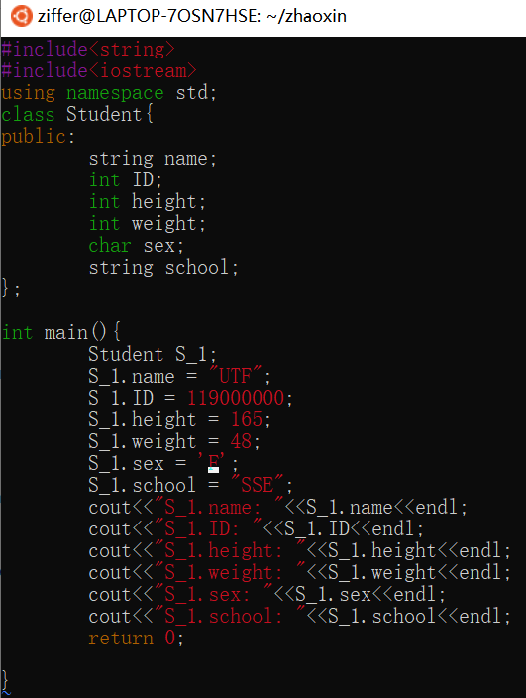
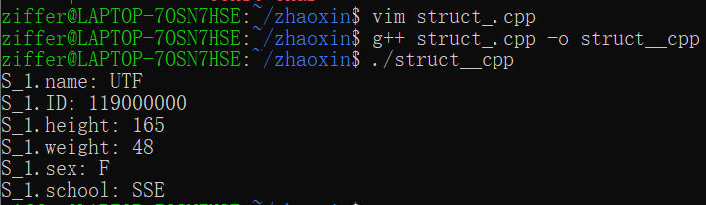
Struct in C & Class in Cpp

Slide 12
Memory: address and pointer

Slide 13
Memory: address and pointer
Maybe this is the first time for you to “touch” memory
expect for stack overflow when you want to set the terminating part of a Recursive function
SIGSEGV: segmentation fault
You only need to know this fault caused by:
attemping to use the Memory that not allocated!
The detail of dividing memory into Segment and Block are in CSC3050

Slide 14
Memory: address and pointer
Sometime a parameter maybe too large. How can we send it into the function?
pass by reference
pass by pointer

Slide 15
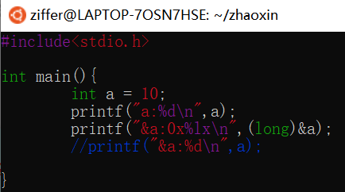
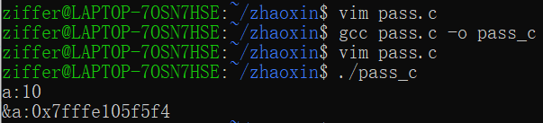
Reference
&a is the address of Variable a

Slide 16
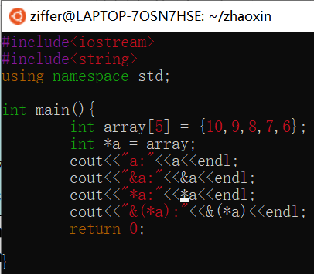
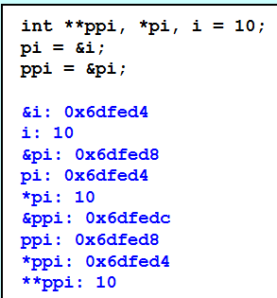
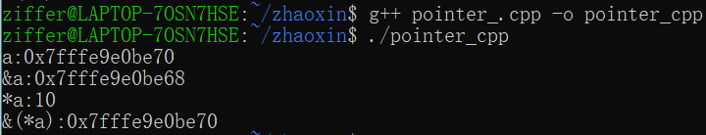
Pointer
Exerciese:

Slide 17
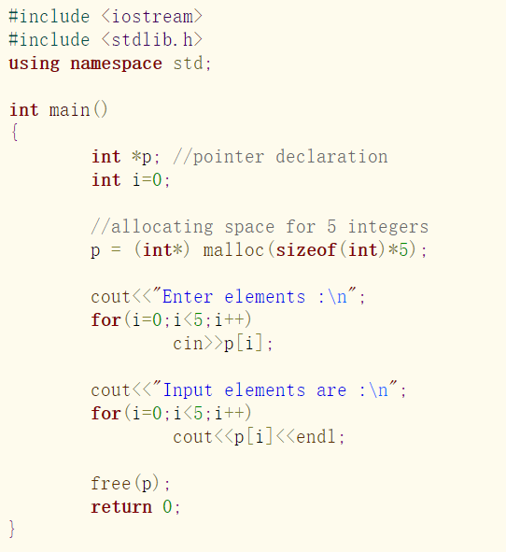
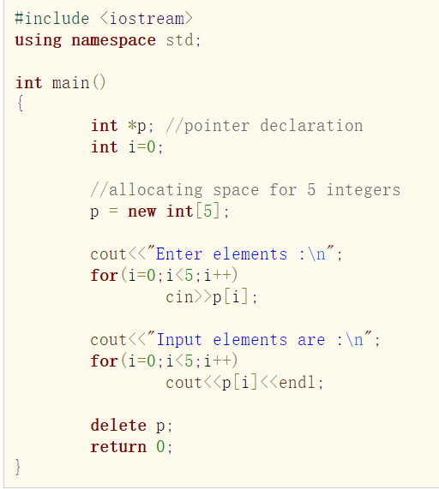
new & malloc

Slide 18
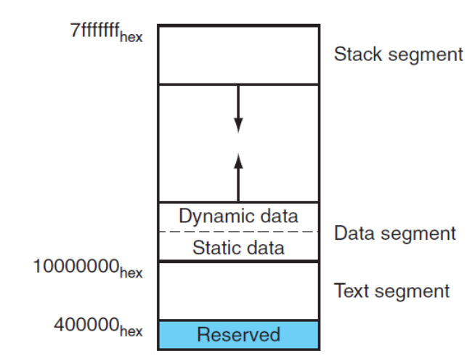
Memory

