Slide 1

What Is The State of Food Security and Nutrition in the US
Khyati Naik
Data 608
Fall 2023
Story 6

Slide 2
Introduction
Uncover correlations between poverty levels and food insecurity, deciphering the intricate relationship that defines the state of nutrition in the United States.
Explore the longitudinal impact on individuals, with a specific focus on the journey from childhood to adulthood, to understand how early-life experiences shape nutritional security.
Contribute to a deeper understanding of the challenges and opportunities in addressing food security issues, paving the way for informed decision-making and targeted interventions.

Slide 3

Data manipulation
In the initial phase of our data processing, we encountered county-level poverty data obtained from the Census Bureau.
To align with our analytical goals, we strategically filtered and transformed the data to be at the state level, setting the foundation for comprehensive state-level insights into poverty and food insecurity.
Simultaneously, addressing nuances in the food insecurity dataset, we strategically synthesized new fields by deriving the total population, distinguishing between overall, children, and senior demographics.
This meticulous approach empowered us to aggregate the data according to distinct poverty levels, facilitating the accurate computation of food insecurity rates across varying socio-economic strata.

Slide 4
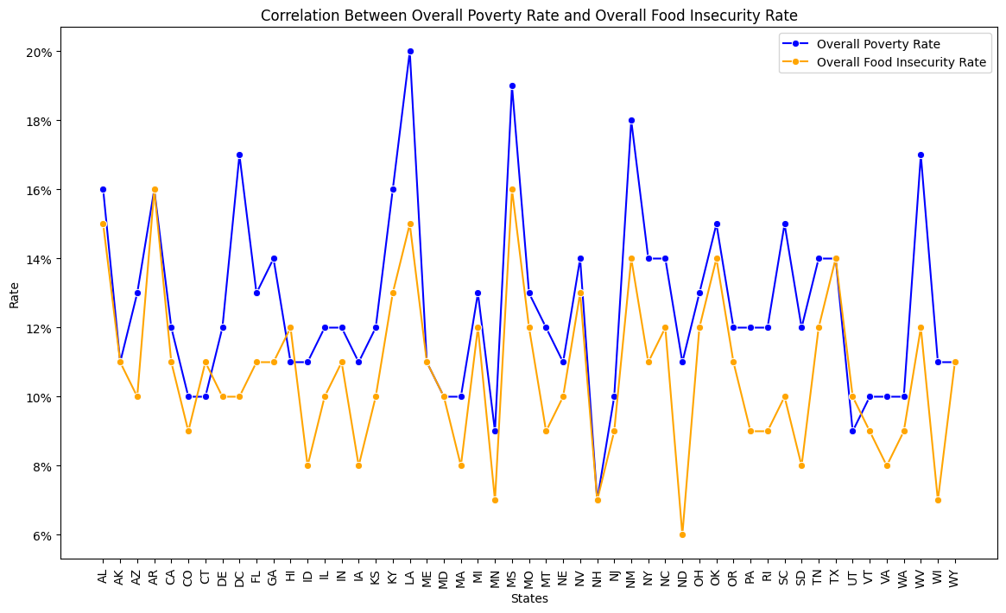
Poverty rate and Food insecurity rate by State
In general, we see in this chart that states with higher poverty rates also have high food insecurity rate.
Correlation between poverty rate and overall food insecurity rate is 78%.

Slide 5
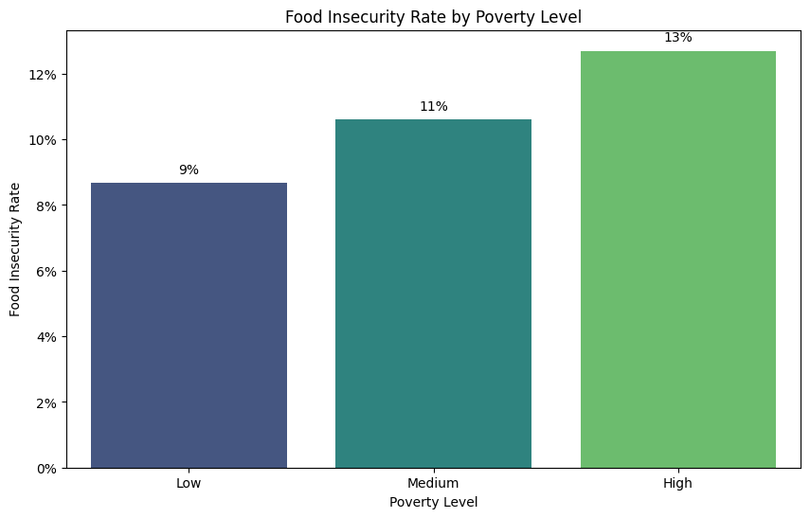
Correlation between level of poverty and food insecurity rate
In this chart, we can see that food insecurity rate increases with increase in poverty level.

Slide 6
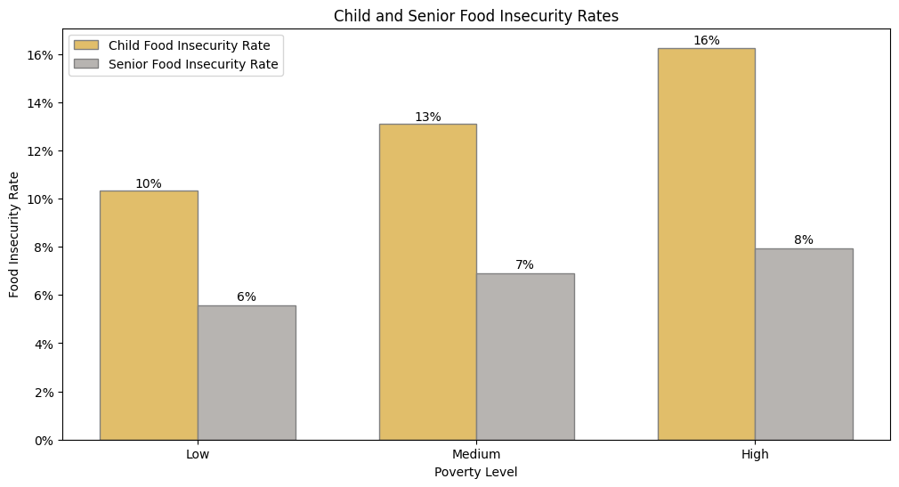
Food insecurity rate lowers as children's mature into adults; but the spread widens with increase in poverty level
The food insecurity rate is lower for senior (age 60+) compared with children food insecurity rate.
The widening spread with increasing poverty levels indicates persistent challenges that demand targeted interventions for vulnerable populations.
8%
6%
4%

Slide 7
Conclusion
This analysis reveals a strong positive correlation of 78% between poverty level and overall food insecurity in the United States.
The visual representation underscores that as poverty levels rise, so does the food insecurity rate.
Furthermore, while there is a decrease in food insecurity as children mature into adults, the widening spread with increasing poverty levels indicates persistent challenges that demand targeted interventions for vulnerable populations.

Slide 8
References
Food insecurity rate data:
https://map.feedingamerica.org/
Poverty rate data:
https://www.ers.usda.gov/data-products/county-level-data-sets/county-level-data-sets-download-data/

