Slide 1

What Is The Effect Of The Earth's Temperature on Cyclonic Storms?
Khyati Naik
Data 608
Fall 2023
Story 5

Slide 2
Introduction
Cyclonic storms can have far-reaching effects, and understanding these relationships can help us prepare for and mitigate the impact of severe weather events.
This analysis is crucial for understanding the impacts of climate change on weather patterns and the environment.
By studying these correlations, we can make more informed decisions about climate resilience, disaster preparedness, and climate change adaptation.

Slide 3
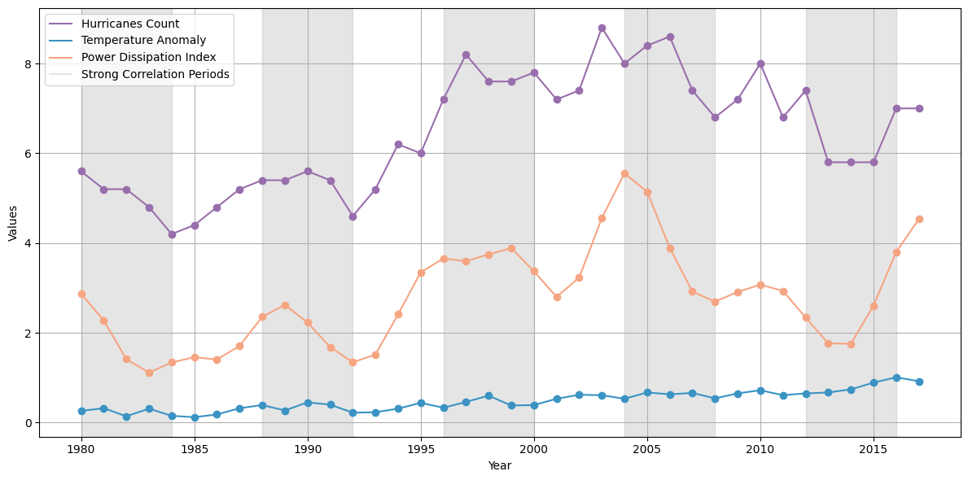
Trend Analysis of Climate and Hurricane Data
The Earth's temperature anomaly has been steadily increasing over the years, which is indicative of global warming and its impact on climate patterns.
The number of adjusted hurricanes and the Power Dissipation Index show variable trends, reflecting the natural variability in cyclonic storm occurrences and their destructive potential.
Analyzing these trends helps us explore potential correlations with temperature anomalies.

Slide 4
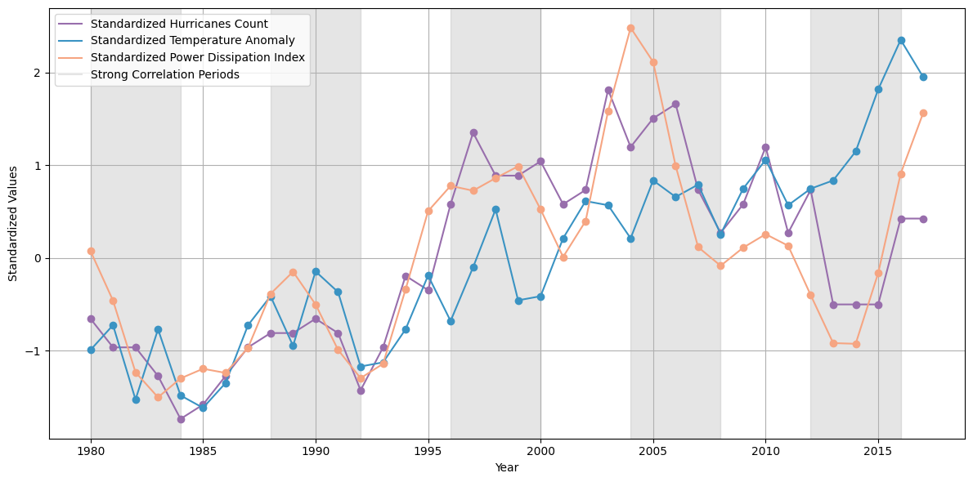
Standardized Trend Analysis of Climate and Hurricane Data
The chart showcases the standardized trends of hurricanes, temperature anomalies, and power dissipation index over time. Standardization is crucial for meaningful comparison, as it allows us to focus on relative changes in these variables without being influenced by their original scales.

Slide 5
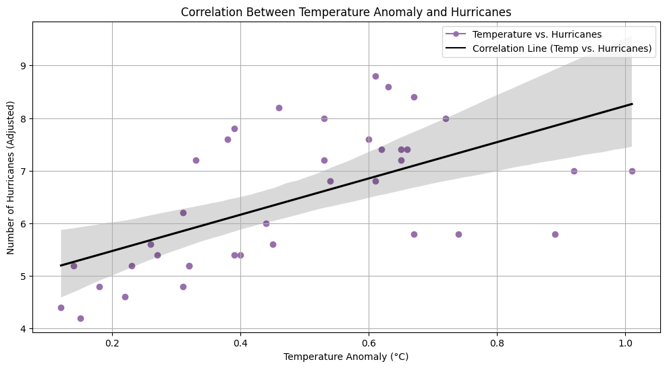
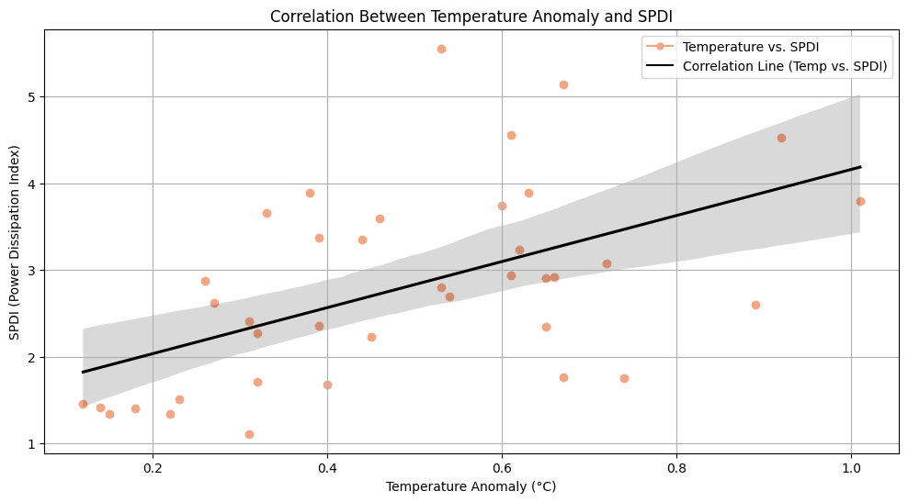
Scatter plot suggest strong correlation between temperature anomaly and climate variables
Above scatter plots provide a visual representation of how Temperature Anomaly is related to both Hurricane Occurrences and the Power Dissipation Index. By examining the distribution of data points, we can assess whether there is a discernible connection.
The black lines represent the correlation between Temperature Anomaly and the respective variable. The slope of these lines indicates a fairly strong correlation between Temperature Anomaly and respective variables.

Slide 6
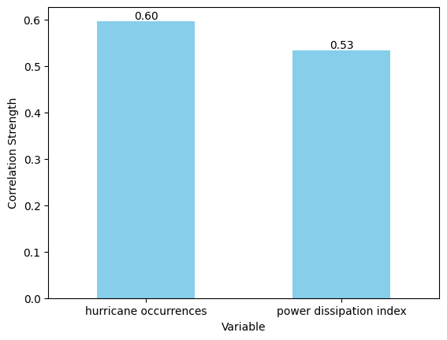
Correlation Strength
We assess the correlation strength between Temperature Anomaly and the other two variables, Hurricane Occurrences and the Power Dissipation Index (PDI).
The positive correlation indicates that an increase in Temperature Anomaly tends to coincide with more hurricanes and a higher PDI, though the strength of the relationship varies between the two variables.

Slide 7
Conclusion
Earth's temperature strongly influences cyclonic storms, with temperature anomalies linked to increased hurricanes and higher PDI.
These findings highlight the urgency of climate change, affecting weather patterns and storm intensity.
Understanding these correlations aids in disaster preparedness, helping communities adapt to the changing climate landscape.
This study emphasizes the need for an interdisciplinary approach to address climate-related challenges effectively.

Slide 8
References
Hurricane occurrences data sourced from NOAA, 2021:
www.epa.gov/climate-indicators
North Atlantic Tropical Cyclone Activity Power Dissipation Index data sourced from NOAA, 2021:
www.epa.gov/climate-indicators
Temperature Anomaly data: https://data.giss.nasa.gov/gistemp/graphs/graph_data/Global_Mean_Estimates_based_on_Land_and_Ocean_Data/graph.txt

