Slide 1

Analyzing Salary Variations of Data Professionals by State
Khyati Naik
Data 608
Fall 2023
Story 4

Slide 2
Introduction
Comprehending the nuances of salary disparities in the field of data professions carries paramount significance, catering to the interests of job seekers and employers alike.
This in-depth analysis serves as a beacon, illuminating the economic terrain and the dynamic demand for data professionals within varying geographic regions.
Our project places primary emphasis on four pivotal data roles: Data Analyst, Data Engineer, Data Scientist, and Research Scientist.
The overarching objective is to glean valuable insights into the intriguing realm of salary variations that exist across the geography of data roles.

Slide 3
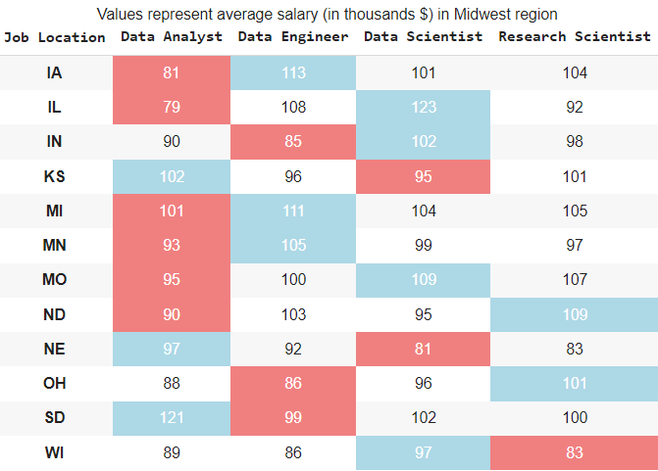
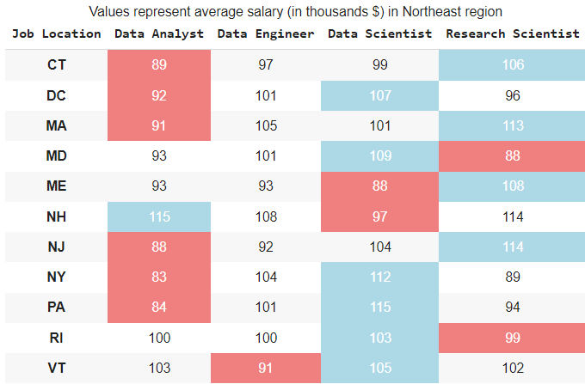
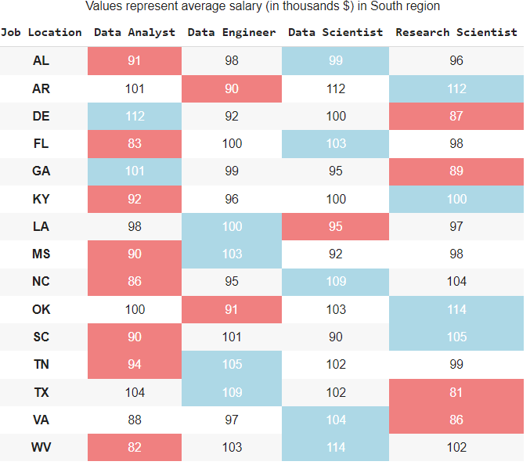
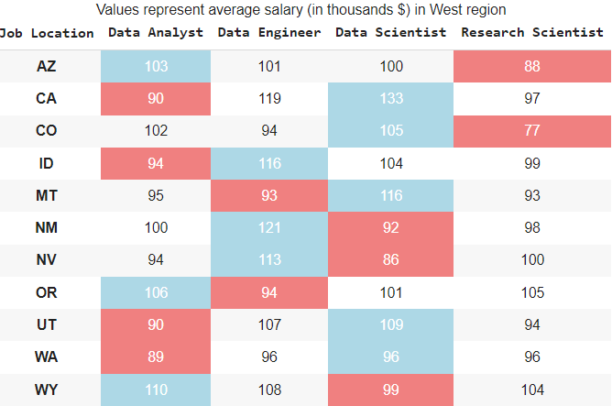
Blue shade in the table represents max salary; whereas red shade represents min salary among the 4 professions.
Data Scientist roles are the most financially rewarding, with the highest average salaries in 20 states.
Data Analyst roles are the least lucrative, with the lowest average salaries in 24 states.
In the Northeast region, Research Scientist roles are more lucrative than Data Engineer positions.

Slide 4
Conclusion
Data Scientists lead with the highest average salaries in 20 states, reflecting their strong demand and value in organizations.
Conversely, Data Analysts see the lowest salaries in 24 states, highlighting the competitiveness of this field.
In the Northeast, Research Scientists surpass Data Engineers financially, indicating a growing need for specialized research expertise in this region.
This data provides valuable insights for both job seekers and employers, revealing the evolving landscape and demand for data professionals.
In conclusion, staying informed and adapting to these trends is crucial as the data profession landscape continues to evolve.

Slide 5
References
Salary by profession and state
https://www.kaggle.com/code/itzikshamli/data-scientists/input
https://www.kaggle.com/datasets/andrewmvd/data-engineer-jobs

