Slide 1

Where Do Strategic Minerals Come From?
Khyati Naik
Data 608
Fall 2023
Story 7

Slide 2
Introduction
Critical or strategic minerals are essential raw materials that are crucial for the functioning of various industries, technologies, and national infrastructure, playing a fundamental role in economic development, national security, and technological innovation.
Analyzing the sources of strategic minerals for the USA is crucial as it enables a comprehensive understanding of supply chain vulnerabilities, ensuring strategic preparedness, and fostering strategies to mitigate potential geopolitical, economic, and security risks associated with external dependencies.
We aim to unravel the origins of the critical minerals, shedding light on the challenges posed by external dependencies and the potential consequences for our nation.

Slide 3
Data manipulation
14 strategic minerals are grouped together as Rare Earth elements.
We did not find data for 3 strategic minerals – Iridium, Rhodium, Ruthenium.
These elements are excluded from our analysis
Special characters are removed from the critical elements names.

Slide 4
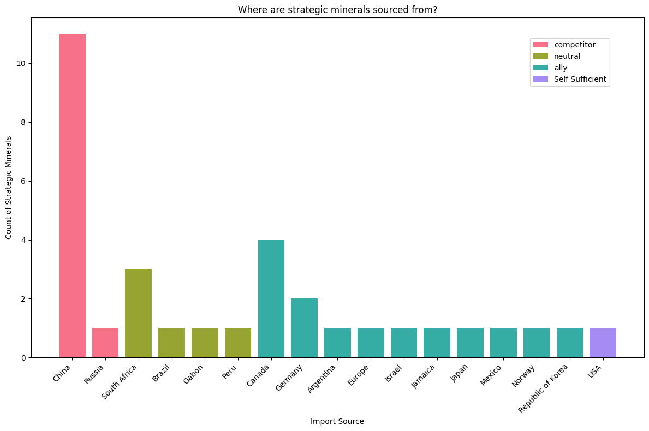
Heavy reliance on China to source strategic minerals
The bar chart illustrates the distribution of mineral imports to the USA from various countries.
Notably, it reveals a substantial reliance on China, with a significant count of 12 (off 34) critical minerals imported, highlighting the critical role of this strategic competitor in the supply chain.
This reliance emphasizes the need for a nuanced approach to diversifying sources and developing domestic alternatives, ensuring resilience against potential disruptions and reinforcing the USA's strategic position in securing critical mineral resources.

Slide 5
Strategic Minerals Sourcing Risk Assessment
The table illuminates the nuanced dynamics of source dependency and the potential impact of shortfalls on critical minerals.
Nine critical minerals present a significant supply risk due to the substantial imports from strategic competitors. This heightened risk is underscored by their extensive applications in key sectors such as electronics, medical applications, energy, and manufacturing, emphasizing the need for a thorough analysis of potential shortfalls.
The USA's status as a net exporter in only one critical mineral category signifies an opportunity for fortifying domestic resilience, mitigating risks tied to specific nations.
In light of these revelations, there is a clear imperative for strategic planning. Addressing dependencies becomes paramount to ensure a secure, sustainable supply of critical minerals and safeguard against potential vulnerabilities in the ever-evolving global landscape.
High
Net exporter Imports <=50% 50%<Imports<=75% Imports>75%
Import Reliance
Low
Self Sufficient Ally Neutral Competitor
Low
Supply Risk
High

Slide 6
Conclusion
The substantial reliance on China for 12 out of 34 critical minerals emphasizes the necessity for a diversified sourcing strategy to ensure resilience against disruptions.
The USA's status as a net exporter in only one critical mineral category presents an opportunity to strengthen domestic resilience and mitigate risks associated with specific nations.
The pronounced dependence on strategic rivals, particularly evident in the "competitor" column with imports>75%, underscores the urgency for strategic planning to secure a sustainable and resilient supply of critical minerals in the face of global uncertainties.

Slide 7
References
List of Critical Minerals:
https://www.usgs.gov/news/national-news-release/us-geological-survey-releases-2022-list-critical-minerals
Mineral Source by Countries:
https://pubs.usgs.gov/periodicals/mcs2023/mcs2023.pdf
https://www.visualcapitalist.com/charted-americas-import-reliance-of-key-minerals/

