Slide 1
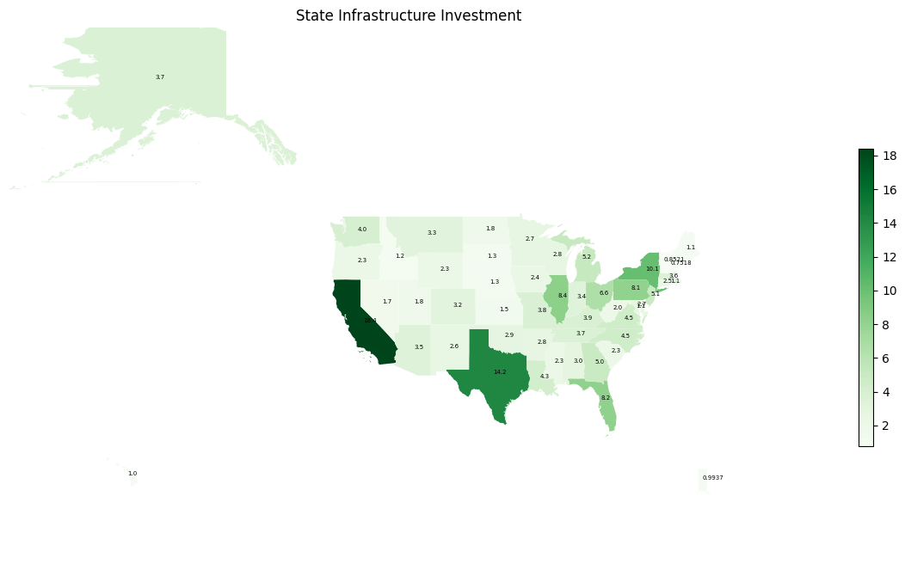
Infrastructure Investment by State (Billion $)
Top 5 investment states are California, Texas, New York, Illinois, Florida

Slide 2
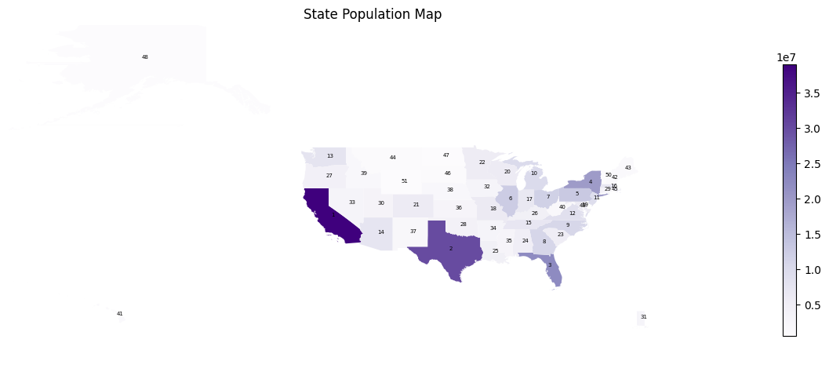
Population by State (Ranked)
Top 5 population states in order are California, Texas, Florida, New York, Pennsylvania.
By only looking at these top 5, we already see negative bias for Florida and Pennsylvania.
While their population is greater than New York and Illinois, their Infrastructure investment is lower.

Slide 3
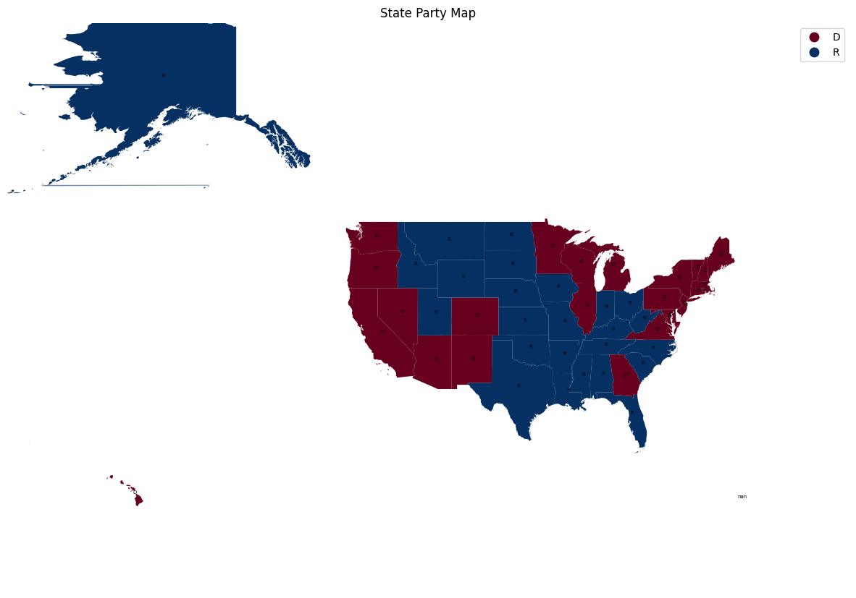
2020 Election Final Results (Republican vs Democratic)
Top 5 negative bias allocation are for Republican States, meaning Biden Administration is not favoring its own political interest.

Slide 4
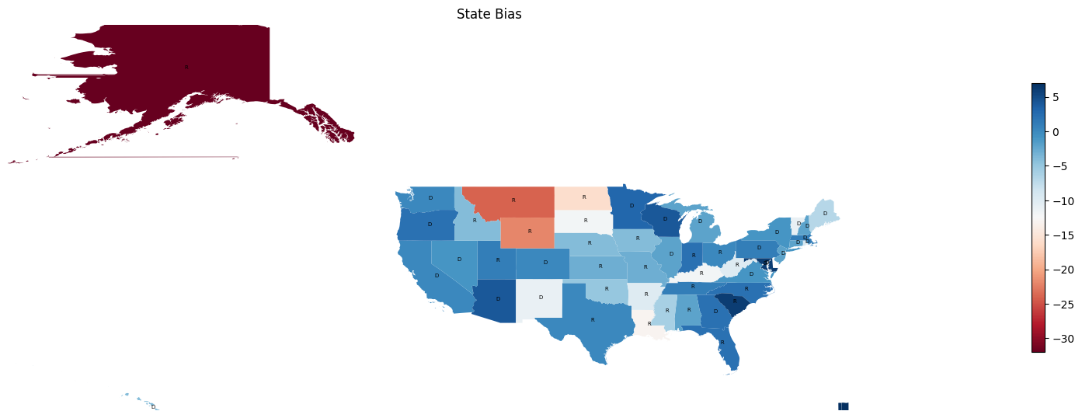
Allocation favor of Biden Administration
Top 5 negative bias allocation are for Republican States, meaning Biden Administration is not favoring its own political interest.

