Slide 1

Applied Biostatistics I
Issues in Regression Analyses:
Nonlinearity
Notes:
1

Slide 2
Learning Objectives
To understand the concept of nonlinearity (of the relationship between Y and X)
To learn basic methods for handling nonlinearities in linear regression analysis.
Notes:
2

Slide 3
Outline
Introduction
Detection
Conversion of X to an ordinary scale
Polynomial regression
Appendix A. Nonlinear regression
Appendix B. Conversion of Y
Notes:
3

Slide 4
§1. Introduction
Basic model of multiple linear regression:
Y and X_{j} may be related, but their relation (controlling for the other X’s) may not be linear.
Notes:
4

Slide 5
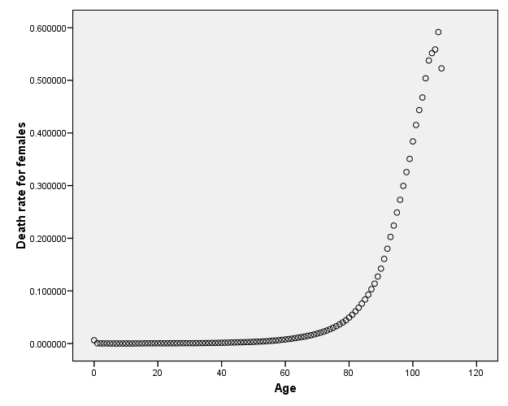
Example: Death rate by age for U.S. women, 2000-2004
Source: www.mortality.org
Notes:
5

Slide 6
§2. Detection
X-Y plot
X-Y plot with local averaging
X-Y plot with smoothing (Loess)
Component-plus-residual plot
(To be discussed in a later class.)
Notes:
6

Slide 7
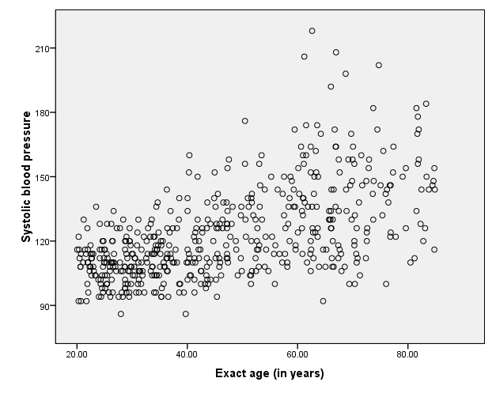
SBP by Age
Notes:
7

Slide 8
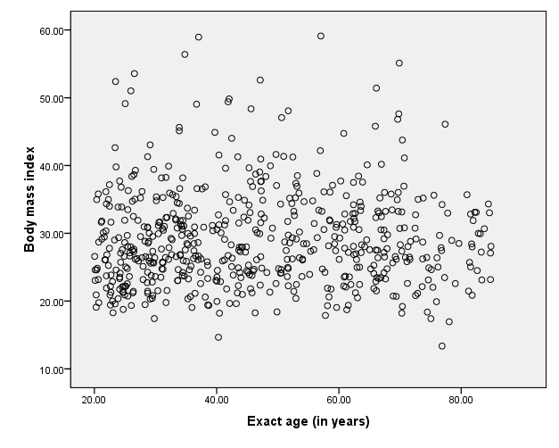
BMI by Age
Notes:
8

Slide 9
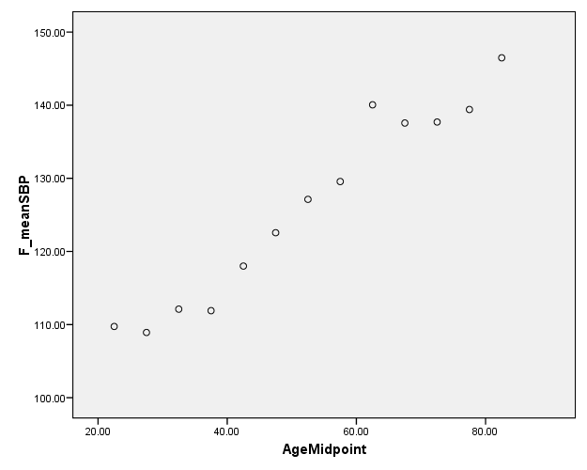
Mean SBP by 5-year age group
Notes:
9

Slide 10
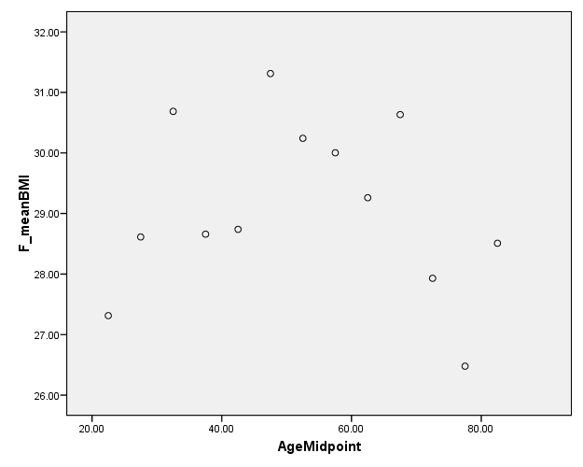
Mean BMI by 5-year age group
Notes:
10

Slide 11
Handling Nonlinear Relationships
Using a linear model after conversion
* Conversion of the independent variable and/or dependent variable to an ordinal scale (categorical variable)
* Mathematical conversion of the independent variable and/or dependent variable
Nonlinear regression (if complicated)
Nonparametric regression (Generalized Additive Models)
MARS (Multivariate Adaptive Regression Splines)
Notes:
11

Slide 12
Example
Y: Systolic blood pressure
Body Mass Index (BMI)
Xs: Ethnicity (categorical)
Education (categorical)
Age (discrete continuous)
For female respondents only
Notes:
12

Slide 13
Example: Age
§3. Conversion to Ordinal Scale
Age, continuous on [20,85)
Five-year age groups:
20-24, 25-29, ... , 80-84
Notes:
13

Slide 14
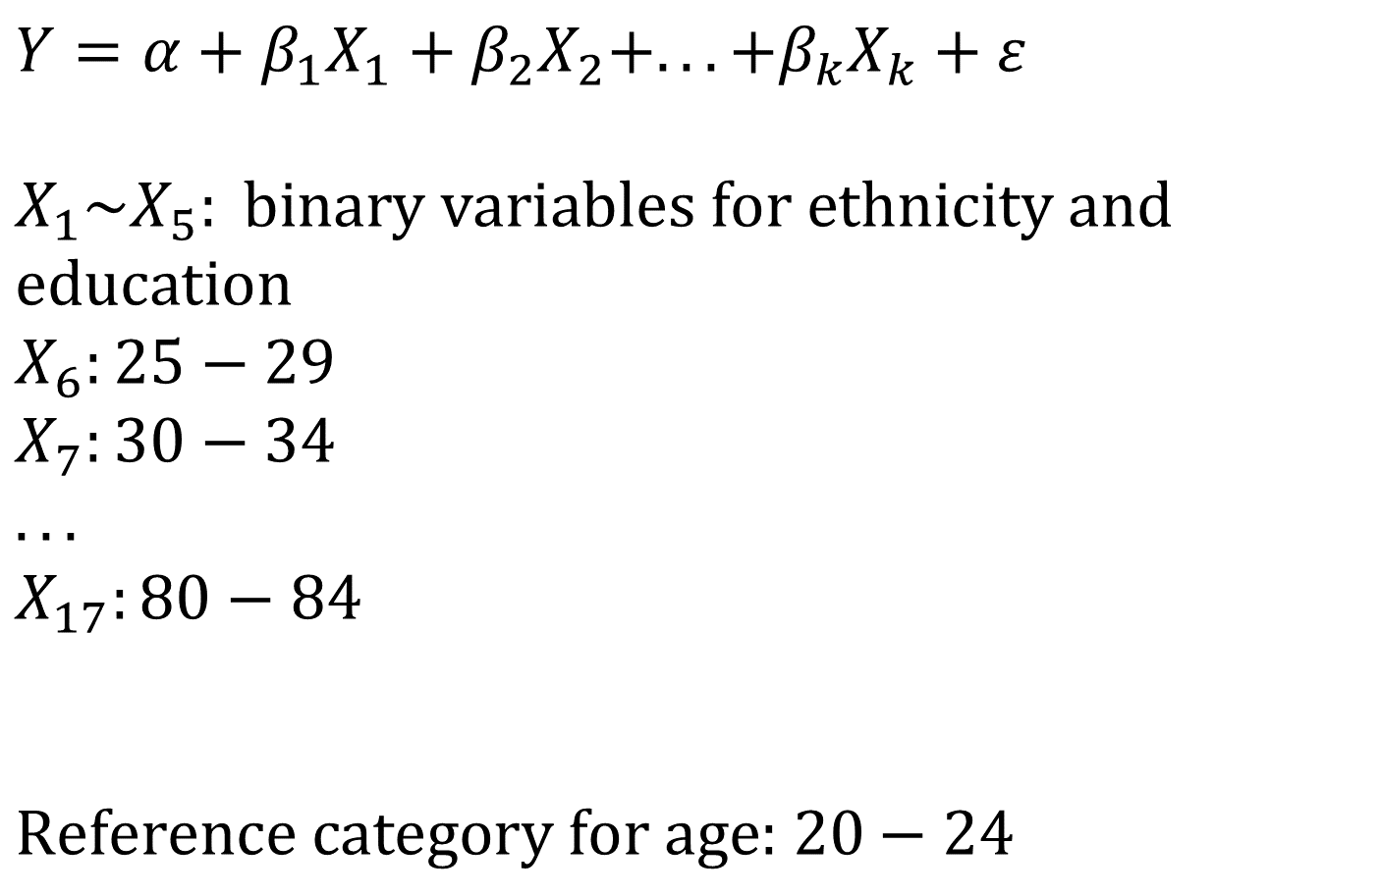
$$Y=α+β_{1}X_{1}+β_{2}X_{2}+...+β_{k}X_{k}+ε$$ $$X_{1}\sim X_{5}: \text{binary} \text{variables} \text{for} \text{ethnicity} \text{and} \text{education} \\ X_{6}:\text{25}−\text{29} \\ X_{7}:30−34 \\ ... \\ X_{17}:\text{80}−\text{84}$$
$$\text{Reference} \text{category} \text{for} \text{age}\text{: 20}−\text{24}$$
Notes:
14

Slide 15

β coefficients for age groups (from regression of SBP)
Notes:
15

Slide 16
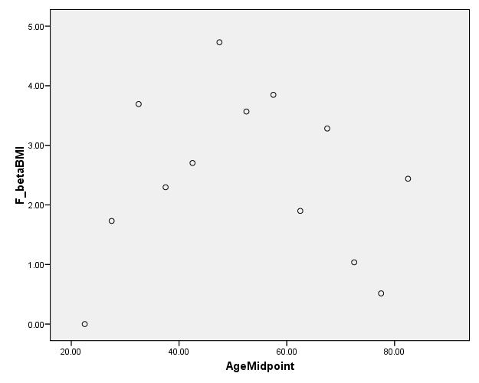
β coefficients for age groups (from regression of BMI)
Notes:
16

