Slide 1

Applied Biostatistics I
Issues in Regression Analyses:
Nonlinearity
Notes:
1

Slide 2
§4. Nonlinear Terms and Polynomial Regression
If there is no theoretical reason for preferring some mathematical form, we need to explore and find an appropriate form by trial and error:
It may replace the linear term
OR
It may be added to the linear term.
Notes:
2

Slide 3
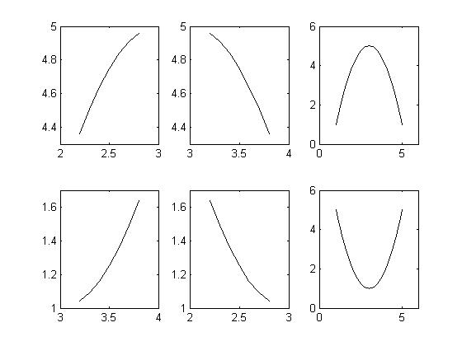
General Issues (cont’d)
Sometimes, simply the addition of X² improves the model fit significantly.
concave
convex
Notes:
3

Slide 4
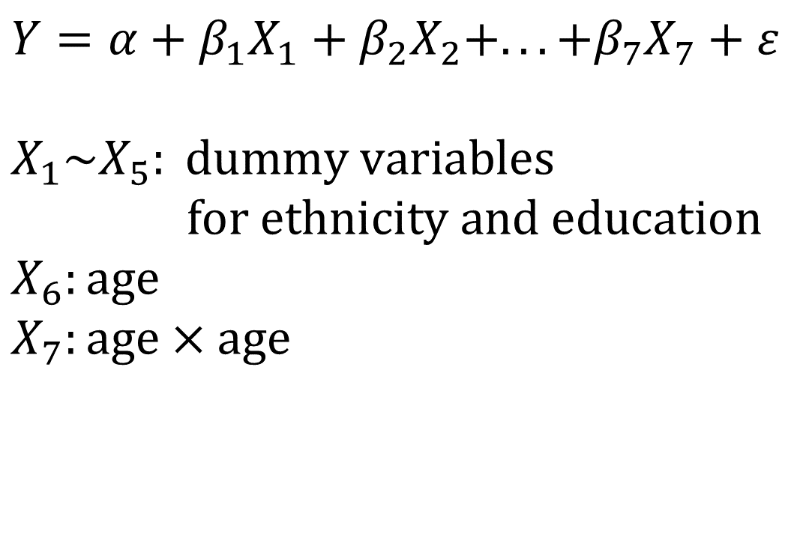
Example
$$Y=α+β_{1}X_{1}+β_{2}X_{2}+...+β_{7}X_{7}+ε$$ $$X_{1}\sim X_{5}: \text{dummy} \text{variables} \\ \text{for} \text{ethnicity} \text{and} \text{education} \\ X_{6}:\text{age} \\ X_{7}:\text{age}×\text{age}$$
Notes:
4

Slide 5
SBP Results
p value
Notes:
5

Slide 6
BMI Results
p value
Notes:
6

Slide 7
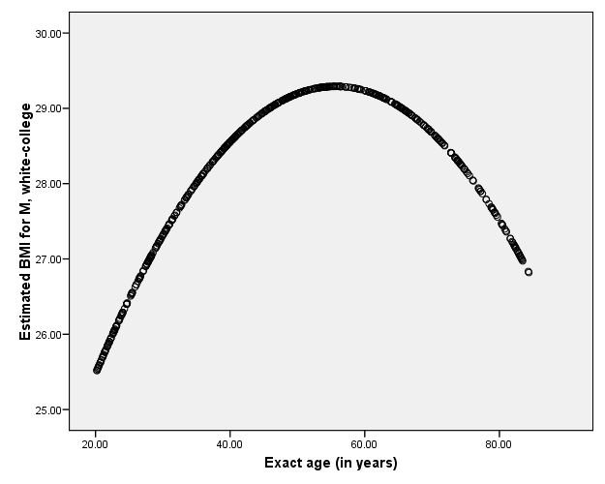
Notes:
7

Slide 8
Appendix A. Nonlinear Regression
Nonlinear regression is needed if it is impossible to produce a linear combination form. For example,
(four-parameter logistic model of age pattern of adult mortality, where m(x) is the death rate at age x)
Notes:
8

Slide 9
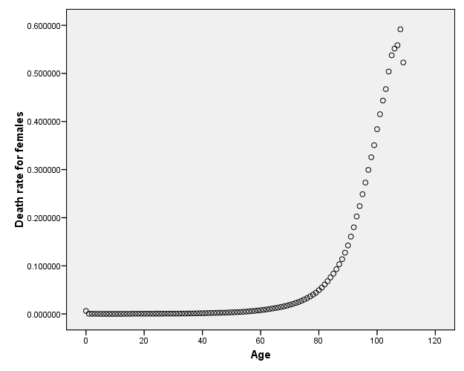
Example: Death rate by age for U.S. women, 2000-2004
Appendix B. Conversion of Y
Source: www.mortality.org
Notes:
9

Slide 10
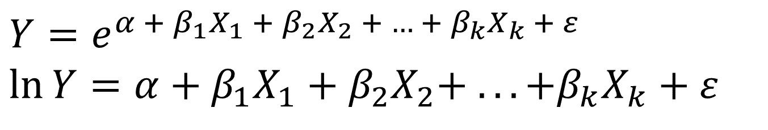

Logarithmic conversion
Remember…
$$Y=e^{X}⇔\ln{Y}=X$$
So,
$$Y=e^{α + β_{1}X_{1} + β_{2}X_{2} + … + β_{k}X_{k} + ε} \\ \ln{Y}=α+β_{1}X_{1}+β_{2}X_{2}+ ...+β_{k}X_{k}+ε$$
Notes:
10

Slide 11
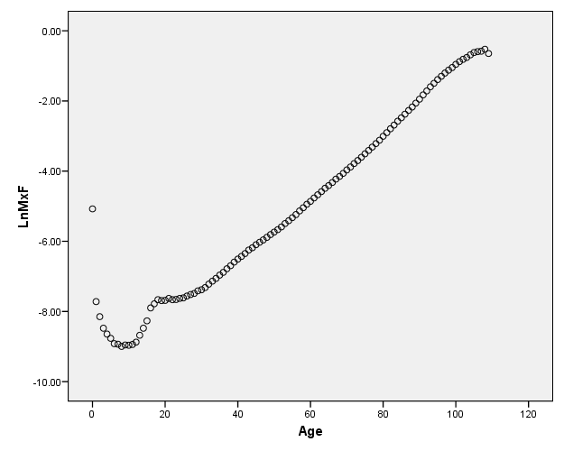
Death rate by age for U.S. women, 2000-2004
Source: www.mortality.org
Notes:
11

Slide 12
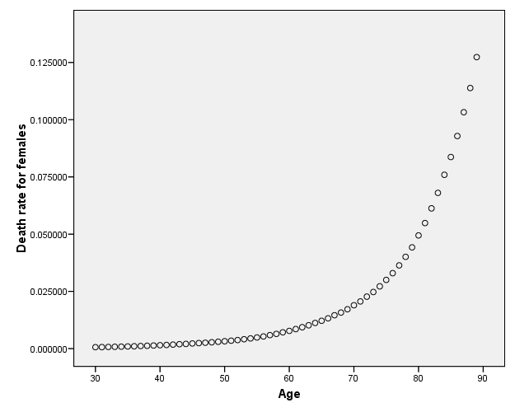
Death rate by age for U.S. women, 2000-2004
Source: www.mortality.org
Notes:
12

Slide 13
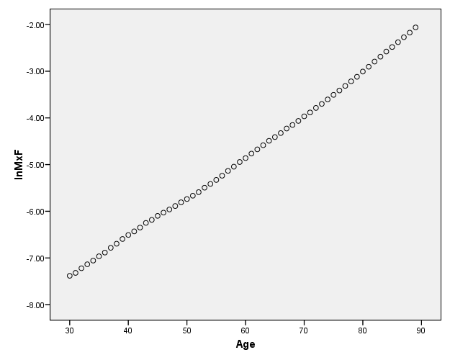
Death rate by age for U.S. women, 2000-2004
Source: www.mortality.org
Notes:
13

Slide 14
Regression Result
R2=0.998!
Note
Notes:
14

Slide 15
Remark
Importance of examination of linearity/non-linearity is not limited to linear regression. It should be examined for each numerical independent variable in any type of regression model (linear, logistic, Probit, c-loglog, Poisson, negative binomial, Cox, etc.)
Notes:
15

