Slide 1

Applied Biostatistics I
Logistic Regression:
Adjusted Odds Ratio
Part 1
Notes:
1

Slide 2
Learning Objectives
To understand the meaning of e^{β} (adjusted odds ratio) in the logistic regression model.
To be able to interpret estimated values of e^{β} in logistic regression results.
Notes:
2

Slide 3
Outline
1. Odds ratio and logistic regression
2. Simple examples
3. Examples from publications
Notes:
3

Slide 4
§1. Odds ratio and logistic regression
Notes:
4

Slide 5
Logistic regression output (β)
Analysis of Maximum Likelihood Estimates
Parameter |  | DF | Estimate | Standard Error | Wald Chi-Square | Pr > ChiSq
Intercept |  | 1 | -3.9618 | 0.2260 | 307.3417 | <.0001
Exactage |  | 1 | 0.0206 | 0.00296 | 48.5596 | <.0001
RIAGENDR | Female | 1 | 0.0657 | 0.0853 | 0.5938 | 0.4409
RaceEthnicity | Hispanic | 1 | 0.8099 | 0.1118 | 52.4519 | <.0001
RaceEthnicity | Non-Hispanic Black | 1 | 0.5219 | 0.1077 | 23.4619 | <.0001
RaceEthnicity | Others | 1 | 0.4798 | 0.2413 | 3.9523 | 0.0468
Education | Graduated from HS | 1 | 0.9865 | 0.1482 | 44.2878 | <.0001
Education | Not graduated from HS | 1 | 1.7584 | 0.1573 | 124.9159 | <.0001
MaritalStatus | Divorced or Separated | 1 | 0.4955 | 0.1168 | 17.9902 | <.0001
MaritalStatus | Living with partner | 1 | 0.1736 | 0.1700 | 1.0432 | 0.3071
MaritalStatus | Never married | 1 | 0.3302 | 0.1435 | 5.2980 | 0.0213
MaritalStatus | Widowed | 1 | 0.1015 | 0.1543 | 0.4330 | 0.5105

Slide 6
Logistic regression output (e^{β})
Odds Ratio Estimates
Effect | Point Estimate | 95% Wald Confidence Limits
Exactage | 1.021 | 1.015 | 1.027
RIAGENDR Female vs Male | 1.068 | 0.904 | 1.262
RaceEthnicity Hispanic vs Non-Hispanic White | 2.248 | 1.805 | 2.799
RaceEthnicity Non-Hispanic Black vs Non-Hispanic White | 1.685 | 1.364 | 2.081
RaceEthnicity Others vs Non-Hispanic White | 1.616 | 1.007 | 2.593
Education Graduated from HS vs Graduated from College | 2.682 | 2.006 | 3.586
Education Not graduated from HS vs Graduated from College | 5.803 | 4.263 | 7.899
MaritalStatus Divorced or Separated vs Married | 1.641 | 1.305 | 2.064
MaritalStatus Living with partner vs Married | 1.190 | 0.853 | 1.660
MaritalStatus Never married vs Married | 1.391 | 1.050 | 1.843
MaritalStatus Widowed vs Married | 1.107 | 0.818 | 1.498

Slide 7
Logistic regression output
(type 3 analysis)
Type 3 Analysis of Effects
Effect | DF | Wald Chi-Square | Pr > ChiSq
Exactage | 1 | 48.5596 | <.0001
RIAGENDR | 1 | 0.5938 | 0.4409
RaceEthnicity | 3 | 56.2794 | <.0001
Education | 2 | 142.0862 | <.0001
MaritalStatus | 4 | 20.3110 | 0.0004

Slide 8
e^{β} = odds ratio
e^{β} in logistic regression can be interpreted as the adjusted odds ratio :(of Y=1, e.g., ill-health)
adjusted, i.e., controlling for the other independent variables
odds (of Y=1, i.e., of the event of our interest)
ratio between the category and the reference category
Odds ratio and relative risk are widely used for measuring risk factor effects on diseases.
Notes:
8

Slide 9
Relative Risk & Odds Ratio
Widely used indicators measuring the effect of a risk factor on disease incidence/prevalence.
Both the risk factor and disease variable need to be dichotomous (exposed versus unexposed, developed/having the disease)
(Each could be a combination of two categories for a polytomous variable.)
Notes:
9

Slide 10
Relative Risk
RR: relative risk, risk ratio, (proportion ratio, probability ratio)
Statistically, it is the ratio of two proportions/probabilities. It is a measure of association between two dichotomous variables.
In epidemiology, it is the ratio of disease incidence/prevalence proportions between two groups, one being exposed to the risk of the factor of interest and the other not being exposed to the risk.
Notes:
10

Slide 11
Odds Ratio
OR: odds ratio
Statistically, it is the ratio of two odds. It is also a measure of association between two dichotomous variables.
In epidemiology, it is the ratio of disease incidence/prevalence odds between two groups, one being exposed to the risk of the factor of interest and the other not being exposed to the risk.
Notes:
11

Slide 12
Example 1: Age at first birth and breast cancer
Age at first birth | Breast cancer |  | Total
 | Developed | Not developed
≥ 25 | 31 | 1597 | 1628
< 25 | 65 | 4475 | 4540
Total | 96 | 6072 | 6168
Source: Pagano & Gauvreau (2000), pp.144-149.
P(BC|AFB ≥ 25)=31/1628, Odds(BC|AFB ≥ 25)=31/1597
P(BC|AFB < 25)=65/4540, Odds(BC|AFB < 25)=65/4475
Notes:
12

Slide 13
P(BC|AFB ≥ 25)=31/1628, Odds(BC|AFB ≥ 25)=31/1597
P(BC|AFB < 25)=65/4540, Odds(BC|AFB < 25)=65/4475
RR of breast cancer between late (≥ 25) first birth and early (<25) first birth
OR of breast cancer between late (≥ 25) first birth and early (<25) first birth
Notes:
13

Slide 14
Odds ratio and case control study
OR is important in case control studies. Suppose in the previous example, we oversample those who developed breast cancer as follows.
Age at first birth | Breast cancer |  | Total
 | Developed | Not developed
≥ 25 | 310 | 1597 | 1907
< 25 | 650 | 4475 | 5125
Total | 960 | 6072 | 7032
RR=1.282 (changed), OR=1.336 (not changed)
Notes:
14

Slide 15
Unadjusted and adjusted ORs
So far we have been studying unadjusted ORs (calculated from 2x2 cross-classification tables)
e^{β} in a multiple logistic regression model is an OR adjusted for the other independent variables.
Notes:
15

Slide 16
Example: Self-reported ill-health for the divorced/separated versus currently married
Unadjusted OR
Marital status | General health condition |  | Total
 | Not healthy | Healthy
Divorced/separated | 163 | 394 | 557
Currently married | 454 | 1915 | 2369
Notes:
16

Slide 17
Logistic regression output (β)
Analysis of Maximum Likelihood Estimates
Parameter |  | DF | Estimate | Standard Error | Wald Chi-Square | Pr > ChiSq
Intercept |  | 1 | -3.9618 | 0.2260 | 307.3417 | <.0001
Exactage |  | 1 | 0.0206 | 0.00296 | 48.5596 | <.0001
RIAGENDR | Female | 1 | 0.0657 | 0.0853 | 0.5938 | 0.4409
RaceEthnicity | Hispanic | 1 | 0.8099 | 0.1118 | 52.4519 | <.0001
RaceEthnicity | Non-Hispanic Black | 1 | 0.5219 | 0.1077 | 23.4619 | <.0001
RaceEthnicity | Others | 1 | 0.4798 | 0.2413 | 3.9523 | 0.0468
Education | Graduated from HS | 1 | 0.9865 | 0.1482 | 44.2878 | <.0001
Education | Not graduated from HS | 1 | 1.7584 | 0.1573 | 124.9159 | <.0001
MaritalStatus | Divorced or Separated | 1 | 0.4955 | 0.1168 | 17.9902 | <.0001
MaritalStatus | Living with partner | 1 | 0.1736 | 0.1700 | 1.0432 | 0.3071
MaritalStatus | Never married | 1 | 0.3302 | 0.1435 | 5.2980 | 0.0213
MaritalStatus | Widowed | 1 | 0.1015 | 0.1543 | 0.4330 | 0.5105

Slide 18
Adjusted OR (categorical risk factor)
Suppose the i-th and h-th indiviudals have the same profiles about gender, age, race/ethnicity and education but the i-th person is divorced and the h-th person is currently married. The binary variable for “divorced/separated” is X₉, and the reference category is “currently married”: i.e.,
Notes:
18

Slide 19
Adjusted OR (categorical risk factor)
OR for the i-th versus h-th individuals is:
Notes:
19

Slide 20
Logistic regression output (β)
Analysis of Maximum Likelihood Estimates
Parameter |  | DF | Estimate | Standard Error | Wald Chi-Square | Pr > ChiSq
Intercept |  | 1 | -3.9618 | 0.2260 | 307.3417 | <.0001
Exactage |  | 1 | 0.0206 | 0.00296 | 48.5596 | <.0001
RIAGENDR | Female | 1 | 0.0657 | 0.0853 | 0.5938 | 0.4409
RaceEthnicity | Hispanic | 1 | 0.8099 | 0.1118 | 52.4519 | <.0001
RaceEthnicity | Non-Hispanic Black | 1 | 0.5219 | 0.1077 | 23.4619 | <.0001
RaceEthnicity | Others | 1 | 0.4798 | 0.2413 | 3.9523 | 0.0468
Education | Graduated from HS | 1 | 0.9865 | 0.1482 | 44.2878 | <.0001
Education | Not graduated from HS | 1 | 1.7584 | 0.1573 | 124.9159 | <.0001
MaritalStatus | Divorced or Separated | 1 | 0.4955 | 0.1168 | 17.9902 | <.0001
MaritalStatus | Living with partner | 1 | 0.1736 | 0.1700 | 1.0432 | 0.3071
MaritalStatus | Never married | 1 | 0.3302 | 0.1435 | 5.2980 | 0.0213
MaritalStatus | Widowed | 1 | 0.1015 | 0.1543 | 0.4330 | 0.5105

Slide 21
Example: Self-reported ill-health with respect to age
Adjusted OR (numerical risk factor)
Suppose the i-th and h-th indiviudals have the same profiles about gender, race/ethnicity, education and marital status but the i-th person is 41 yeas old and the h-th person is 40 years old. Age is X₂: i.e.,
Notes:
21

Slide 22

Adjusted OR (numerical risk factor)
OR for the i-th versus h-th individuals is:
Notes:
22

Slide 23
§2. Odds ratio and logistic regression: Simple Examples
Logistic regression of self-reported health (healthy/unhealthy) on race/ethnicity & education.
NHANES 2005-2006
Hispanic (W+B) and Non-Hispanic White
ages 25-84
Reference categories: White, College graduate

Slide 24
Case 1: Only a Constant
Notes:
24

Slide 25

Case 1: Only a Constant
R/E | Unhealthy | Healthy | Odds
W+H | 480 | 1947 | 0.247

Slide 26
Case 2: One Factor
Notes:
26

Slide 27
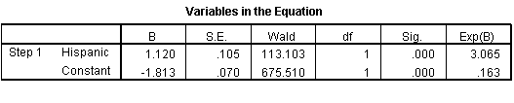
Case 2: One Factor
R/E | Unhealthy | Healthy | Odds | OR
H | 241 | 482 | 0.500 | 3.065
W | 239 | 1465 | 0.163

Slide 28
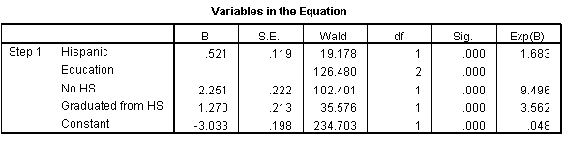
Case 3: Two Factors

Slide 29
Educ | R/E | Unhealthy | Healthy | Odds | OR
Total | W+H | 480 | 1947 | 0.247
 | H | 241 | 482 | 0.500 | 3.065
 | W | 239 | 1465 | 0.163
NoHS | H | 189 | 219 | 0.863 | 2.377
 | W | 65 | 179 | 0.363
HS | H | 48 | 220 | 0.218 | 1.153
 | W | 151 | 798 | 0.189
College | H | 4 | 43 | 0.093 | 1.974
 | W | 23 | 488 | 0.047

Slide 30
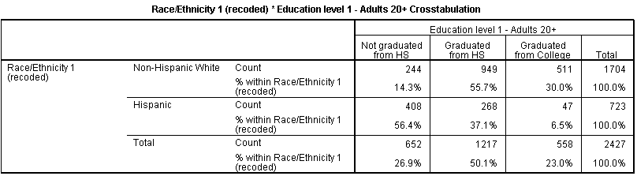

Slide 31
Controlling for Education
Race/Ethnicity S.R. Health
Education
S.R. Health
Race/Ethnicity
(OR=3.065)
(OR=1.683)
Notes:
31

Slide 32
§3. Presentation of logistic regression results as adjusted odds ratios
Examples:
Wisborg et al. 2001
Ford et al. 2005
Notes:
32

Slide 33
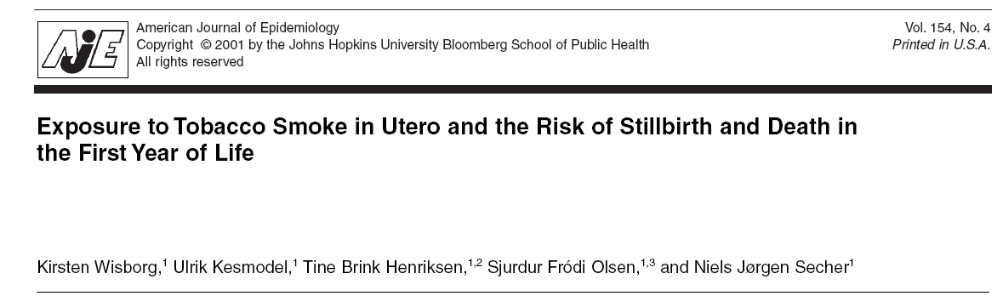
Notes:
33

Slide 34
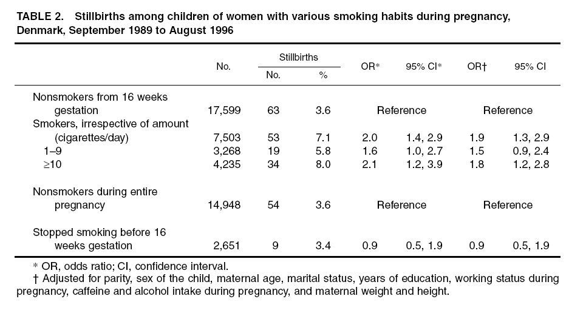
Notes:
34

Slide 35
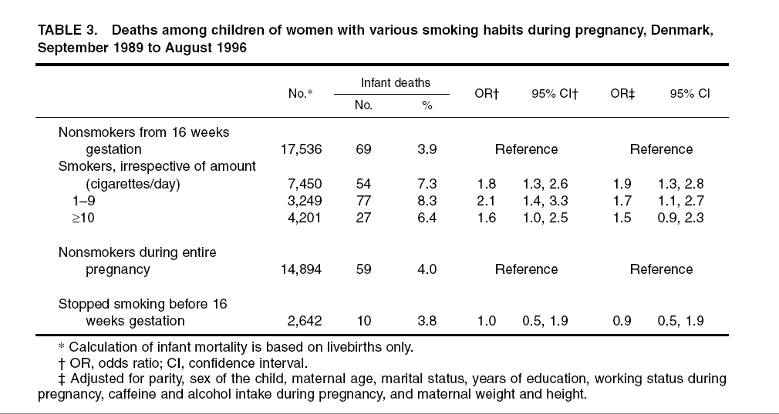
Notes:
35

Slide 36
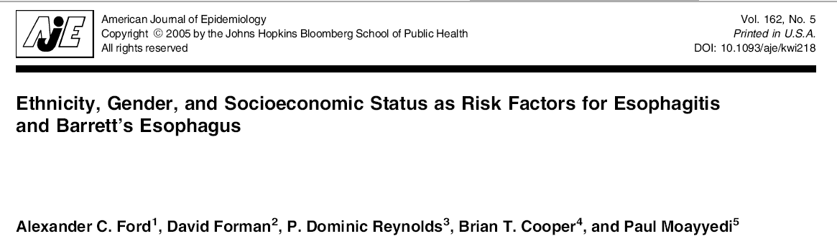
Notes:
36

Slide 37
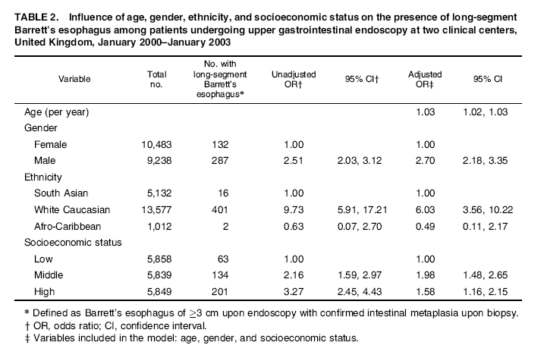
Notes:
37

Slide 38
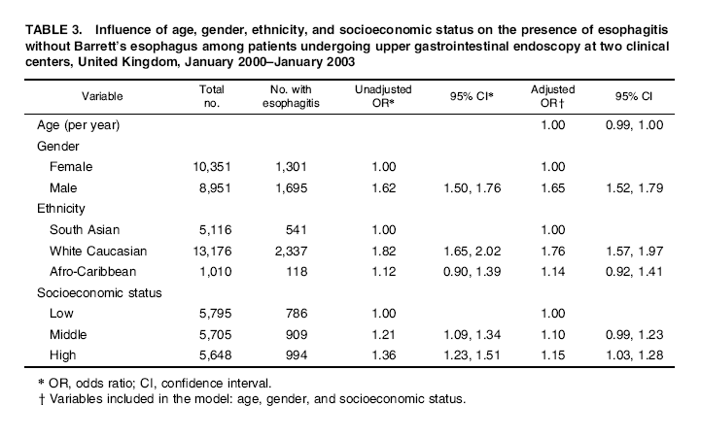
Notes:
38

