Slide 1

Applied Biostatistics I
Logistic Regression:
Adjusted Odds Ratio
Part 4
Notes:
1

Slide 2
§3. Presentation of logistic regression results as adjusted odds ratios
Examples:
Wisborg et al. 2001
Ford et al. 2005
Notes:
2

Slide 3
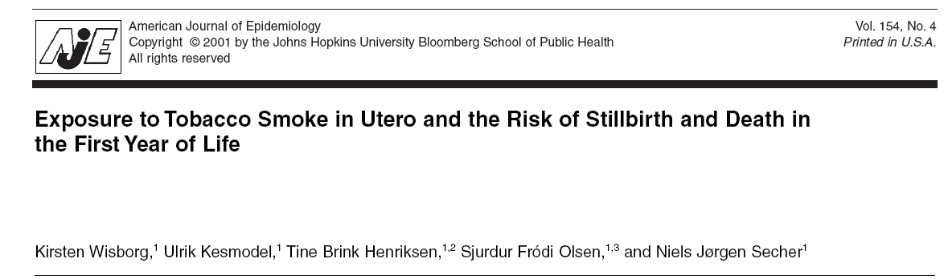
Notes:
3

Slide 4
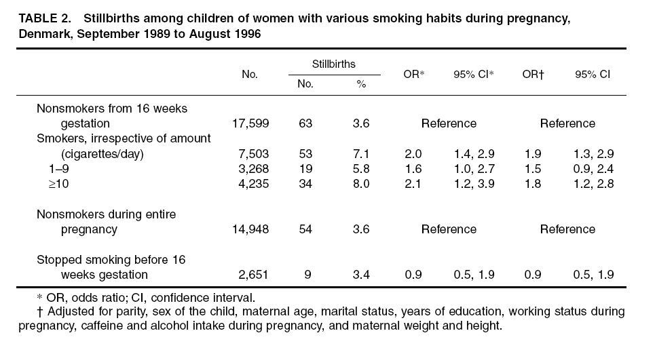
Notes:
4

Slide 5
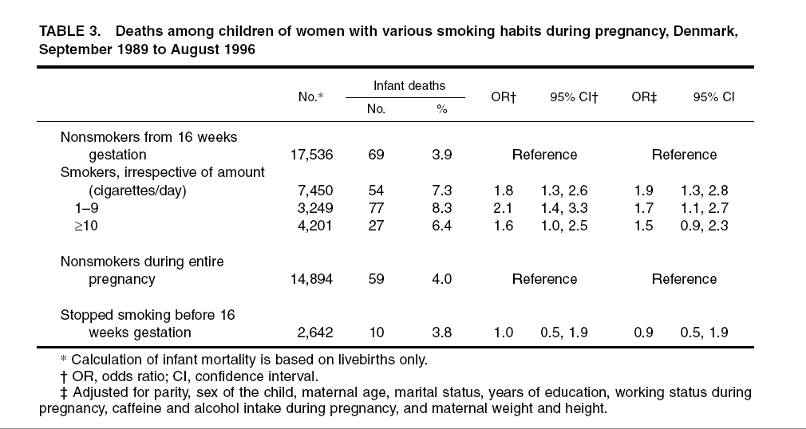
Notes:
5

Slide 6
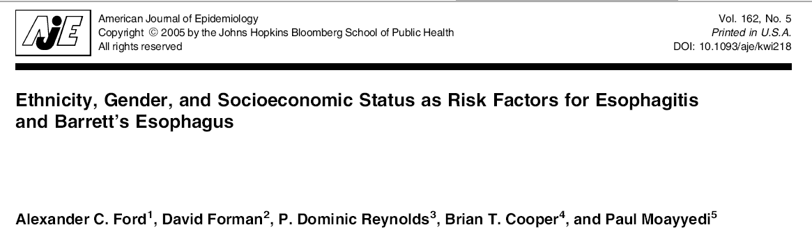
Notes:
6

Slide 7
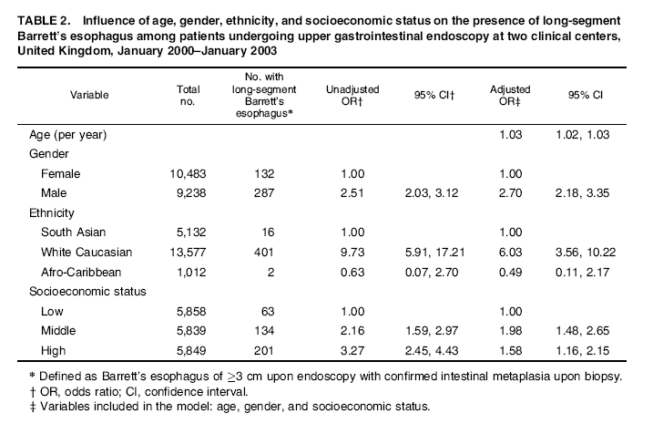
Notes:
7

Slide 8
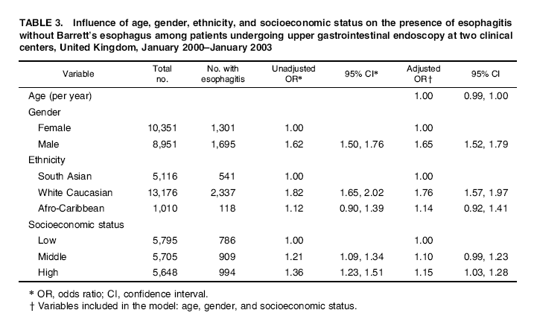
Notes:
8

