Slide 1
Intro to Unity #1 - Unity2D
Panther Games Workshop

Slide 2
Topics
Navigating Unity
Window Configuration
Hierarchy & Inspector
GameObject Hierarchy & Components
GameObjects
Colliders
Different Types of Colliders
Selecting the Right One
Sprite Renderer
Rigidbody & Physics
Scripting
Adding Scripts
Creating Player Movement
Unity Input Manager
Workshop Overview

Slide 3
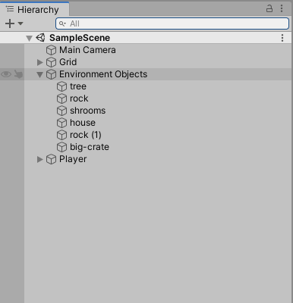
The Unity Hierarchy
The Unity Hierarchy is where you will be able to find all the GameObjects you create in your Scene
Objects can be collapsed and expanded to keep things neat and in order
This is typically located on the left hand side of the Unity Editor

Slide 4
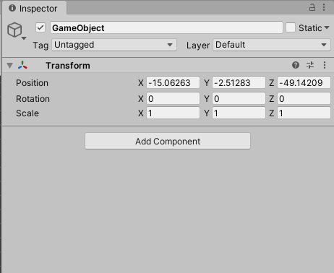
The Unity Inspector
For each GameObject that you create and select, you can view their details in the Inspector
The Inspector is typically located on the right hand side of the Unity Editor
In the Inspector, you can adjust the position, rotation, and scale of an object by default
By selecting Add Component, you can add a variety of different components to your selected Game Object

Slide 5
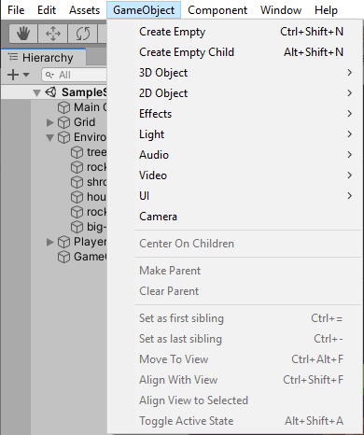
GameObjects
At the top of the Unity Editor, you have a box dedicated to GameObjects
Here, you can choose what type of GameObject you want to create
There are Empty, 3D, 2D, Effects, Lights, Audio, Video, UI and Camera GameObjects available to the User
For the purpose of this Workshop, we are going to create an Empty GameObject and name it Player

Slide 6
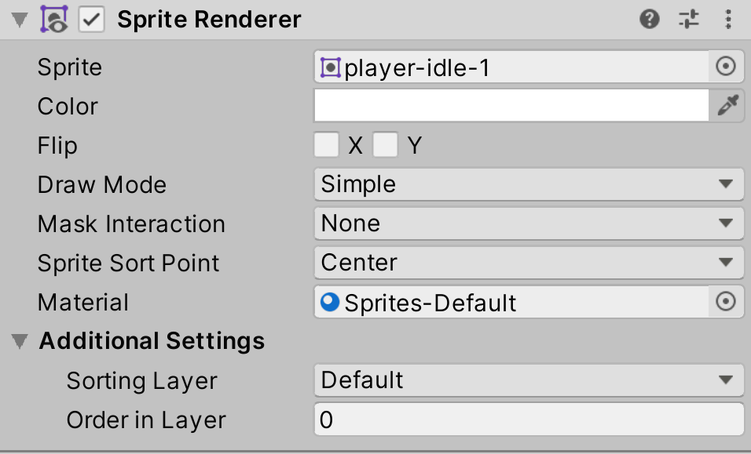
Sprite Renderer
In order to see the Player GameObject that we have created, we will want to go to Add Component > Sprite Renderer
After adding the component, select the circle icon on the Sprite line and select the image/sprite you want for your character
For the purpose of this Workshop, select player-idle-1
In Additional Settings, we can also edit the Order In Layer of specific GameObjects and how they appear on screen
For the purpose of this Workshop, we will enter 2

Slide 7
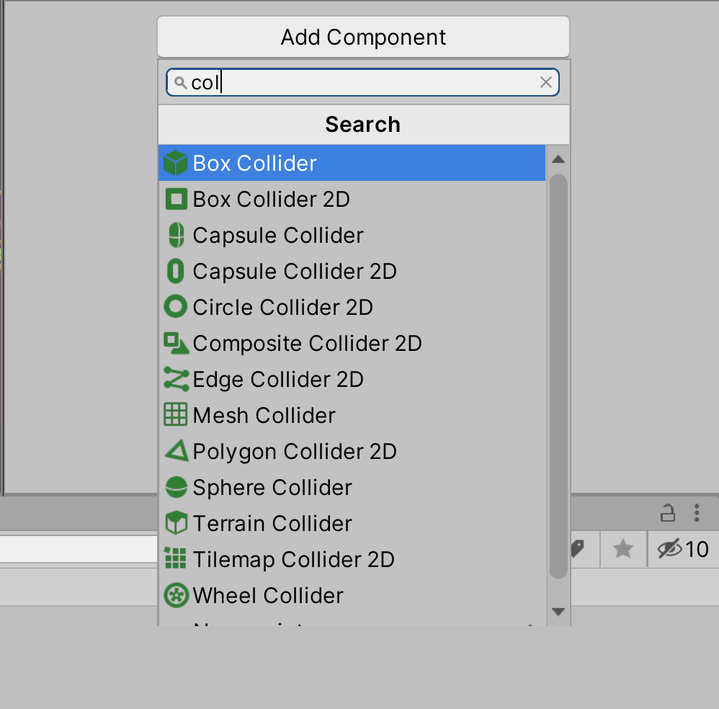
Colliders - Different Types of Colliders
Unity has a wide variety of different Colliders, ranging from 3D Colliders to 2D Colliders
Each Collider has the ability to be listed as a Trigger, making the User able to pass through the object but throw a trigger for scripting
Each Collider also has the ability to edit the Collider Zone, allowing the User to expand it on the X, Y, and Z axis

Slide 8
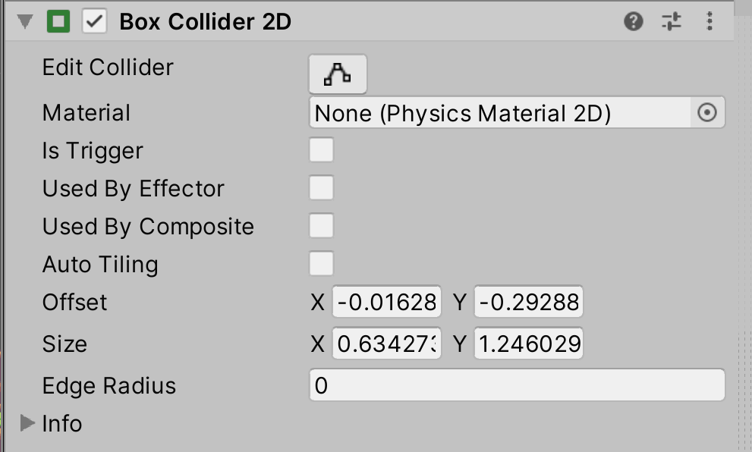
Selecting the Right Collider
For the purpose of this project, we will be using a Box Collider 2D

Slide 9
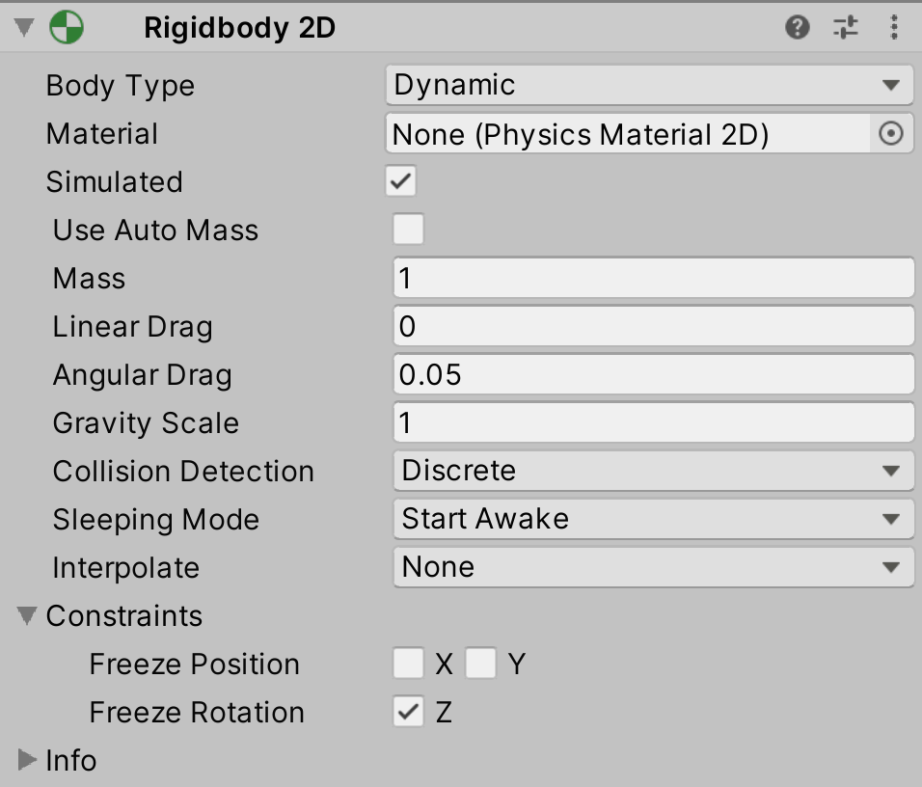
Rigidbody & Physics
In addition to adding a Collider to our Player GameObject, we will also Add Component > Rigidbody 2D
The Rigidbody controls the physics of an object in the scene; from adding mass to giving an object gravity
Any object that the User wants to control should and must have a Rigidbody, this will be expanded upon when we create our Player Scripts

Slide 10
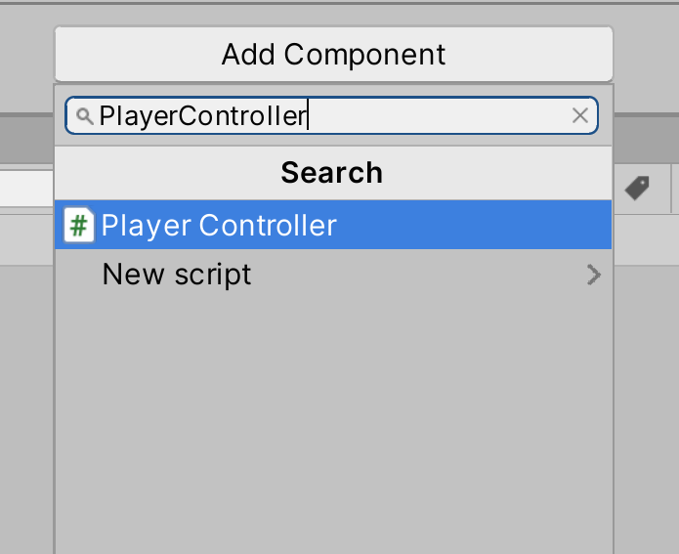
Scripting - Adding a Script to a GameObject
To create your Player Controller Script, go to Add Component and type out the name of your script
For this Workshop, we will call this PlayerController
Once you type this out, click New Script

Slide 11
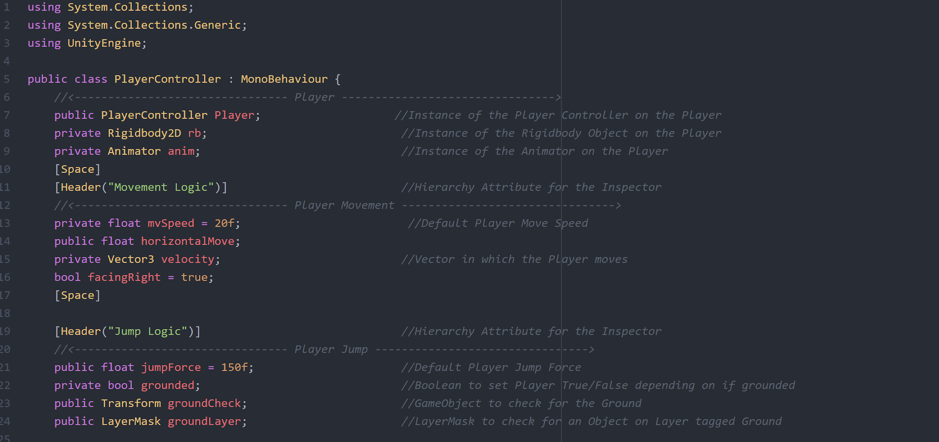
Scripting - Creating Variables

Slide 12
Scripting - Creating Variables
Types of Variables being used
Public - A public variable is accessible through the Unity Inspector
Private - A Private variable is only accessible in the script
Types of Components being used
PlayerController - Declare the PlayerController as a GameObject in the script
Rigidbody2D - Declare the Rigidbody2D as a GameObject in the script to manipulate the physics that are being applied to the Player
Animator - Declare the Animator to set Animations based on Triggers
Vector3 - Declare Vector3 to establish that the character can move on the X, Y, and Z axis
Transform - Declare Transform to store and manipulate positions of GameObjects
LayerMask - Declare a LayerMask to look for a specified Layer in the scene

Slide 13
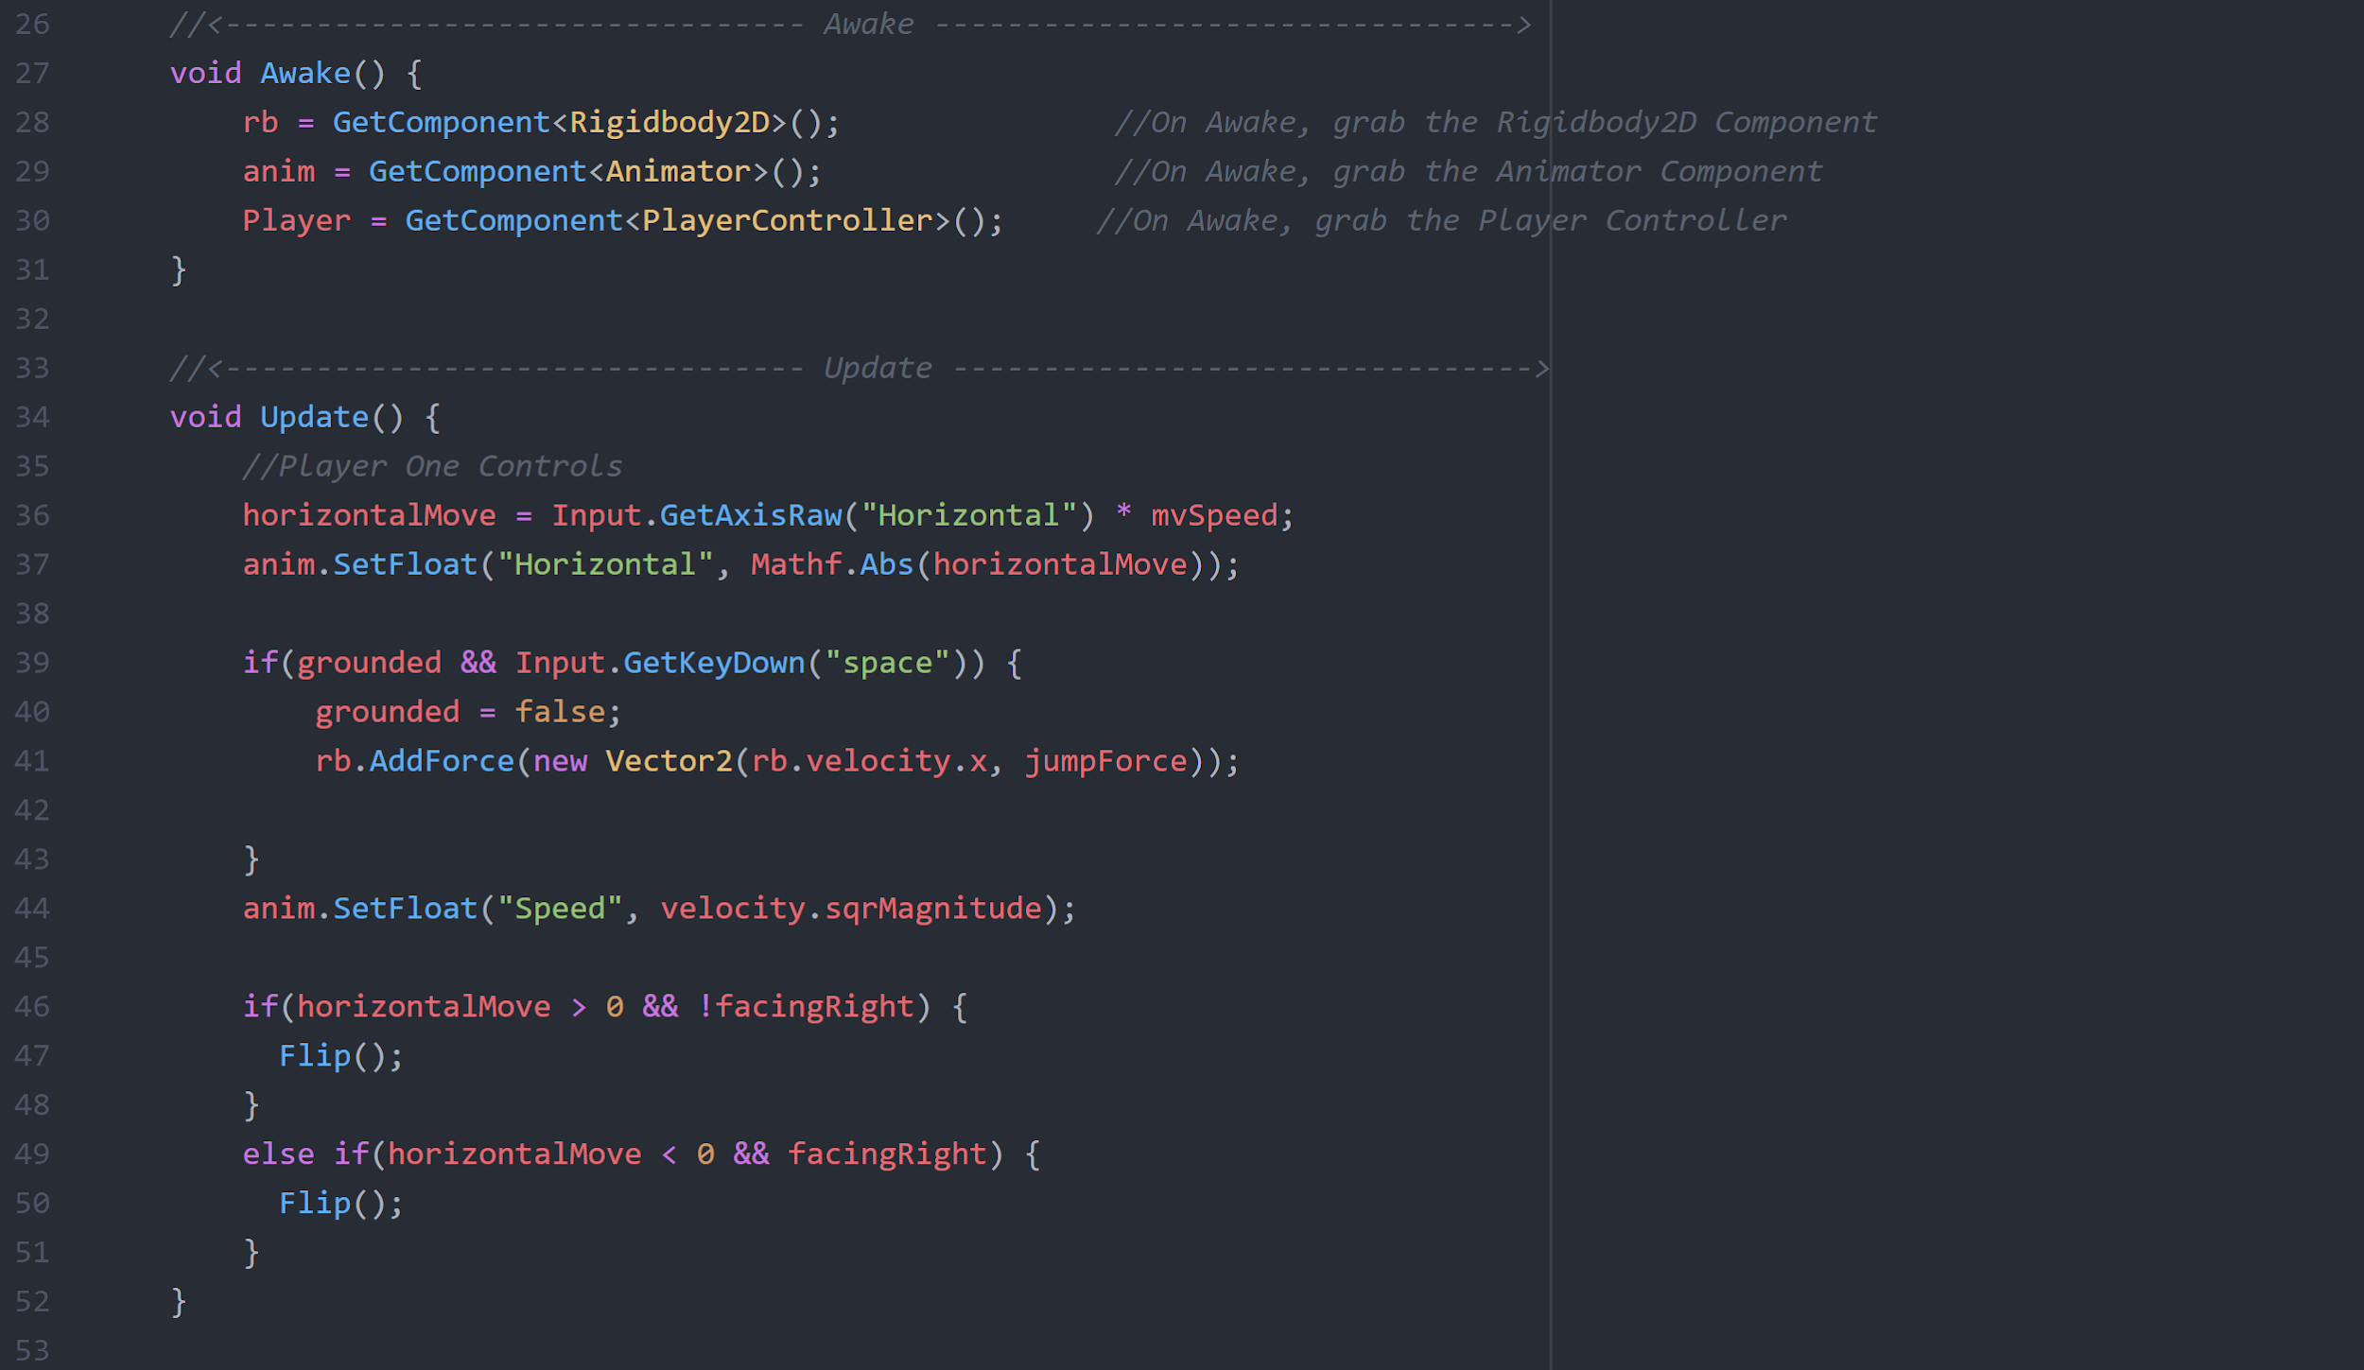
Scripting - Creating Functions

Slide 14
Scripting - Creating Functions
Awake()
Awake runs only once throughout the entire game
It is used to initialize variables and game stats before the game starts
Update()
Update is called every frame
It is the most commonly used function to implement a game script

Slide 15
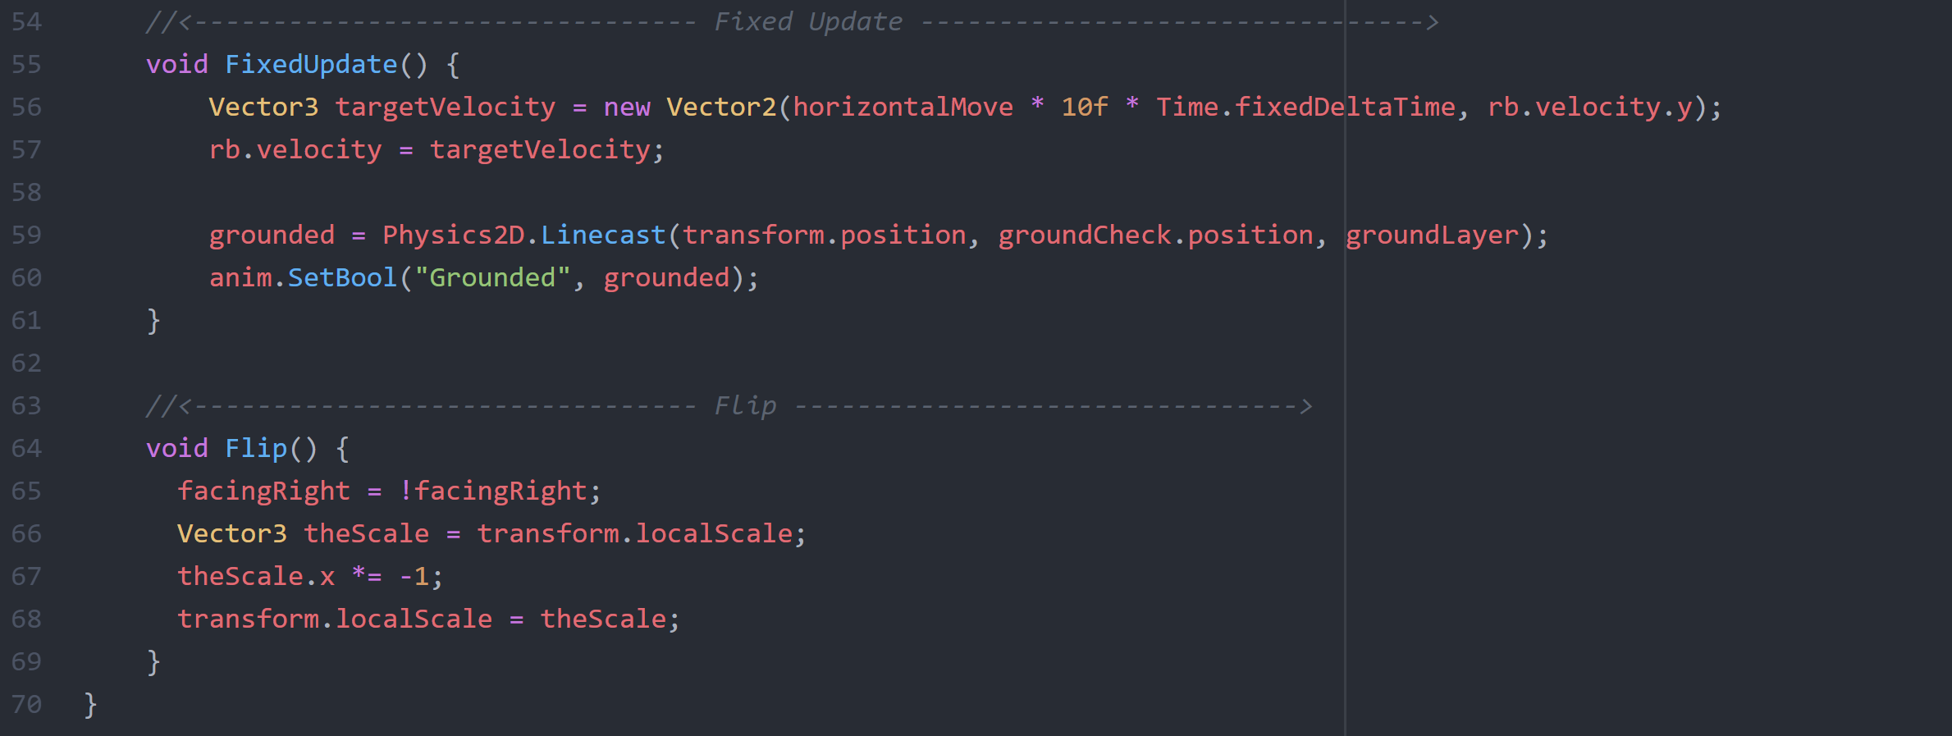
Scripting - Creating Functions

Slide 16
Scripting - Creating Functions
FixedUpdate()
FixedUpdate is called every fixed frame-rate frame
This being at 0.02 seconds (roughly 50 calls per second)
It is generally used to calculate/compute physics in the game
Flip()
Flip is a self-created function
It allows the player sprite to flip to face the other direction instead of creating/adding animations for an entire direction

Slide 17

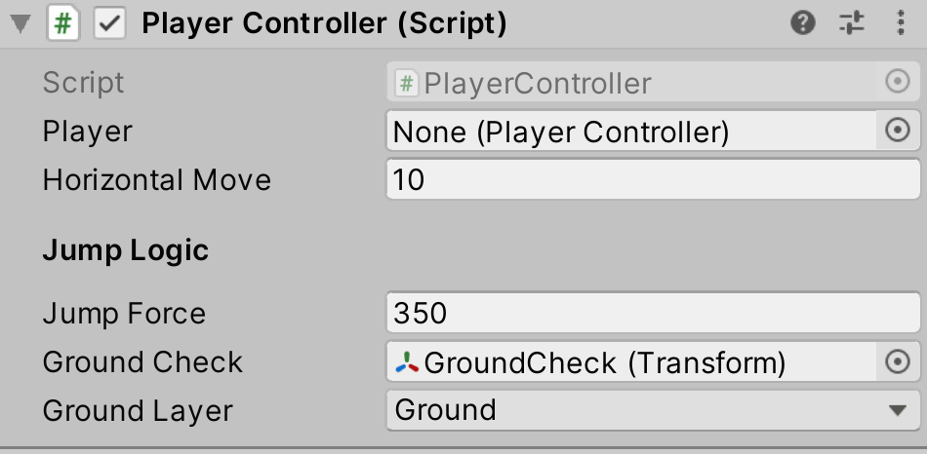
Player GameObject
After creating our PlayerController script, we will need to add a few things to our Player GameObject
We will want to create an Empty Child GameObject on our Player and rename it to GroundCheck
Position the GroundCheck GameObject in the scene to be underneath the Player (We have already set our Ground Layer in the provided files)
In the Inspector, we will drag GroundCheck onto its respective line so the script can reference it
We will also set Ground Layer to Ground

Slide 18
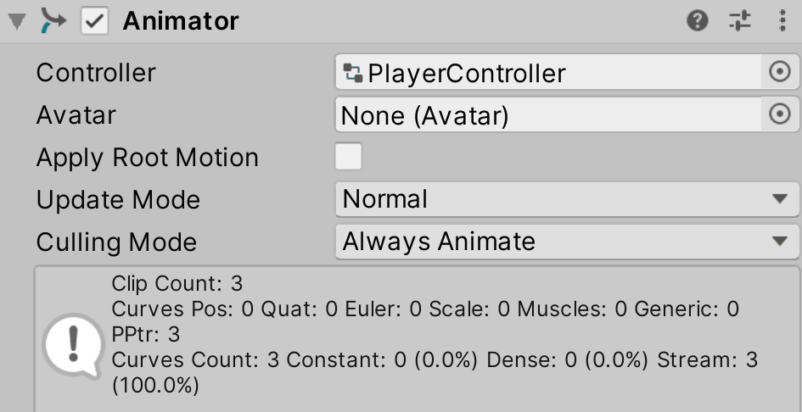
Player GameObject - Animator
Finally, we will Add Component > Animator to our Player GameObject
We have provided you the Animator Controller and Animations, which we will cover in a future workshop
Add the Animator Controller to the Controller line and your character should be able to run Animations for Idle, Walk, and Jump!

Slide 19
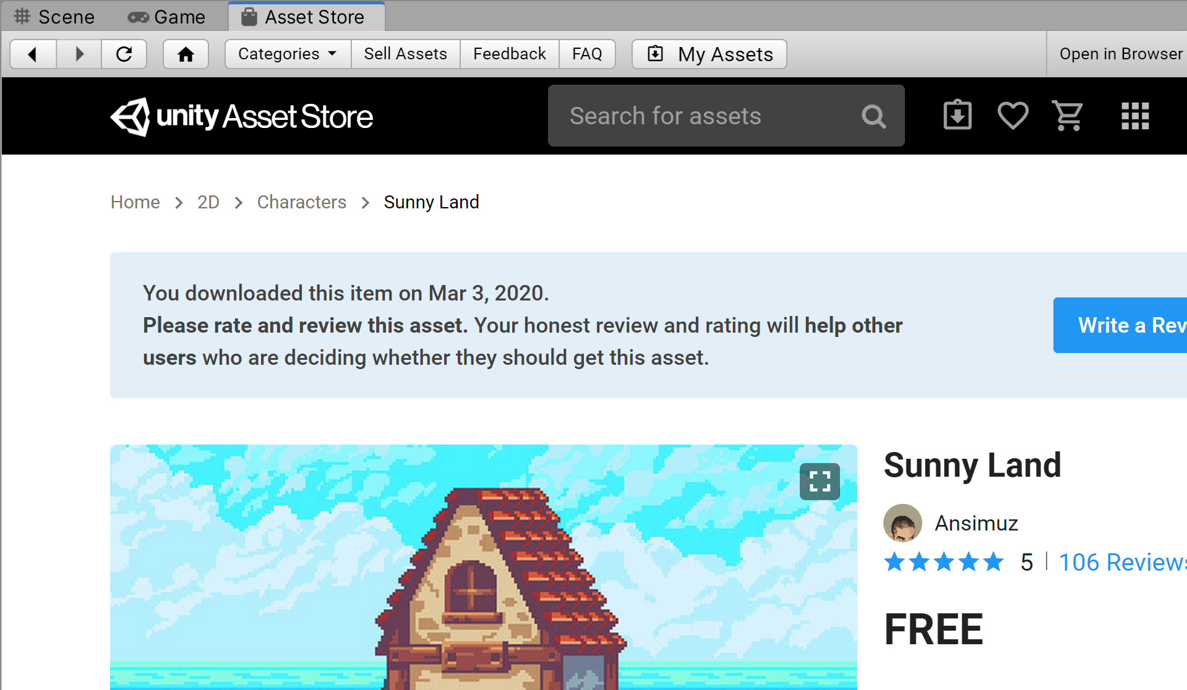
Unity - Asset Store
For this project, we used the Sunnyland Asset Pack, which is available for free on the Asset Store
The Asset Store table is a default tab in the Unity Editor, and can also be found through Window > Asset Store
We highly recommend using free assets for your projects if you are just starting out, it makes development much quicker and easier!

Slide 20
Thank You For Attending
We hope to provide you more Workshops throughout the semester, ranging from Unity to Unreal
Our next Intro to Unity Workshop can cover topics such as:
Unity Tilemaps
Unity2D Animations
Or more!
If you have a Workshop you want to see, send us an email at cu.panthergames@gmail.com

