Slide 1
CURENT Large-scale Testbed (LTB)
Monthly Meeting
10/26/2026
CURENT, University of Tennessee, Knoxville
Leadership Team | Dr. Fran Li
Senior Advisor | Dr. Kevin Tomsovic, Dr. Hantao Cui, Dr. Xin Fang
Core Development | Dr. Hantao Cui, Dr. Xin Fang, Dr. Jinning Wang, Nicholas Parsly, Nick West, Zack Malkmus, Junjie Yin, Matthew Cannavaro, Hank Lin, Jian Han, Dr. Chenchen Li
Other Contributors | Dr. Qiwei Zhang, Dr. Buxin She, Dr. Hang Shuai

Slide 2
1. Summary
Community
Homepage: https://ltb.curent.org/
LinkedIn: https://www.linkedin.com/company/76122605
YouTube: https://www.youtube.com/@curentltb
GitHub: https://github.com/CURENT
Administration:
10/11-13 NAPS 2026 meeting
10/21 NASA visit CURENT
Development
LLM with LTB AMS
    Configuration file update
    Revise parameter classification
    How to ensure the LLM executes prompt correctly?
LLM with LTB Andes

Slide 3
Configuration file update
A reviewed catalog can describe model edits; the compiler applies only declared templates.
FORMULATION CONTROL SPEC
DECLARATION → MODEL CHANGE
control_id · operation_kind
scenario | formulation
routines · target_scope
Config
Validate
Compile
DCOPF / ED / UC / ACOPF
›
›
reviewed
template
routine · types
bounds · conflicts
AMS model
operations
variables · objective_terms
what the template adds or changes
constraint_templates
named, versioned, reviewed blocks
Live AMS model
parameters · bounds · units
typed values with validation rules
Only validated, routine-compatible edits are applied.
preconditions · conflicts · reset
safe composition and recovery
Design direction
Replace one-off executor branches with configuration-driven, validated operations.
Monthly Meeting · 10/26/2026
3

Slide 4
Revise parameter classification
Route by what the request changes in the optimization model.
SCENARIO INPUT
FORMULATION CHANGE
Updates values or availability within an existing model template
Changes variables, objective terms, or feasible set
•
Load level / demand scaling
•
Add or revise an objective cost term
•
Line status or rating
•
Add / remove a named constraint block
•
Routine setting such as config.t
•
Replace PV with an IBR: variables + limits + cost
Model data changes; decision structure stays fixed.
Prioritize these structural edits in the formulation catalog.
CLASSIFICATION RULE
Data / availability only → scenario | New variables, objective terms, or constraints → formulation
Monthly Meeting · 10/26/2026
4

Slide 5
How to ensure the LLM executes a prompt correctly?
Treat execution as a verifiable transaction, not a reasoning claim.
1 REQUEST
2 PLAN
3 PRECHECK
4 APPLY
5 READ BACK
“Set a = 0.9”
›
a := 0.9
›
a exists · in range
›
Declared edit
›
Actual value = 0.9
Target + value
Typed, scoped
operation
Routine · units ·
preconditions
One controlled
model operation
Model diff + solve
feasibility check
EXECUTION RECORD
Intent
Applied state
Model effect
Outcome
target a · requested value 0.9
read back from the live AMS object
changed fields / objective / constraints
solver status + feasibility checks
Block and ask when target, units, bounds, or post-apply state do not match.
Monthly Meeting · 10/26/2026
5

Slide 6
Revise the optimization problem formulation
Terminal (CLI):
Question 1: doubling a generator's cost weight
--> Question 2 Replace PV_1 with an IBR with available power 1 pu, dispatch cost 1 dollar per pu, curtailment penalty 20 dollars per pu.
formulation_controls.json
├── version
├── constraint_labels
├── ramping_constraints
├── controls
│ ├── id / label / description
│ ├── enabled
│ ├── routines
│ ├── requires_constraints
│ ├── parameters
│ └── prompt_examples
└── unsupported_message
LLM
Revised Problem Formulation
AMS (revised)
Add optimization term
Add constraints
Revise certain elements
……
Config
file

Slide 7
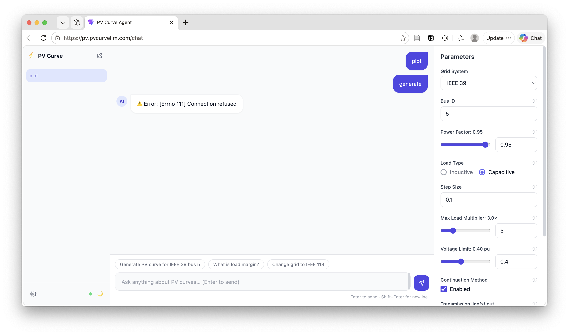
Hank’s PV curve interface

Slide 8
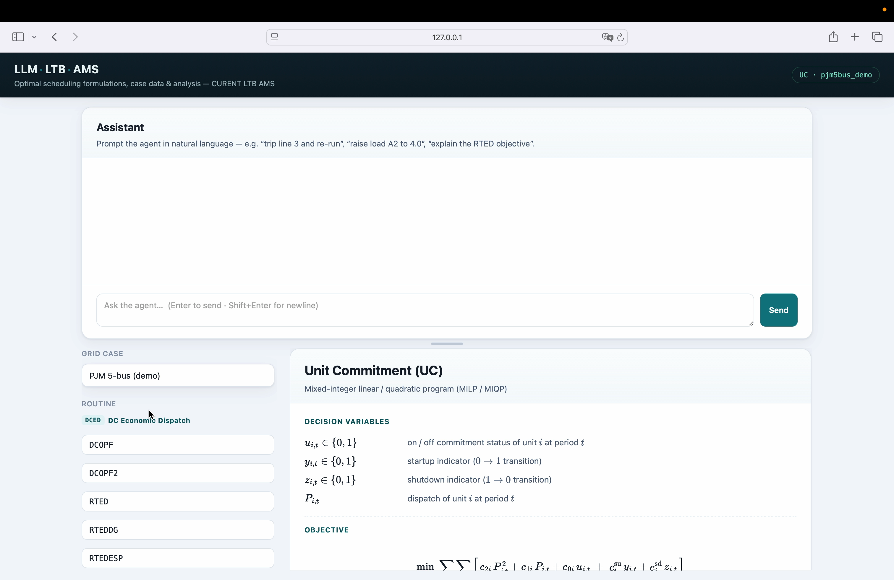
Revise the optimization problem formulation
Web UI: the formulation the agent edits

Slide 9
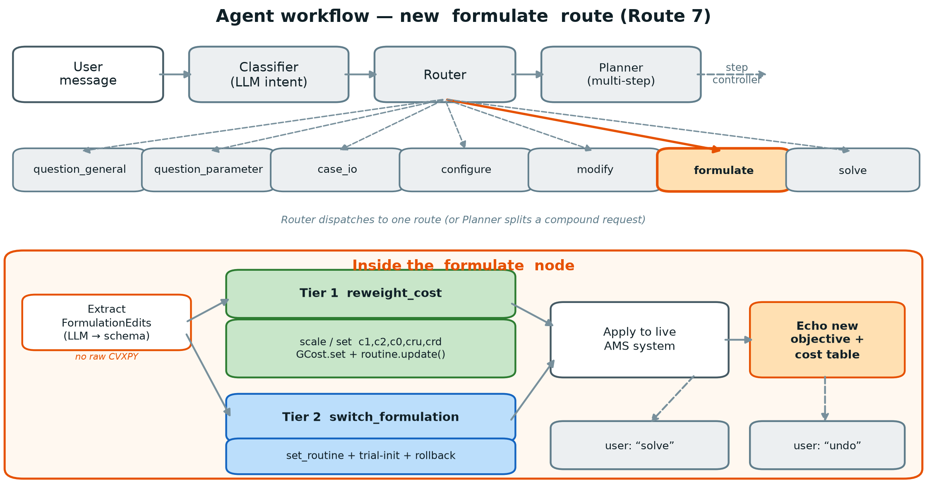
Revise the optimization problem formulation
Workflow: the new formulate route

Slide 10
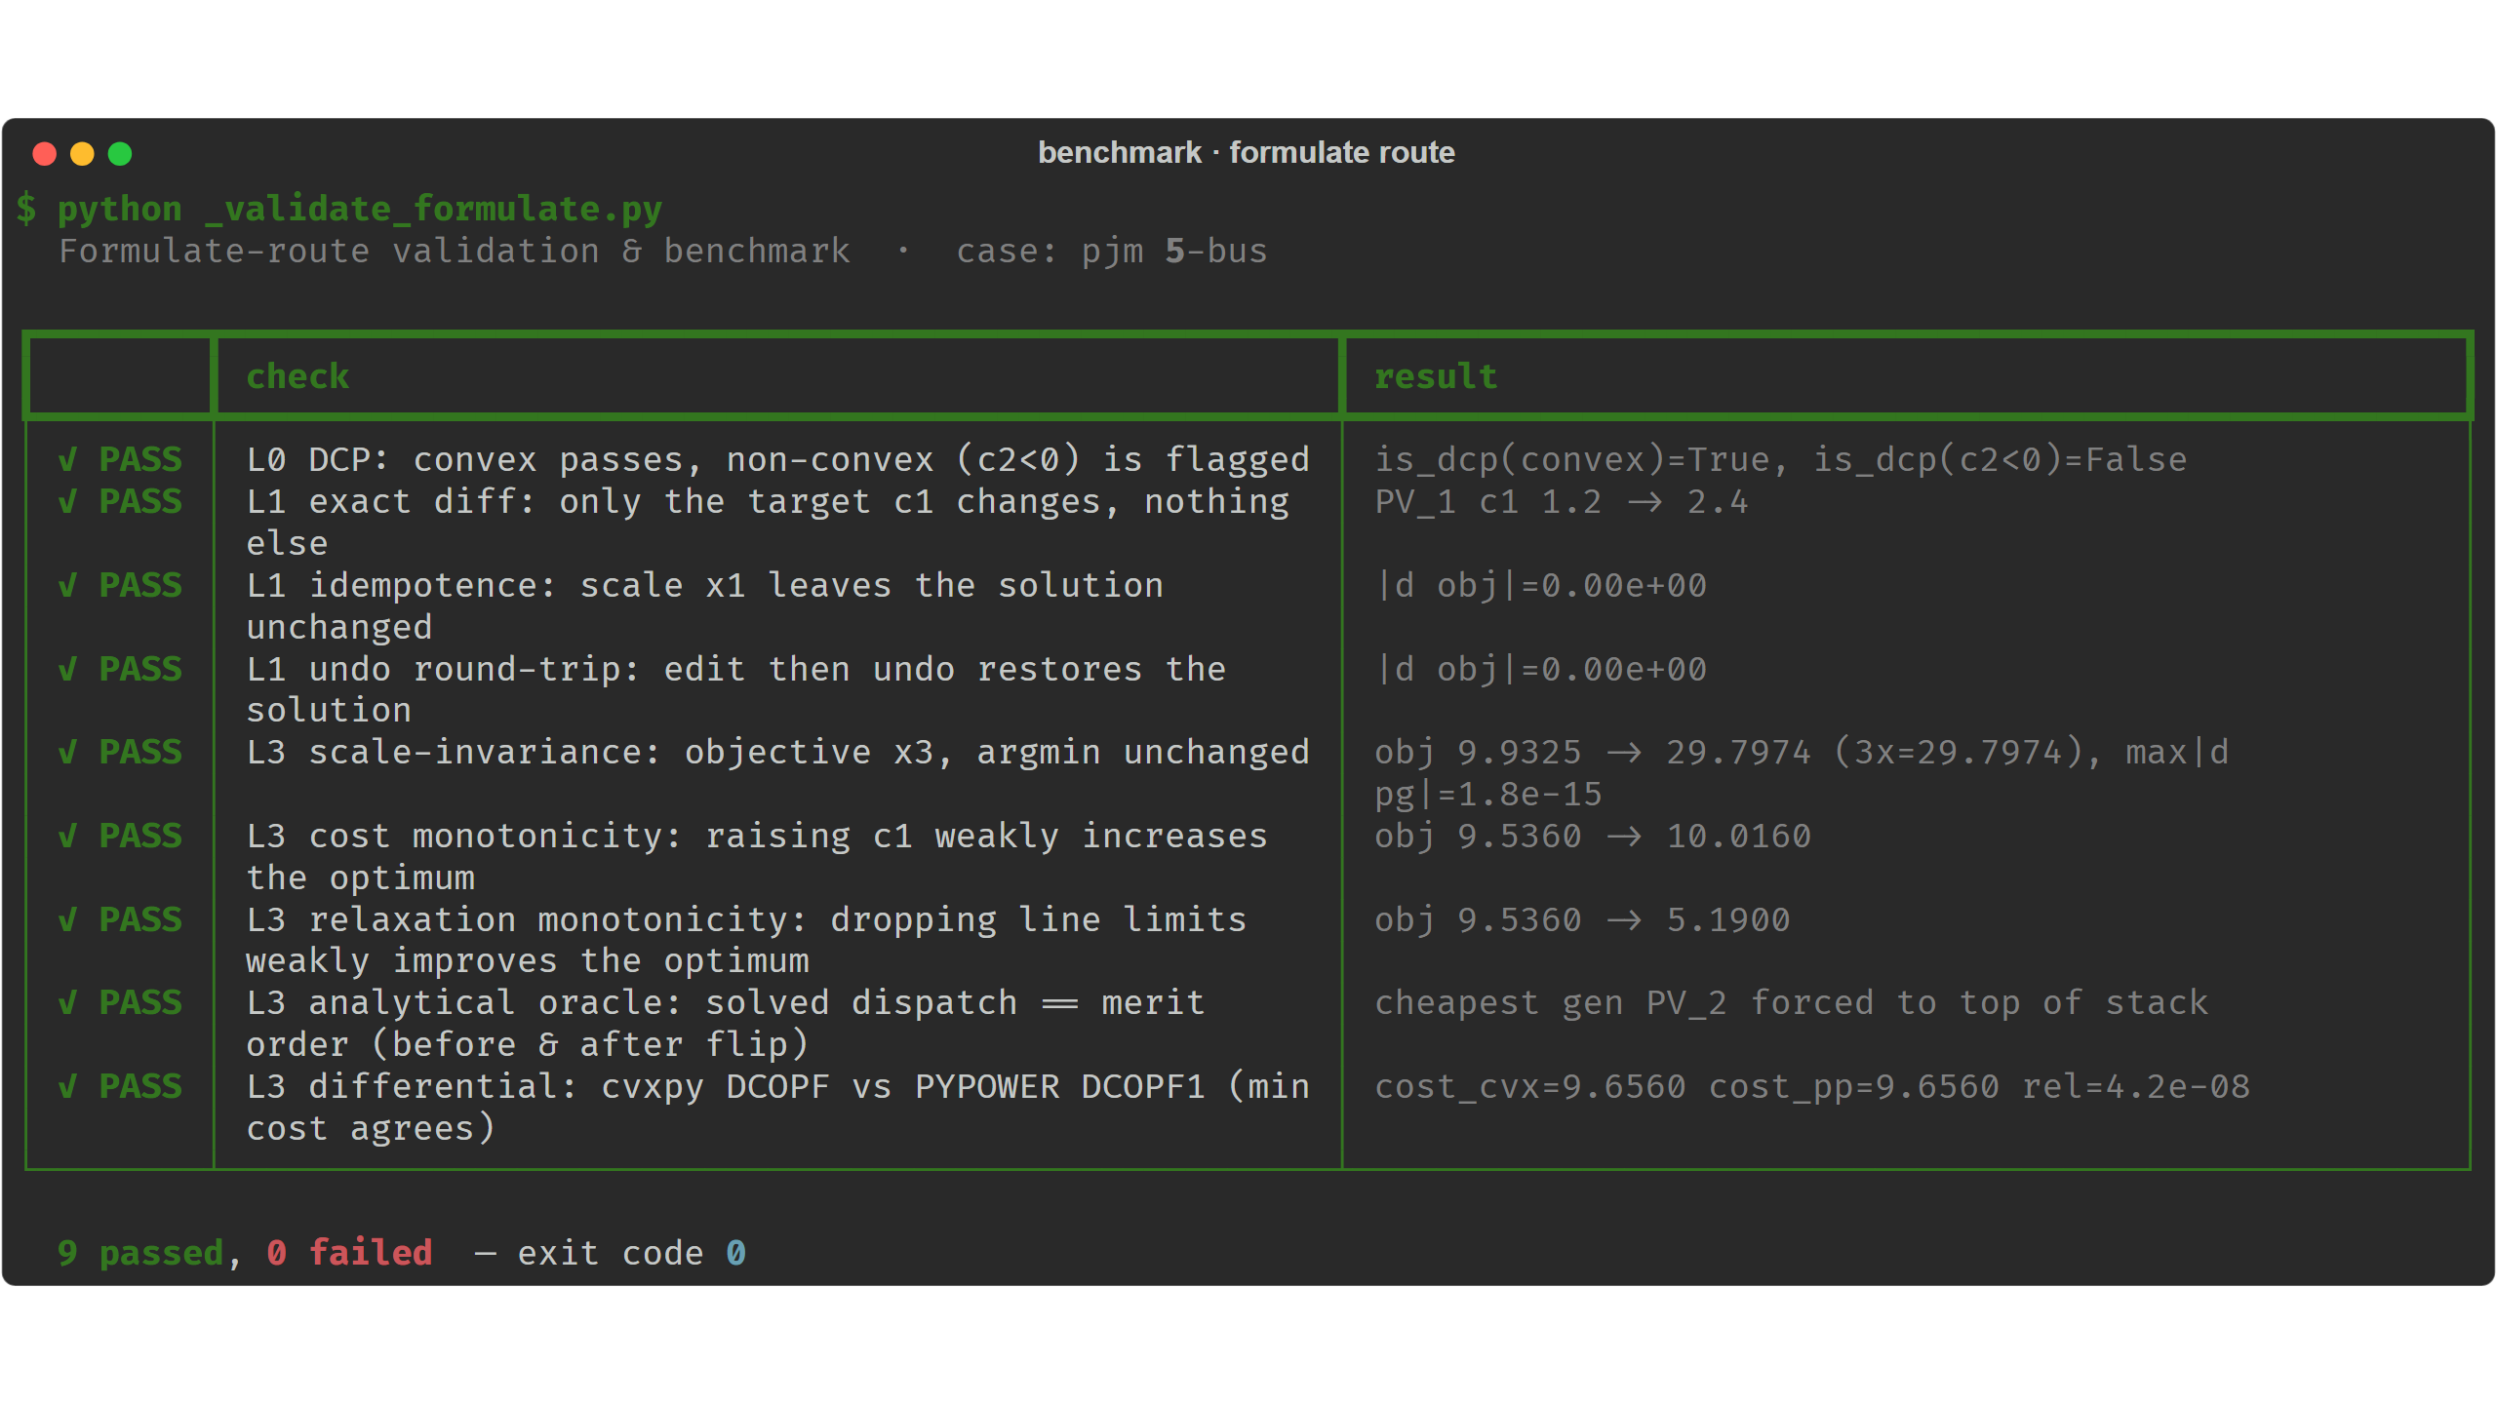
How to verify or benchmark?
Benchmark: 9 / 9 checks pass on PJM 5-bus

Slide 11
How to verify or benchmark?
Layered verification: Check user intent, formulation, implementation, and solution feasibility/optimality—not just solver success.
New benchmarks: Combine expert-reviewed components, hand-solvable cases, and mathematical property tests (e.g., relaxing constraints cannot worsen the optimum).
Verifier evaluation: Inject missing constraints, sign errors, and incorrect device mappings; supplement with cross-tool comparisons and expert review.
Notes:
ISO, market clear, re-check (like PJM validate)

Slide 12
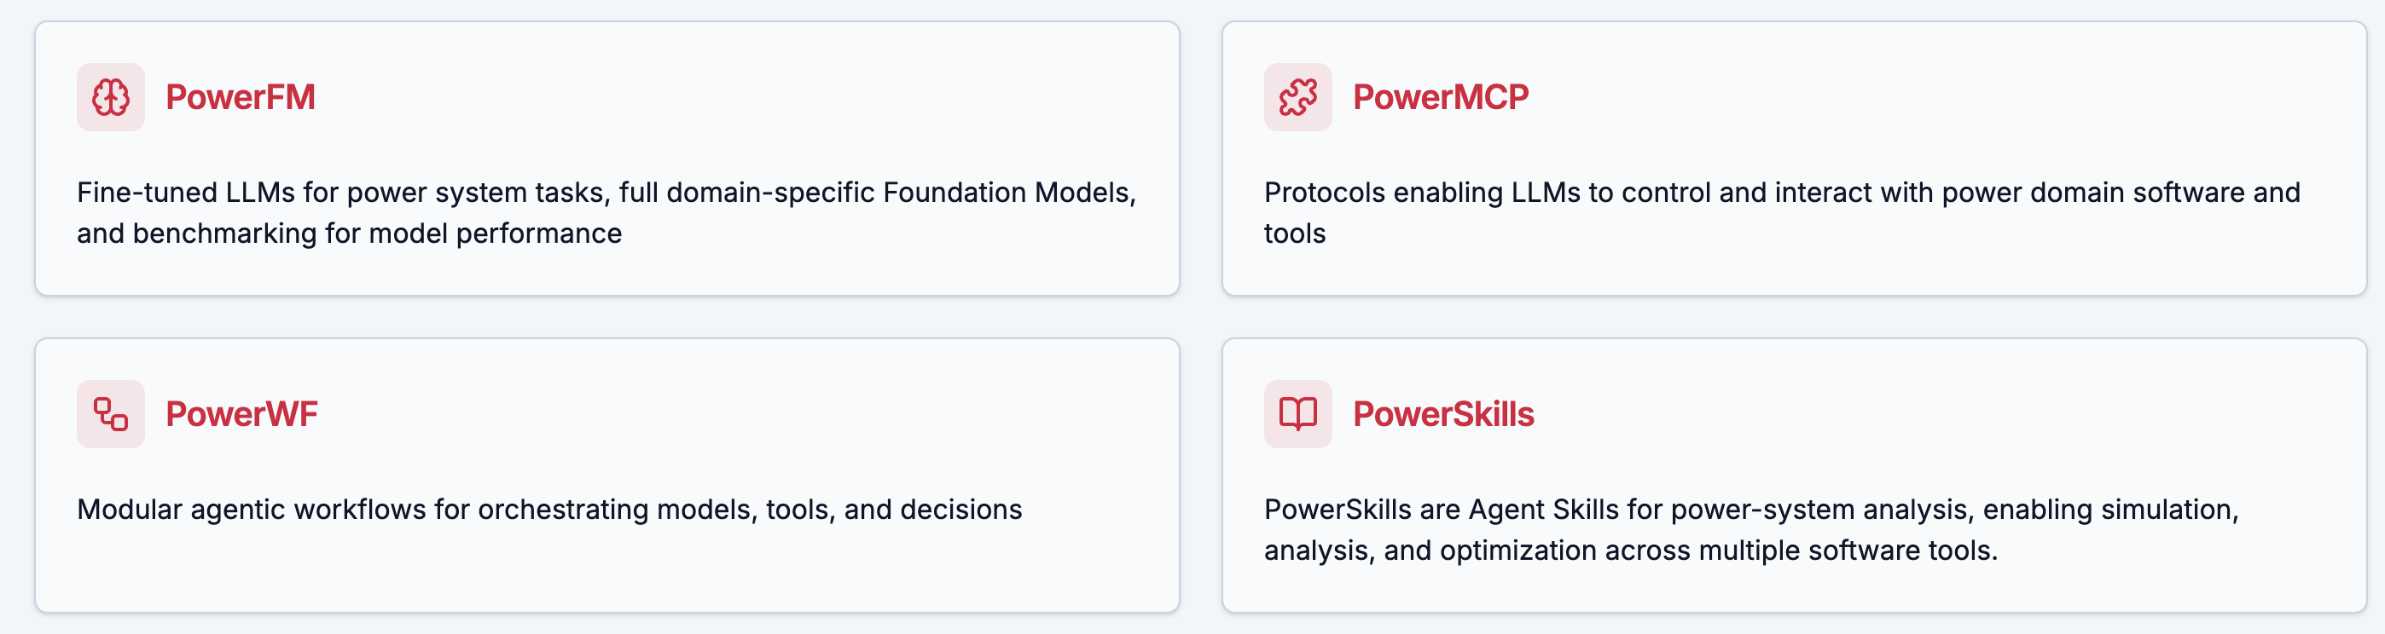
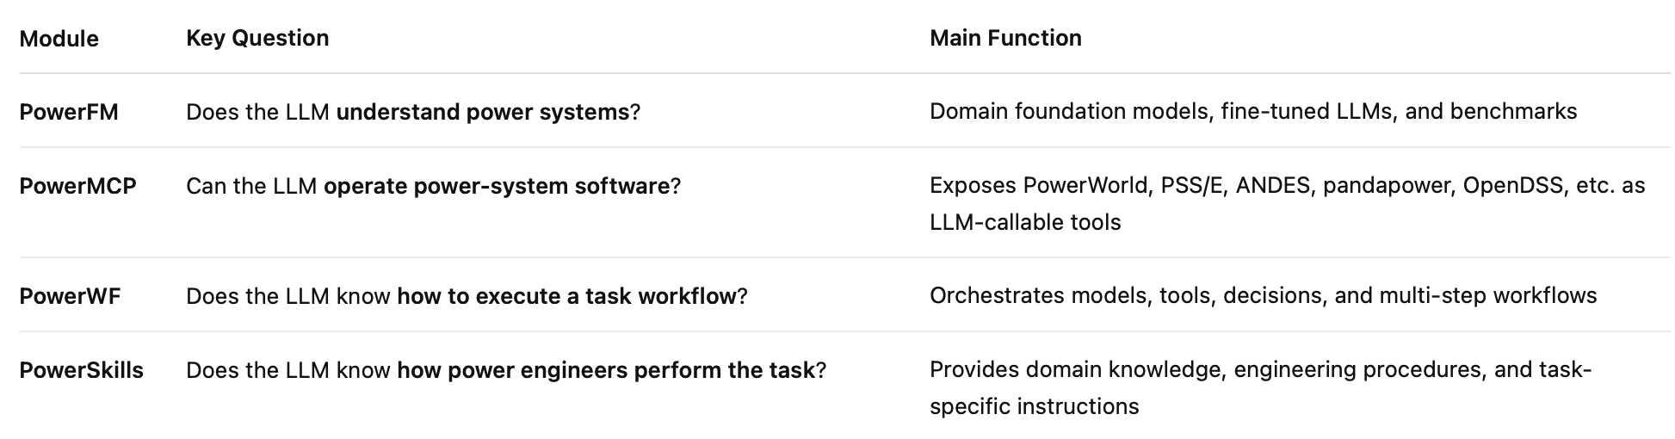
Comparison with peer works
PowerAgent – Harvard Dr. Le Xie

Slide 13
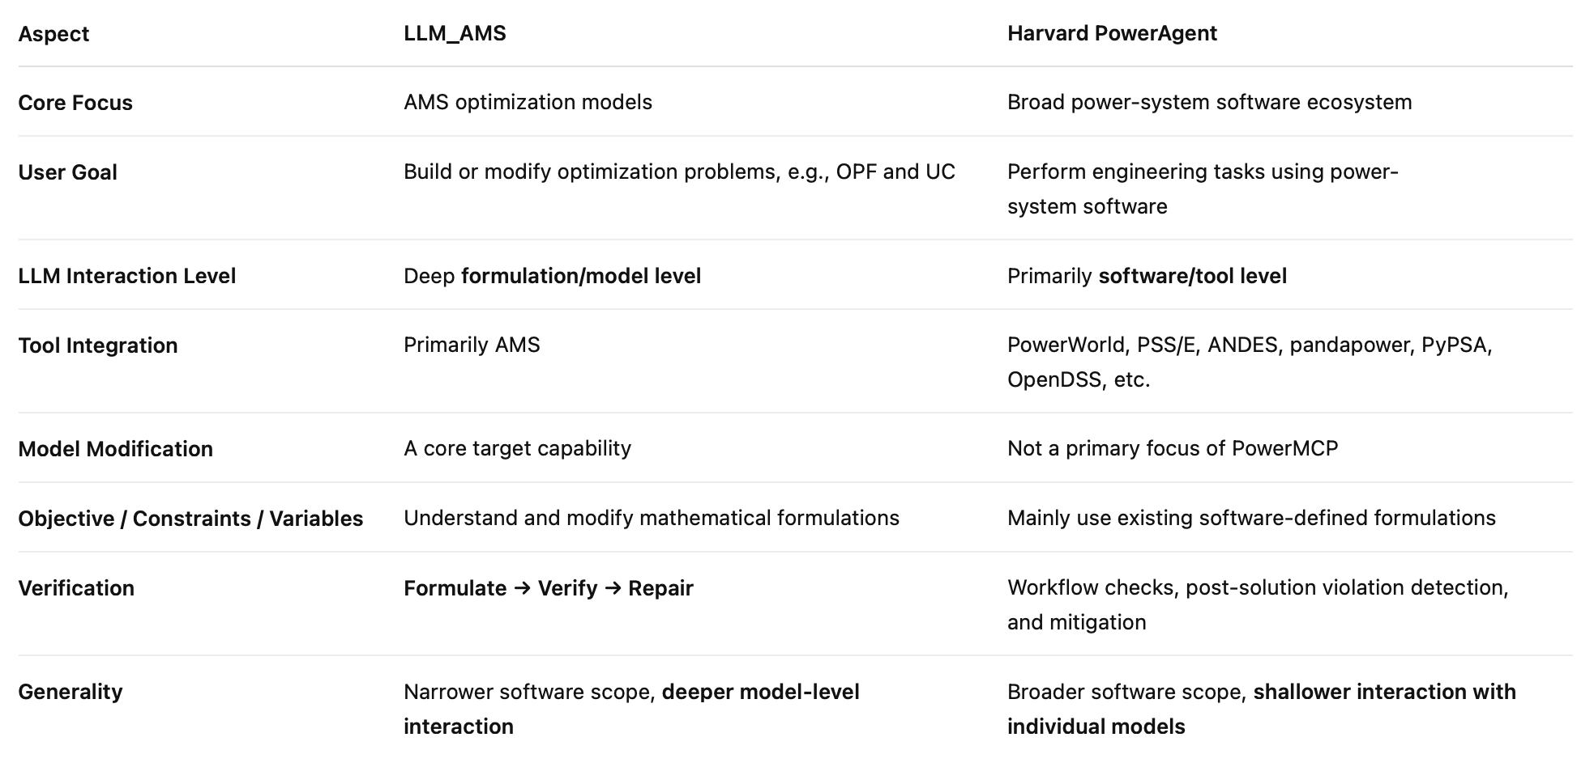
Comparison with peer works
PowerAgent emphasizes broad software-level integration, while LLM_AMS targets deeper interaction with optimization formulations.

Slide 14
















Acknowledgements
Contributors:
Users:
Acknowledgements:
Notes:
Two layers: Contributors and users
MSU as a user

