Slide 1
CURENT Large-scale Testbed (LTB)
Monthly Meeting
10/26/2026
CURENT, University of Tennessee, Knoxville
Leadership Team | Dr. Fran Li
Senior Advisor | Dr. Kevin Tomsovic, Dr. Hantao Cui, Dr. Xin Fang
Core Development | Dr. Hantao Cui, Dr. Xin Fang, Dr. Jinning Wang, Nicholas Parsly, Nick West, Zack Malkmus, Junjie Yin, Matthew Cannavaro, Hank Lin, Jian Han, Dr. Chenchen Li
Other Contributors | Dr. Qiwei Zhang, Dr. Buxin She, Dr. Hang Shuai

Slide 2
1. Summary
Community
Homepage: https://ltb.curent.org/
LinkedIn: https://www.linkedin.com/company/76122605
YouTube: https://www.youtube.com/@curentltb
GitHub: https://github.com/CURENT
Administration:
10/11-13 NAPS 2026 meeting
10/21 NASA visit CURENT
Development
LLM with LTB AMS
    Configuration file update
    Revise parameter classification
    How to ensure the LLM executes prompt correctly?
LLM with LTB Andes

Slide 3
Configuration file update
A reviewed catalog can describe model edits; the compiler applies only declared templates.
FORMULATION CONTROL SPEC
DECLARATION → MODEL CHANGE
control_id · operation_kind
scenario | formulation
routines · target_scope
Config
Validate
Compile
DCOPF / ED / UC / ACOPF
›
›
reviewed
template
routine · types
bounds · conflicts
AMS model
operations
variables · objective_terms
what the template adds or changes
constraint_templates
named, versioned, reviewed blocks
Live AMS model
parameters · bounds · units
typed values with validation rules
Only validated, routine-compatible edits are applied.
preconditions · conflicts · reset
safe composition and recovery
Design direction
Replace one-off executor branches with configuration-driven, validated operations.
Monthly Meeting · 10/26/2026
3

Slide 4
Revise parameter classification
Classify controls by their effect on data, constraints, and decision structure.
TYPE
CURRENT OPERATIONS
EFFECT ON THE OPTIMIZATION MODEL
Input values
scale_pq_load — PQ_1 +10%
set_line_rate — Line_1 rate_a = 0.9
Updates demand or line limits. Existing variables, objective terms, and constraint definitions remain; changed limits may still alter the feasible region.
scenario
Device / topology status
set_line_status — open Line_1
set_generator_status — disable unit
Changes device availability, network state, and solve inputs. Results can shift without adding a decision-variable class.
scenario
Routine settings
set_config_t — ED interval = 0.5 h
Changes the active routine’s time setting and rebuilds its model; adds no custom objective term or constraint.
scenario
Existing constraint toggles
set_constraint_status — disable plfub
set_ramping_status — disable ED ramping
Changes which existing constraints participate in the solve. This is a formulation change; no new constraint is defined.
formulation
Add objective / constraint
add_dispatch_cost
set_total_generation_cap
First use adds an objective term or generation-cap constraint. Repeated use updates its coefficient or upper limit.
formulation
New variables + model rewrite
replace_generator_with_ibr
DCOPF adds pibr / pcurt, availability limits, and cost terms, then rewrites nodal power balance (active-power scope).
formulation
Sources: formulation_controls.json:43–179 · parameter_controls.py:230–302 · formulation_edit.py:105–129
Monthly Meeting · 10/26/2026
4

Slide 5
How to ensure the LLM executes a prompt correctly?
Treat execution as a verifiable transaction, not a reasoning claim.
1 REQUEST
2 PLAN
3 PRECHECK
4 APPLY
5 READ BACK
“Set a = 0.9”
›
a := 0.9
›
a exists · in range
›
Declared edit
›
Actual value = 0.9
Target + value
Typed, scoped
operation
Routine · units ·
preconditions
One controlled
model operation
Model diff + solve
feasibility check
EXECUTION RECORD
Intent
Applied state
Model effect
Outcome
target a · requested value 0.9
read back from the live AMS object
changed fields / objective / constraints
solver status + feasibility checks
Block and ask when target, units, bounds, or post-apply state do not match.
Monthly Meeting · 10/26/2026
5

Slide 6
Revise the optimization problem formulation
Terminal (CLI):
Question 1: doubling a generator's cost weight
--> Question 2 Replace PV_1 with an IBR with available power 1 pu, dispatch cost 1 dollar per pu, curtailment penalty 20 dollars per pu.
formulation_controls.json
├── version
├── constraint_labels
├── ramping_constraints
├── controls
│ ├── id / label / description
│ ├── enabled
│ ├── routines
│ ├── requires_constraints
│ ├── parameters
│ └── prompt_examples
└── unsupported_message
LLM
Revised Problem Formulation
AMS (revised)
Add optimization term
Add constraints
Revise certain elements
……
Config
file

Slide 7
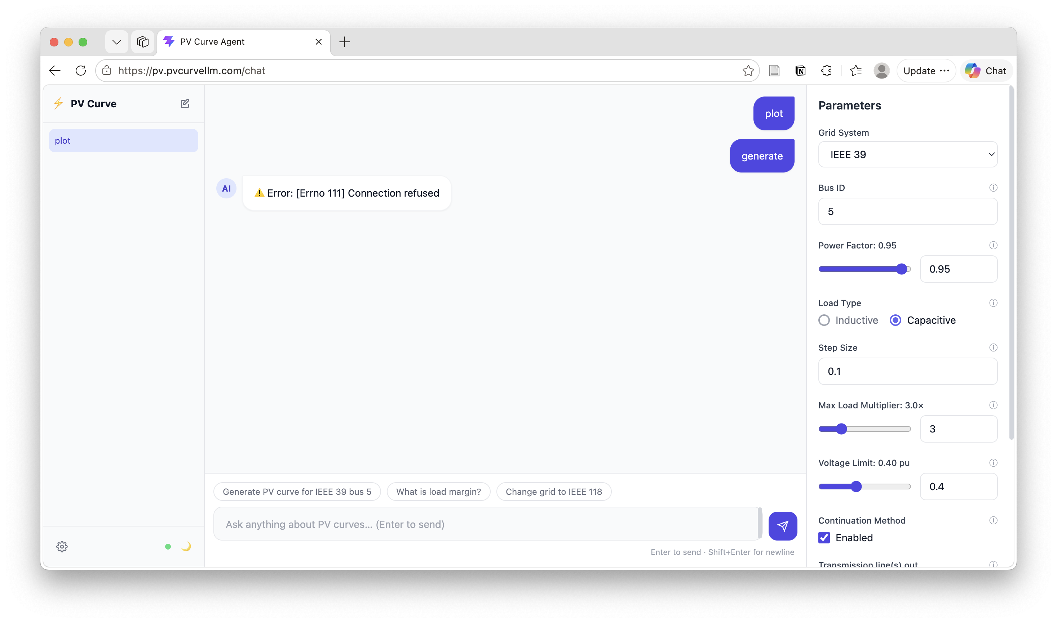
Hank’s PV curve interface

Slide 8
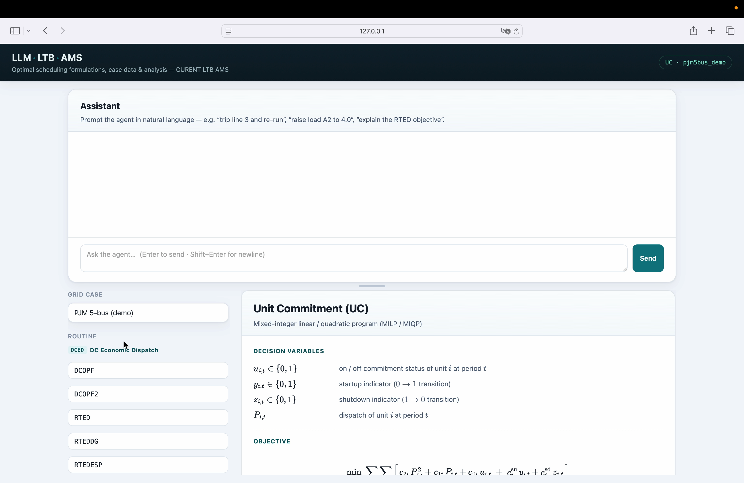
Revise the optimization problem formulation
Web UI: the formulation the agent edits

Slide 9
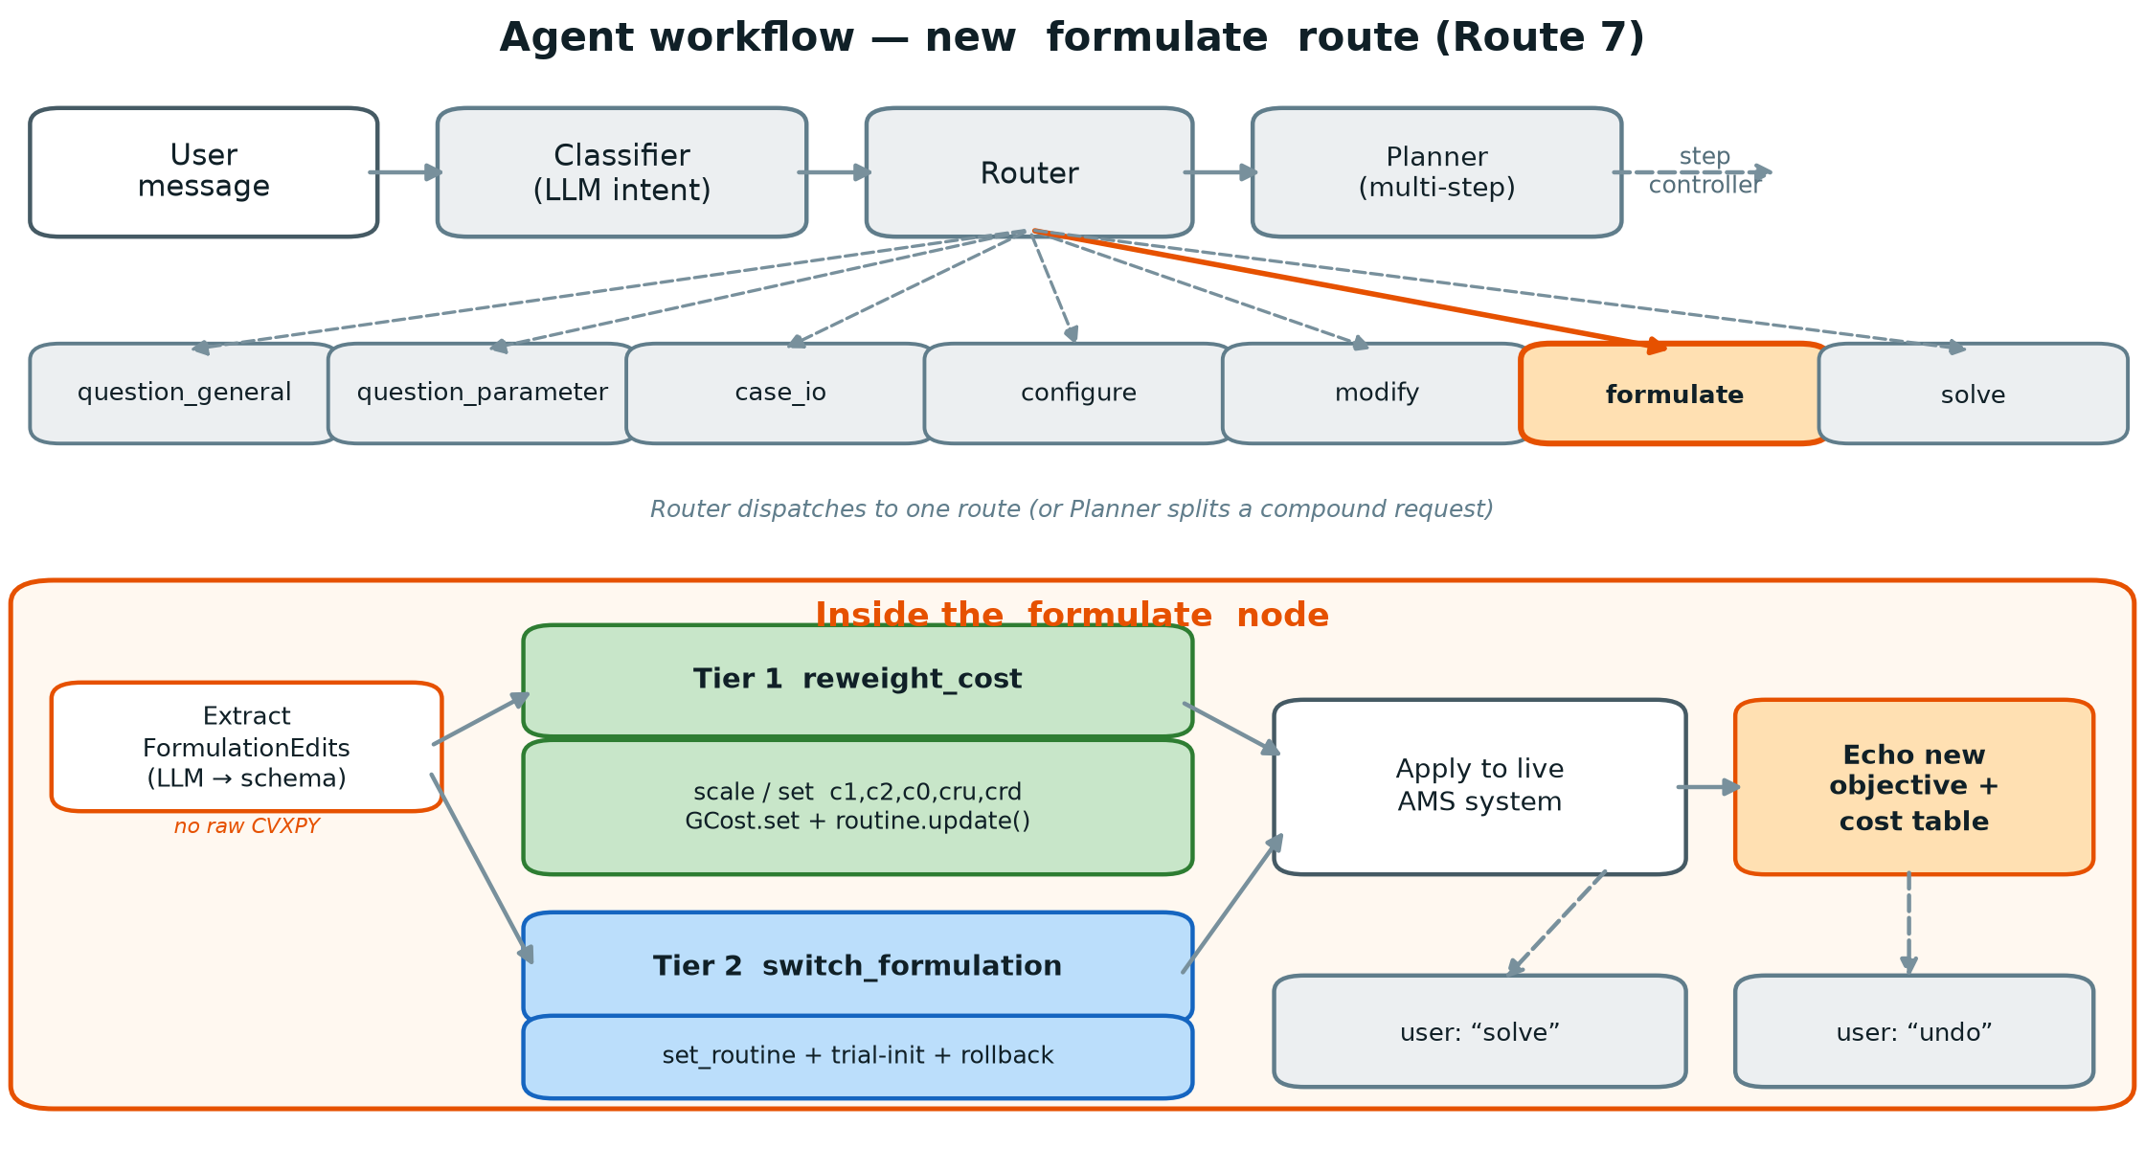
Revise the optimization problem formulation
Workflow: the new formulate route

Slide 10
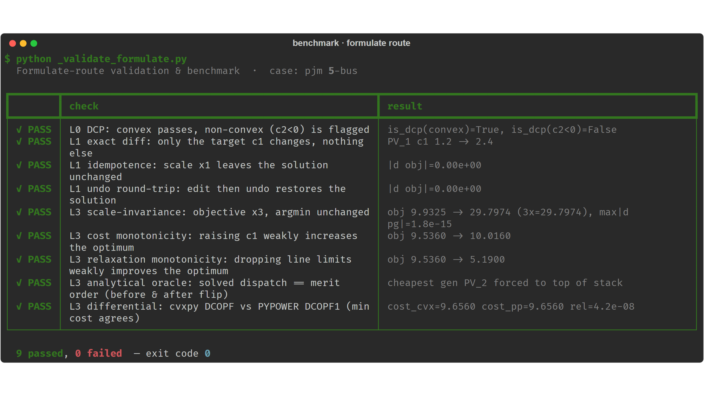
How to verify or benchmark?
Benchmark: 9 / 9 checks pass on PJM 5-bus

Slide 11
How to verify or benchmark?
Layered verification: Check user intent, formulation, implementation, and solution feasibility/optimality—not just solver success.
New benchmarks: Combine expert-reviewed components, hand-solvable cases, and mathematical property tests (e.g., relaxing constraints cannot worsen the optimum).
Verifier evaluation: Inject missing constraints, sign errors, and incorrect device mappings; supplement with cross-tool comparisons and expert review.
Notes:
ISO, market clear, re-check (like PJM validate)

Slide 12
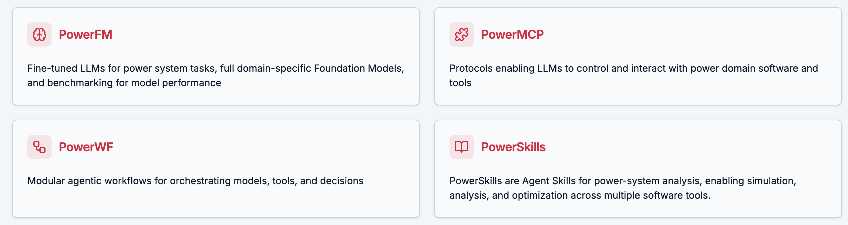
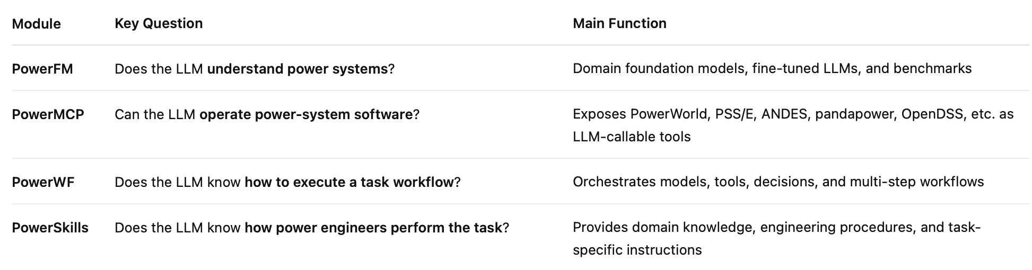
Comparison with peer works
PowerAgent – Harvard Dr. Le Xie

Slide 13
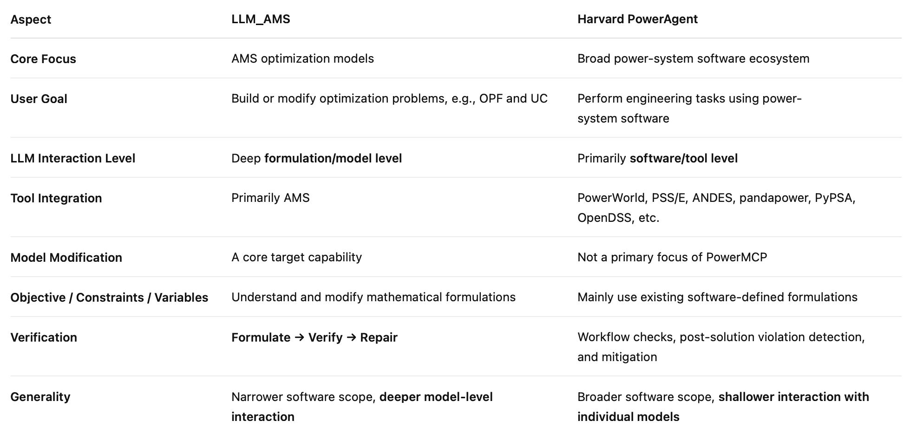
Comparison with peer works
PowerAgent emphasizes broad software-level integration, while LLM_AMS targets deeper interaction with optimization formulations.

Slide 14
















Acknowledgements
Contributors:
Users:
Acknowledgements:
Notes:
Two layers: Contributors and users
MSU as a user

