Slide 1


Hackathon 2018: The influence of the 2nd Ave Subway on Yellow Taxi Ridership in the UES
By: Pablo Mandiola, Soham Mody, Devashish Khulbe, Max Brueckner-Humphreys

Slide 2
Overview
Deliverable: statistical conclusion on distribution of the ridership ratio in the affected neighborhoods a year from the launch compared to the previous two years as well as in the nearby/far away control areas compared to the previous years.

Slide 3
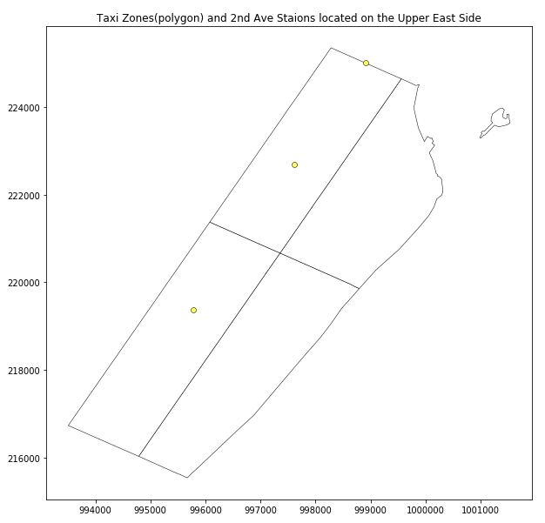
Defining Geographies
How we defined them...
Used Taxi Zones defined by the TLC as our area of study known as the “Upper East Side”
Taxi Zones included: 140, 141, 262, 263
Issues...
The UES is served by both the Lex Ave Line and the 2nd Ave Line. How do we accurately represent which areas taxi ridership was affected by the introduction of the 2nd Ave line?

Slide 4
Defining Geographies

Slide 5
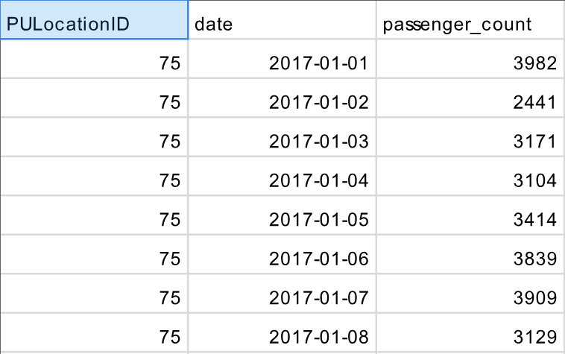
Data

Slide 6
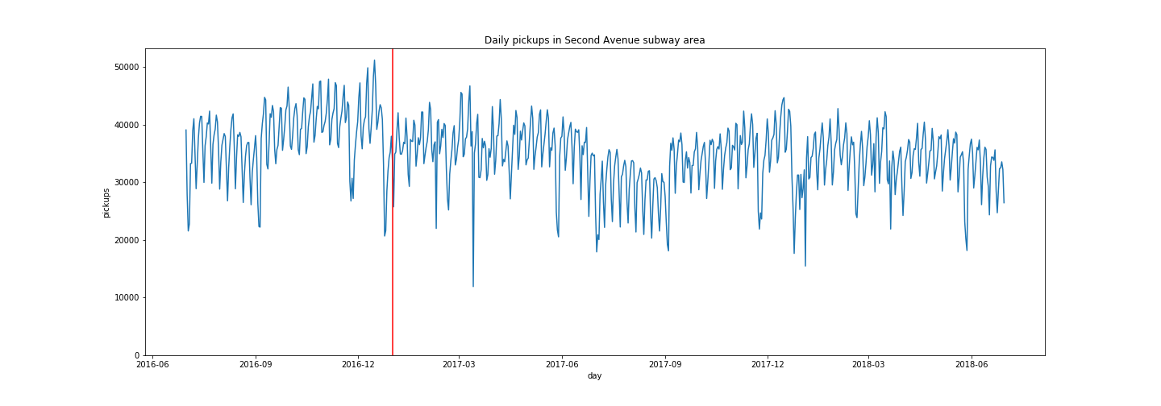
Daily Pickups in 2nd Ave Geography

Slide 7
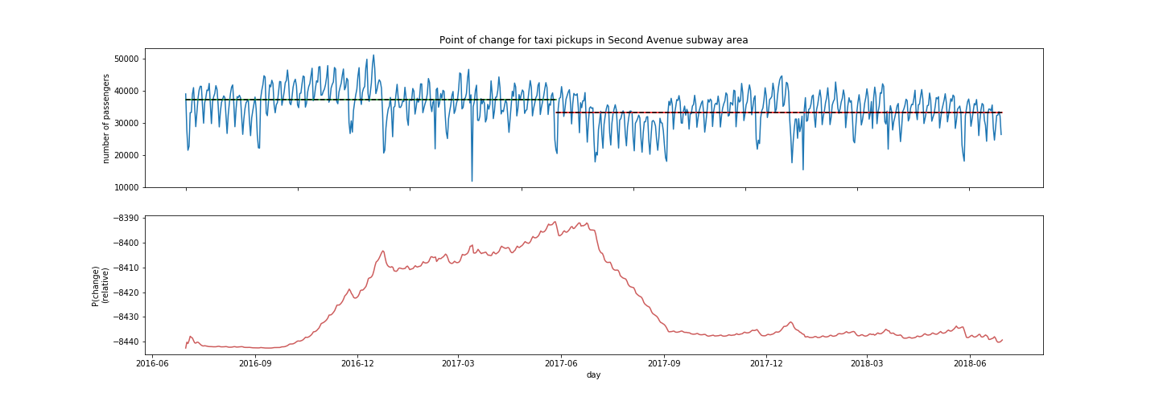
Point of Change Analysis

Slide 8
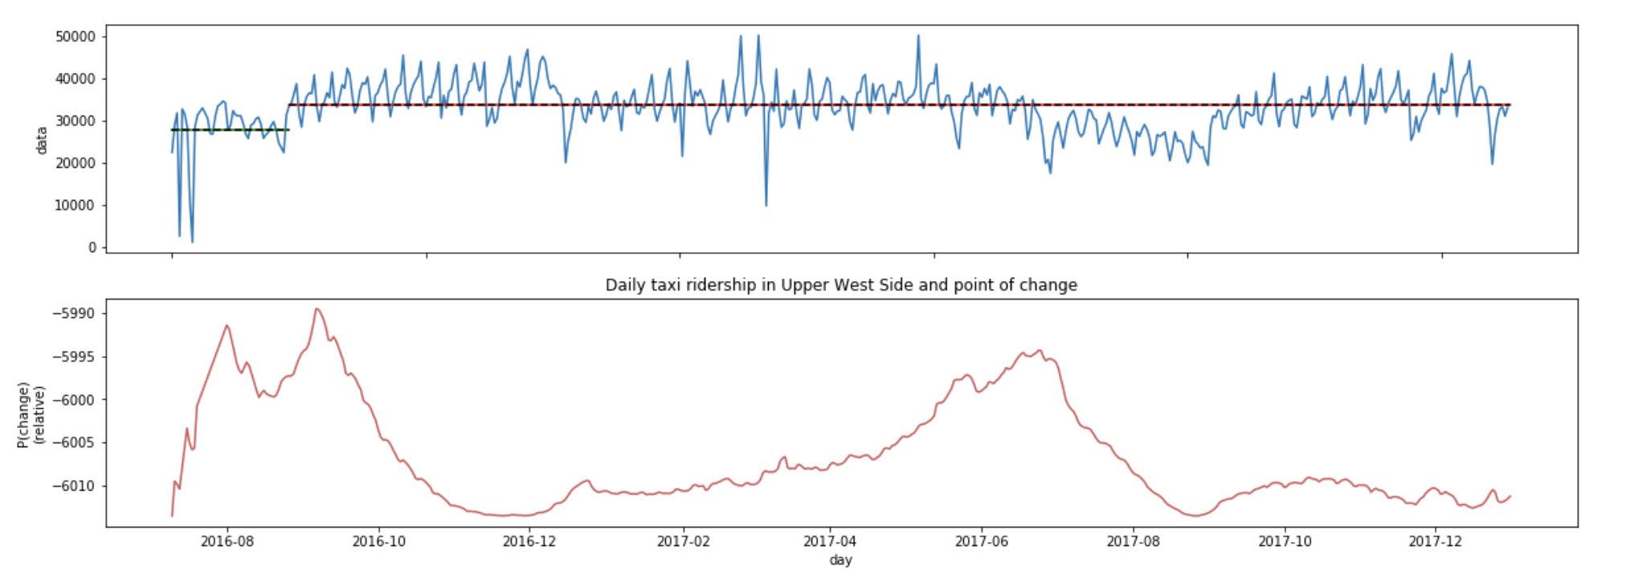
Comparing with a similar neighborhood (with no new subway line) - Upper West Side

Slide 9
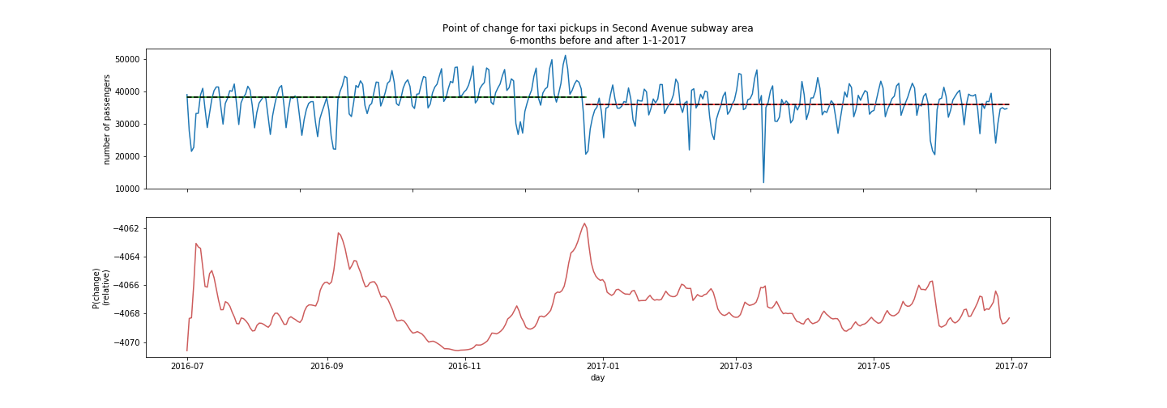
Point of Change for Taxi Pickups 6mon before (left) and 6months after (right) 2nd Ave Subway: 2017

Slide 10
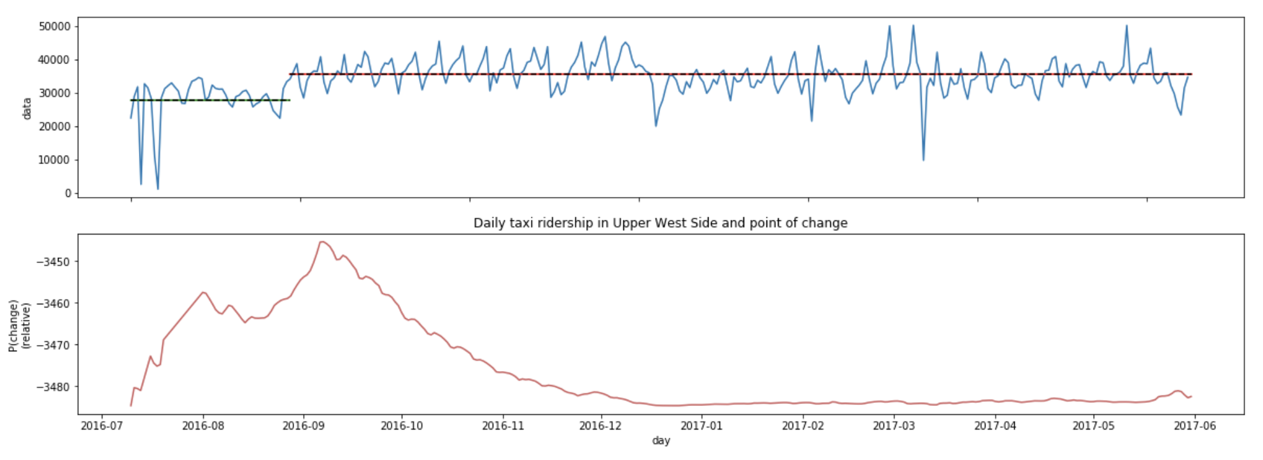
Upper west side for mid 2016-mid 2017

Slide 11
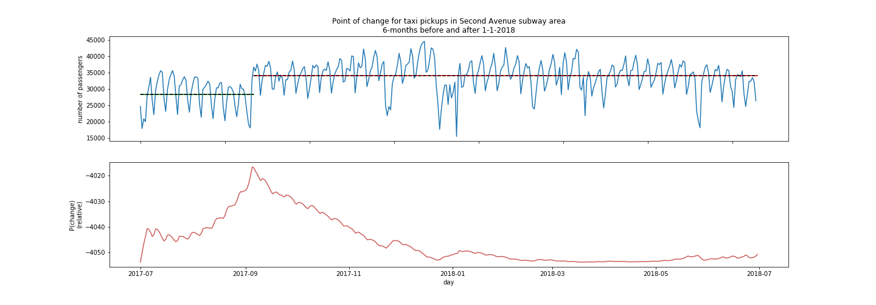
Point of Change for Taxi Pickups 6mon before (left) and 6months after (right): 2018

Slide 12
Limitations
Data
Format of TLC ridership (pick-up/drop-off) data changed in mid 2016 from lat, long to Taxi Zones
Format of TLC data imported incorrectly. Columns shifted to rep. Different attributes

Slide 13
References:
http://www.nyc.gov/html/tlc/html/about/trip_record_data.shtml
https://data.cityofnewyork.us/Transportation/Subway-Stations/arq3-7z49
https://s3.amazonaws.com/nyc-tlc/misc/taxi_zones.zip

