Slide 1
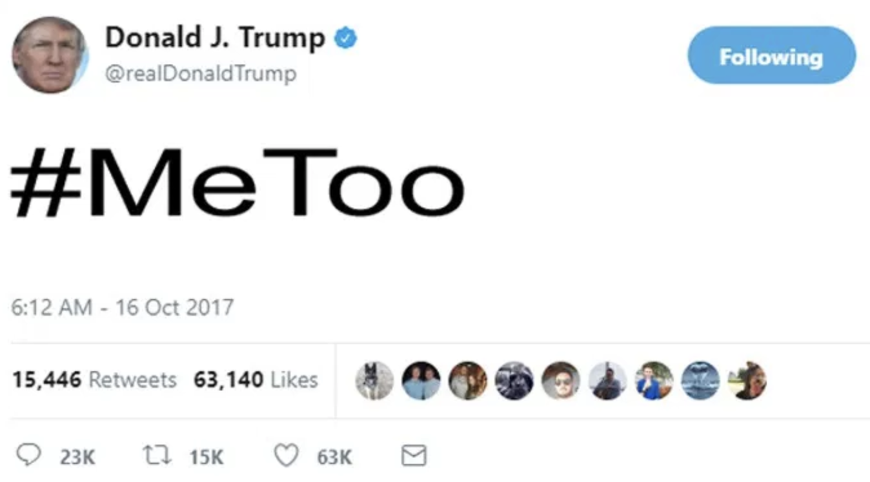
#MeToo
Presented by: Rachel Lim, Ben Steers, Yu Chen, Isha Chaturvedi

Slide 2
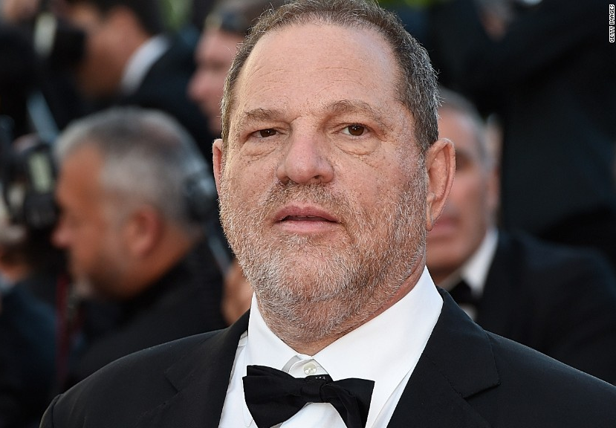
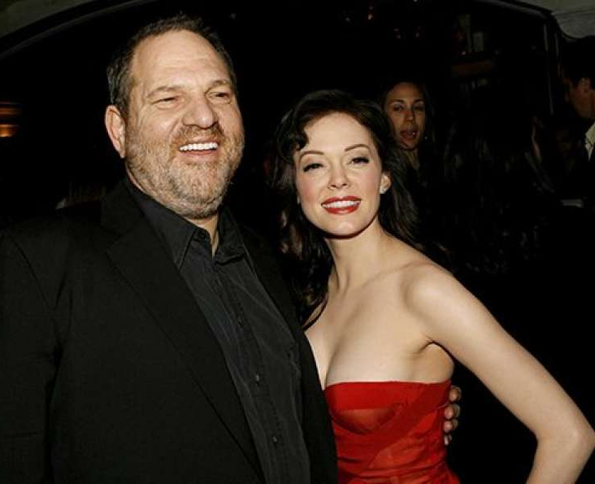
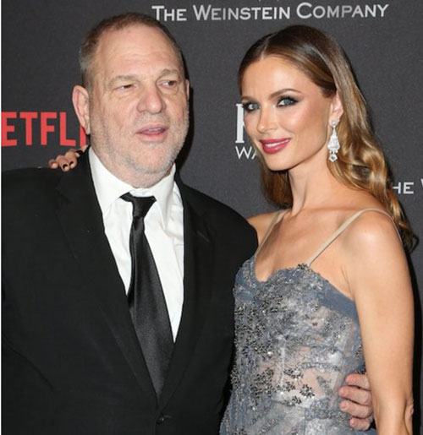
Harvey Weinstein Scandal

Slide 3
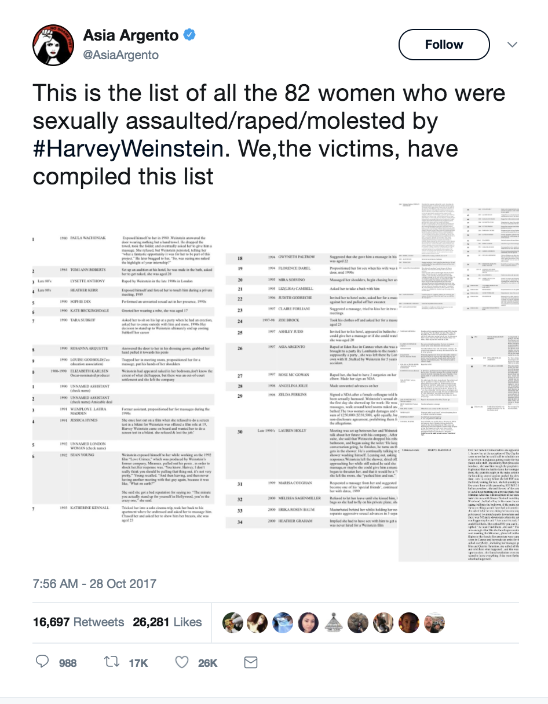
1. Amber Anderson
2. Lysette Anthony
3. Asia Argento
4. Rosanna Arquette
5. Jessica Barth
6. Ambra Battilana Gutierrez
7. Kate Beckinsale
8. Juls Bindi
9. Zoe Brock
10. Cynthia Burr
11. Liza Campbell
…...
…...
…...
79. Lupita Nyong’o
80. Rose McGowan
81. Ashley Judd
82. Paula Williams

Slide 4
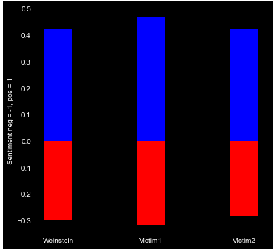
Overall Sentiment Analysis for Accused and Victims
Initial Expectation:
Given high profile of victims, public sentiment would shift in favor of victims
Sentiments towards Accusers and Victims do not differ much
Similar positive/ negative scores observed for both victims and accused

Slide 5
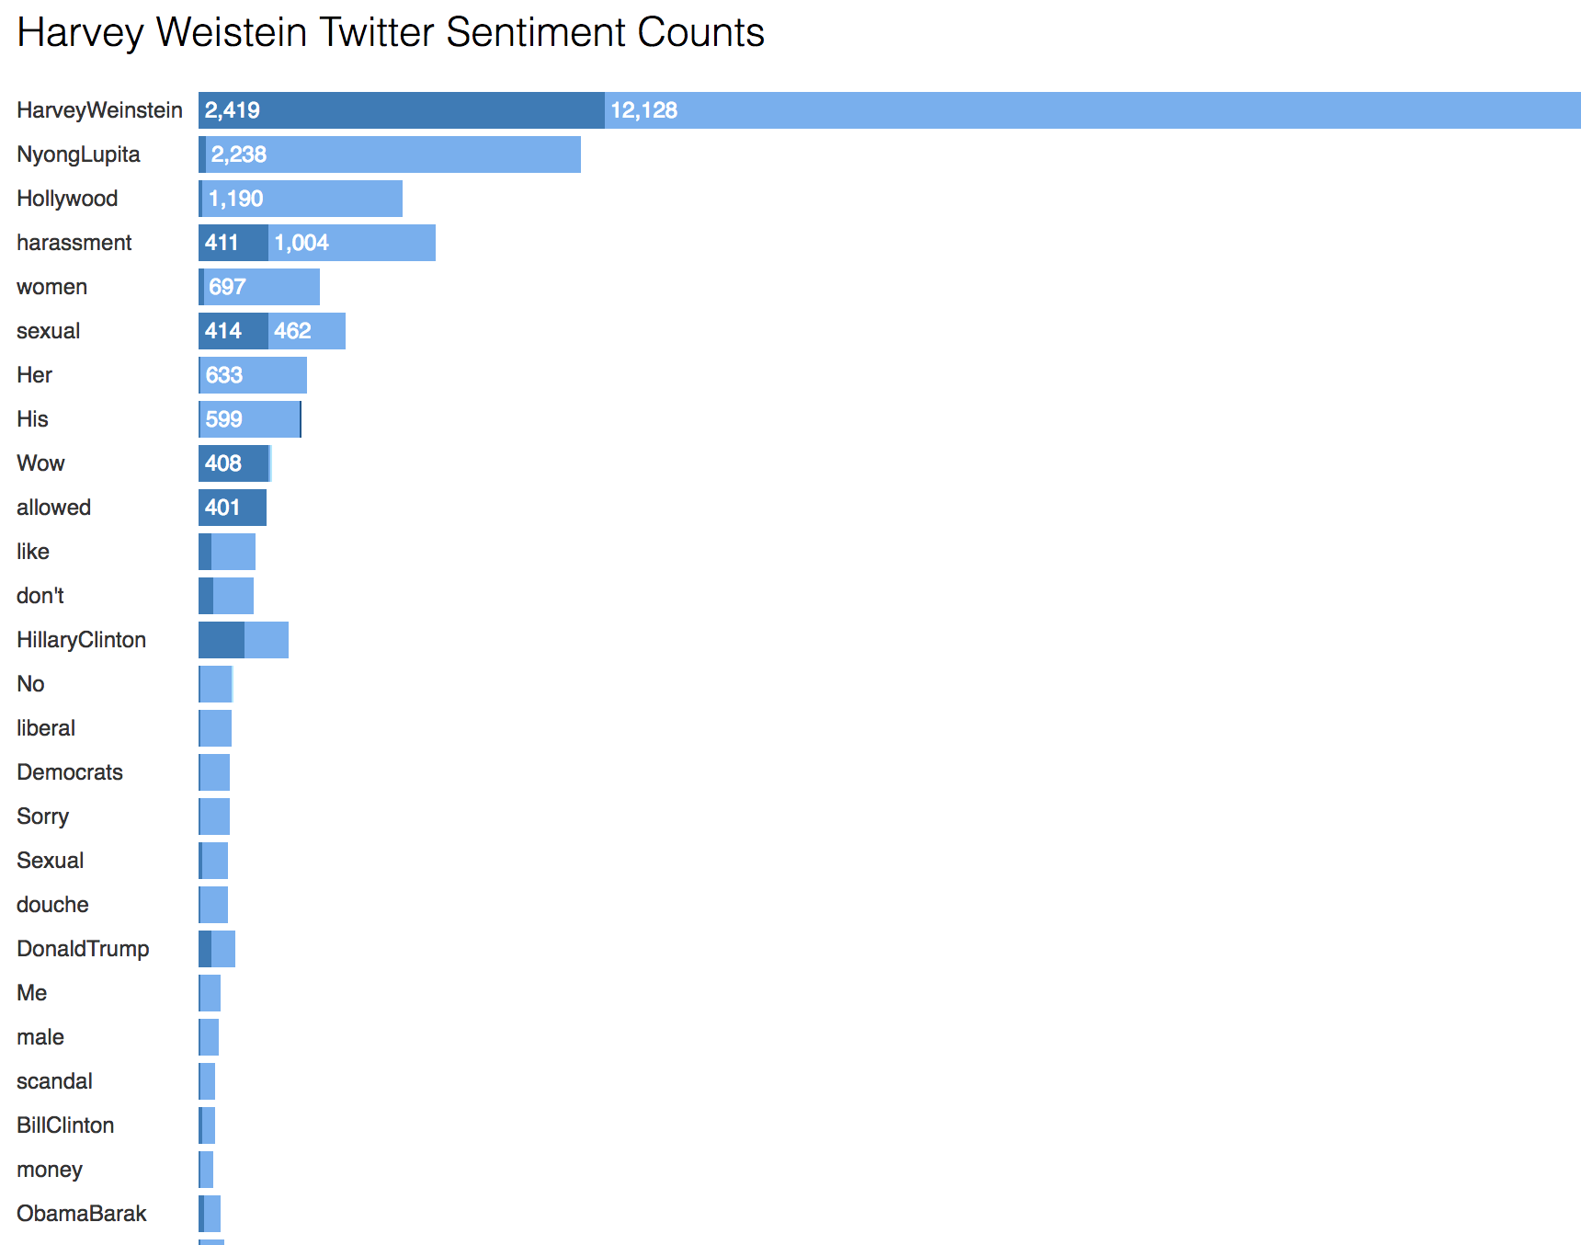

Slide 6
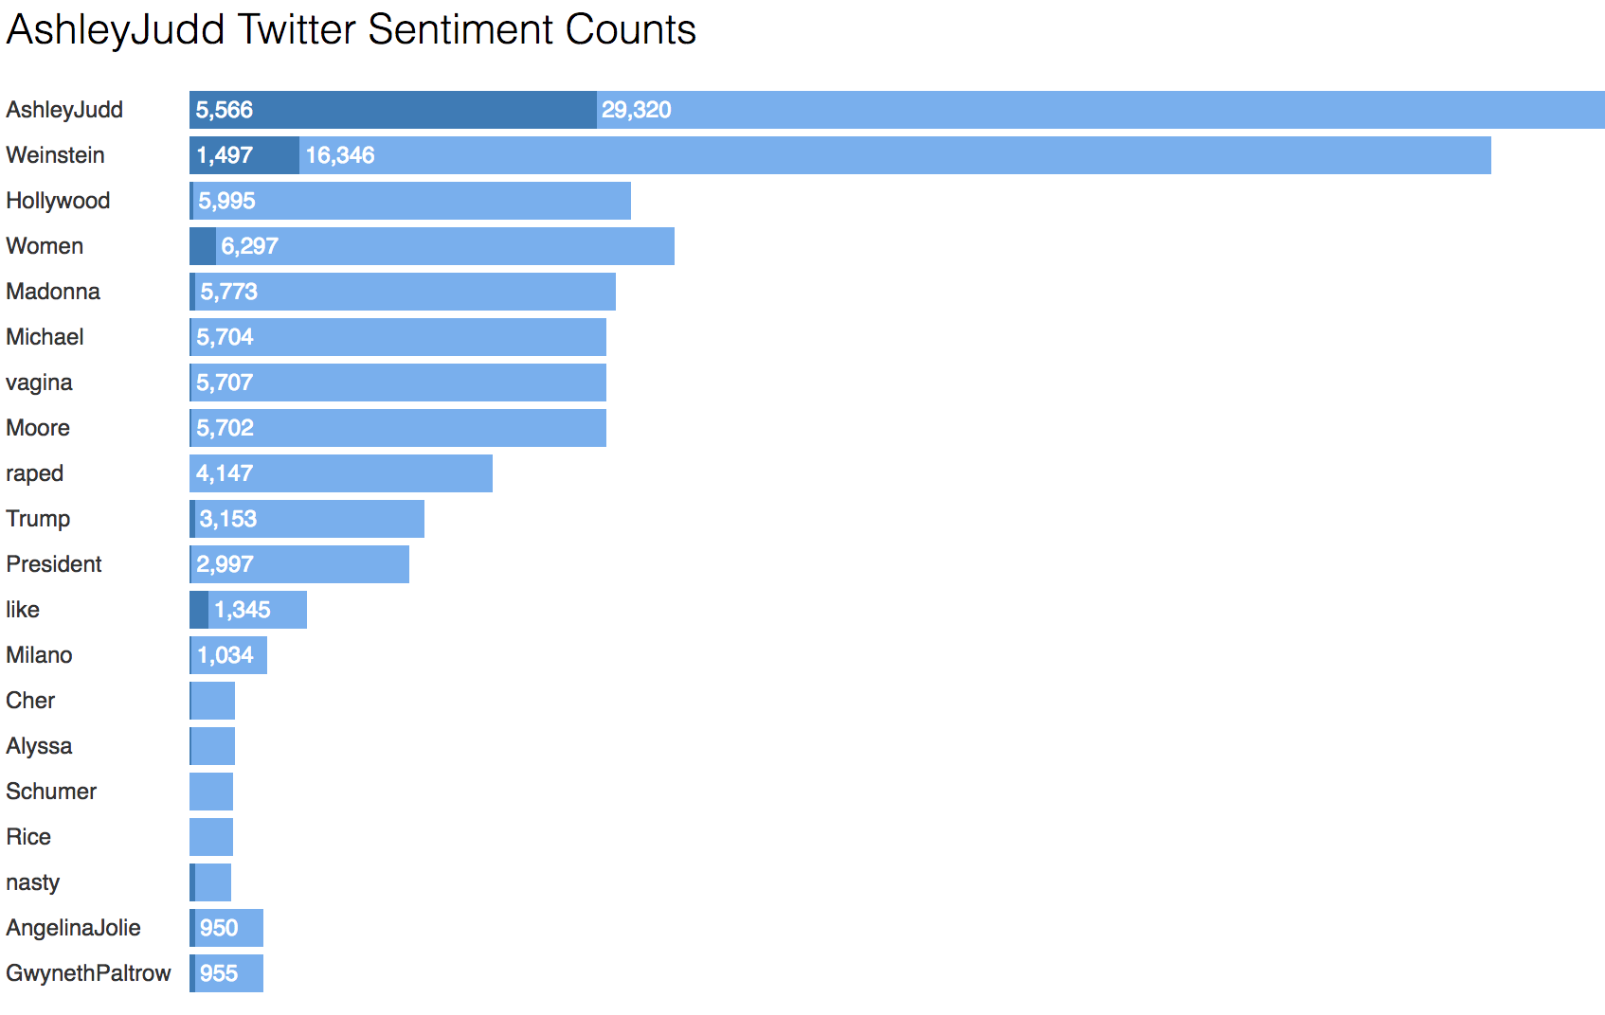

Slide 7
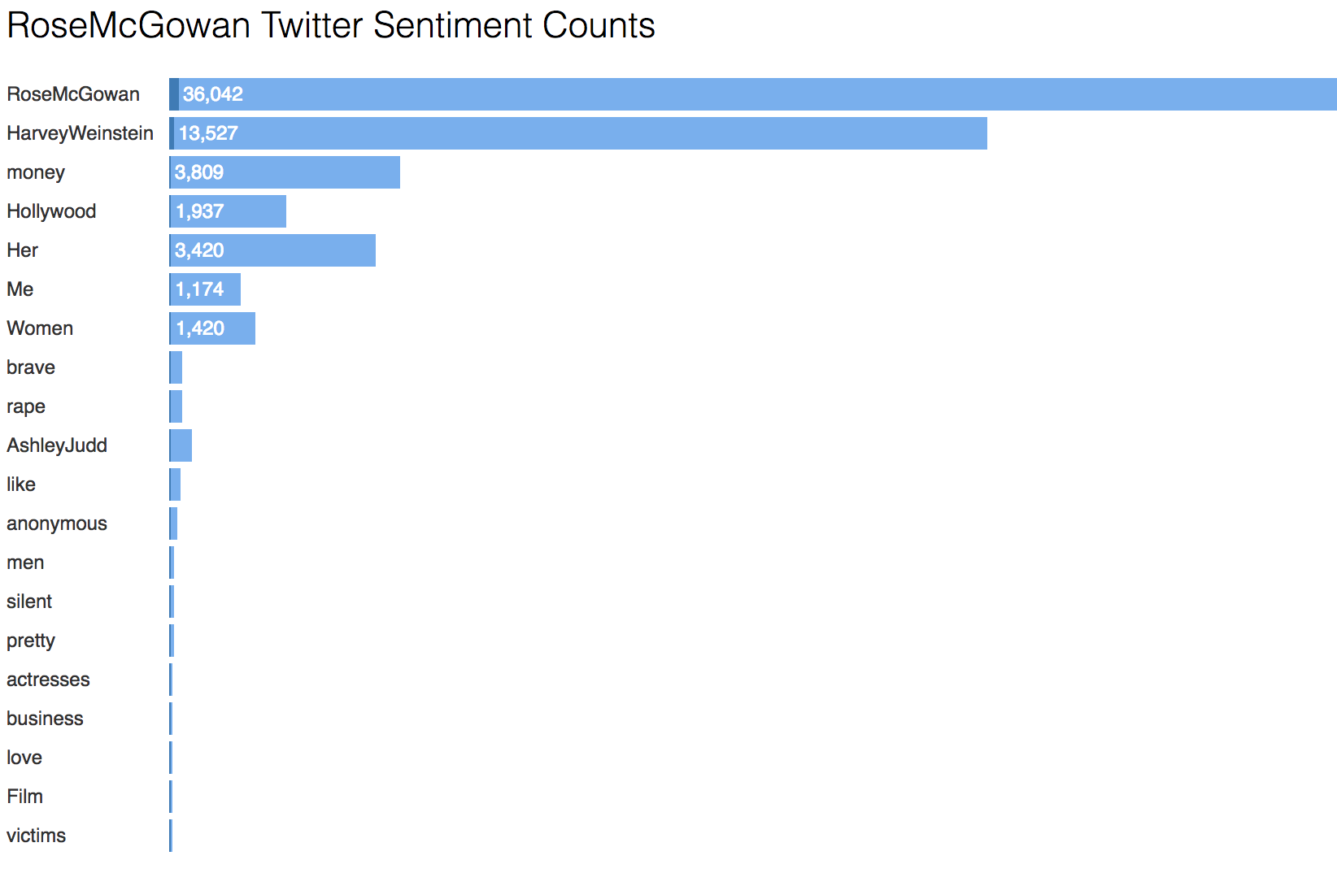

Slide 8
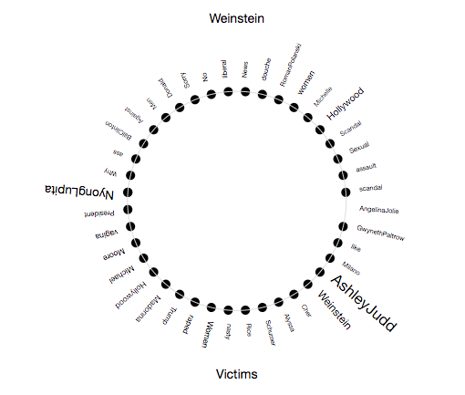
Wheel of Sentiment

