Slide 1
Chain Of Responsibility
OOD Pattern Presentation, Fall 2018
Prepared By
Alex Arcuti
Chaitanya Chakka
Chris Andrews
Chris Unger
James Kelly
William Hou

Slide 2
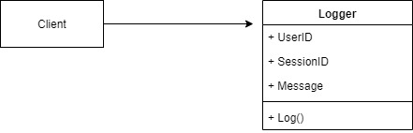
Logging Module at XYZ, Inc
User executes and action
The request is logged
The request is processed and a response is returned
James uses a simple Logger Class to accept the user information and message and logs the message into console.

Slide 3

Change request #1
Impressed by the ability to track requests into a text file the company now wants to add the ability to have the ability to allow the user to email a log.

Slide 4
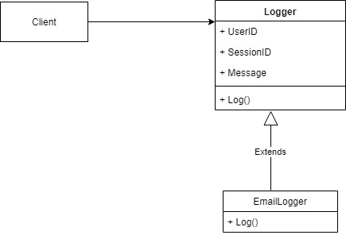
Decorator to the rescue
Since the initial class structure was simple it was easy to use the decorator pattern and create an Email Logger extension that would add the additional feature

Slide 5
Change request #2
Impressed by the ability to track requests into the console the company now wants to add the ability to create different types of logging messages (information, warning, error).
There is one additional requirement they want to continue logging everything to the console but now they want to customize the behavior of some logging types.
Warning message should be logged to a file.
Error message should be emailed to the administrator.

Slide 6
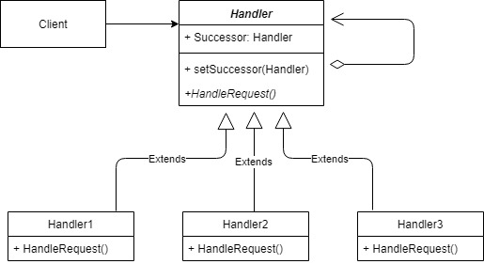
Chain of Responsibilities
Intent
Avoid coupling the sender of a request to its receiver by giving more than one object a chance to handle the request. Chain the receiving objects and pass the request along the chain until an object handles it.

Slide 7
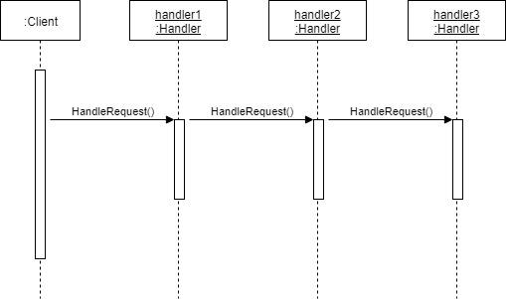
Sequence Diagram

Slide 8
Logger Class
public abstract class Logger
{
protected LogLevel level;
// The next Handler in the chain
protected Logger next;
public Logger(LogLevel mask)
{
this.level = mask;
}
/// <summary>
/// Sets the Next logger to make a list/chain of Handlers.
/// </summary>
public Logger SetNext(Logger nextlogger)
{
next = nextlogger;
return nextlogger;
}

Slide 9
Logger Class continued…
public void Message(string msg, LogLevel severity)
{
if ((severity & level) != 0)//True only if all logMask bits are set in severity
{
WriteMessage(msg);
}
if (next != null)
{
next.Message(msg, severity);
}
}
abstract protected void WriteMessage(string msg);
}

Slide 10
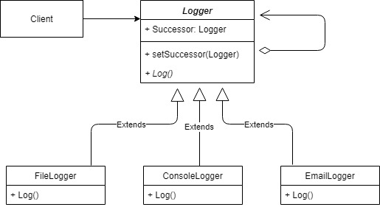
Final Class Structure for Logger Module

Slide 11
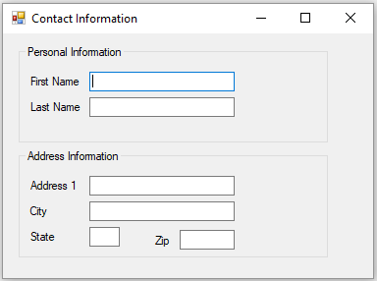
Event Bubbling
In designing software that uses a set of GUI elements. There is often a need to propagate GUI events from one object to another.
Event bubbling is the propagation of an event where the event first triggers on the innermost target element, and then successively triggers on the ancestors (parents) of the target element in the same nesting hierarchy till it reaches the outermost element.
Name should accept alphabets as input
Zip should accept numeric input
This form should display alphabets in Upper Case

Slide 12
Event Bubbling continued….
public partial class Form1 : Form
{
public Form1()
{
InitializeComponent();
}
private void Form1_Keypress(object sender, KeyPressEventArgs e)
{
e.KeyChar = (e.KeyChar.ToString()).ToUpper().ToCharArray()[0];
}
private void TextBox1_Keypress(object sender, KeyPressEventArgs e)
{
e.Handled = !char.IsLetter(e.KeyChar);
}
private void TextBox6_KeyPress(object sender, KeyPressEventArgs e)
{
if (!char.IsControl(e.KeyChar) && !char.IsDigit(e.KeyChar))
{
e.Handled = true;
}
}
}

