Slide 1
CRLT-DD: Condense and Rebalance Long-Tailed Dataset with Dataset Distillation Group: A Teammates: Keya Hu & Yijin Guo

Slide 2
Introduction

Slide 3
Introduction
Contributions
- For the first time to our knowledge, we utilize the method of dataset distillation to rebalance long-tailed datasets and prove that dataset distillation is an effective way to alleviate the long-tailed problem.
- Our method shows great potential in that it can maintain good training results on long-tailed datasets while effectively reducing the size of the datasets.
- We propose the combination of self-supervised learning with dataset distillation, which may become a new pattern for pre-training with further study.

Slide 4
Related Work

Slide 5
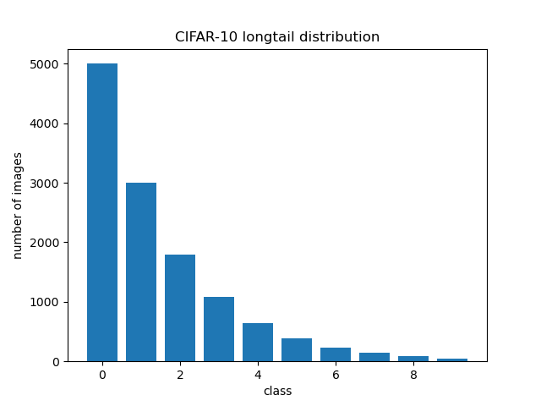
Related Work
Deep Long-Tailed Classification
This imbalanced data distribution tends to bias classification tasks towards predicting the head data, affecting the accuracy of the larger proportion of tail data.
head
tail

Slide 6
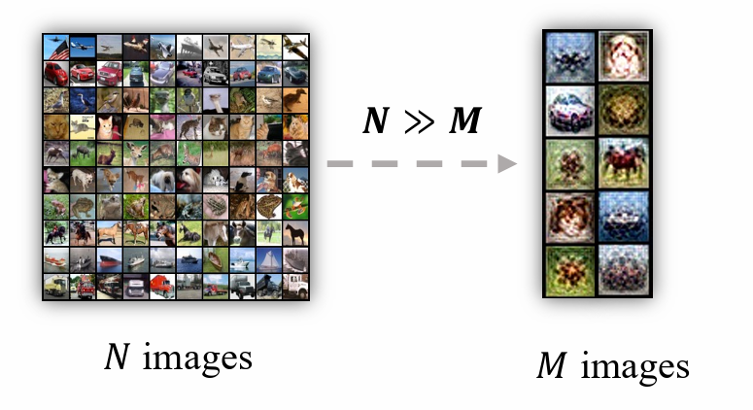
Related Work
Dataset Distillation
Original Data
Large datasets
Synthesize Data
Smaller datasets with high information density.
Reserving model performance
https://arxiv.org/pdf/2301.07014.pdf?ref=blog.roboflow.com

Slide 7
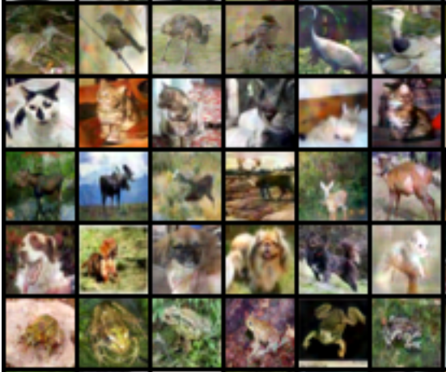
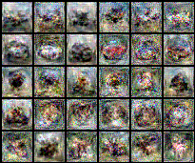
Related Work
Dataset Distillation
Initialize by real images
Initialize by noise

Slide 8
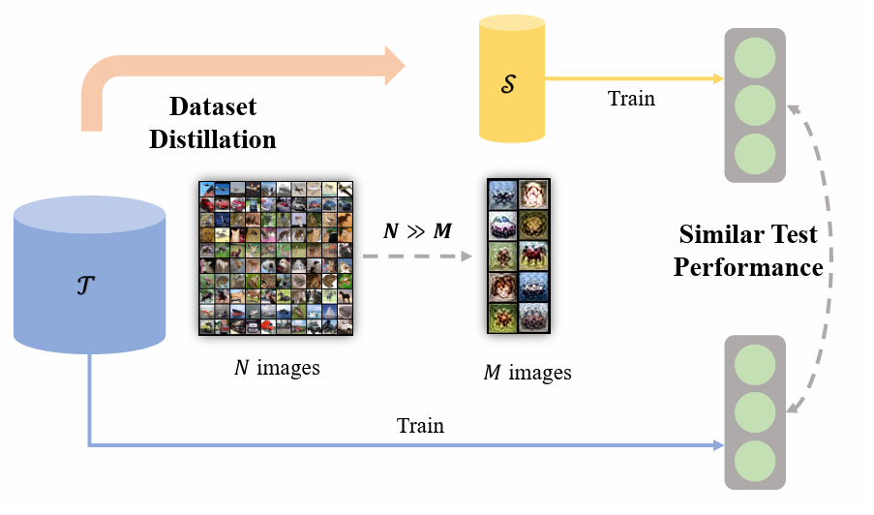
Related Work
Dataset Distillation
Performance Matching
Optimize a synthetic dataset such that neural networks trained on it could have the lowest loss on the original dataset
Thus the performance of models trained by synthetic and real dataset is matched
https://arxiv.org/pdf/2301.07014.pdf?ref=blog.roboflow.com

Slide 9
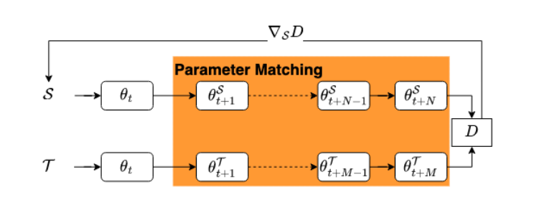
Related Work
Dataset Distillation
Gradient Matching
Train the same network using synthetic datasets and original datasets for some steps, respectively
Encourage the consistency of their trained neural parameters
https://arxiv.org/pdf/2305.01975.pdf

Slide 10
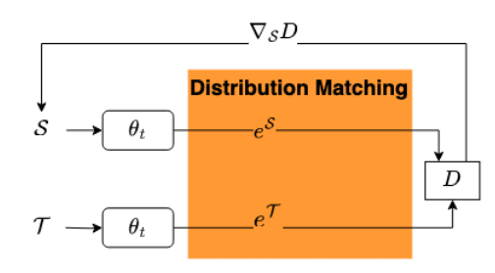
Related Work
Dataset Distillation
Distrubution Matching
Obtain synthetic data whose distribution can approximate that of real data
https://arxiv.org/pdf/2305.01975.pdf

Slide 11
Method

Slide 12
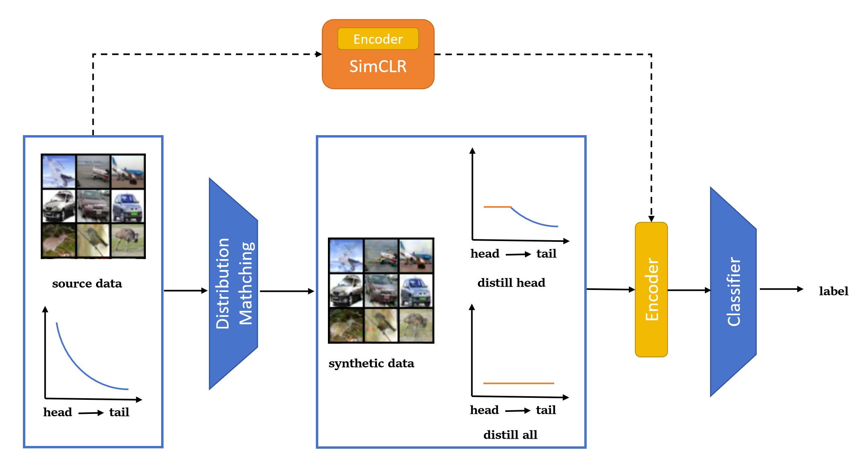
Method
An overview of CRLT-DD

Slide 13
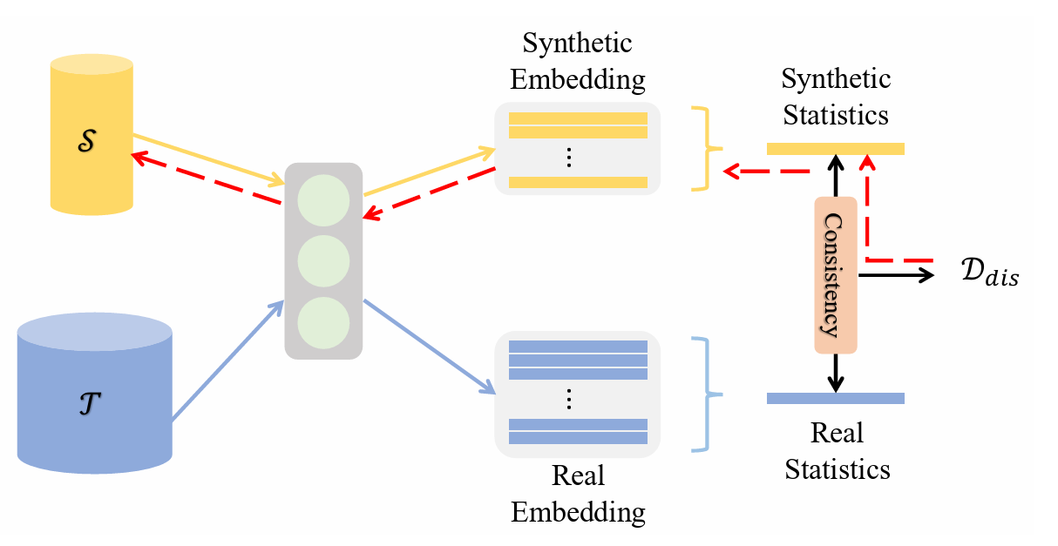
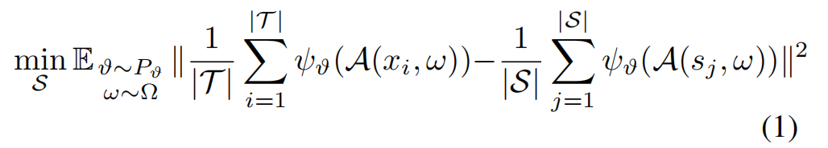
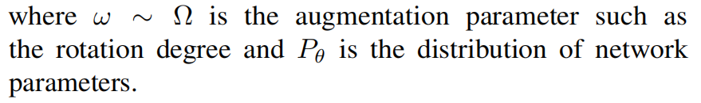

Method
Dataset Distillation with Distribution Matching
Loss Function
https://arxiv.org/pdf/2301.07014.pdf?ref=blog.roboflow.com

Slide 14
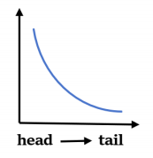
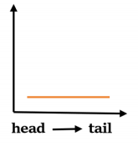

Method
Rebalance Long-Tailed Dataset
Distill All Classes Into Same Size
Compressing all data to the size of the smallest class

Slide 15
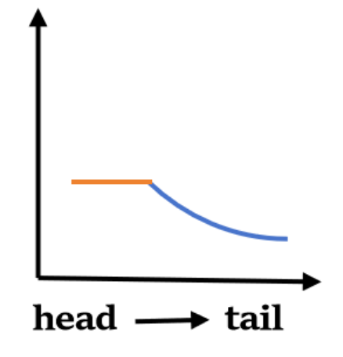
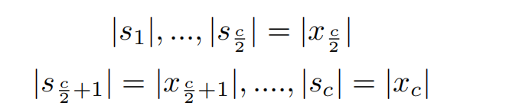
Method
Rebalance Long-Tailed Dataset
Distill Head Classes Into Same Size
Compressing the larger half of classes to the median size among all classes.
Remaining half of the data unchanged
Concatenate the distilled head data and unchanged tail data for training.

Slide 16
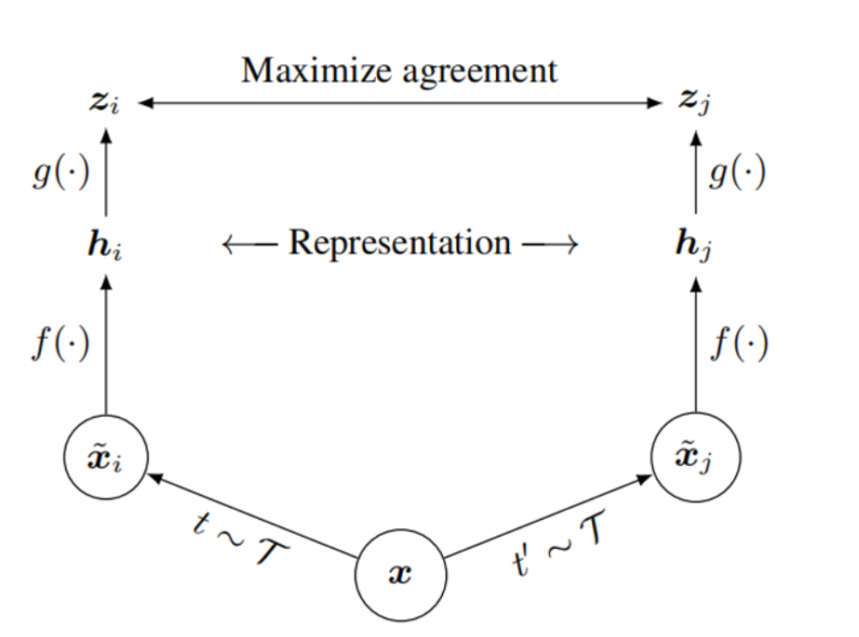
Method
Self-supervised Learning for Better Classification
We attempt the self-supervised method utilizing contrastive learning, specifically the SimCLR.
The encoder will be fine-tuned during the training process of classification tasks.
https://arxiv.org/pdf/2002.05709.pdf

Slide 17
Experiment

Slide 18
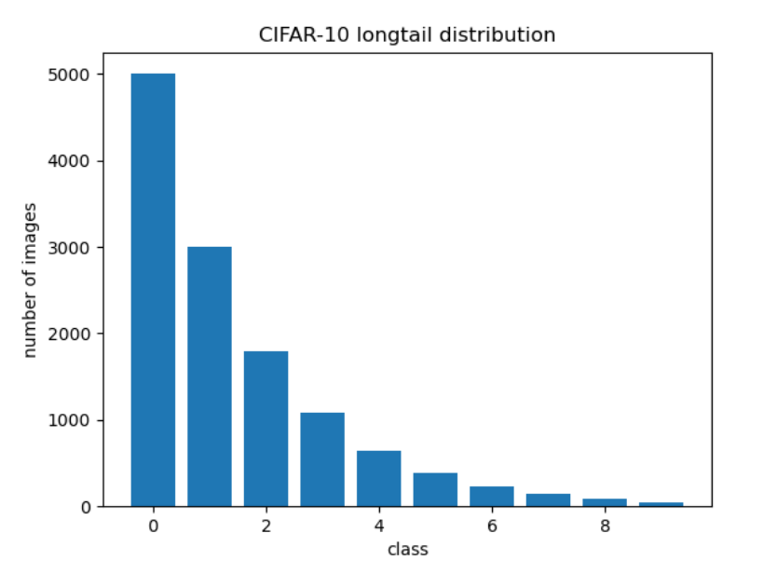


Experiment
Set up
Datasets. CIFAR10_LT, CIFAR100_LT

Slide 19
Experiment
Set up
Evaluation protocol.
In all the experiments, we repeat the procedures including distilling, training and testing for 3 times and average the results.
We also repeat the testing experiment five times in each procedure and take the average results to avoid large errors.

Slide 20
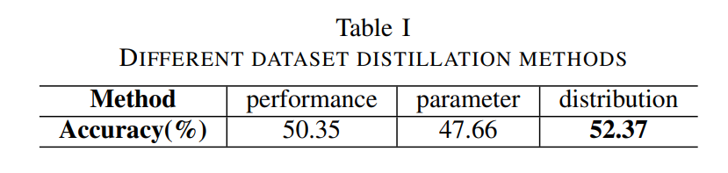
Experiment
1. Different Dataset Distillation Methods

Slide 21
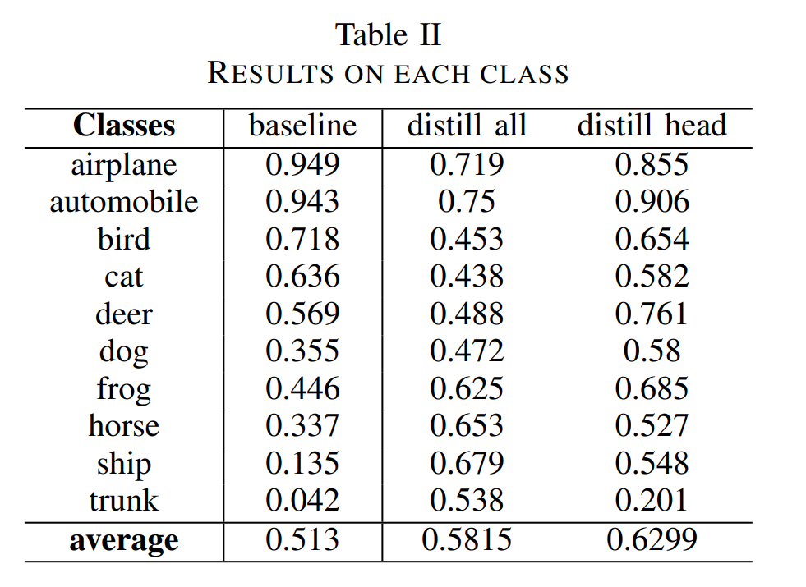
Experiment
2. Results on each class

Slide 22
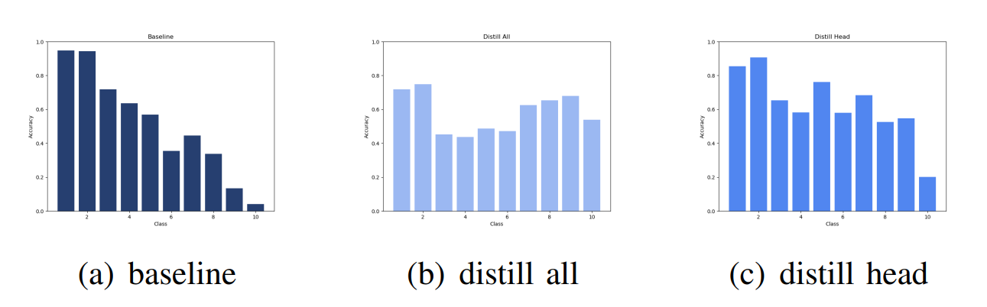
Experiment
2. Results on each class

Slide 23
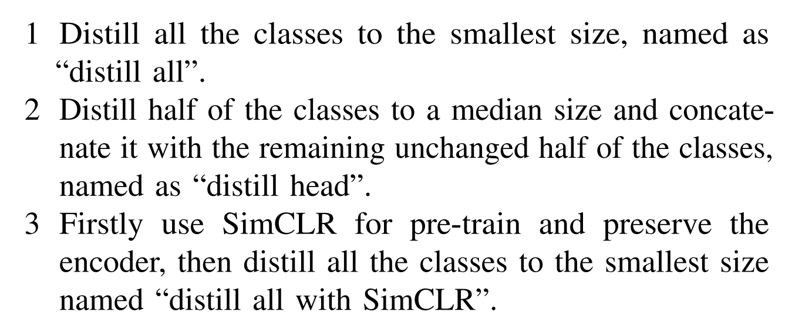
Experiment
3. More results and self-supervised

Slide 24
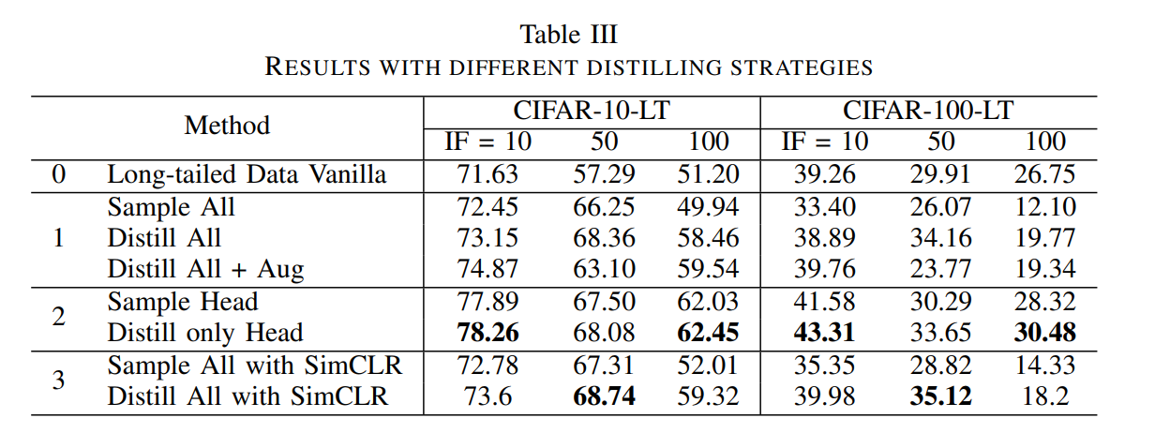
Experiment
3. More results and self-supervised

Slide 25
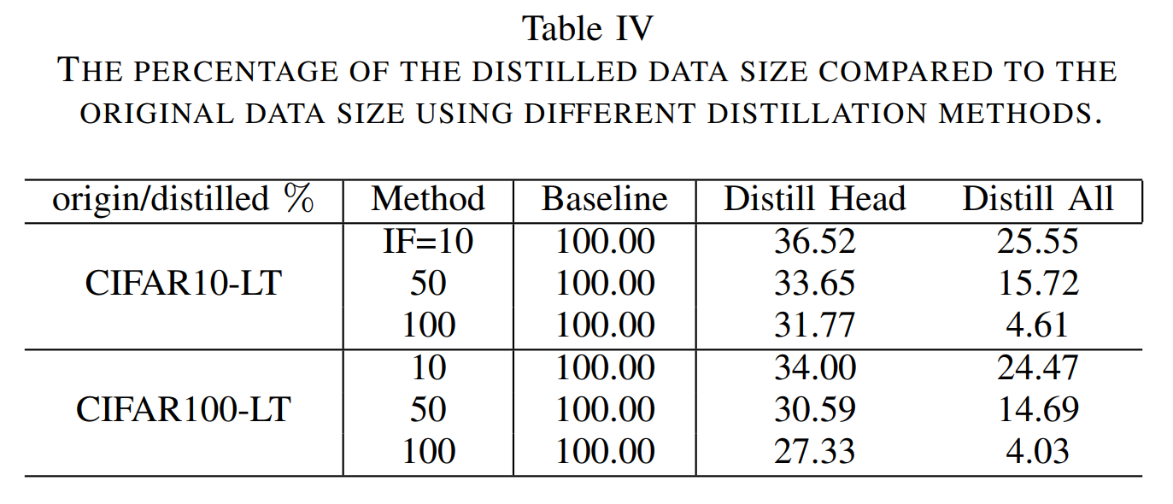
Experiment
3. More results and self-supervised

Slide 26
Future work

Slide 27
Future Work
Attempt a more refined approach to rebalancing the data
Experiment with altering the number of classes distilled in the head and the data size they are distilled into to achieve better classification results.
Attempt to validate our experiments on a larger dataset
When the dataset scales significantly, the superiority of condensing and rebalancing
data can be more comprehensively demonstrated.
Try other self-supervised and data augmentation methods
There are many other self-supervised methods worth exploring.
Data augmentation methods are also good ways to balance long-tailed data

