Slide 1

XJTLU AI Coding Hackathon
Build anything with pure AI coding
Open theme · Open format · Real working result
Final Presentation: 9 April
Tonight: Q&A in D2001 · 6:30–8:30 PM
Notes:
[Sources] - User brief provided in chat for all event details. - Visual assets adapted from the uploaded XJTLU template master deck. [/Sources]

Slide 2
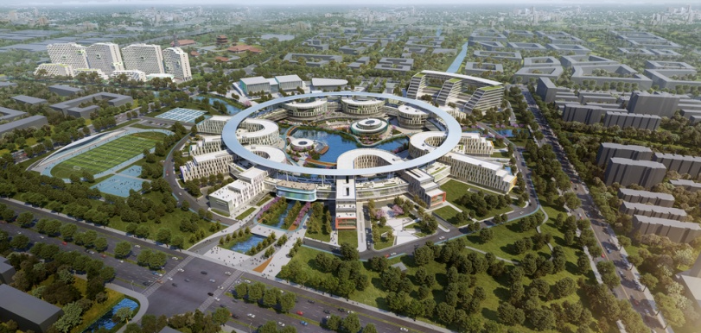
Challenge Brief
Hackathon Overview
Use AI coding to turn an idea
into something people can see, test, or experience.
Any topic is welcome — apps, tools, games, automations, agents, websites, utilities, experiments, or something completely unexpected.
Open theme
No restriction on subject area or use case.
Open format
Software, prototype, workflow, product concept, or interactive demo.
Notes:
[Sources] - User brief provided in chat for all event details. - Visual assets adapted from the uploaded XJTLU template master deck. [/Sources]

Slide 3

Rules & Team Setup
Participation Requirements
Build
Team
Deliver
AI-first
4–5
Present
Your project must be created with pure AI coding. Make the AI workflow central to the way you build.
Each group must have at least 4 members and no more than 5 members.
Show the result on presentation day and explain what you built with AI coding.
Tip: Start simple, ship something real, and make your AI-coding process easy for judges to understand.
Notes:
[Sources] - User brief provided in chat for all event details. - Visual assets adapted from the uploaded XJTLU template master deck. [/Sources]

Slide 4
Timeline & Tonight's Q&A
Key Milestones
Tonight
Build Sprint
9 April
Q&A session
D2001 · 6:30–8:30 PM
Use AI coding to build
and refine your project
Final presentation
with live demo or walkthrough
Bring your questions, early ideas, and potential teammates to the Q&A session tonight.
D2001
6:30–8:30 PM
Notes:
[Sources] - User brief provided in chat for all event details. - Visual assets adapted from the uploaded XJTLU template master deck. [/Sources]

Slide 5
Judging Criteria
Suggested Weights
Use clear, balanced criteria so strong ideas and strong execution are both rewarded.
These weights are editable if the organizing team wants a different emphasis.
Innovation & problem fit
25%
How compelling is the idea, and does it solve a real need or create a meaningful experience?
Execution & completeness
25%
How polished, functional, and well delivered is the final build or prototype?
Depth of AI coding
20%
How clearly did the team use AI coding as the main way to design, build, debug, and iterate?
Impact & demo clarity
20%
How easy is it to understand the value, workflow, and result during the presentation?
Teamwork & presentation
10%
How effectively does the group communicate, divide work, and present the project together?
Notes:
[Sources] - User brief provided in chat for all event details. - Visual assets adapted from the uploaded XJTLU template master deck. [/Sources]

Slide 6
Awards & Final Reminder
First Prize
Second Prize
Third Prize
Present your project on 9 April.
Make the demo clear, concise, and memorable.
Good luck — and see you tonight in D2001.
Notes:
[Sources] - User brief provided in chat for all event details. - Visual assets adapted from the uploaded XJTLU template master deck. [/Sources]

