Slide 1



Restoring Negative Information in
Few-Shot Object Detection
Yukuan Yang¹, Fangyun Wei², Miaojing Shi³, Guoqi Li¹
yyk17@mails.tsinghua.edu.cn fawe@microsoft.com miaojing.shi@kcl.ac.uk liguoqi@mail.tsinghua.edu.cn
¹ Tsinghua University ² Microsoft Research Asia ³ King's College London
34th Conference on Neural Information Processing Systems (NeurIPS 2020), Vancouver, Canada.

Slide 2
Outline
A Brief Introduction of Few-shot Learning
Representative approaches for Few-shot Object Detection
Our approach: Restoring Negative Information in Few-shot Object Detection
Notes:
This is an outline of today’s presentation.

Slide 3



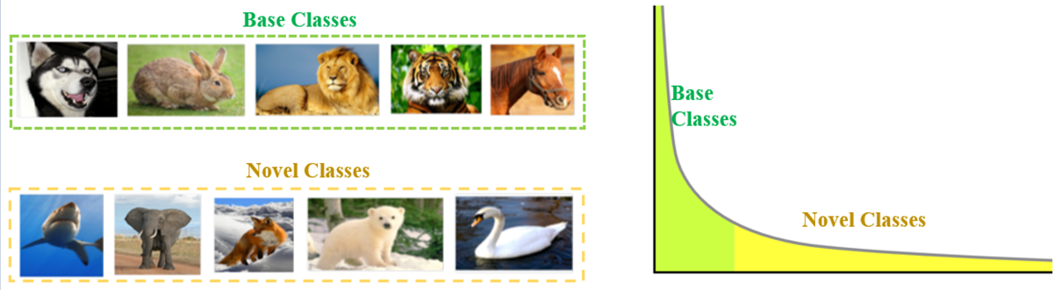
Few-shot Learning
Machine Learning VS Human Learning:
Machine: learning from many samples
Human: learning from few samples
See
Few-shot Learning:
Using prior knowledge, Few-shot Learning can rapidly generalize to new tasks containing only a few samples with supervised information
Base classes: sufficient samples and labels
Novel classes: limited samples and labels
New task: visual recognition (classification, detection, segmentation, etc.) on novel classes
Recognize
Sample number
Category
Notes:
Firstly I want to compare the current machine learning and human learning. As we all know, current machine learning models are all relied on large-scale data training. While human can learn new tasks rapidly with very few samples. A typical example for this can be seen as the right figure. One kid can recognize one person from crowds with a single image. Even the person has different hair color. While it’s a very hard task for machine learning. Inspired by human learning, few-shot learning is proposed. It aims to generalize to new tasks by using only a few samples with supervised information.

Slide 4
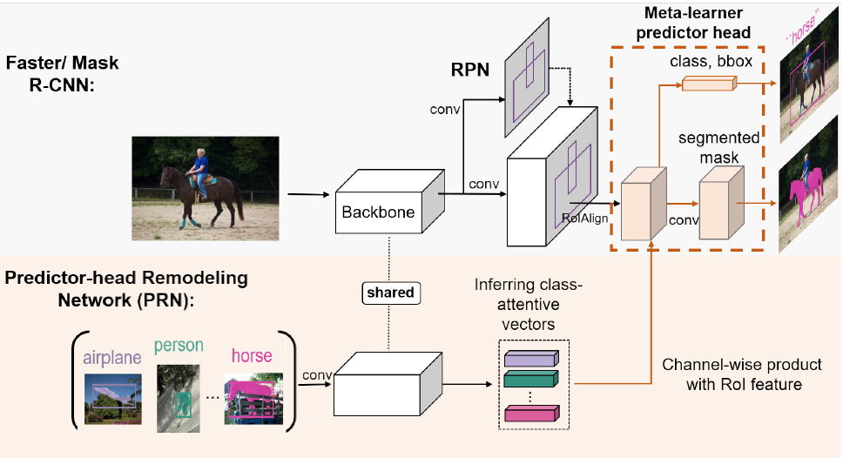
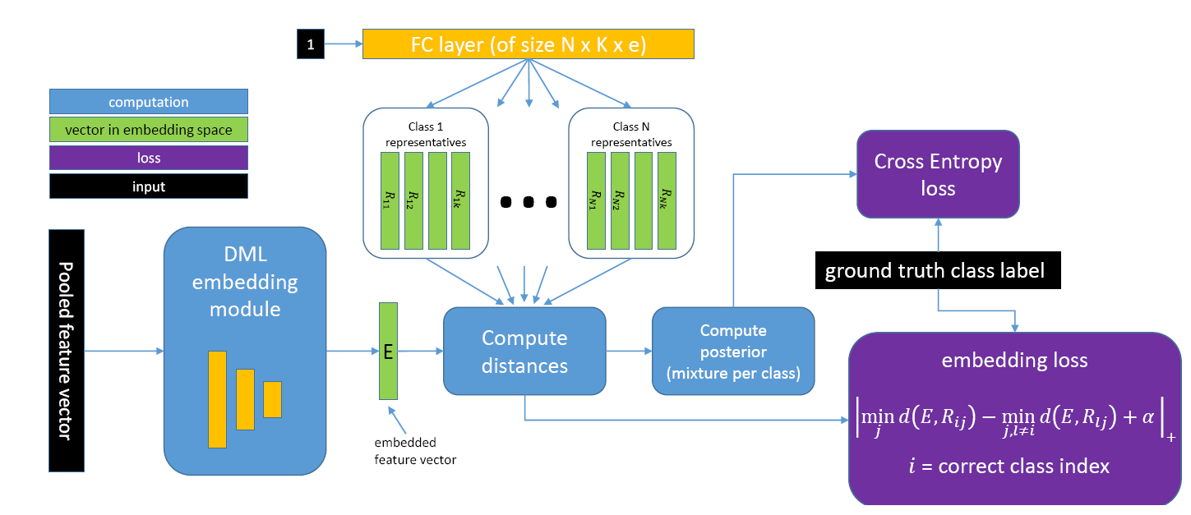
Few-shot Object Detection
Representative Approaches:
Positive information
Positive information
Meta R-CNN [CVPR2019]
RepMet [CVPR2019]
Positive (foreground) information is extracted and utilized from support images.
Negative information in support images is ignored in few-shot object detection.
Notes:
Few-shot learning was first used in classification tasks. Nowadays, few-shot learning starts to be used in more complex object detection task. Meta RCNN and RepMet try to use positive information obtained from the support set of novel classes for few-shot object detection. However, they all ignored the negative information and the performance has reached a ceiling.

Slide 5
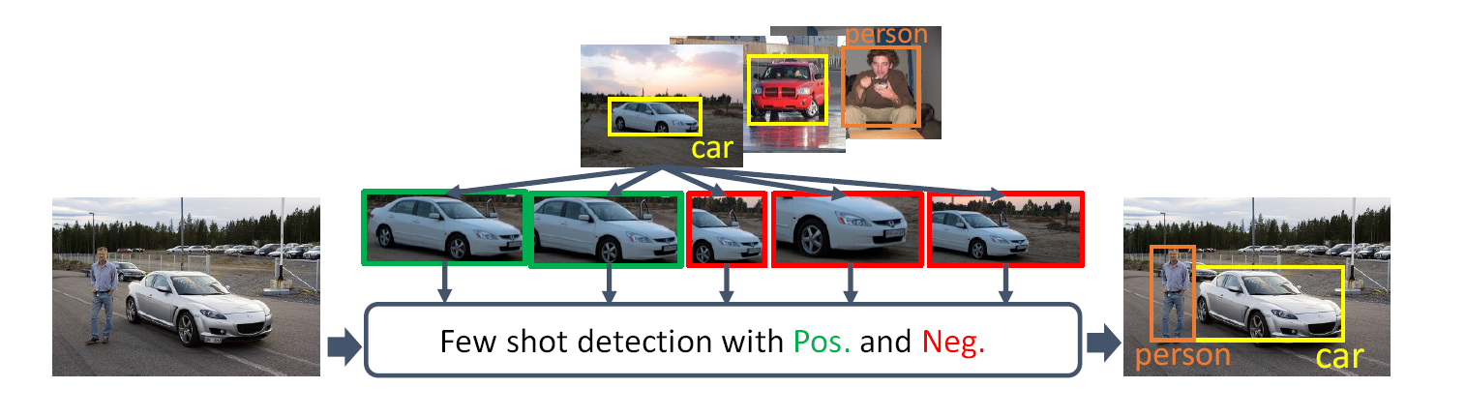
Our approach
Restoring Negative Information in Few-shot Object Detection：
The information obtained from the few samples for novel classes is very limited.
Motivation: Utilize both positive and negative information for better few-shot detection performance.
Information classification standard according to IoU:
Positive information: Proposals with IoU > 0.7
Negative information: Proposals with 0.2< IoU <0.3
Our method
Traditional methods
Notes:
Based on this, we try to restore negative information in few-shot object detection. As shown in the bottom figure, the bounding box containing the whole or most of the car is considered as positive information and the bounding box containing part of the car is used as the negative information. We distinguish positive and negative information according to the IoU and we try to utilize both positive and negative information for better few-shot detection performance.

Slide 6
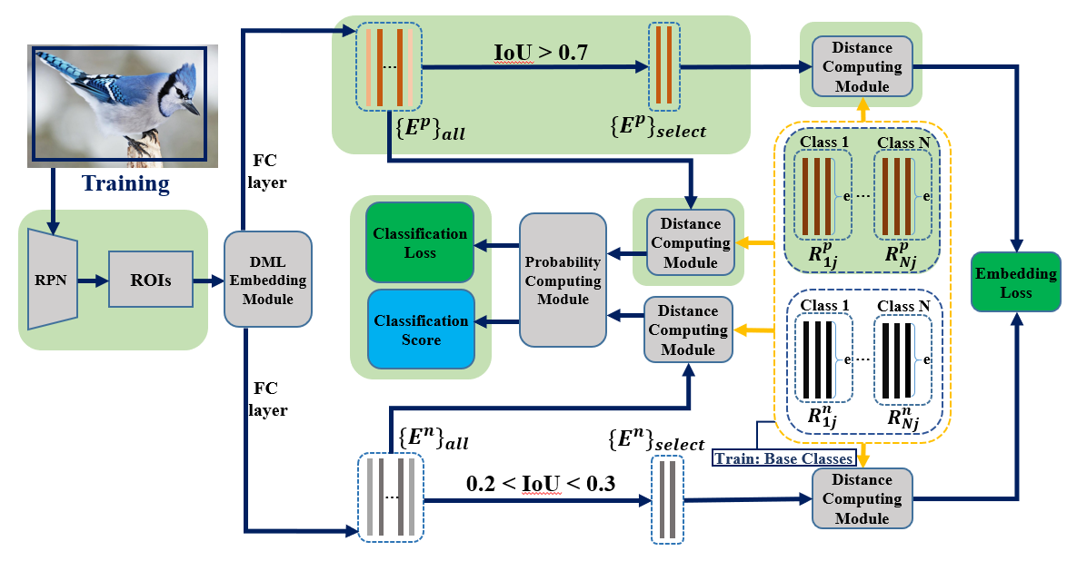
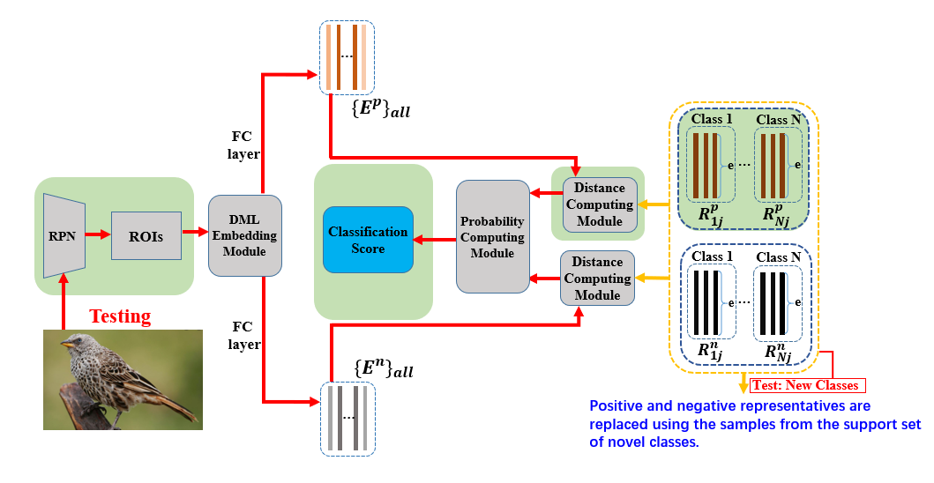
Framework
Negative- and Positive-Representative based Metric Learning (NP-RepMet)
Based on Faster R-CNN and RepMet [CVPR2019]
Adding new modules (green) for negative representatives
NP-RepMet Training
NP-RepMet Test
Notes:
To realize this idea, by adding embedding module, positive and negative representatives module to faster rcnn, we establish a NP-RepMet framework. In addition, we propose two different schemes for NP-RepMet training and test. The embedding loss is used to train the positive and negative representatives in the training process. And in the NP-RepMet test process, they are replaced by the features generated after the embedding module on the sample from the novel class support set.

Slide 7
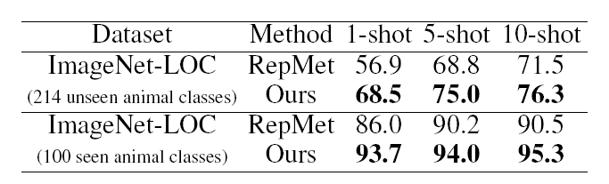
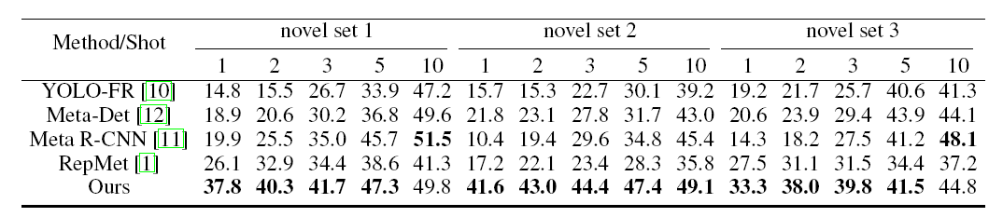
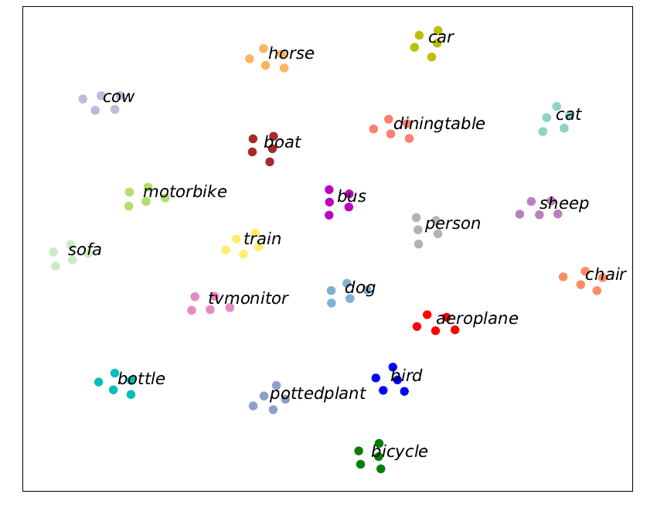
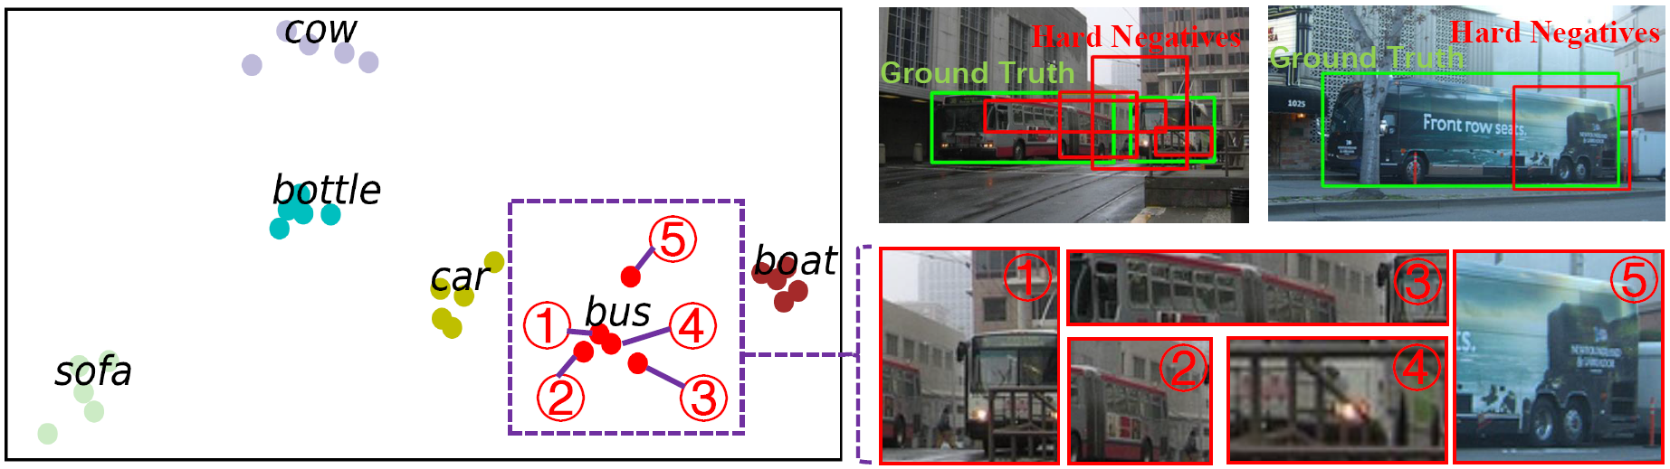
Experiments Results
Restoring Negative Information in Few-shot Object Detection：
ImageNet-LOC:
11.6% mAP Improvement in 5-way 1-shot detection
Pascal VOC:
Up to 19.8% mAP Improvement in 5-way 1-shot detection
T-SNE visualization:
Positive representatives visualization
Negative representatives visualization and corresponding proposals
Notes:
Experiment results have shown the effectiveness of our approach. The results on ImageNet-LOC and Pascal VOC show that by restoring negative information, the mAP can be improved greatly in few-shot object detection. We also give the tsne visualization of the Positive and Negative representatives.

Slide 8
Thanks for your listening！
For more information, please refer to our paper.
Git code available in the paper.
Notes:
That’s all. Thanks for your listening！For more information， please refer to our paper.

