Slide 1
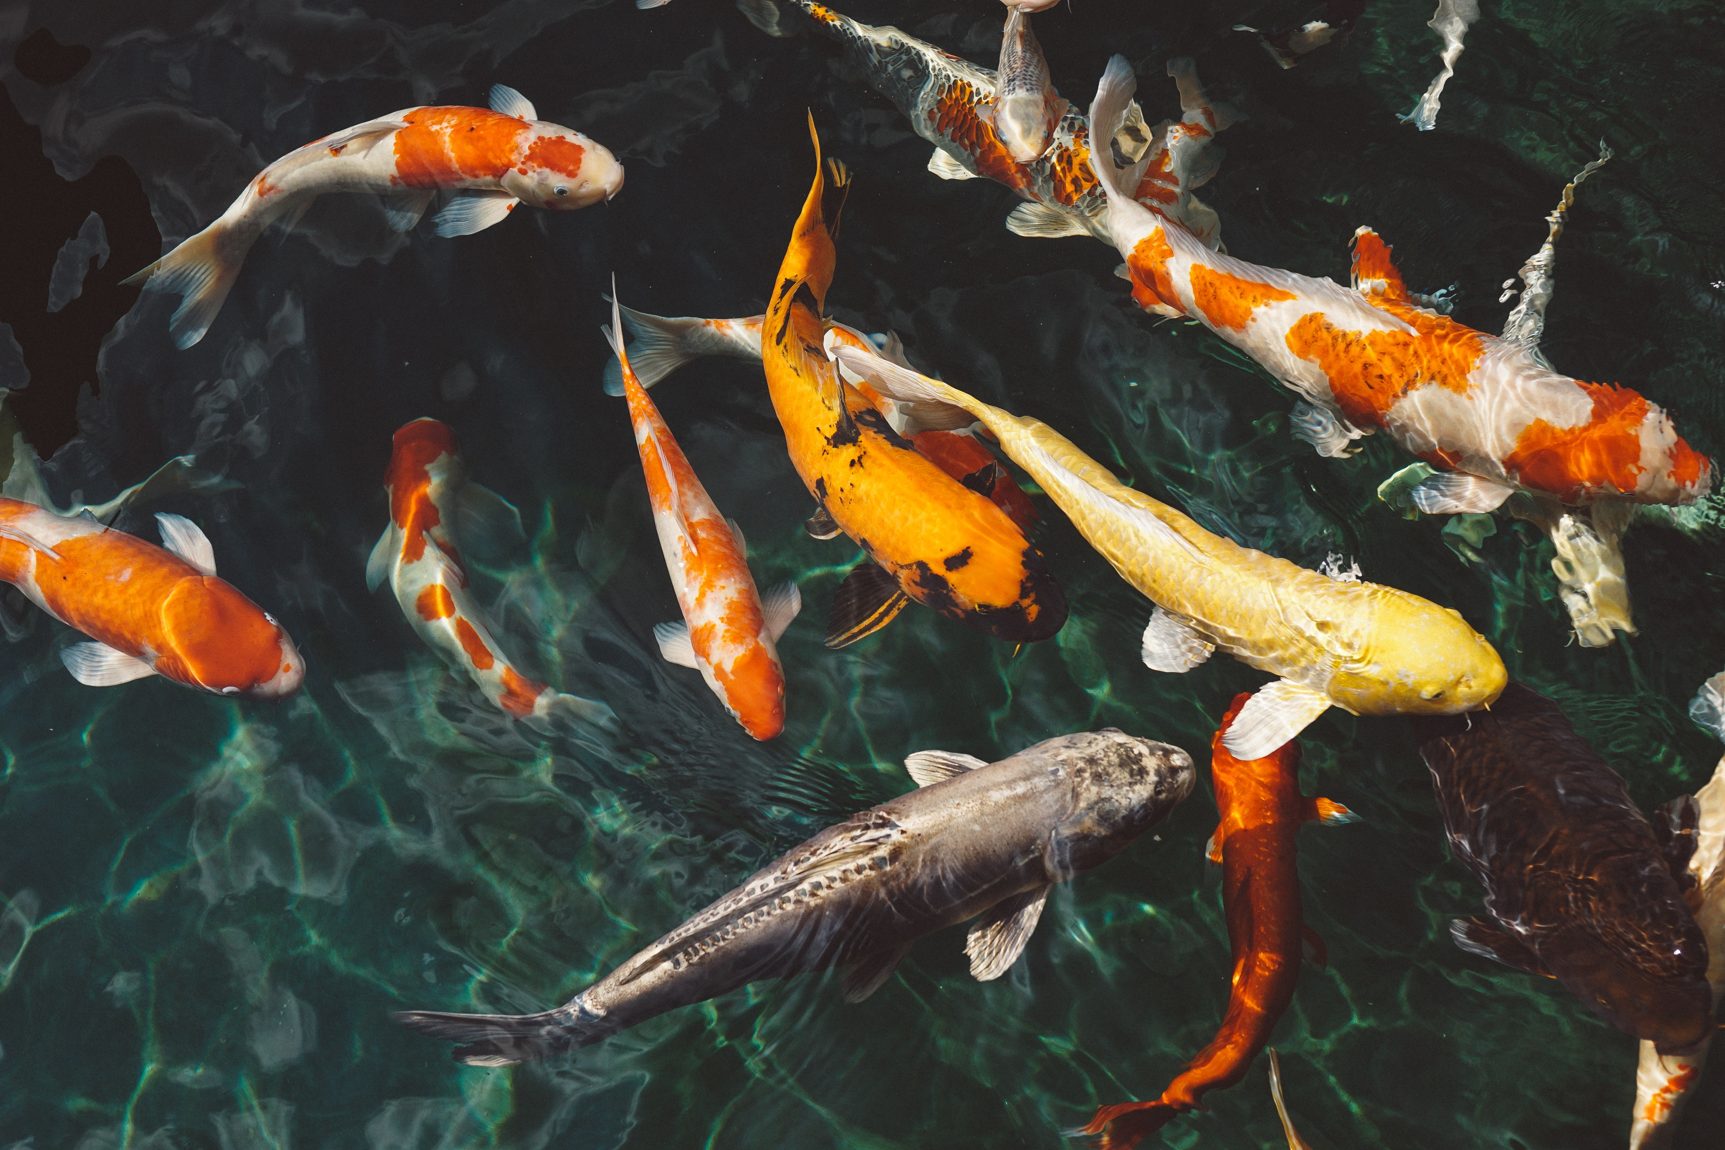
Fish Detection and Categorization
Group 5

Slide 2
Problem Statement
Given a dataset of fish images, the project aims to:
Design and develop an algorithm to detect and categorize different species of fish from images,
Count and present the count of each fish category of image
Design and develop an algorithm to track the motion of the fish in videos (for learning the behaviour of fish during high-speed water, spraying of fish food, and different food habitat conditions)

Slide 3
Motivation
The project aims to develop a computer vision system for accurate detection and categorization of fish species from images, finding the count of the species, and tracking their motion to analyze their behaviour, especially during high-speed water, serving as a tool for marine biologists and conservationists to monitor and study fish populations in various aquatic environments.

Slide 4
Challenges
Variability in Fish Appearance: Fish can vary significantly in size, shape, color, and texture, making it challenging to develop a robust detection and categorization algorithm.
Underwater Conditions: Our project will need to account for the unique challenges posed by imaging conditions, such as poor lighting, water distortion, and occlusions.
Fish Camouflage and Complex Backgrounds: Fishes often blend into their surroundings, making them hard to detect.
Subtle Variations Between Species: Some fish species look very similar to each other, making it difficult to classify them correctly.
Fish Deformation: Fish can change their shape while swimming, making it difficult to detect and classify them.
Injuries and Diseases: The project will need to account for the presence of injuries and diseases or anything of the sort that would result in the program being unable to recognize or identify the fish.

Slide 5
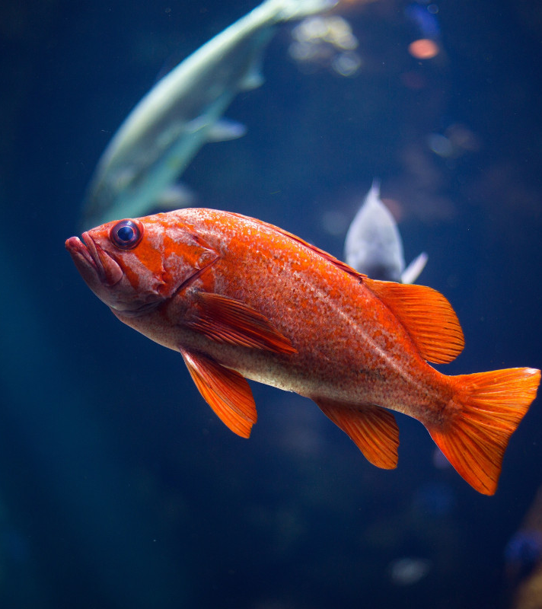
Dataset
Images Dataset¹:
This dataset contains 9 different seafood types collected from a supermarket in Izmir, Turkey for a university-industry collaboration project at Izmir University of Economics, and this work was published in ASYU 2020.
The dataset includes images of
gilt head bream, red sea bream, sea bass, red mullet, horse mackerel, black sea sprat, striped red mullet, trout, and shrimp.
Own dataset preparation and collection in progress.

Slide 6
Dataset Details
S.No. | Dataset Name | Resolution | Color | Image Format
1 | A Large-Scale Dataset for Fish Segmentation and Classification¹ | 590×445 | RGB, | .png

Slide 7
Literature Survey

Slide 8
A Large-Scale Dataset for Fish Segmentation and Classification
Aim | To create a large-scale dataset for fish segmentation and classification, and to analyze its usability with different feature extraction and classification methods.
Dataset Used | A dataset of nine different seafood types (eight fish species and shrimp) collected from a supermarket fish counter, with various displacements, angles, and lighting conditions. The dataset contains 1000 images per class, obtained by augmenting the original samples with rotation and reflection.
Models Used | SegNet for semantic segmentation, SVMs for feature-based classification, AlexNet for CNNs feature extraction.
Metrics Used | Jaccard similarity index for segmentation, accuracy for classification.
Proposed Methodoloy | The authors manually extracted the ground-truth segmentation masks of the seafood images, and then used SegNet to segment them automatically. They also extracted four types of features from the segmented images: GLCM, moments, BoF, and CNNsF. They fed these features to SVMs classifiers and compared their performance.
Conclusion | The authors found that SegNet achieved high segmentation accuracy rates (average of 98.01% for training and 88.69% for testing). For classification, they found that the GLCM contrast feature produced the best results (average of 98.74% for training and 97.64% for testing), followed by CNNsF (average of 97.81% for training and 93.25% for testing). They also observed that the concatenation of different features did not always improve the accuracy, and that BoF performed poorly compared to other features.
Future Scope | The authors stated that their dataset will be publicly available for further research in the field of seafood quality assessment. They also suggested that future work could explore other feature extraction and classification methods, as well as the detection of spoilage and diseases in different fish species.

Slide 9
A Novel Approach for Detection and Classification of Fish Species
Aim | To develop a novel approach for detection and classification of fish species using deep learning techniques, such as YOLO and SE-Net.
Dataset Used | A Kaggle dataset of 430 images belonging to nine different fish species, such as gilt head bream, trout, red sea bream, etc.
Models Used | YOLO for object detection and SE-Net for image classification, both trained and fine-tuned on the fish species dataset.
Metrics Used | Accuracy, loss, and confusion matrix to evaluate the performance of the models on the test set.
Proposed Methodoloy | The proposed approach consists of four steps: pre-processing, object detection, fish species classification, and post-processing. The input image or video frame is first pre-processed to correct for distortions and variations. Then, YOLO is used to detect and locate fish in the image/frame and output bounding boxes and class probabilities. Next, the region of interest around the detected fish is cropped and passed through SE-Net to classify the fish species. Finally, the post-processing step filters out low-confidence predictions and assigns a class label and localization information to each fish instance.
Conclusion | The proposed approach achieves an accuracy of 99.89% on the fish species dataset, outperforming the existing models by 6%. The proposed approach also demonstrates robustness to variations in the underwater environment and species similarity. The proposed approach can be used for monitoring and managing fish populations, as well as enhancing the understanding of fish behaviour and ecology.
Future Scope | The future work includes extending the proposed approach to more fish species and regions, as well as incorporating more environmental and contextual information to improve the classification results. Additionally, developing more efficient and lightweight models that can be deployed on resource-constrained platforms for real-time applications is also a direction for future research.

Slide 10
COMPUTER VISION BASED FISH TRACKING AND BEHAVIOUR DETECTION SYSTEM
Aim | To develop a computer vision-based decision support system for detecting abnormal behaviour patterns of Sillago-sihama fish in aquaculture systems.
Dataset Used | Nine video sequences of 10 seconds each, captured by a CCTV camera installed in an aquarium with Sillago-sihama fish. The ground truth for fish trajectories and behaviour patterns was manually annotated.
Models Used | A tracking by detection (TBD) model based on Histogram of Oriented Gradient (HOG) and Local Binary Patterns (LBP) features and Support Vector Machine (SVM) classifier, and a pattern analysis model based on Euclidean distance and thresholding.
Metrics Used | True positive rate (TPR), false positive rate (FPR), and equal error rate (EER) at the frame level.
Proposed Methodoloy | The TBD model detects and associates the fish in each frame using a sliding window approach and a linear sum assignment algorithm. The pattern analysis model identifies three abnormal behaviour patterns: swimming at the surface, frantic movement, and no movement, based on the temporal information of the fish trajectories.
Conclusion | The proposed system successfully detects the various fish behaviour patterns and can assist the fish farmers in improving productivity and avoiding commercial losses. The average ratio of misclassified frames is 28.34%, which can be further reduced by using deep networks.
Future Scope | The robustness of the system can be verified by performing exhaustive analysis on larger and more diverse datasets. The performance of the tracking algorithm can be improved by using stereo vision systems and reducing false positives. The system can be extended to detect other behaviour patterns and other fish species.

Slide 11
Underwater Fish Detection and Classification using Deep Learning
Aim | The aim of the research is to address the challenge of detecting and classifying underwater fish species using deep learning techniques.
Dataset Used | The Kaggle dataset, which includes images of nine different fish breeds, is utilized for the study.
Models Used | The MobileNet model is employed for the detection and recognition of fish breeds.
Metrics Used | Performance metrics such as accuracy (99.74%) and validation accuracy (99.78%) are used to evaluate the model.
Proposed Methodoloy | The methodology involves preprocessing the dataset, implementing the MobileNet model, training it for 30 epochs, and using image pre-processing and prediction techniques.
Conclusion | The trained Convolutional Neural Network, leveraging the MobileNet architecture, successfully detected nine different fish breeds with high accuracy and low loss.
Future Scope | Improving the model’s accuracy, extending it to more fish species, and enhancing its robustness to different underwater conditions.

Slide 12
Fish Detection and Classification for Automatic Sorting System with an Optimized YOLO Algorithm (Article)
Aim | To develop an automatic fish recognition system for the fish industry to improve productivity and address food scarcity concerns due to population growth and climate change.
Dataset Used | A custom dataset of eight cultivated fish species called “Ben-Cak” was compiled, including both static images and videos of fish on a conveyor belt at different speeds.
Models Used | YOLOv4 optimized with a unique labeling technique.
Metrics Used | Accuracy, precision, recall/sensitivity, specificity, and F-score, evaluated using a confusion matrix.
Proposed Methodoloy | The study employed YOLOv4, optimized with a unique labeling technique, and conducted trials with various schemes to determine their effectiveness12. The method was tested with real videos of fish on a conveyor.
Conclusion | The proposed method achieved an accuracy of 98.15% in detecting and classifying moving fish on a conveyor, indicating high potential for practical application in the fish sorting industry.
Future Scope | Future developments include optimization studies by modifying the YOLOv4 or YOLOv4-Tiny algorithms, using higher versions of YOLO, or combining approaches with other classification algorithms or unsupervised learning. A tuning or inference method could be proposed to optimize accuracy further.

Slide 13
Computer Vision Models in Intelligent Aquaculture with Emphasis on Fish Detection and Behavior Analysis: A Review
Aim | The paper aims to review computer vision models for fish detection in intelligent aquaculture, with a focus on Fish Species Identification , Counting and Behavior Analysis
Dataset Used | Fish4-Knowledge :700,000Videos Fish4-Knowledge PartA:27,370 Images LCF-14: 1000 videos SeaCLEF2016: 20 videos and 20,000 images sample, 73 test videos
Models Used | The image acquisition system based on 2D and 3D for fish detection
Metrics Used | Not Mentioned
Proposed Methodoloy | Various fish detection techniques are categorized as appearance-based, motion-based, and deep learning, which can be employed for accurate fish detection .
Conclusion | Fish detection using computer vision faces challenges such as variations in illumination, low contrast, high noise, fish deformation, frequent occlusion, and dynamic background.
Future Scope | In Future sensors should be integrated into the system for real-time analysis of the data, as the sensor continuously monitors daily weather changes to more accurately understand fish feed behavior, which will be a pivotal step towards the development of automated feeding systems.

Slide 14
Fish species classification by color, texture and multi-class support vector machine using computer vision
Aim | This paper presents a novel method of classifying species of fish based on color and texture features and using a multi-class support vector machine (MSVM)
Dataset Used | The dataset comprises images of six common freshwater fish species captured using a Nokia N8-00 smartphone camera in different ponds of Tian Jing aquafarm during July and August of 2011, sent to the data acquisition system via MMS.
Models Used | ANOVA , SVM
Metrics Used | F-Value,T-value,Sensitivity,Accuracy,Overall Fin Identification Accuracy
Proposed Methodoloy | Initial Segmentation,Detection of Fish orientation and Fin Locations , Fin Segmentation, Fin Identification, Cutting Point Extraction
Conclusion | the experimentation and analysis conducted in various studies, it has been determined that utilizing statistical texture features and wavelet-based texture features in the HSV color space, particularly with the Bior4.4 wavelet filter, yields favorable results for fish species recognition.
Future Scope | improving silver carp classification, automating image selection, and further testing the proposed classification method.

Slide 15
Roll No. | Name | Email Id | Role
CB.EN.U4CSE21307 | Ashwini K | cb.en.u4cse21307@cb.students.amrita.edu | Dataset, Pattern Matching Canny and Sobel edge detection, smoothing, and blurring filters
CB.EN.U4CSE21309 | Darneshwar S | cb.en.u4cse21309@cb.students.amrita.edu | Detection Frei-chen operator and Zero Crossing Edge Detection for edge detection, Gabor filter
CB.EN.U4CSE21310 | Dhayanandh N | cb.en.u4cse21310@cb.students.amrita.edu | Tracking Prewitt and Laplacian of Gaussian for edge detection, Morphological operations
CB.EN.U4CSE21321 | J R Parthan | cb.en.u4cse21321@cb.students.amrita.edu | Pattern Matching
Github URL: https://github.com/CV-Org1/Fish_Detection_and_Categorization

