Slide 1
﻿Document Modeling with Gated Recurrent Neural Network for Sentiment Classification
Paper by Duyu Tang, Bing Qin, Ting Liu
Robin Kemminer, Timo Mechsner, Lukas Vollenkemper
Statistical Natural Language Processing
University of Bielefeld

Slide 2
Overview
The Problem
Architecture in the Paper
Data
Paper Results
Implementetion
Our Results
Discussion

Slide 3
The Problem
Given a piece of text, sentiment classification focuses on inferring the sentiment polarity of the text.
Positive / Negative: 1-5 stars
The task can be at Word/phrase level, sentence level, document level
The paper wants to build an end-to-end neural network approach for document level sentiment classification

Slide 4
Architecture
﻿The method is based on the principle of compositionality:
„The meaning of a longer expression depends on the meanings of its constituents.“ (Frege, 1892)
Modeling in multiple steps:
Words -> Word Embedding (Word2Vec, 200 dim)
Embeddings -> Sentence Representation (LSTM / Conv, 50 dim)
Sentence Representation -> Document Representation (GNN, 50 dim)

Slide 5
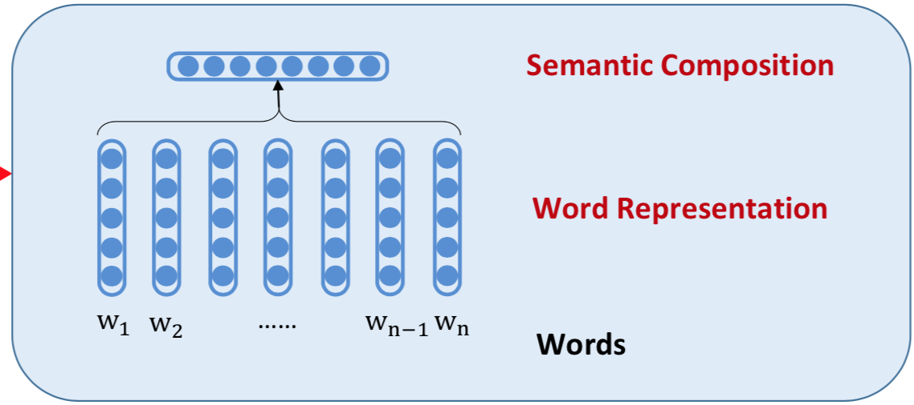
Architecture
We learn the word, sentence and document representation from data
Represent each word as a n-dimensional, real-valued vector
Word2Vec

Slide 6
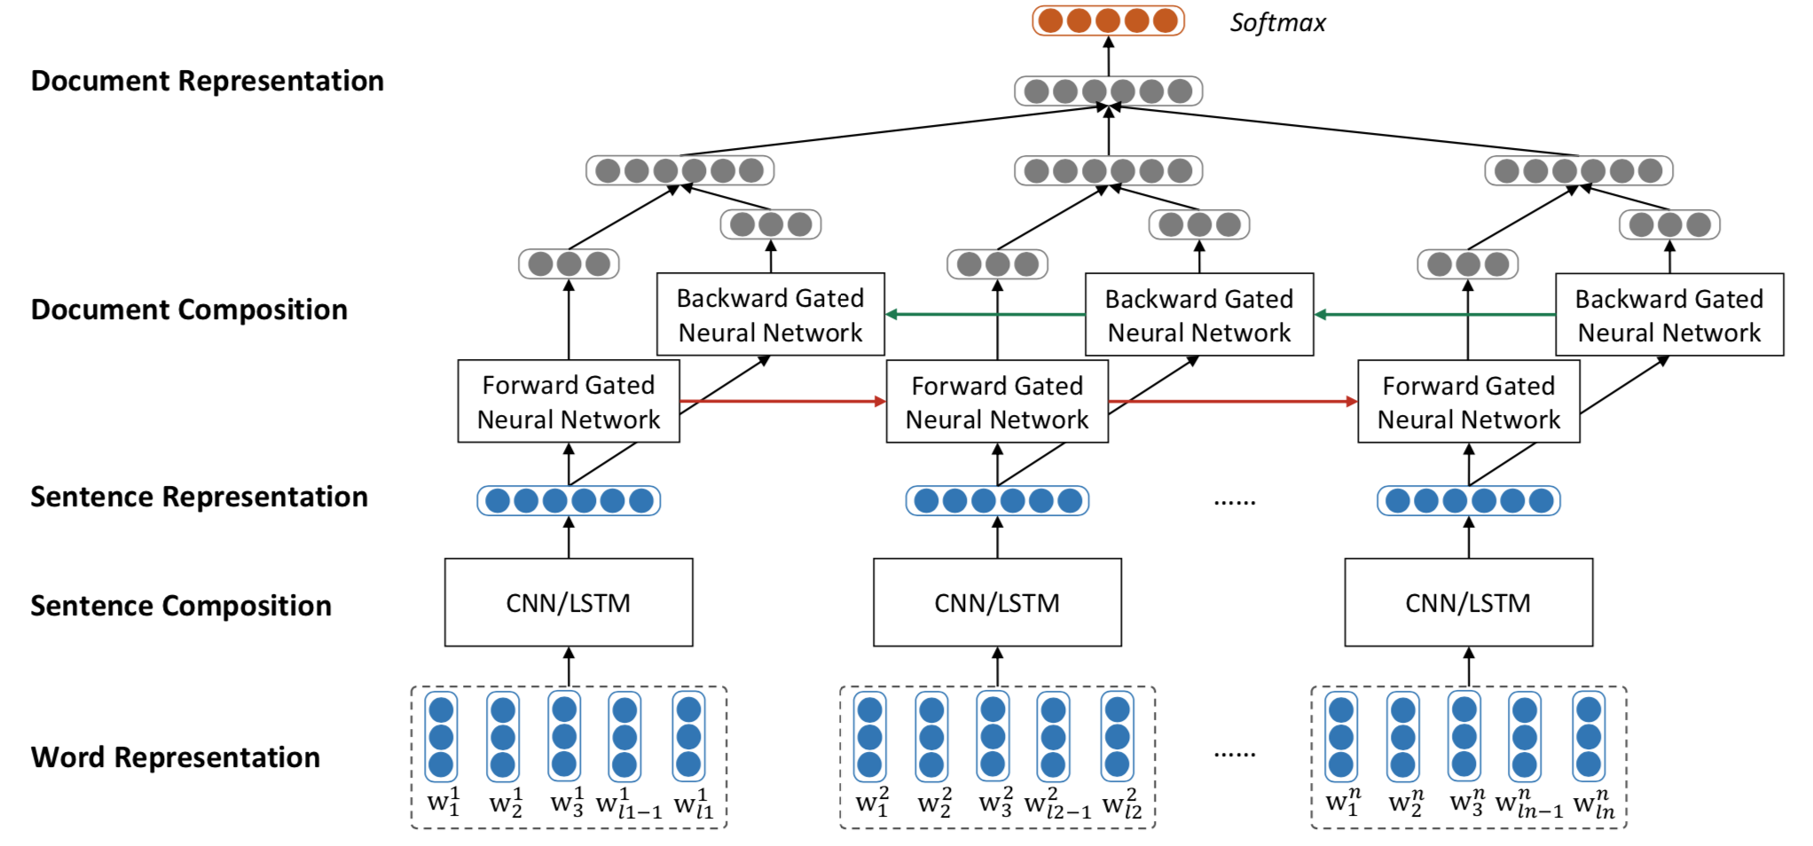
Architecture

Slide 7
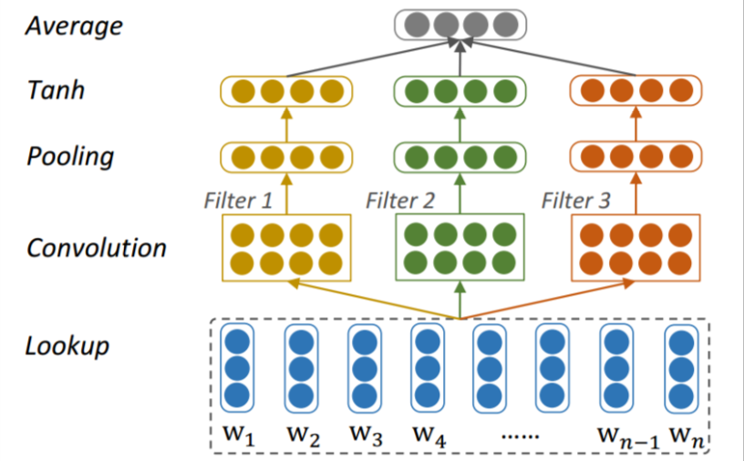
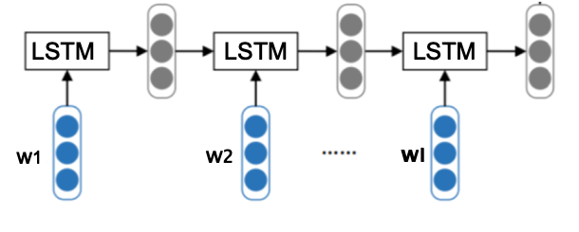
Architecture – Sentence Modeling
Alternative: LSTM instead of convolution
Conv filter widths: 1, 2, 3
Notes:
Conv: 1x50x33 -> Pooling: 1x50x1

Slide 8
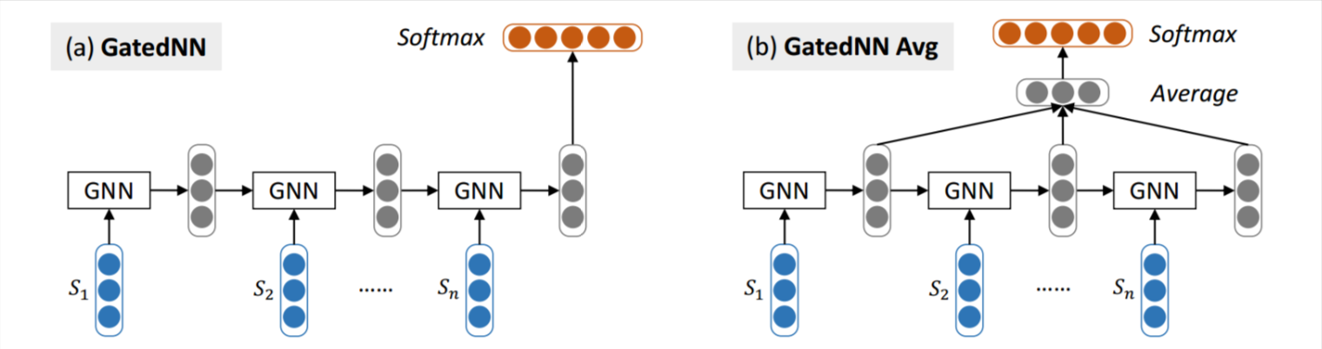
Architecture – Document Modeling

Slide 9
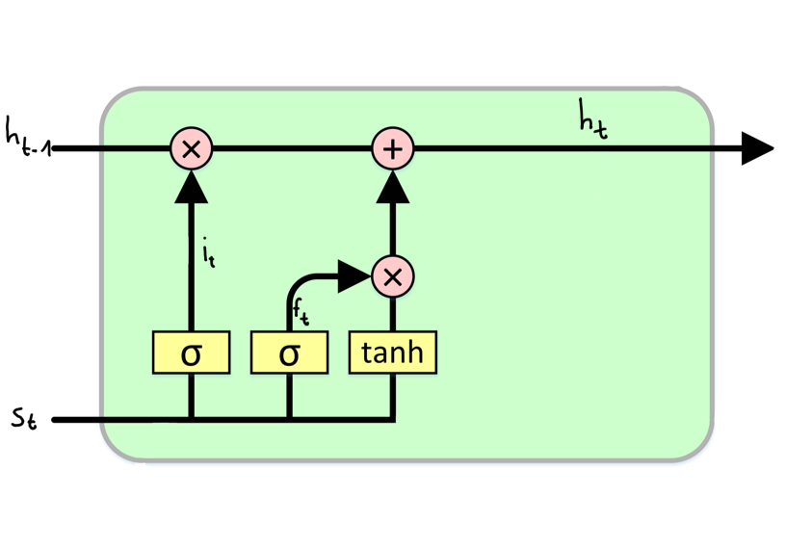
Architecture – GNN Cells
﻿GNN cells are similar to LSTM cells with the output gate always on
LSTM
GNN

Slide 10
Data
Corpus | #docs | #s/d | #w/d | |V| | #classes | Class Distr: 1 to 5(10) stars
Yelp 2013 | 335,018 | 8.90 | 151.6 | 211,245 | 5 | ﻿.09/.09/.14/.33/.36
Yelp 2014 | 1,125,457 | 9.22 | 156.9 | 476,191 | 5 | ﻿.10/.09/.15/.30/.36
Yelp 2015 | 1,569,264 | 8.97 | 151.9 | 612,636 | 5 | .﻿10/.09/.14/.30/.37
IMDB | 348,415 | 14.02 | 325.6 | 115,831 | 10 | ﻿.07/.04/.05/.05/.08/.11/.15/.17/.12/.18
Notes:
Column Meanings
Classes: Ratings 1-5 / 1-10
Unbalanced class distribution
Our Vocab size: 41,718

Slide 11
Paper Results
 | Accuracy
 | Yelp 2013 | Yelp 2014 | Yelp 2015 | IMDB
Majority | 0.356 | 0.361 | 0.369 | 0.179
Conv-GRNN (Bi) | 0.637 | 0.655 | 0.660 | 0.425
LSTM-GRNN (Bi) | 0.651 | 0.671 | 0.676 | 0.453
Conv-GRNN (fw) | 0.636 | 0.656 | 0.651 | 0.430
Conv-GRNN (avg) | 0.635 | 0.659 | 0.657 | 0.416

Slide 12
Implementation
Technology (PyTorch + Gensim)
Assumptions we had to make:
Batch size
LR decay und Momentum
Number of LSTM layers,
Hidden layer sizes (only conv output was given)
Word Embedding: Window Size, min count in corpus
Forward & Backward GNN Output is just a concatenation
We also added a linear lookup layer on the embedding instead of training the embedding
Notes:
Window Size and min_count 5

Slide 13
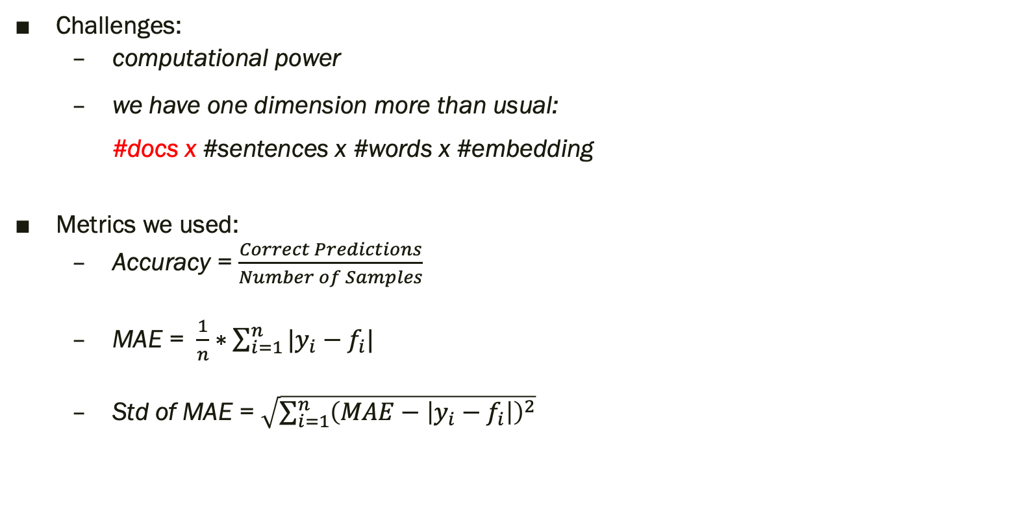
Implementation
Challenges:
computational power
we have one dimension more than usual: #docs x #sentences x #words x #embedding
Metrics we used:
Accuracy = $\frac{Correct Predictions}{Number of Samples}$
MAE = $\frac{1}{n}∗\sum_{i=1}^{n}{|y_{i}−f_{i}|}$
Std of MAE = $\sqrt{\sum_{i=1}^{n}{{\left(MAE−\left|y_{i}−f_{i}\right|\right)}^{2}}}$

Slide 14
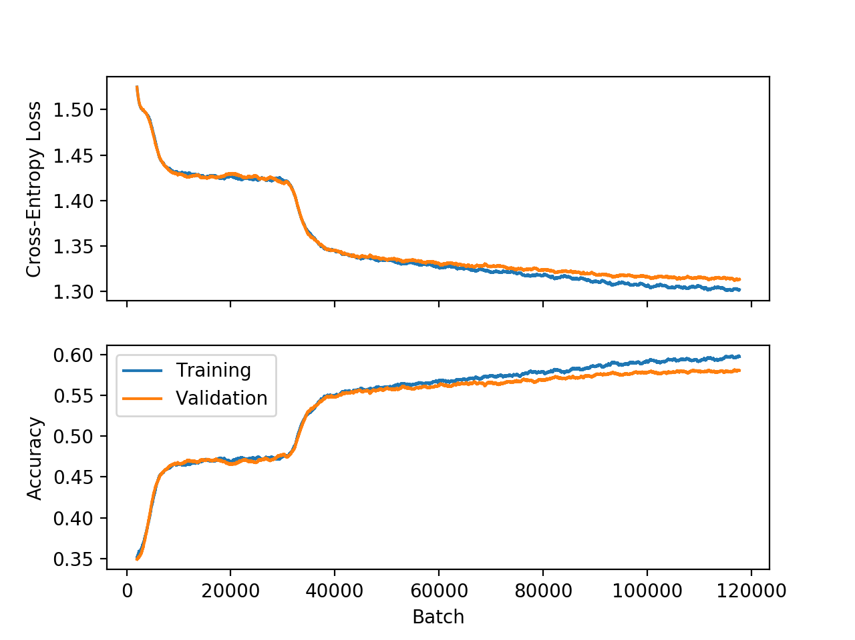
Results Conv Bi
Accuracy:
Our Result: 0.581
Paper: 0.637
Mean Absolute Error: 0.51
Absolute Error Std.: 0.715

Slide 15
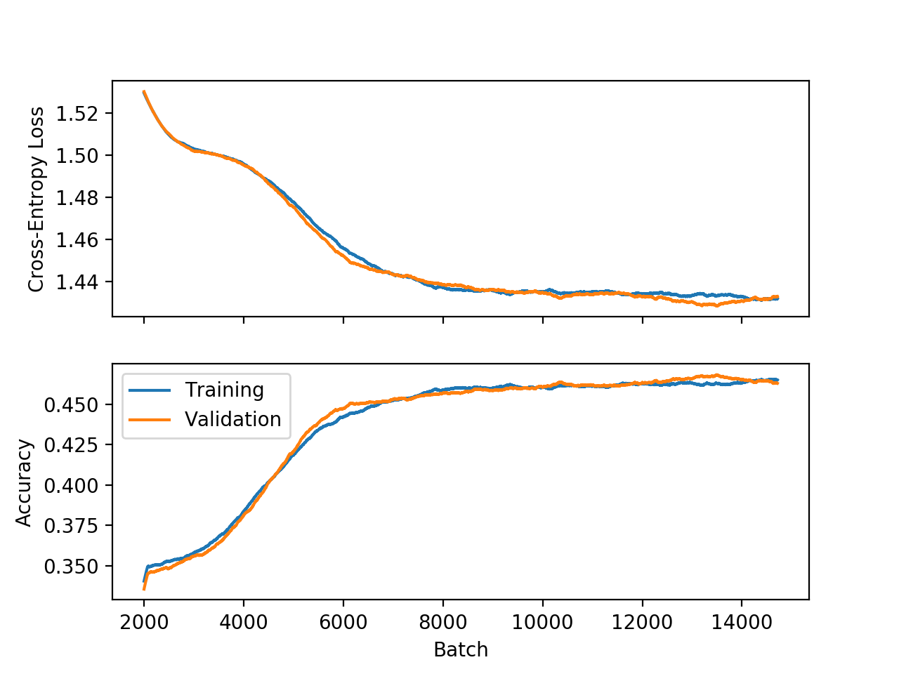
Results Conv Avg
Accuracy:
Our Result: 0.466
Paper: 0.635
Mean Absolute Error: 0.839
Absolute Error Std.: 1.023

Slide 16
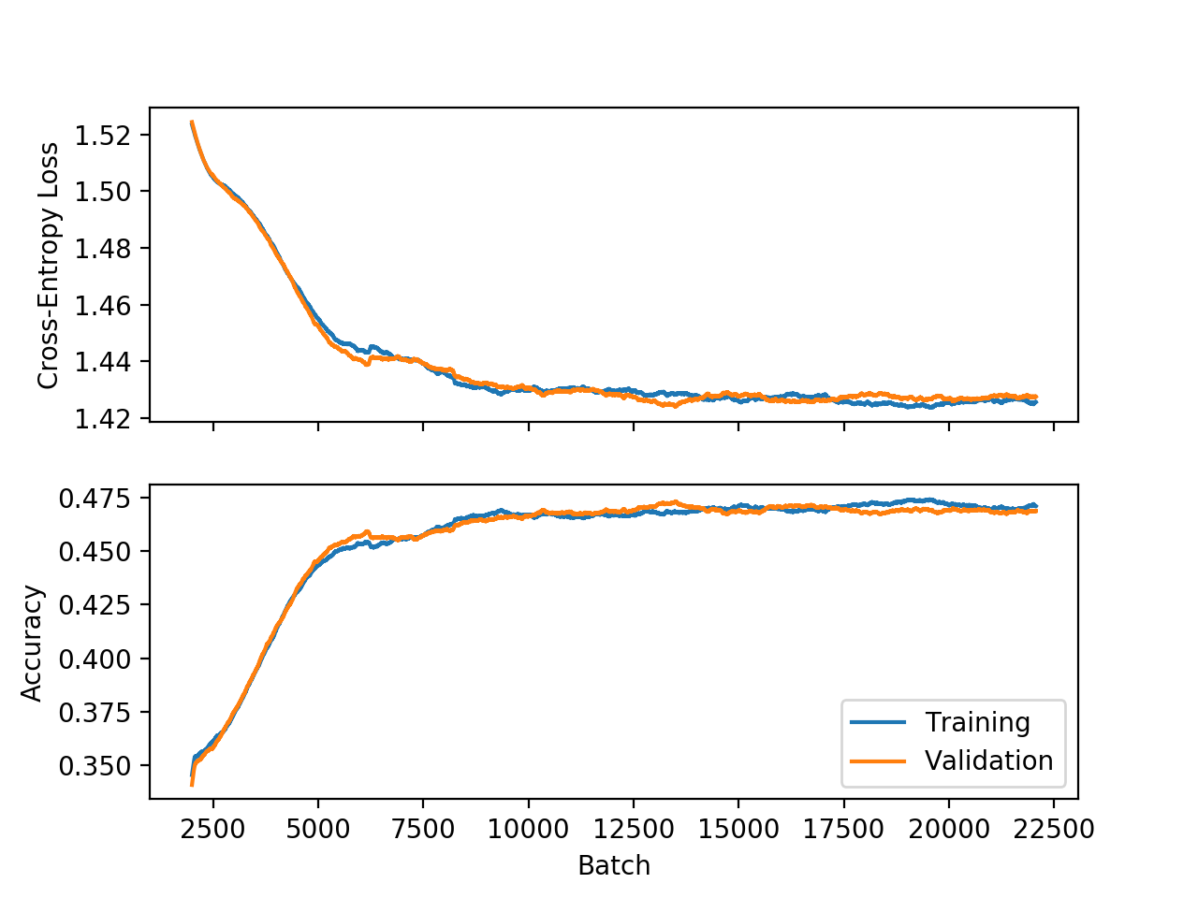
Results Conv Last
Accuracy:
Our Result: 0.470
Paper: 0.636
Mean Absolute Error: 0.837
Absolute Error Std.: 1.027

Slide 17
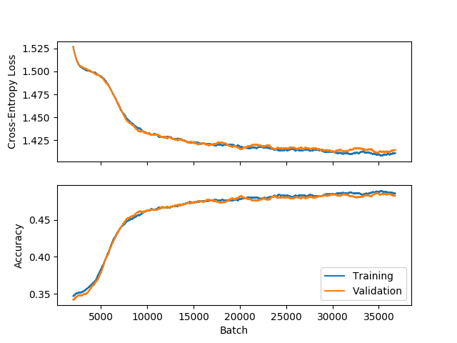
Results LSTM
Accuracy:
Our Result: 0.484
Paper: 0.651
Mean Absolute Error: 0.802
Absolute Error Std.: 0.999

Slide 18
Discussion
Why are our results worse?
Assumptions
Random init of the parameter and the train/test split
Limited ressources
Ideas
Regression instead of classification (the model doesn‘t know that class 1 is close to class 2)
Use only the last layer of forward and backward GNN for document modeling

