Slide 1
Web Programming
Project
By Veronica, Nino, Claudia, Edder and Azuka

Slide 2
Introduction
In this project we explore building a functional social media style web application using HTML, CSS, Java and Firebase. It demonstrates how these front-end technologies can work together to create interactive social pages.

Slide 3
Abstract
In this project our main goal was to implement a multi –page social media prototype web page that uses HTML for structures, CSS for styling & UI and Java script for interactions. Firebase is used by utilizing a cloud backend that manages the logging in of current users and registration of new users, using these tools to form a variant of the modern social media platforms we use today.

Slide 4
HTML Design
The HTML files we implemented define the structure of each page in the app by organizing content such as headers, images, buttons and navigation links
SocialMediaYapp.html = Main feed layout
Auth.html: login/register interface
Profile Pages for individual users
Semantic Tags used of organization

Slide 5
CSS Design
We used CSS to customize the overall layout, colors, and visual identity of the website. Stylesheets helped shape the user-interface, so the pages look consistent.
StyleC.css was the main styling file used for the home and explore feed pages
Styles.css & Edderstyles.css were additionally used for more custom themes

Slide 6
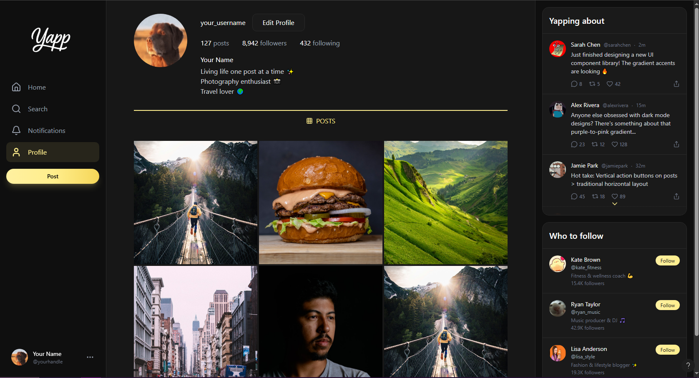
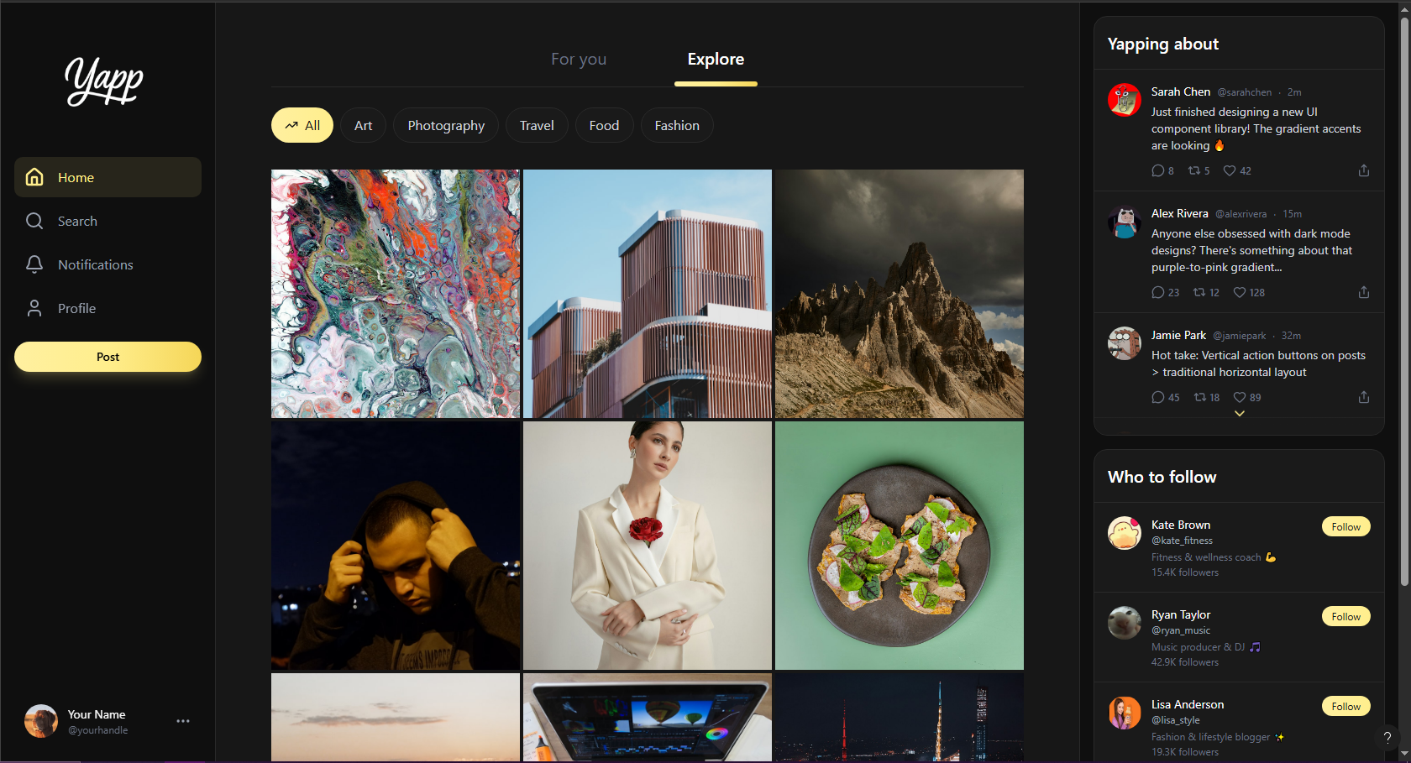
CSS Design Webpage
Explore Page
User Profile Page

Slide 7
JavaScript Design
Java was used to control dynamic features of the webpage and carry out the operations from Firebase. It enables validation, animations, and overall user interaction across the pages.
auth.js: Handles logins interactions such as login, log out and registration
firebase-init.js Connects to firebase
Scripts.js and collection.js: Manages the user interface

Slide 8
Database
For the database we used Firebase authentication to manage the confidential information of users securely. It acts as a backend identity service to keep the user's information safe.
Stores user credentials
Maintains session states
Allows logging in and logging out across pages
Allows for hosting of user information e.g. pictures

Slide 9
Hosting and Development
This site is developed as a client side-side web application utilizing firebase with backend features. All pages run in the browser using static files.
Firebase provides authentication
Stores media locally
Uses a lightweight front-end structure

Slide 10
Conclusion
This project demonstrates how web technologies can be combined to build fully functioning social media prototypes using HTML, Firebase, Java and CSS. The structure provides a solid foundation for further development.

Slide 11

Future Work
Future improvements that can be made in the future can include implementing databases for saved content, creating a responsive mobile design, expanding to more authentication methods and more enhancements to boost the overall user experience with the platform

Slide 12
References
Add
Them
Here

