Slide 1
Self sustained automated mango cultivation with remote monitoring
TEAM : CHITLURU VENKATA BHANU PRAKASH (S20200020255)
BTP Code : B23PB01
Mentor : Dr.Paul Braineard

Slide 2
Outline
Introduction
Literature review
Motivation
Objectives
Hardware Implementation
Conclusion
References

Slide 3
Introduction
The aim of this project is to develop an automated system for mango cultivation.
It is remotely monitored.
Energy Harvesting techniques can be implemented.
Solar, Piezoelectric etc.
Traditional Cultivation
No optimization in utilizing resources.
Huge labour and cost is involved.

Slide 4
Literature review
Reference 1: In this paper the author aims to develop a system to detect the soil moisture
using sensors and provide water to the plants appropriately.
Reference 2: This paper is about the modern techniques developed in the mango farming. Practices like High density farming and mulching are discussed in this journal.
Reference 3: The author discussed some basic points related to mango culture like soil and climate, season of planting, propagation, varieties, dwarfing, culture, spacing, irrigation, intercropping, manures and fertilizers, training and pruning, use of growth regulators, plant protection measures, harvest season, harvest and yield,
post harvest treatment.
Reference 4: This is an article about VNC viewer setup to run the python file.

Slide 5
Conclusions from literature review
The first reference only talks about the automatic irrigation of the field but there are some flaws like farmer not being able to observe the system remotely. I have taken this issue into our consideration and building a system which solves this problem.
Most of the farms don’t have proper network coverage. Hence I came up with the idea of using a LoRa device to transmit the data to the nearest node.

Slide 6
Conclusions from literature review
I have chosen 2 acres of land in hot semiarid region for our research. Hot Semiarid regions usually have :
1. Temperatures ranging from 12 to 48 degrees Celsius.
2. Humidity ranging from 20% to 55%(Rarely higher).
3. Soil moisture from 10% to 70%(When just watered).
I am using the DHT11 sensor which is suitable to measure the temperature(0-50 degrees Celsius range) and humidity(20% - 90% RH range).
The soil moisture sensor is also capable of working in the required ranges.

Slide 7
Objectives
To plant 45 trees per acre.
Moisture requirement is above 50%.
Assuming a spacing of 10 meters in x and y directions, it comes out to 49 trees in an acre.
That can be rounded off to 45 trees in an acre because the land probably won't be in a square form. Therefore 90 trees in 2 acres.
Coming to a middle ground of 230 liters per tree per day, we will need anywhere between 20kL to 22kL of water per day.
We need 5-30 HP water pump for the farm irrigation. But as this is a prototype, we are using a toy water pump for demonstration.
(An acre of land is 4046sqmetres. In a square form, this means each side is 63 meters long.)

Slide 8
Hardware Tools Used
DHT11 Sensor: Humidity and Temperature
Soil moisture sensor: soil moisture percentage
Relay : To control water pump
Water Pump
Arduino Uno
LoRa Tx
LoRa Rx
Raspberry Pi
LCD display

Slide 9
Software Tools Used
Arduino IDE
Putty
VNC Viewer
Advanced IP Scanner
Raspberry Pi Imager
Programming Languages
Embedded C
Python

Slide 10
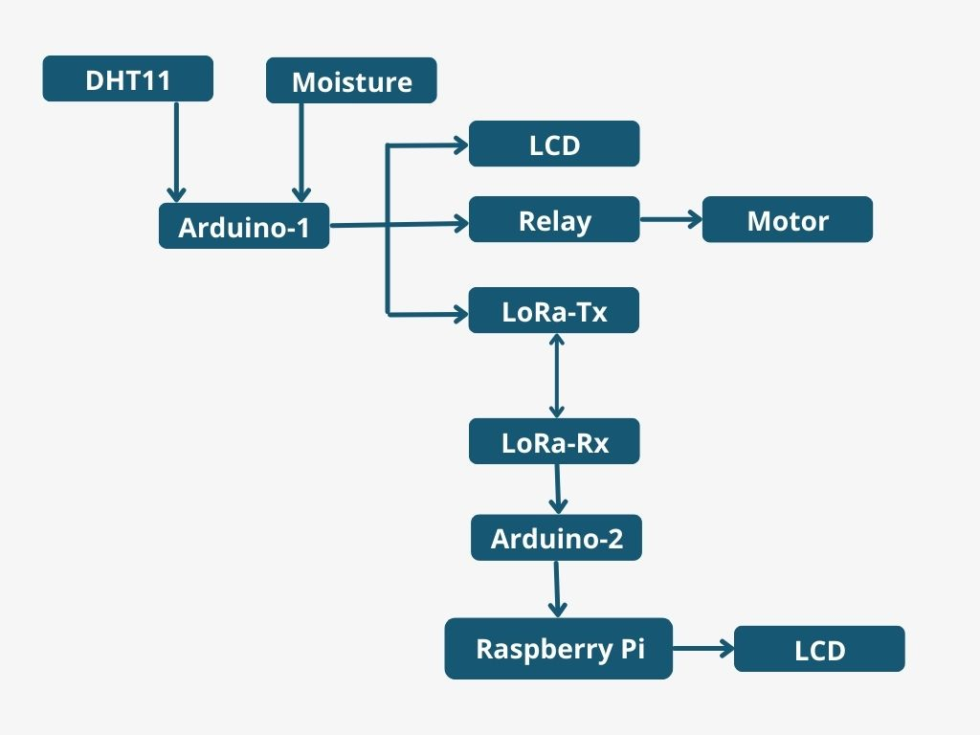

Block Diagram of automated cultivation
Collecting humidity, temperature from DHT11, and soil moisture from soil moisture sensor to Arduino Uno-1.
Arduino Uno-1 commands relay to turn on pump if moisture percentage is less than 50.
The readings will be send to LoRa Tx by using rf95 module.

Slide 11
Block Diagram of automated cultivation
The data will be sent to LoRa Rx at 868MHz.
The range is about 1km and 10kms if we use gateway.
Arduino Uno-2 will receive data from LoRa Tx and share with Raspberry Pi using USB serial communication.
Display the data in LCD which is connected to Raspberry Pi via I2C.

Slide 12
Conclusion
This project minimizes the manual intervention by the farmer in mango farm. This system will serve the following purposes:
The irrigation is done only when there is not enough moisture in the soil and the Arduino decide when the pump should be turned on/off.
Can monitor the mango farm anytime at the ease of his home.
Energy harvesting technique.

Slide 13
References
THILAGAVATHI, S., AISHWARYA RAJENDRAN, and K. PRIYADHARSHINI. "AUTOMATIC PLANT IRRIGATION SYSTEM." (2016). [Reference 1]
S.Parthiban & V.P.Santhi & M.S.Snehapriya & K.Indumathi & P. Masilamani. "Recent Advances in Enhancing the Productivity of Mango through Hi-tech Practices." (2020)[Reference 2]
Biswas, B., and Lalit Kumar. "Revolution of Mango production." Fertilizer Marketing News (2011): 1-24. [Reference 3]
Article about VNC-Connect-and-Raspberry-Pi [Reference 4]

Slide 14
THANK YOU

