Slide 1
ELECTRONIC PACKAGING PROJECT
GROUP – 19
C.V.BHANU PRAKASH – S20200020255
VIKAS CHELLURU – S20200020252

Slide 2
INTRODUCTION
We designed PCB Layout for FM Transmitter which is used to transmit desired radio frequencies for radio communication.
We optimized the size of PCB in several procedures and finally designed the double layered PCB.

Slide 3
MOTIVATION
We already did the Hardware circuit level implementation of an FM Transmitter on a bread board in the last semester’s FCOM course.
Thus we both formed a group and decided to work on same project as we are having basic knowledge on it’s working principles.
We are very much interested in designing the FM Transmitter in PCB level and explore the features of Eagle software.

Slide 4
PROCEDURE
From the Schematic we switch to board and start designing the layout.
Placing the components.
Routing
Vias
Holes
DRC check
Remove Errors
Generate GERBER files

Slide 5
WORK DONE SO FAR
We completed the Schematic part of the current project for mid evaluation.
Now we have completed the Layout part as well.
First we designed a single layered basic PCB layout.
We further reduced the size of PCB in four designs and resolved the errors by performing ERC(schematic) and DRC(board) checking.
For further reduction in size, we came up with double-layered PCB design.

Slide 6
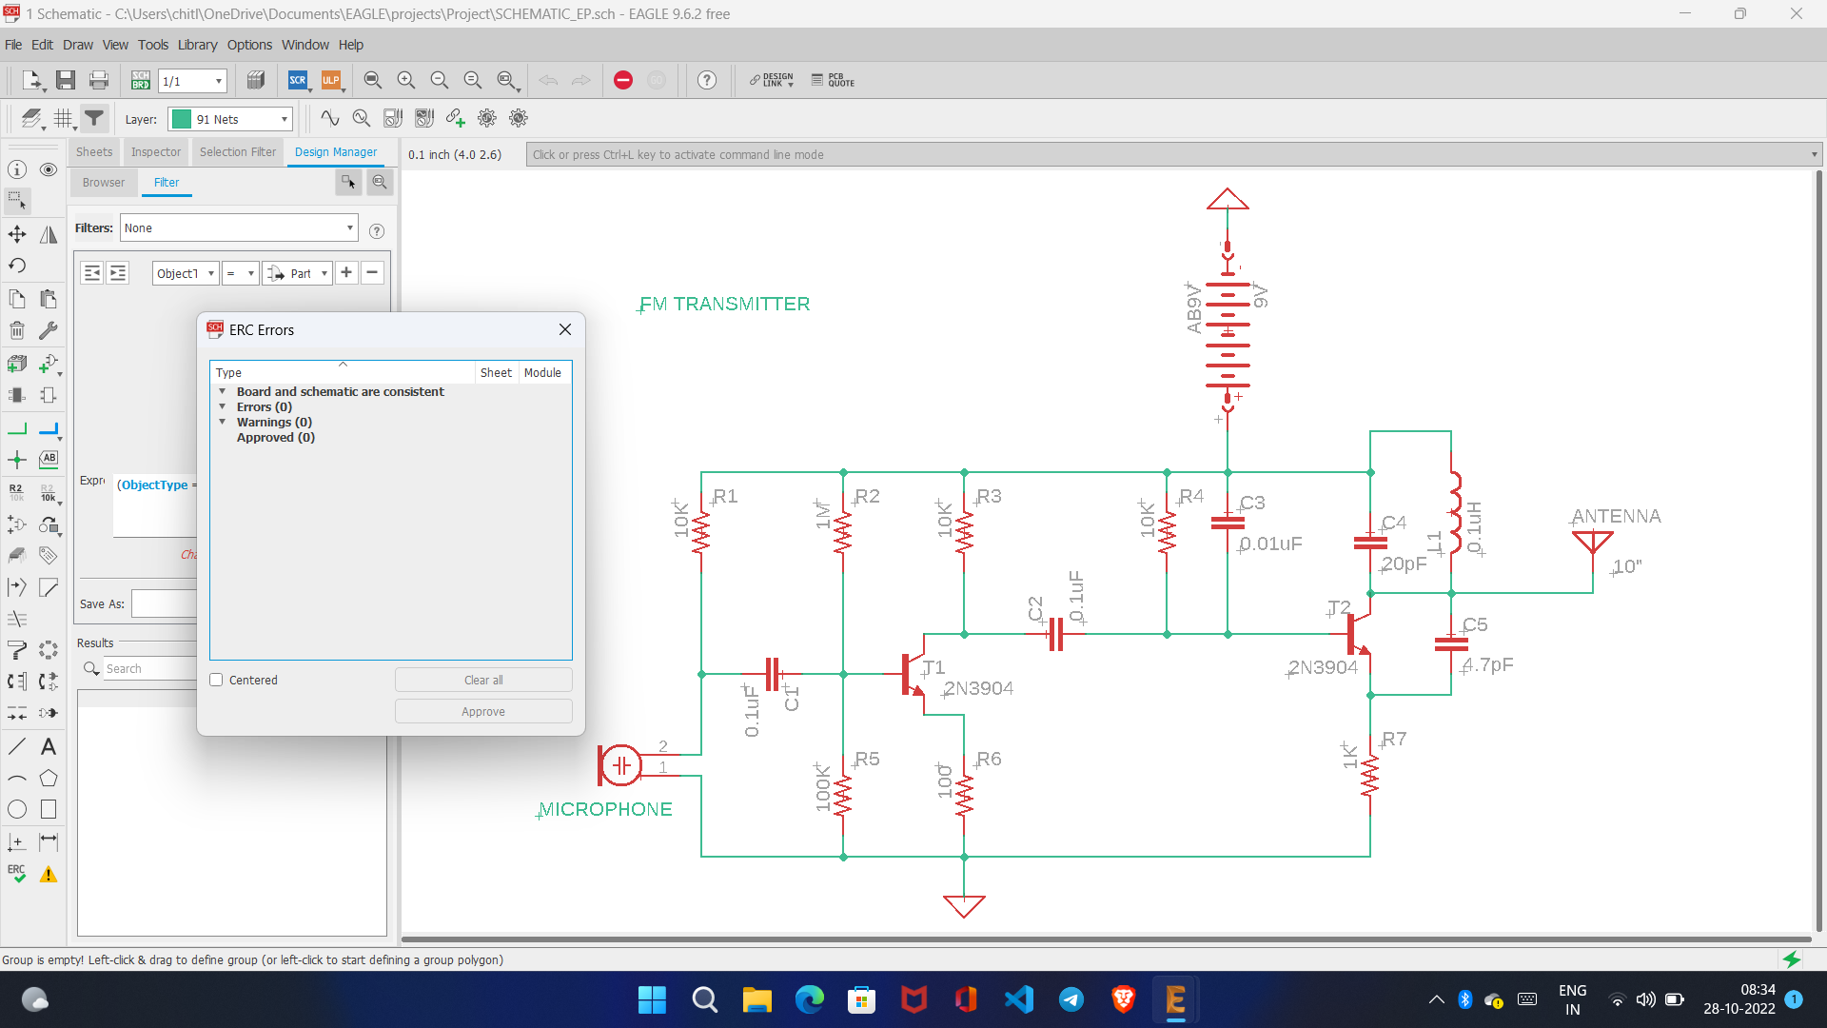
ReSULT
SCHEMATIC:

Slide 7
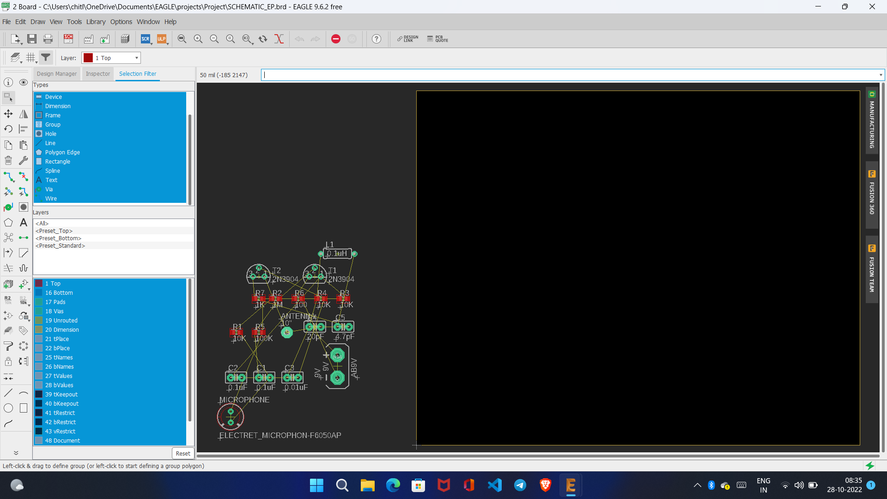
Layout before placing components

Slide 8
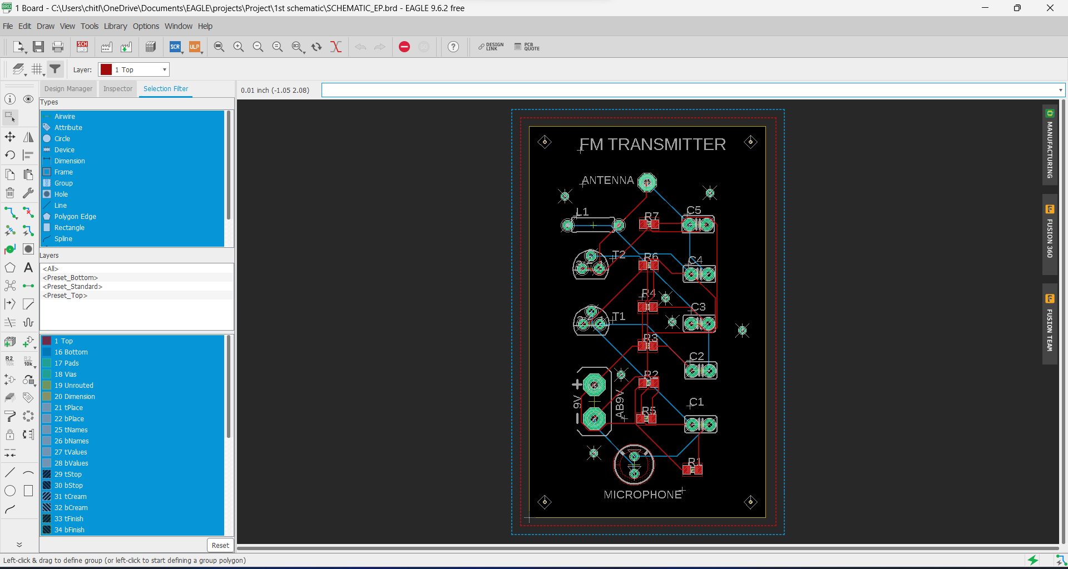
LAYOUT 1(manual routing)

Slide 9
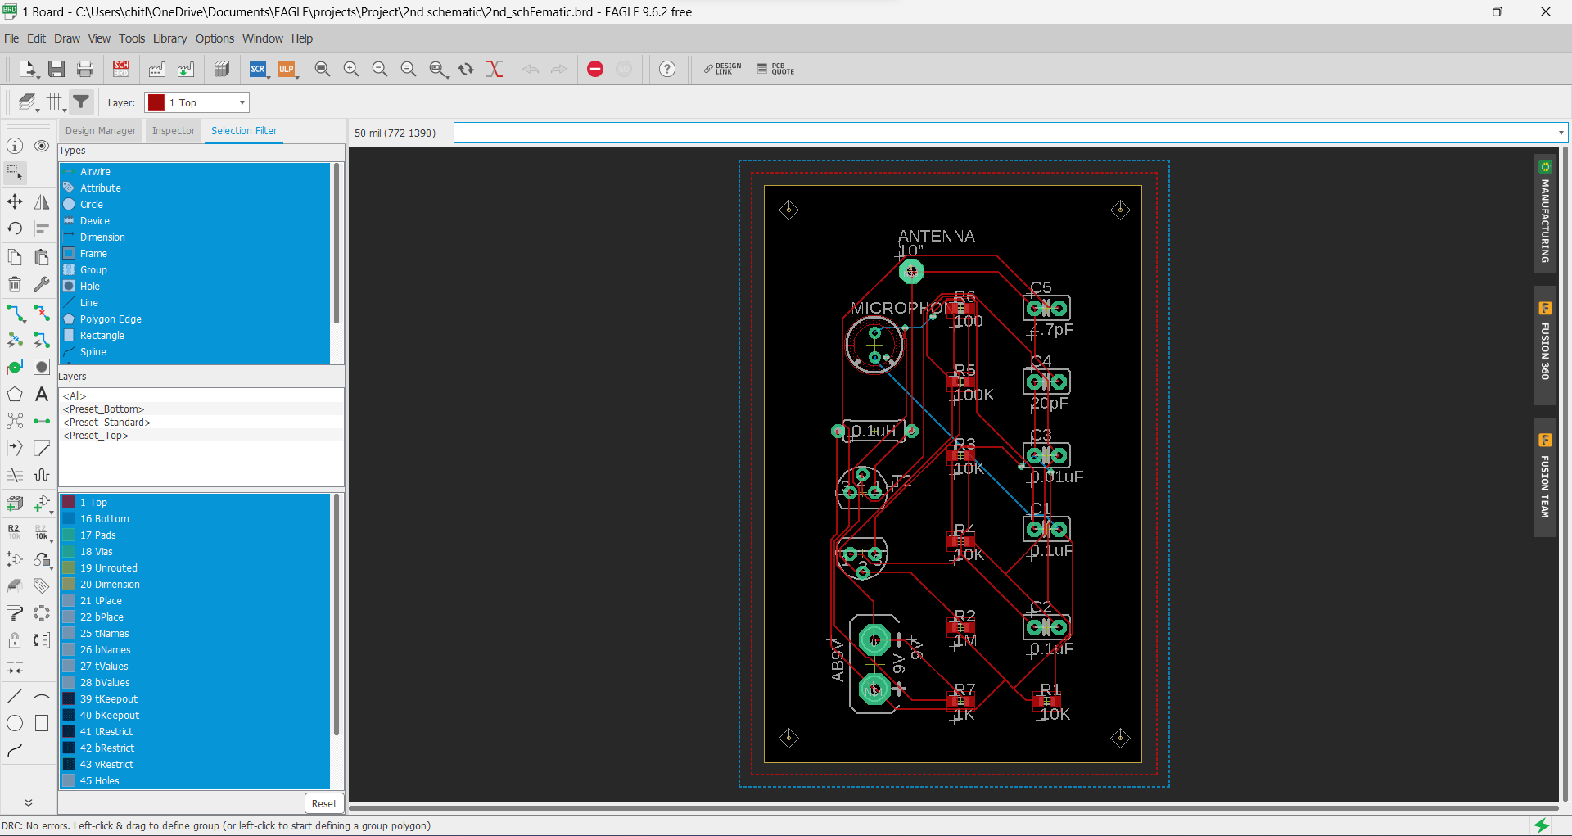
LAYOUT 2(Autorouting)

Slide 10

LAYOUT 3

Slide 11
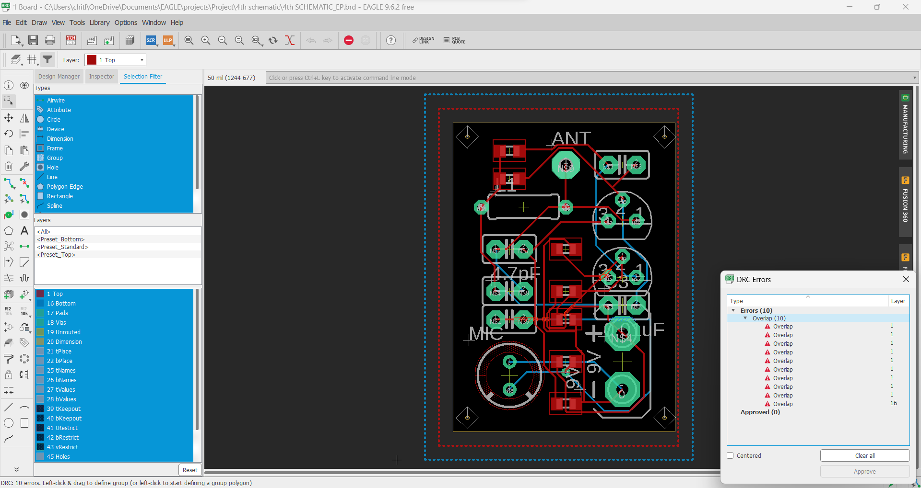
LAYOUT 4(Double Layered PCB) – 10 errors

Slide 12
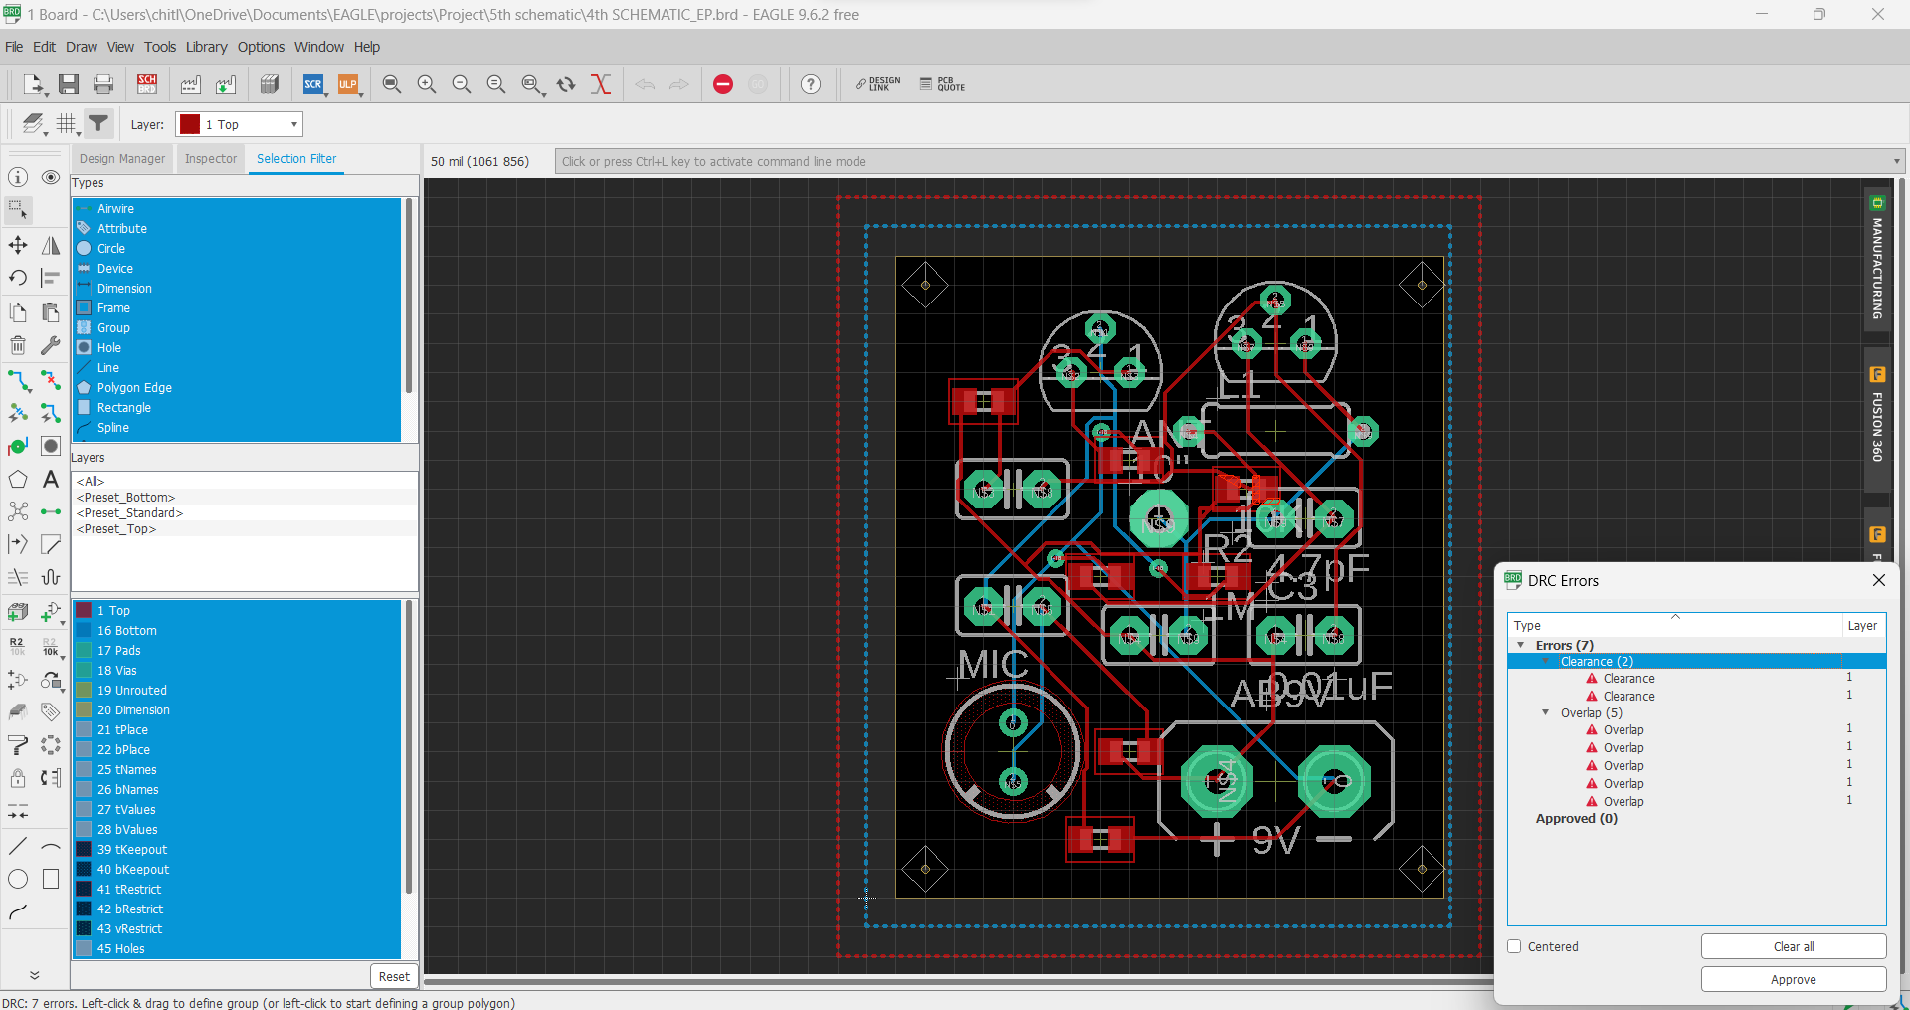
LAYOUT 4(Double Layered PCB) – 7 errors

Slide 13
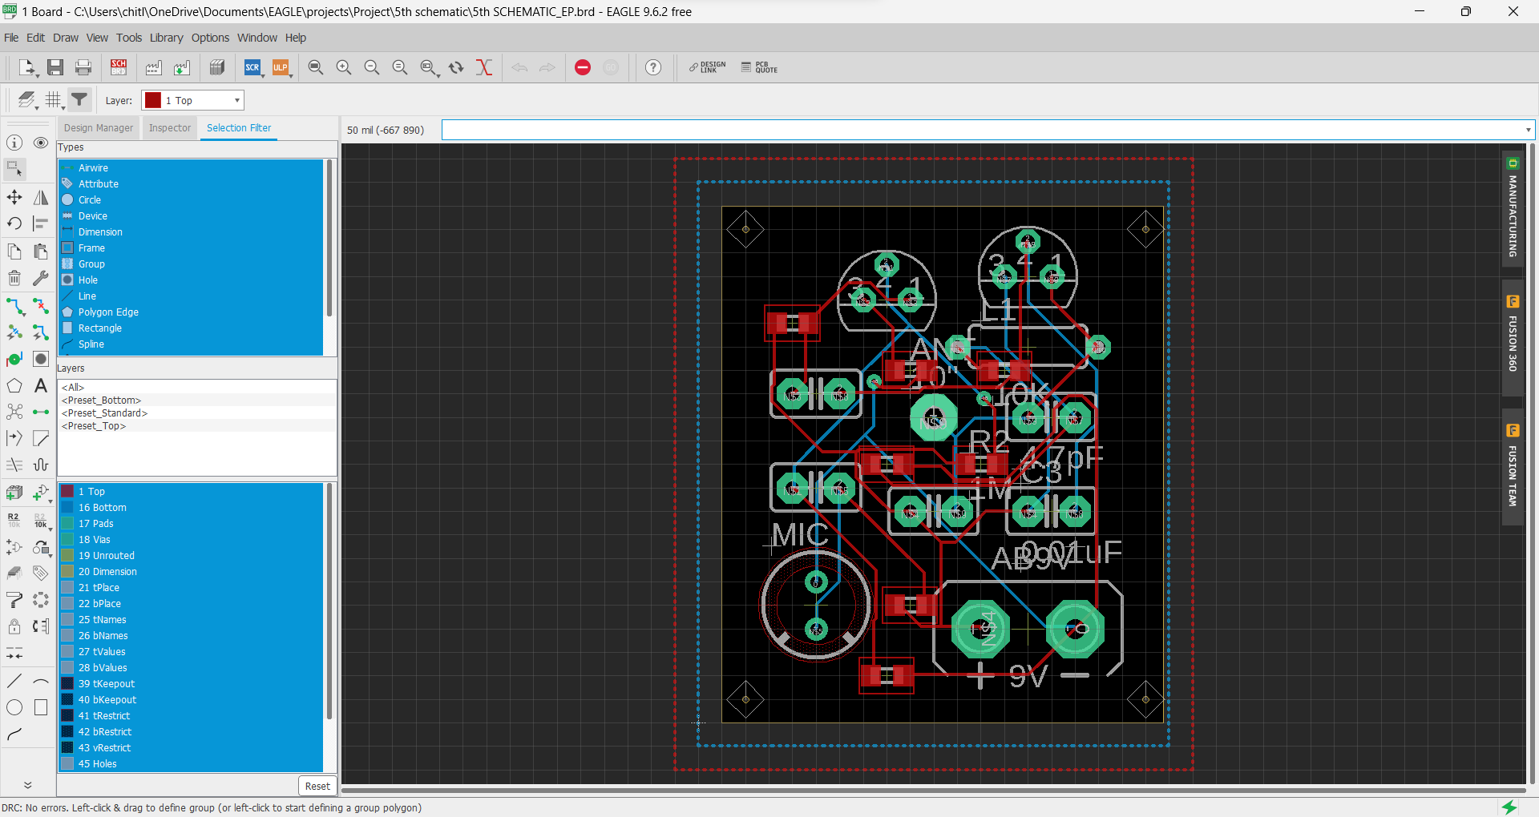
LAYOUT 4(Double Layered PCB) – No errors

Slide 14
CHALLENGES FACED
Overlapping of interconnections in manual routing.
Via diameter and interconnect width should be same.
In DRC several errors – Airwire, Dimension, Clearance, Overlap, Width.

Slide 15
Contributions
As the both schematic part and layout are important and interlinked, we both designed the individual layouts.
C.V.BHANU PRAKASH – Schematic, LAYOUT 1, 4
VIKAS CHELLURU – Schematic, LAYOUT 2, 3

Slide 16
THANK YOU

