Slide 1
MSA PROJECT REPORT Piezoelectric Rate Gyroscope
Group-12
Team Members:
C.V.Bhanu Prakash – S20200020255
T.V.S.Kalyan – S20200020305
S.Sai Anirudh – S20200020299

Slide 2
Outline
Introduction
Literature review
Objective
Methodology
Results
Discussions
Conclusions
References
Contributions

Slide 3
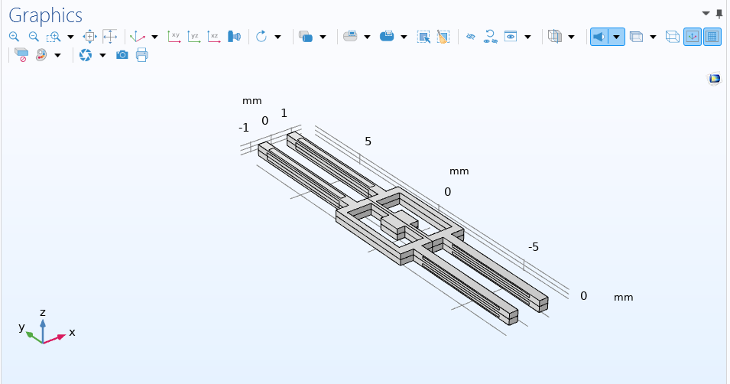
Introduction
Gyroscope is a device that can measure and maintain the orientation of angular velocity of an object. These are more advanced than accelerometer. These can measure the tilt and lateral orientation of the object whereas an accelerometer can only measure the linear motion.

Slide 4
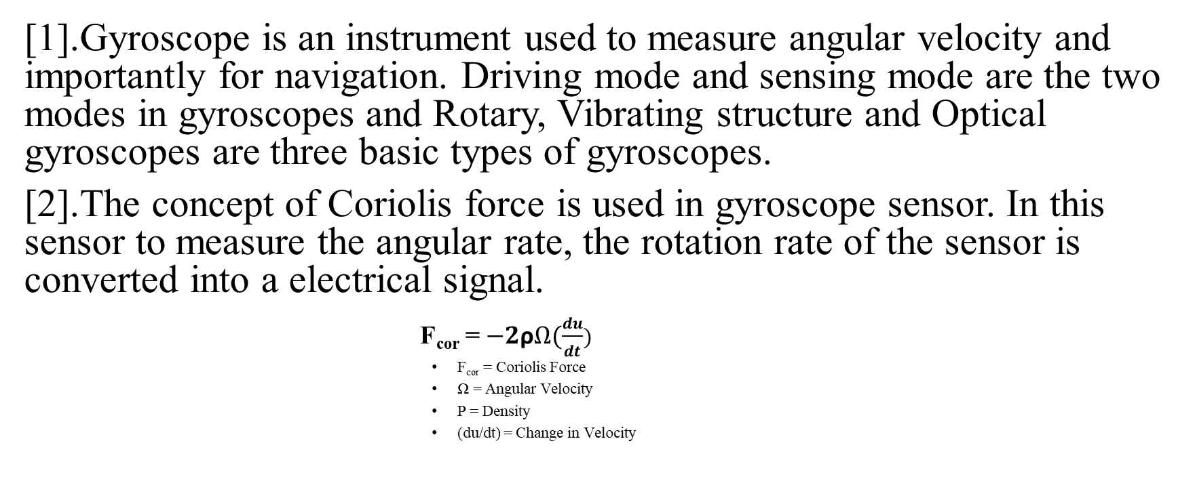
Literature Review
[1].Gyroscope is an instrument used to measure angular velocity and importantly for navigation. Driving mode and sensing mode are the two modes in gyroscopes and Rotary, Vibrating structure and Optical gyroscopes are three basic types of gyroscopes.
[2].The concept of Coriolis force is used in gyroscope sensor. In this sensor to measure the angular rate, the rotation rate of the sensor is converted into a electrical signal.
F_{cor} = $−2\text{ρ}Ω(\frac{du}{dt})$
F_{cor} = Coriolis Force
Ω = Angular Velocity
Ρ = Density
(du/dt) = Change in Velocity

Slide 5
[3].When a Piezoelectric gyroscope is excited into vibration in one of the two modes by an applied alternating voltage and attached to a rotating body, Coriolis Force will excite the other mode through which the rotation rate of the body can be detected.
[4].The geometry of tuning forks is designed so that the eigen frequencies of the nearby modes are separated in frequency space. The frequency response of the signal is computed and the rotation rate sensitivity is evaluated.
[5].As for the solid-rate gyroscope we used, the piezoelectric material serves as the excitation source and sensing element simultaneously, so the piezoelectric material should have larger piezoelectric constant and electromechanical coupling constants.

Slide 6
Objective
Designing a piezoelectric rate gyroscope structure.
Simulate the design using COMSOL software.
Compute angular velocity and plot graphs of sense voltage vs angular velocity and sense voltage vs frequency.
Compare results of two materials Quartz and PZT-5A.

Slide 7
Methodology
The methodology for simulating a Piezoelectric Rate Gyroscope using COMSOL Multiphysics software has several steps following:
Geometric creation
Material properties
Electrode modelling
Boundary conditions
Meshing
Physics setting
Simulation
Sensitivity analysis
Optimization
Validation

Slide 8
Experimental details
Mesh profile
Sequence type: User-controlled mesh
Element size: Finer
Element size parameters:
Maximum element size = tQz/4
Minimum element size – tQz/12
Mesh consists of 15630 domain elements, 5220 boundary elements, and 1139 edge elements.
Material : Quartz LH (1978 IEEE) and PZT-5A

Slide 9
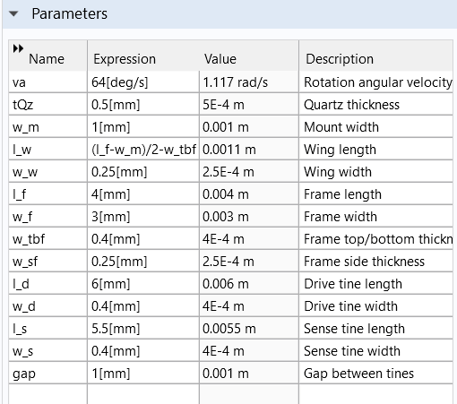
Experimental details
Parameters

Slide 10
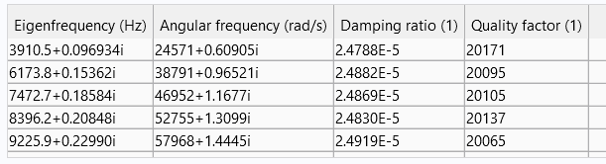
Experimental details
Eigen Frequencies:
These are also known as natural frequencies at which a system vibrates or oscillates when it is exited by an external force or disturbance and allowed to freely oscillate.
These are the Eigenfrequencies we used for the study:

Slide 11
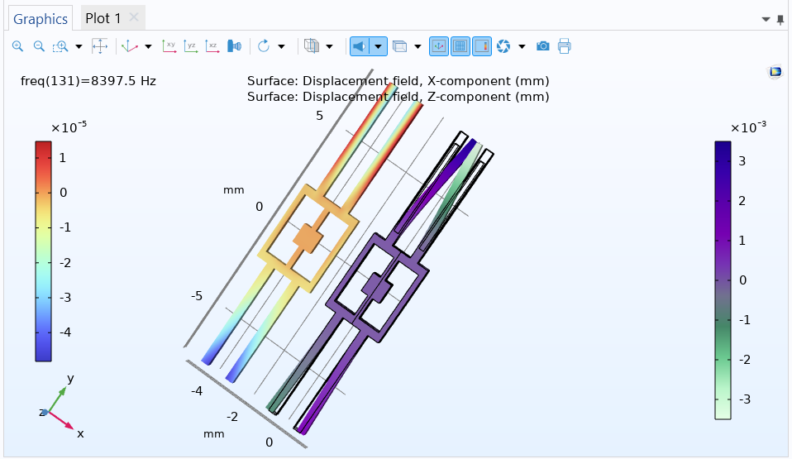
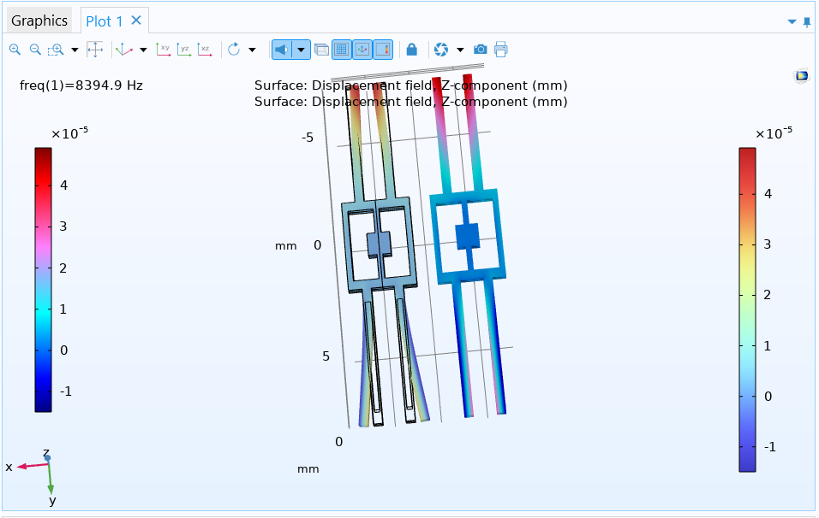
Results

Slide 12
Discussion
To determine which is better, we performed simulations for both materials in a piezoelectric rate gyroscope. The selection depends on several characteristics like:
Sensitivity
Stability
Frequency range
Size and weight
Cost

Slide 13
Results

Slide 14
Results

Slide 15
Conclusions
This model shows how to analyze a tuning fork based piezoelectric rate gyroscope. The reverse piezoelectric effect is used to drive an in-plane tuning fork mode. This mode is coupled to an out of plane mode by the Coriolis force and the resulting out of plane motion is sensed by the direct piezoelectric effect. The geometry of the tuning forks is designed so that the eigen frequencies of the nearby modes are separated in frequency space. The frequency response of the system is computed and the rotation rate sensitivity is evaluated.

Slide 16
References
[1].Jacek Nazdrowicz ,Michal Szermer, Adam Stawinski,Andrzej Napieralski, “MEMS gyroscope FEM modelling and simulation”,25th International Conference on mixed design of integrated circuits and systems.
[2].Lee,Sang Woo, et al. “ a micro rate gyroscope based on the SAW gyroscopic effect.” Journal of Micromechanics and Microengineering 17.11(2007); 2272.
[3]. Sato, Kenji, Atsushi Ono, and Yoshiro Tomikawa. “Experimental study of gyro sensor using double-ended tuning fork quartz resonator.” Proceedings of the 2004 IEEE International Frequency Control Symposium and Exposition, 2004. IEEE, 2004.
[4].Hu, Xiaojun, et al,”Model design of piezoelectric micromachined modal gyroscope.” Journal of sensors 2011 (2011).
[5].Vineela,V., Rao,B.R.,Nath, T.M. and Rao,K.S.,Design and simulation of MEMS piezoelectric gyroscope.

Slide 17
Contributions
T.V.S.Kalyan: Simulation of Gyroscope with Quartz and PZT-5A.
C.V.Bhanu Prakash: Verifying Gyroscope properties for different eigen frequencies.
S.Sai Anirudh: Meshing and referring to base papers.

Slide 18
THANK YOU

