Slide 1
Embedded Systems Project Group-15
Two wheeler safety system
C.V.Bhanu Prakash (S20200020255)
Sreeja Dacharla (S2020002056) Vidya Sagar (S20200020312)
Yashwanthi Priya (S20200020315)

Slide 2
Block Diagram
Power Supply
Power Supply
Ultra Sonic Sensor
Node MCU
Arduino Uno
GyroScopic Sensor
Fire Base
LEDs
App in Phone

Slide 3
Hardware modules used:
🠶 Hardware:
NodeMCU
Arduino uno
Ultrasonic sensor
Gyroscopic sensor
Phone

Slide 4
Software modules used:
🠶 Software:
Wire library
MPU6050 library
Fire base libraries
ESP8266 library

Slide 5
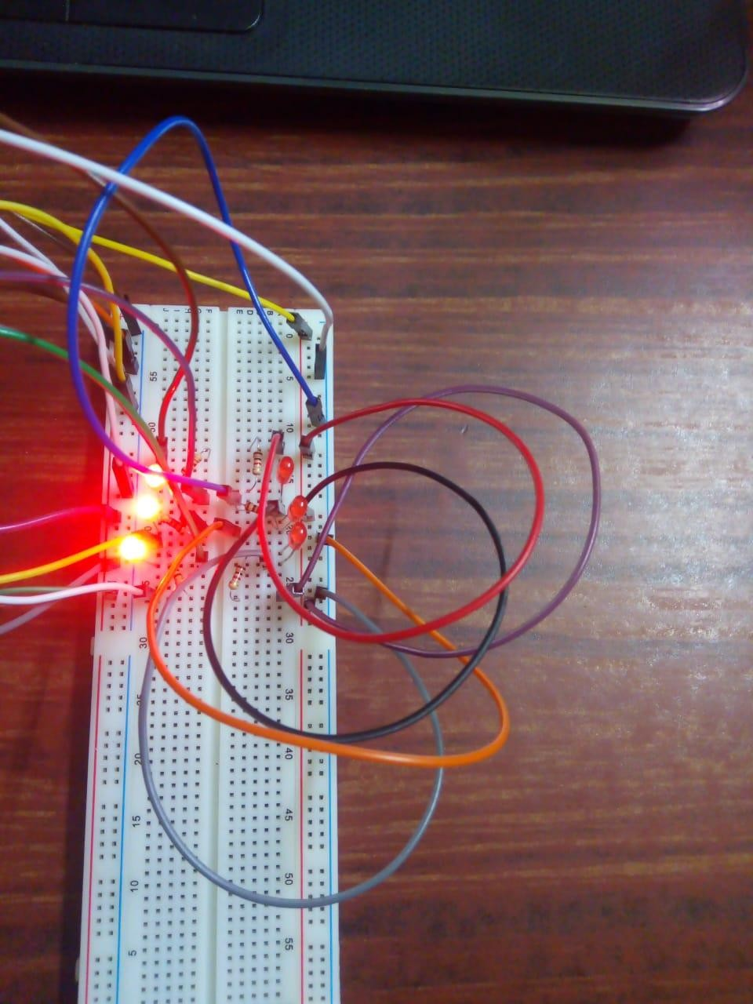
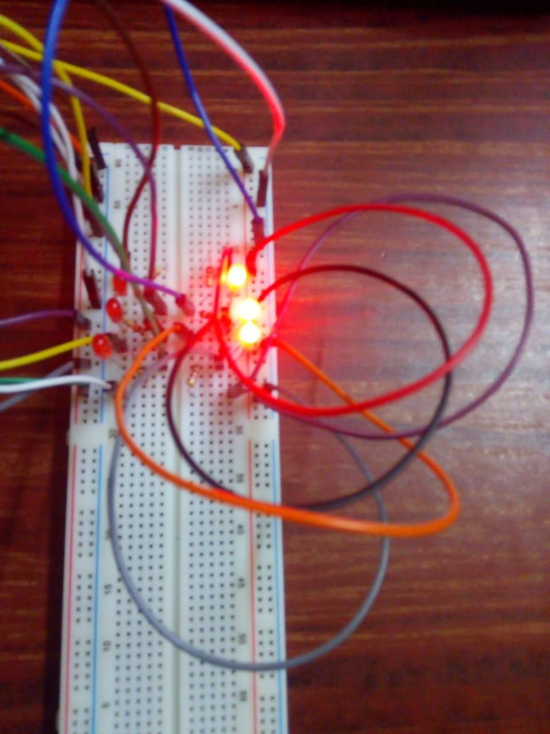
Outputs:1

Slide 6
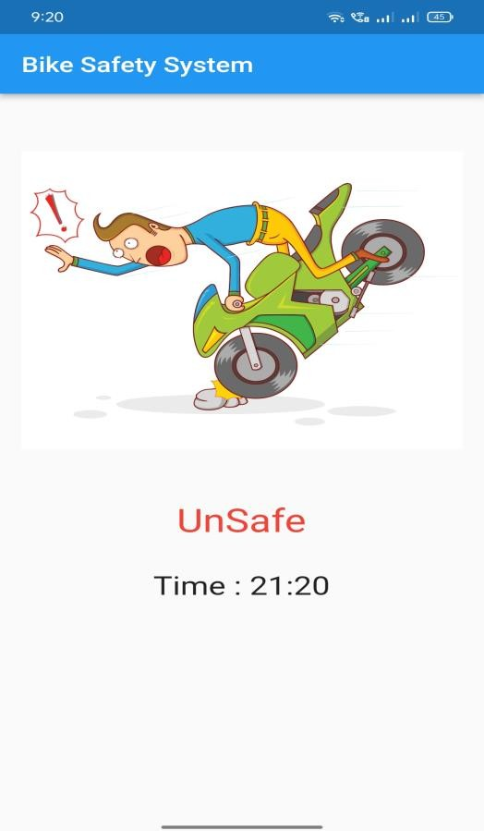
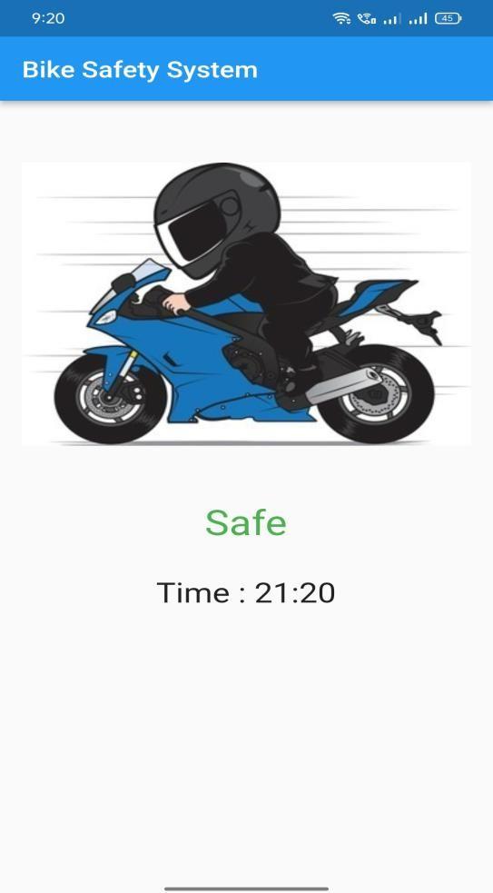
Outputs:2

Slide 7


Slide 8
Challenges we faced:
🠶 Connecting to nodemcu to the wifi or hotspot since it requires a strong connection
🠶 Downloaded libraries required for Gyroscope and firebase .
Final outputs and Observations:
We prepared a model for two wheeler safety, which gives whether a person is whether the person riding it is wearing the helmet or not.
It also turns on the indicating lights automatically.
Thank you.

