Slide 1
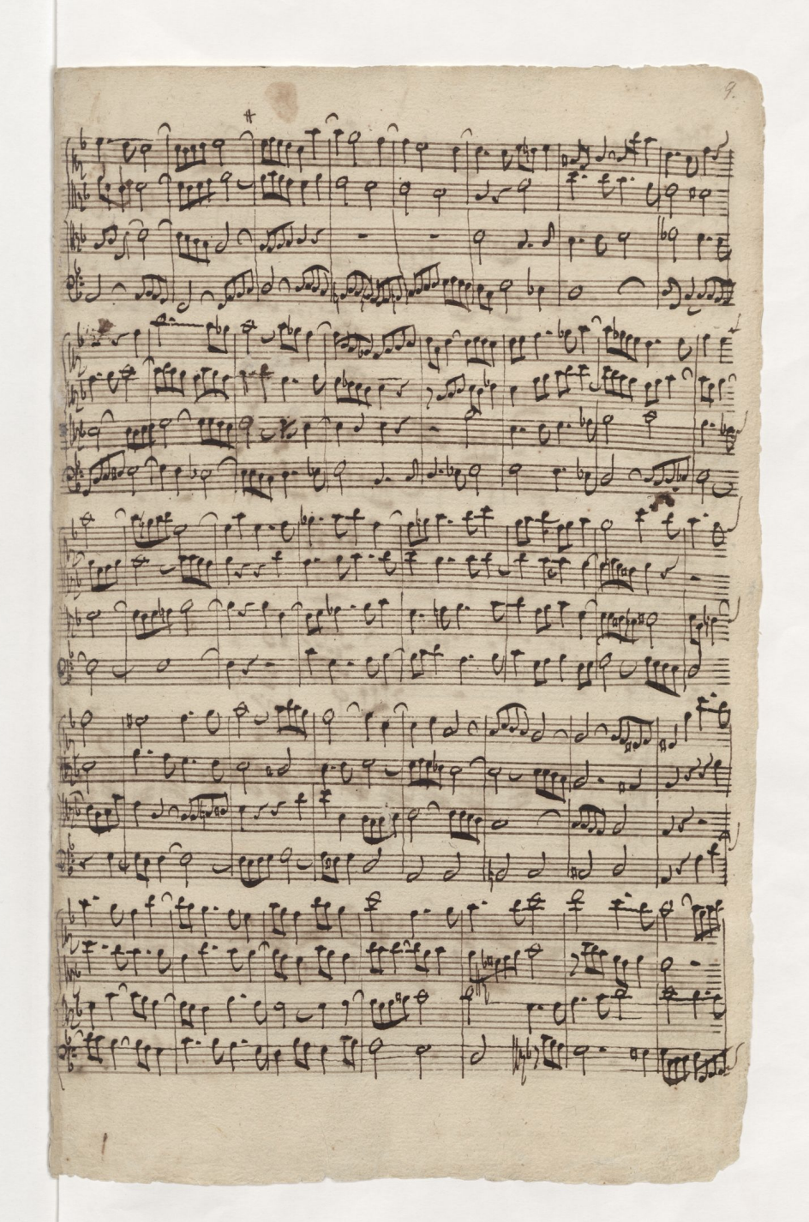

Analysis
Typesetting
OMR
System
Archival

