Slide 1
PIN Local Control Overlay: Optimization + Demonstration
Minimal-slide briefing: problem formulation, A/B evidence, and mechanism
Per-radio constrained control (local only): a_t^(i) ~ π_θ(.|h_t^(i)), h_t^(i) = (o_0:t^(i), a_0:t-1^(i)) max_π E[Σ_{t=0}^{T-1} γ^t r_t] s.t. PDR_t^cmd ≥ p_min, L95_t^cmd ≤ l_max, Drop_t^cmd ≈ 0 r_t = α·PDR_t^high - β·L95_t^high - δ·Drop_t^high + ζ·Deliveries_t^high
Decision objective: improve PDR and latency over scenario life with no waveform rewrite.
Control scope: each PIN agent controls only its local radio MAC.
Action vector (per class): service bias, admission threshold, CW aggressiveness.
Traffic classes: command, voice, best-effort.
Local observation window o_t^(i) (every 250 ms)
Queue length by class
TX attempts/success, retries, ACK timeouts by class
Drops + deliveries by class
Per-class p95 latency
Collisions, CCA busy fraction, mean backoff slots

Slide 2
Experiment Description and PIN I/O Interface
CSMA local-overlay validation setup
Protocol | CSMA
Nodes / area / duration | 8 nodes / 150 m / 1.5 s
Traffic model | Bernoulli, 1024-bit packets
Class mix | Command 0.15, Voice 0.25, Best-effort 0.60
Control interval | 250 ms
Training | 2 episodes
Eval seeds | 201, 202
A/B design | Baseline A0 (neutral) vs learned local policy
Per-node control loop (local overlay)
1) collect LocalObservation at t
2) map obs to compact state bins (queue, busy, high-drop)
3) choose action template A0..A3
4) apply LocalAction to local MAC only
5) step 250 ms, observe reward, update policy
Action | Service Bias | Admission | CW Aggressiveness
A0 Neutral | [1.0, 1.0, 1.0] | [1.0, 1.0, 1.0] | [1.0, 1.0, 1.0]
A1 Aggressive-priority | [1.8, 1.5, 0.5] | [1.0, 1.0, 0.25] | [0.75, 0.85, 1.35]
A2 Balanced | [1.4, 1.2, 0.8] | [1.0, 0.9, 0.45] | [0.85, 0.95, 1.15]
A3 Conservative | [1.2, 1.1, 0.9] | [0.9, 0.8, 0.35] | [0.95, 1.0, 1.2]

Slide 3
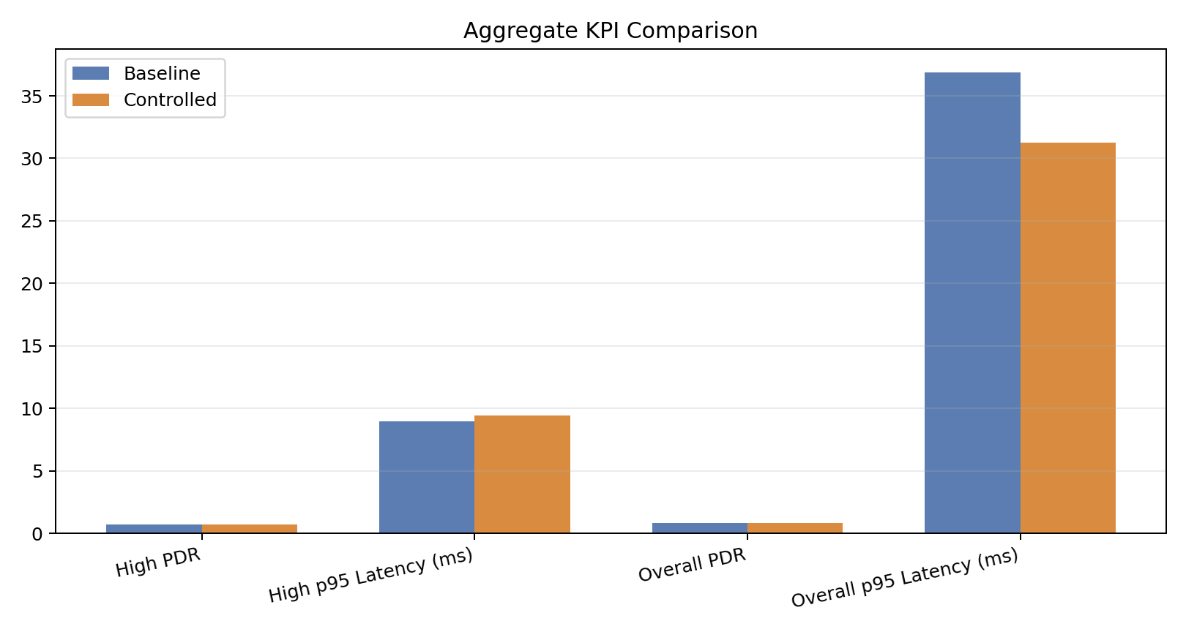
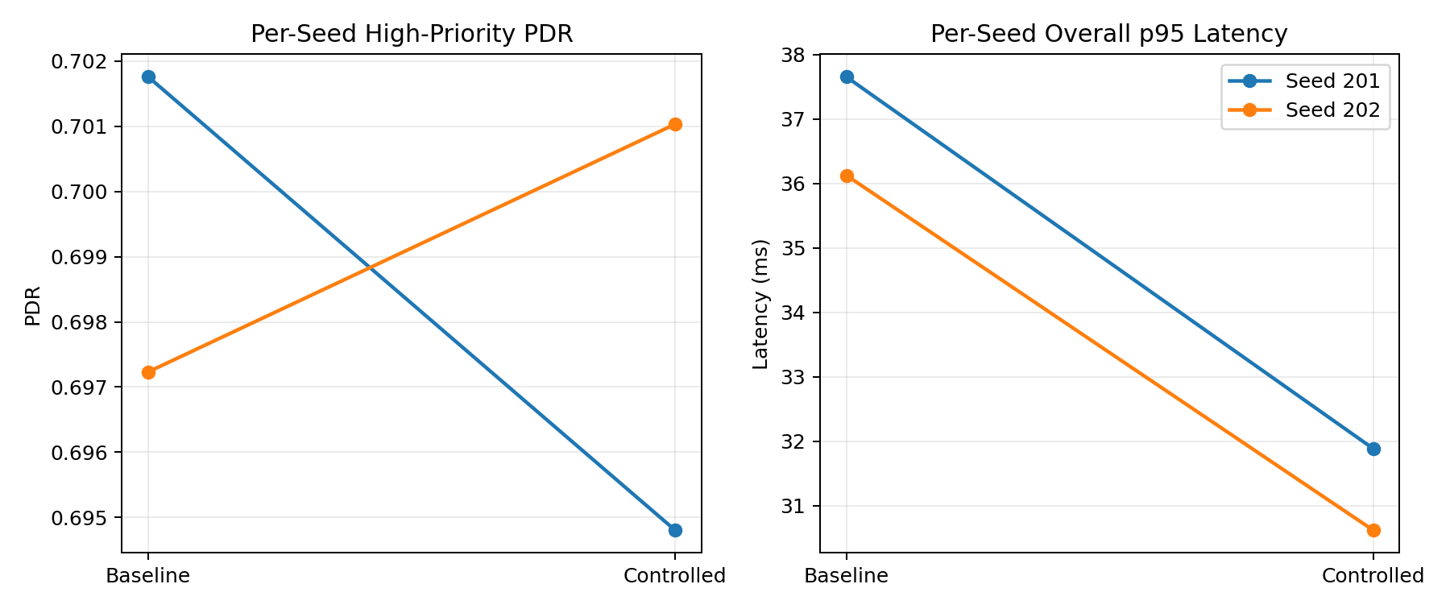
Seeded A/B Results: Baseline vs PIN-Controlled
Aggregate KPIs and per-seed behavior
KPI | Baseline mean | Controlled mean | Delta (C-B)
High-priority PDR | 0.6995 | 0.6979 | -0.0016
High-priority p95 latency (ms) | 8.9836 | 9.4497 | +0.4662
Overall PDR | 0.8193 | 0.8270 | +0.0077
Overall p95 latency (ms) | 36.8898 | 31.2521 | -5.6377
Overall PDR improved (+0.0077) and overall p95 latency improved (-5.64 ms). High-priority KPIs are mixed in this small 2-seed evaluation.

Slide 4
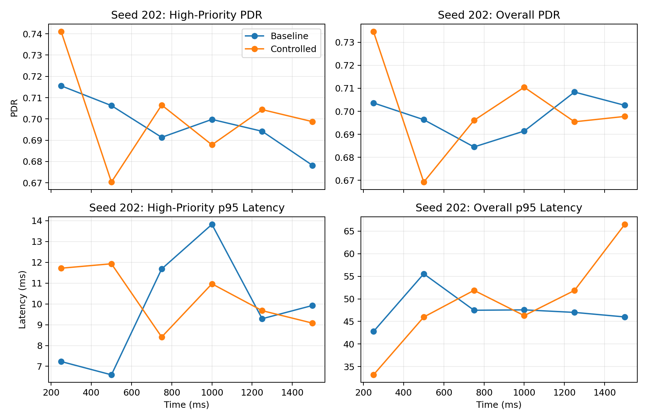
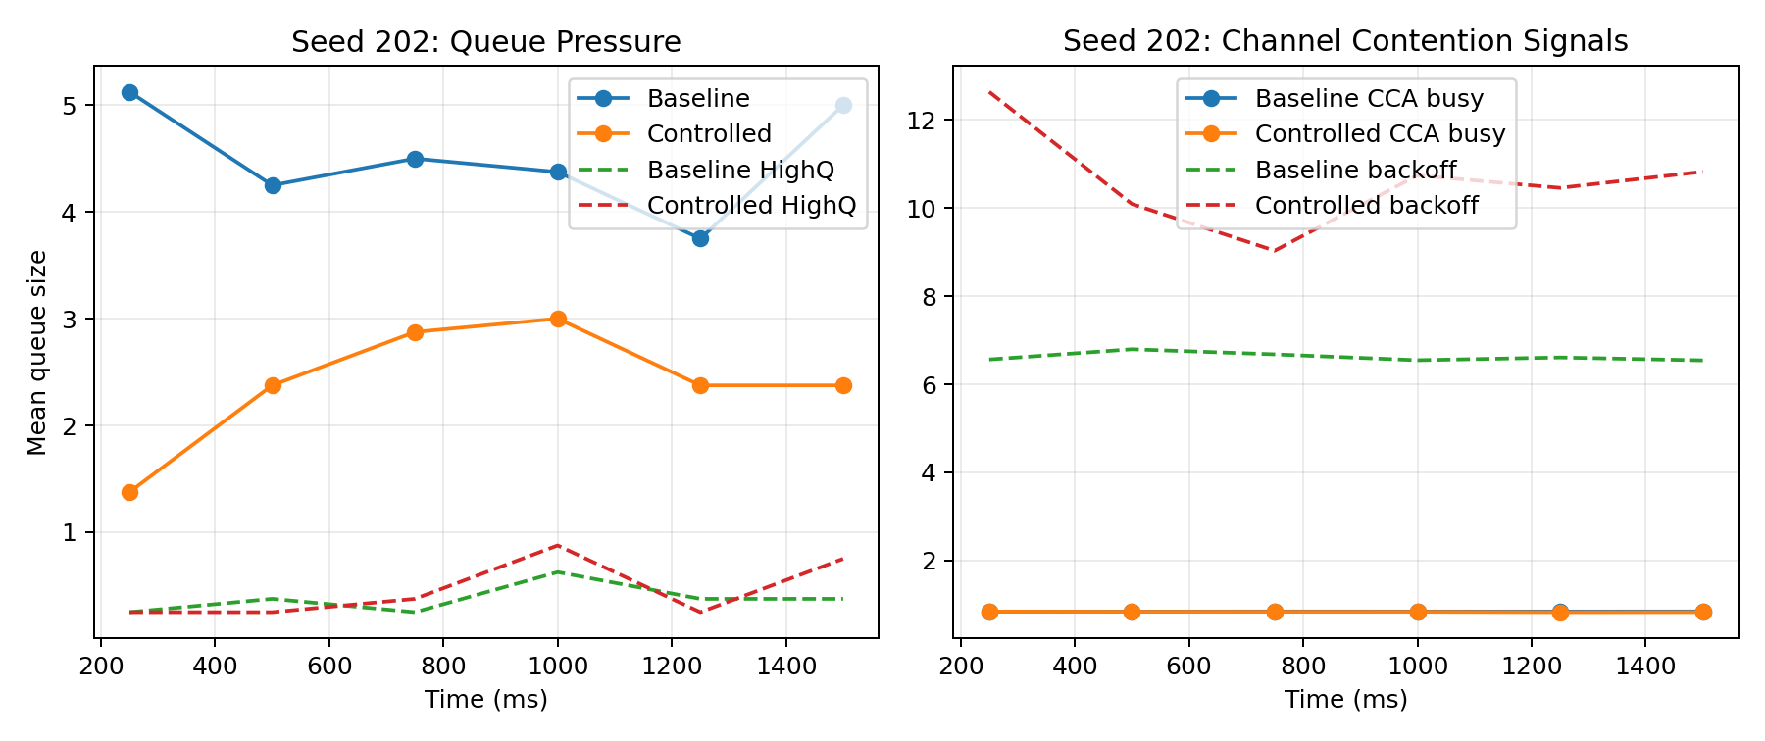
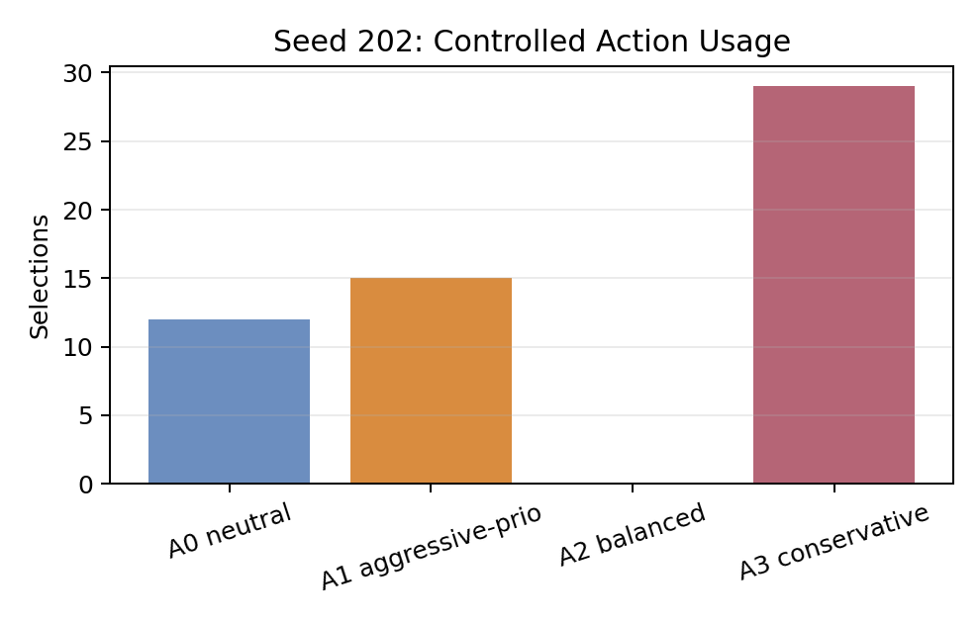
Specific Improvement Scenario: Seed 202
Selected seed 202 due to strongest combined high-priority PDR gain and overall latency reduction.
KPI | Baseline | Controlled | Delta
High-priority PDR | 0.6972 | 0.7010 | +0.0038
High-priority p95 latency (ms) | 9.3991 | 9.6750 | +0.2758
Overall PDR | 0.8230 | 0.8398 | +0.0169
Overall p95 latency (ms) | 36.1259 | 30.6193 | -5.5065
Interval spotlight (t=250 ms window):
ΔHigh PDR +0.0255
ΔOverall PDR +0.0310
ΔOverall p95 latency -9.58 ms
ΔBest-effort queue -3.75
ΔBackoff +6.07

Slide 5
Validation Outcome and Implications
What this proves, what needs hardening next
Demonstrated: local PIN overlay can materially change scenario outcomes without global control.
Observed benefit in this run: better overall PDR and lower overall latency tail.
Important caveat: high-priority aggregate KPIs are mixed with current reward/action tuning.
Mechanism seen in highlight seed: reduced best-effort pressure and higher contention conservatism.
This is sufficient as a reportable proof-of-control-value demonstration, not final policy quality.
Hardening target | Next implementation step
Army realism: traffic/service classes | Keep class priorities explicit and scenario-driven mission mix.
PHY/MAC realism | Inject jamming/interference/mobility variability and richer link adaptation hooks.
PIN observations | Add neighbor/link quality summaries and queue age to local telemetry vector.
Control safety | Constrain best-effort shedding + enforce command/voice minimum service guarantees.
Validation rigor | Scale evaluation seeds/scenarios and report confidence intervals, not point estimates.
Artifacts: docs/pin_demo_metrics.json, docs/pin_demo_results.md, docs/figures/pin_demo/*

