Slide 1
CVE Submission Process
CVE Team

Slide 2
Disclaimers
These slides assume that the information needed for the entry is already generated.
These processes are specific to MITRE. Other Root CNAs may have other processes CNAs need to follow.

Slide 3
Outline
Information Requirements
Approved Formats
Flat File
CSV
JSON (preferred)
Approved Submission Channels
Git (preferred)
Web Form
Email
Submission Process
Tools

Slide 4
Who to send the info to?
Root CNA
Primary CNA (MITRE)

Slide 5
Required Information
CVE ID
Products
Versions
Problem Type (Vulnerability type or Impact)
References
Description
This should include product / version information as well as the problem type as it will be used to populate the entry in the CVE list.
Assigning CNA
Cautions
ASCII Only – no UTF or Unicode.
Plain text only – no HTML or proprietary document formats.
Avoid MS-DOS style line endings (CR/LF).

Slide 6
Approved Formats

Slide 7
Approved Formats
Flat file
Comma-Separated Values (CSV)
CVE JSON

Slide 8
Flat file
[CVEID]:
[PRODUCT]:
[VERSION]:
[PROBLEMTYPE]:
[REFERENCES]:
[DESCRIPTION ]:
[ASSIGNINGCNA]:
Field order should be maintained.
A single field should not span multiple lines.
https://cve.mitre.org/cve/list_rules_and_guidance/cve_assignment_information_format.html#format

Slide 9
Flat file – Handling Multiples
Multiple CVE Entries
Concatenate entries, optionally separated by a blank line.
Multiple Products/Versions
Separate products, and correspondingly versions, by a semicolon followed by a space and, to separate multiple versions for a given product by a comma followed by a space; eg,
[PRODUCT]:IOS; IOS XE
[VERSION]:12.2, 15.0 through 15.6; 3.2 through 3.18
[DESCRIPTION]:... IOS 12.2 and 15.0 through 15.6 and IOS EX 3.2 through 3.18 …
Multiple References
Separate references by a space; eg,
[REFERENCES]: https://tomcat.apache.org/security-9.html#Fixed_in_Apache_Tomcat_9.0.0.M13 https://tomcat.apache.org/security-8.html#Fixed_in_Apache_Tomcat_8.5.8 https://tomcat.apache.org/security-8.html#Fixed_in_Apache_Tomcat_8.0.39 https://tomcat.apache.org/security-7.html#Fixed_in_Apache_Tomcat_7.0.73 https://tomcat.apache.org/security-6.html#Fixed_in_Apache_Tomcat_6.0.48

Slide 10
Flat File Example
[CVEID]:CVE-2017-1194
[PRODUCT]:IBM WebSphere Application Server
[VERSION]:7.0, 8.0, 8.5, 9.0
[PROBLEMTYPE]:Cross-site request forgery
[REFERENCES]:http://www.ibm.com/support/docview.wss?uid=swg22001226
[DESCRIPTION]:IBM WebSphere Application Server 7.0, 8.0, 8.5, and 9.0 is vulnerable to cross-site request forgery which could allow an attacker to execute malicious and unauthorized actions transmitted from a user that the website trusts. IBM X-Force ID: 123669.
[ASSIGNINGCNA]:IBM

Slide 11
Comma-Separated Values (CSV)
Fields :
CVE ID
Product
Version
Problem type
Description
Assigning CNA
Omit field headers.
Use double-quotes if fields contain commas or quote characters.
Do not use embedded line-breaks.
Write any double-quote characters in a field as two double-quote characters.

Slide 12
CSV – Handling Multiples
Multiple CVE Entries
Multiple lines, one per entry.
Multiple Products/Versions
Separate products, and correspondingly versions, by a semicolon followed by a space and, to separate multiple versions for a given product by a comma followed by a space; eg,
CVE-2017-3862,”IOS; IOS XE”,”12.2, 15.0 through 15.6; 3.2 through 3.18”,…
Multiple References
Separate references by a space; eg,
CVE-2016-6816,…,”https://tomcat.apache.org/security-9.html#Fixed_in_Apache_Tomcat_9.0.0.M13 https://tomcat.apache.org/security-8.html#Fixed_in_Apache_Tomcat_8.5.8 https://tomcat.apache.org/security-8.html#Fixed_in_Apache_Tomcat_8.0.39 https://tomcat.apache.org/security-7.html#Fixed_in_Apache_Tomcat_7.0.73 https://tomcat.apache.org/security-6.html#Fixed_in_Apache_Tomcat_6.0.48”,…

Slide 13
CSV Example
"CVE-2017-1194","IBM WebSphere Application Server"," 7.0, 8.0, 8.5, 9.0",“Cross-site request forgery","http://www.ibm.com/support/docview.wss?uid=swg22001226","IBM WebSphere Application Server 7.0, 8.0, 8.5, and 9.0 is vulnerable to cross-site request forgery which could allow an attacker to execute malicious and unauthorized actions transmitted from a user that the website trusts. IBM X-Force ID: 123669.","IBM"

Slide 14
CVE JSON 4.0
Required Data Strings
Data_type - CVE
Data_format - MITRE
Data_version – 4.0
Required Data Objects
CVE_data_meta
CVE ID
ASSIGNER
Affects
Vendor
Product
Version
Description
References
Problemtype
Additional optional objects can be included. For a full list see:
https://github.com/CVEProject/automation-working-group/blob/master/cve_json_schema/DRAFT-JSON-file-format-v4.md

Slide 15
CVE JSON Example
{
"data_type": "CVE",
"data_format": "MITRE",
"data_version": "4.0",
"CVE_data_meta": { "ASSIGNER": "psirt@us.ibm.com", "ID": "CVE-2017-1194" },
"affects": { "vendor": { "vendor_data": [ { "vendor_name": "IBM", "product": { "product_data": [ { "product_name": "WebSphere Application Server", "version": { "version_data": [ { "version_value": "7.0, 8.0, 8.5, 9.0" } ] } } ] } } ] } },
"problemtype": { "problemtype_data": [ { "description": [ { "lang": "eng", "value": "Cross-site request forgery" } ] } ] },
"references": { "reference_data": [ { "url": "http://www.ibm.com/support/docview.wss?uid=swg22001226" } ] },
"description": { "description_data": [ { "lang": "eng", "value": "IBM WebSphere Application Server 7.0, 8.0, 8.5, and 9.0 is vulnerable to cross-site request forgery which could allow an attacker to execute malicious and unauthorized actions transmitted from a user that the website trusts. IBM X-Force ID: 123669." } ] }
}
Note that whitespace, including line breaks, can be included to improve readability.

Slide 16
Submission Channels

Slide 17
Approved Submission Channels
Web form
Supports all three file types.
Suited to new submissions only.
Has limits on form field sizes!
cve@mitre.org
Supports all three file types.
Suited to new submissions only.
Git
Supports CVE JSON only!
Avoid files with MS-DOS style line endings (CR/LF).
Suited to both new and updated submissions.

Slide 18
Submissions through the web form

Slide 19
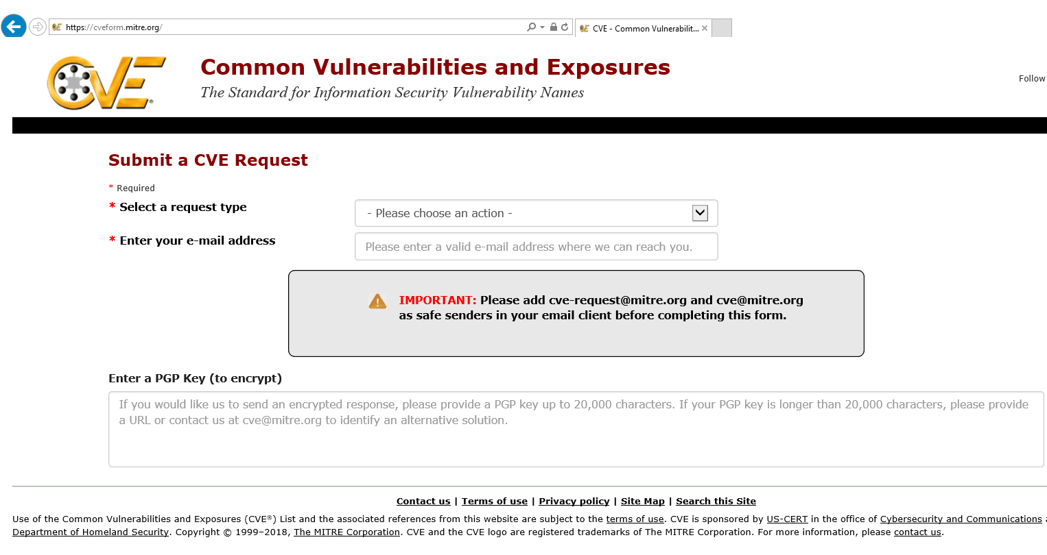
Go to https://cveform.mitre.org/

Slide 20
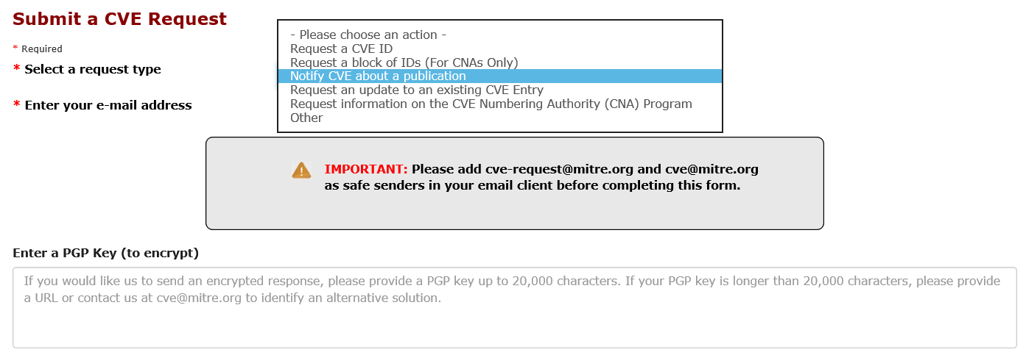
Select the “Notify CVE about a publication” request type

Slide 21
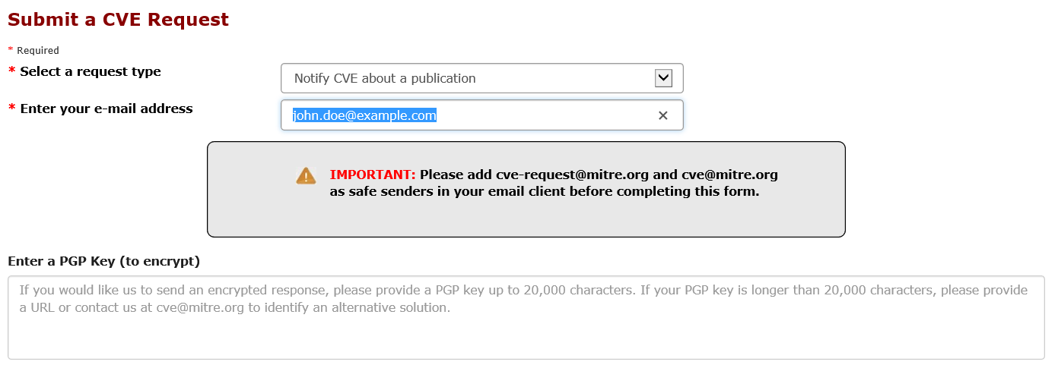
Fill in Contact Information

Slide 22
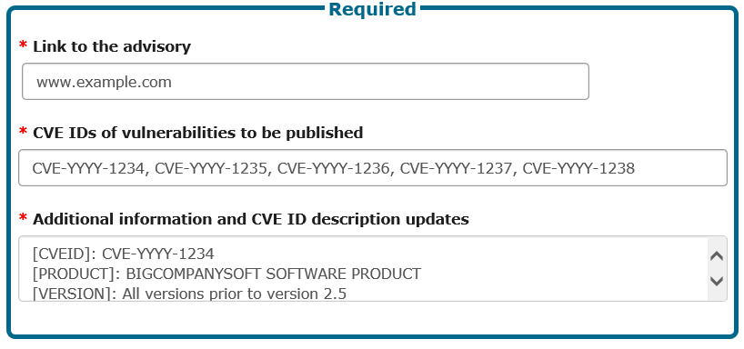
Fill in the Submission Information
Instructions for submissions greater than 2000 characters in size are at the end of the slides.

Slide 23
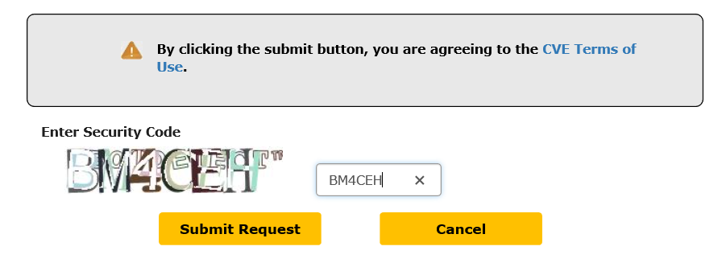
Fill in the Captcha and Select the Submit Request Button

Slide 24
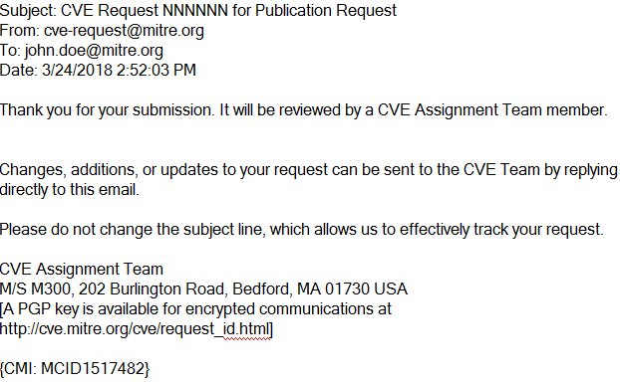
A Ticket will be Created and Email Acknowledging Sent

Slide 25
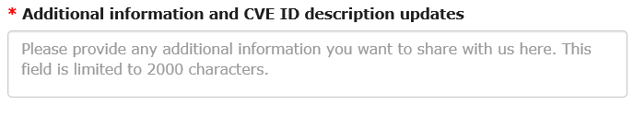
The Description Field is Character Limited

Slide 26
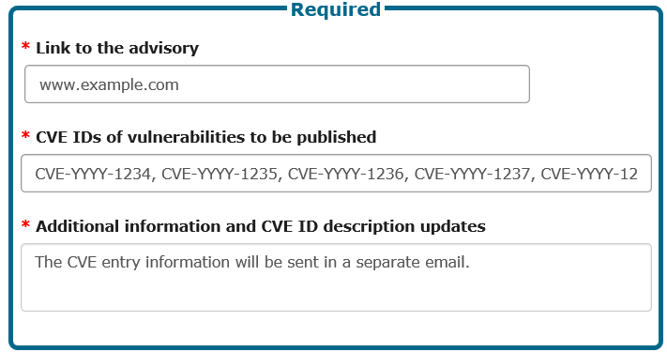
If you need more characters, use email …

Slide 27
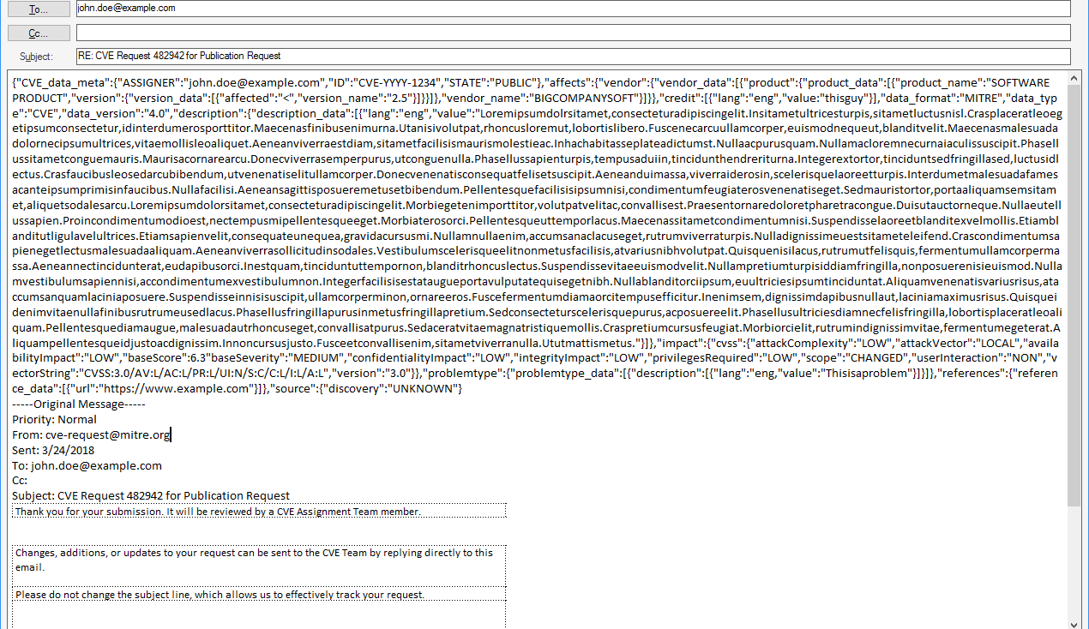
By Replying to the Acknowledgement Email

Slide 28
Submission through GitHub

Slide 29
Git Submission (Initial Setup)
Create a Github.com account
Inform your parent CNA of the account you will be using
Fork your parent’s repository
E.g. child CNAs of MITRE fork CVEProject/cvelist, but child CNAs of DWF for distributedweaknessfiling/cvelist
You can use your personal account or an organization account for the fork.
GitHub provides a web interface for organization forks
Clone the your fork to a local repository
Set the upstream git repo
git remote add upstream git@github.com:[PARENT REPO]
[PARENT REPO] is the path to your parent’s repo, e.g. CVEProject/cvelist

Slide 30
Git Submission, part 1
Ensure your fork is up to date
git fetch upstream
git checkout master
git merge upstream/master
Optionally push any updates from the upstream CVEProject/cvelist master back to you fork on Github.com:
git push
Create a new branch, separate from master, for each submission
git branch $YOUR_BRANCH master
Include multiple, related updates when possible
If you are working on multiple branches make sure you explicitly branch against master otherwise future branches may include work from other local branches

Slide 31
Git Submission, part 2
Make changes to your branch
git checkout $YOUR_BRANCH
Edit the files you want to change in your branch
Limit your changes to only the portions of the JSON that needs updating. Otherwise, you may accidentally overwrite information.
Validate the changes against the JSON schema
python -m json.tool < $CHANGED_FILE.json
jsonschema -i $CHANGED_FILE.json CVE_JSON_4.0_min_public.schema
The schema file is available in the CVE Automation Working Group and version 4 is currently in use.

Slide 32
Git Submission, part 3
Review the updates
Make sure that only information intend to make public is included.
For example, check that every CVE id is mentioned in one of the references associated with it to avoid making public information about a vulnerability ahead of schedule.
Also, review the details in the description. Do they agree with information in the associated references?
Commit the changes
git commit –av
If necessary, push your branch to Github.com
Git push origin $YOUR_BRANCH

Slide 33
Git Submission, part 4
Create a pull request
Browse to https://github.com/$YOUR_FORK/cvelist/pull/new/master
Fill in the form
Important fields:
base fork is the upstream repo in which you want your updates merged - CVEProject/cvelist
base is the branch in the upstream repo in which the changes should be placed – master
head fork is your repo from which the updates should be taken; e.g., /$YOUR_FORK /cvelist
compare is the branch in your repo where the changes are; e.g., $YOUR_BRANCH
Make sure that GitHub reports that the branches can be merged.
Resolve any conflicts before you merge.

Slide 34
Notes on Git usage
Only submit information to the MITRE cvelist repo that is intended to become public immediately. There is no support for embargoed submissions!!
Understand that this is only a pilot - it could be changed significantly or even halted.
Submissions should be made subject to the CVE Submissions License Terms of Use.
It is strongly recommended that submissions use signed commits. Please note that some hierarchies (e.g. the DWF) require all submissions to be signed.

Slide 35
What happens on MITRE’s end
Review
Is the assignment data for ids assigned to the CNA?
Do the ids exist in the CVE list as “RESERVED”?
Do the references exist and are they public?
Does the assignment data agree with the associated references?
Submission Processing
Resolve with CNA any issues uncovered during review.
Incorporate assignment data into the cvelist git repo.
Populate associated entries in the master CVE List.
Other processing
Announce “new” CVEs.
Publish master CVE List on cve.mitre.org
http://cve.mitre.org/data/downloads/index.html

Slide 36
Resources
CVEProject GIT Project (https://github.com/CVEProject)
- automation-working-group/tree/master/tools repo
cmdlinejsonvalidator.py - Python script to validate JSON files. Requires a valid schema file.
automation-working-group/tree/master/cve_json_schema repo
CVE_JSON_4.0_min.schema - Schema for validating a JSON file against the minimal CVE structure.
DRAFT-JSON-file-format-v4.md - 4.0 CVE JSON spec.
Vulnogram - tool for creating and editing CVE information in CVE JSON format
https://github.com/Vulnogram/Vulnogram
https://vulnogram.github.io/
Created by Chandan Nandakumaraiah
CVE Request Form (https://cveform.mitre.org/)

Slide 37
Backup Slides

Slide 38
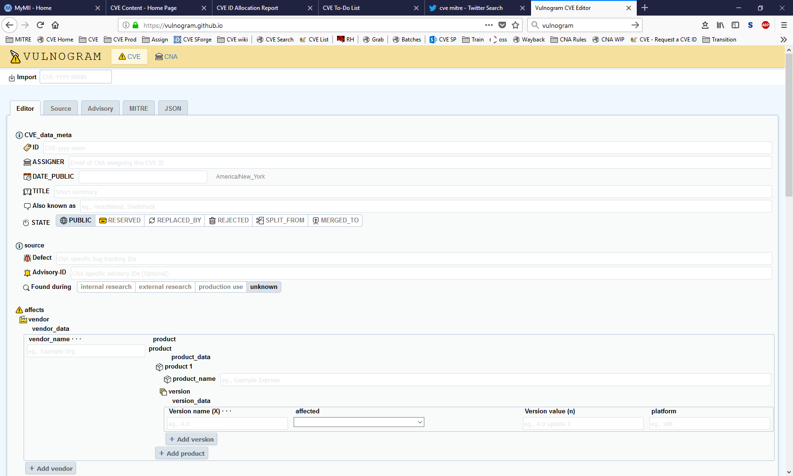
Vulnogram

Slide 39
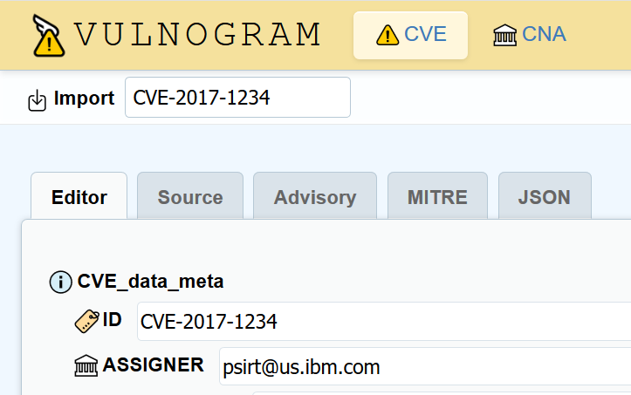
Vulnogram – Choose the CVE ID to edit
Input the ID you want to update

Slide 40
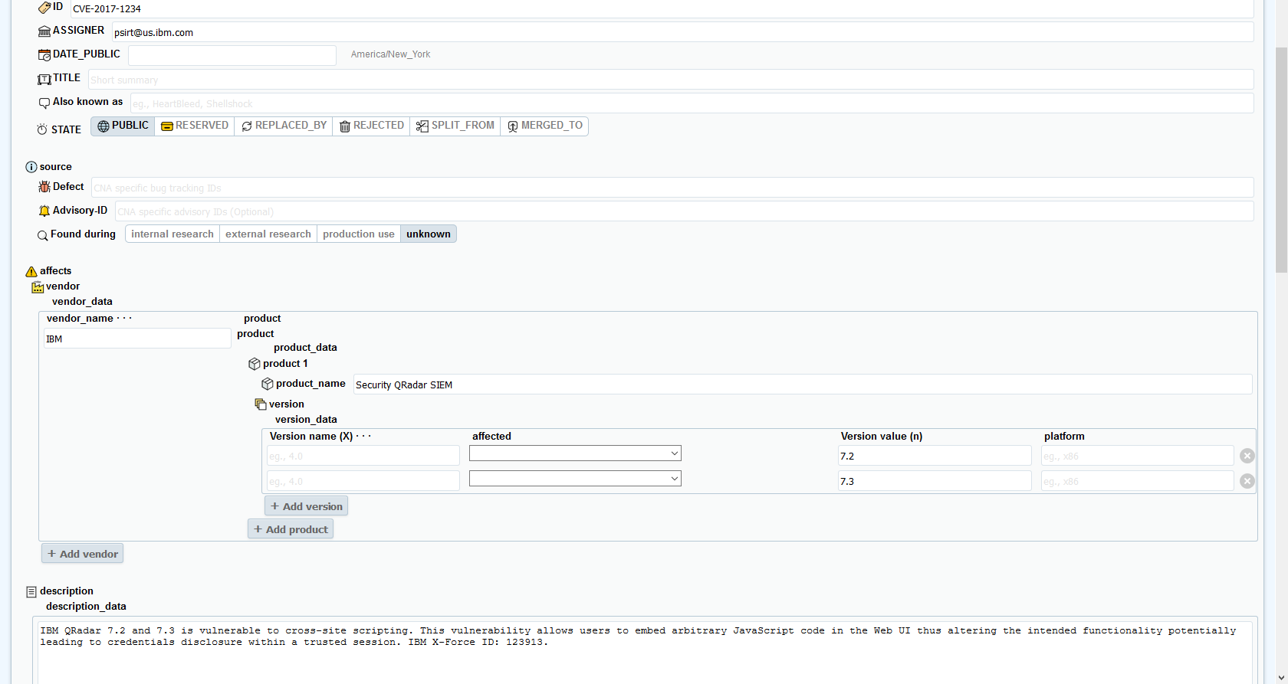
Vulnograms – CVE Info is Imported from the Official List

Slide 41
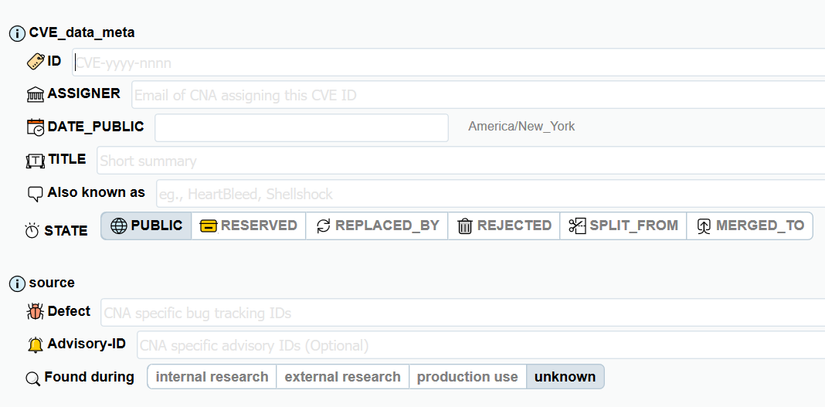
Vulnogram – Fill in Metadata
Required Fields

Slide 42
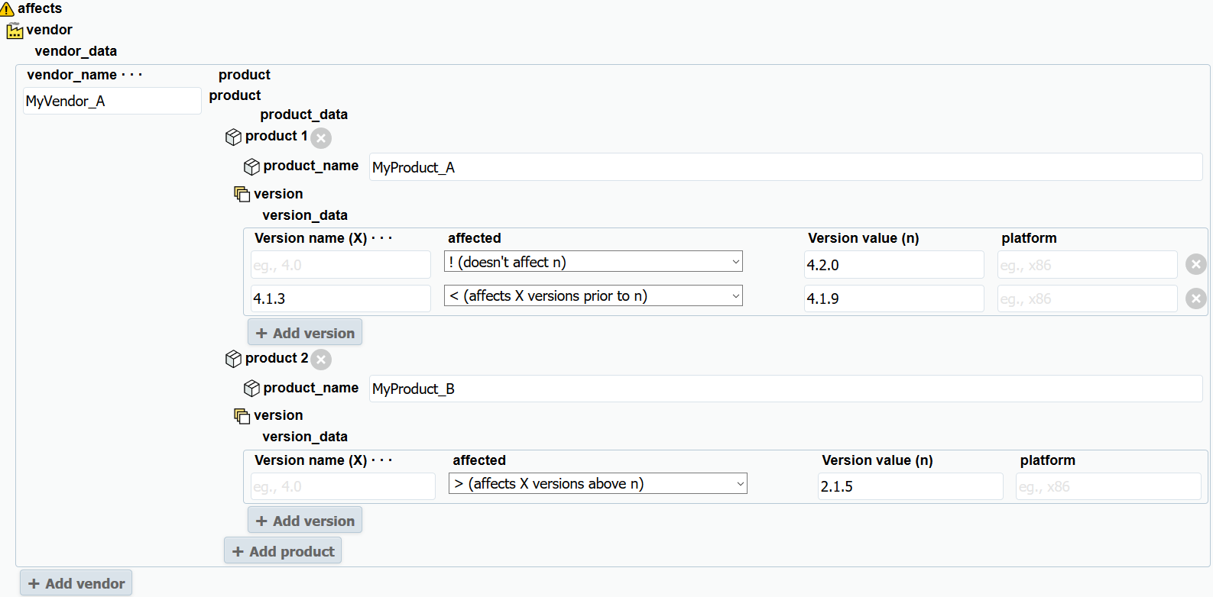
Vulnogram – Fill in Product/Version Info.
At least one vendor/product/version group is required
Optional
Required

Slide 43
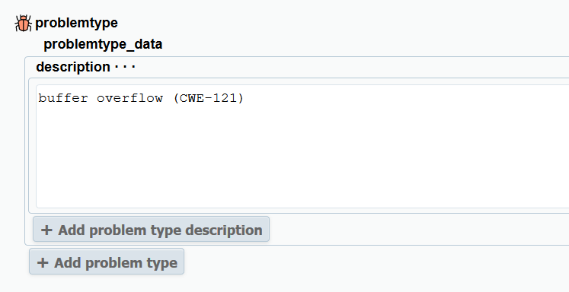
Vulnogram – Fill in Problem Type

Slide 44
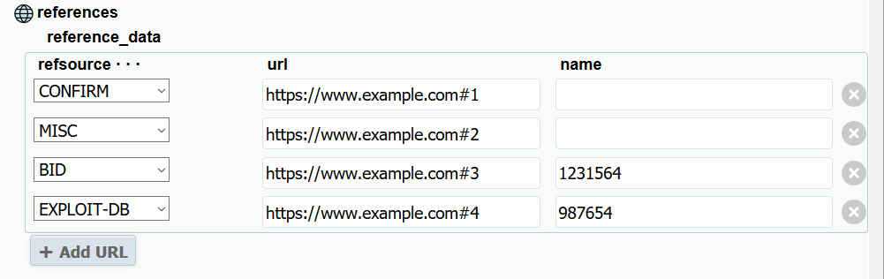
Vulnogram – Add Reference(s)

Slide 45
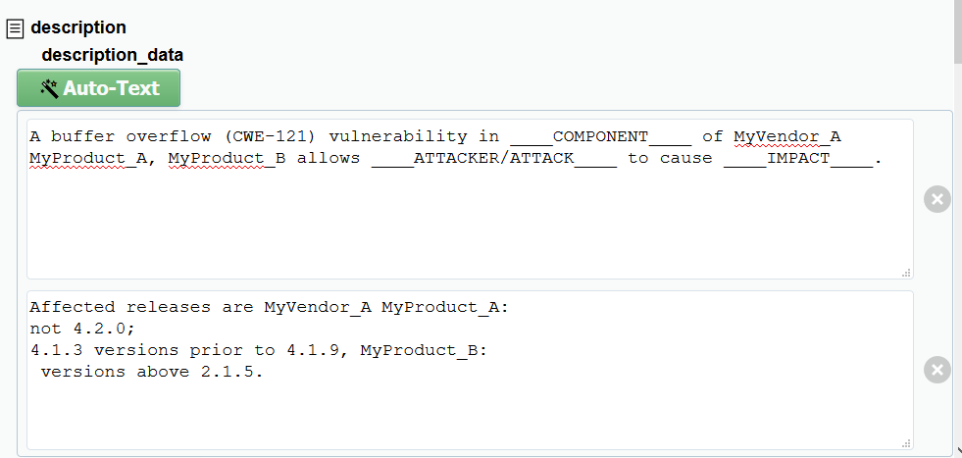
Vulnogram – Use the Auto-Text feature to Start the Description

Slide 46
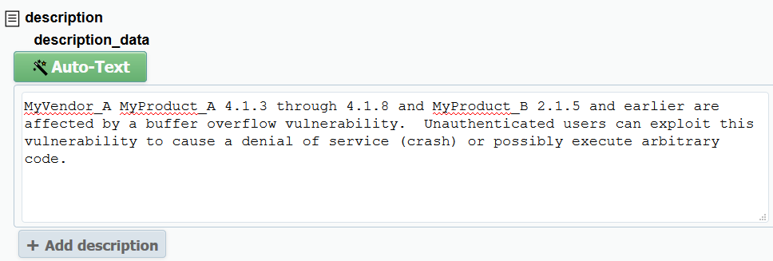
Vulnogram – Or Start the Description from Scratch

Slide 47
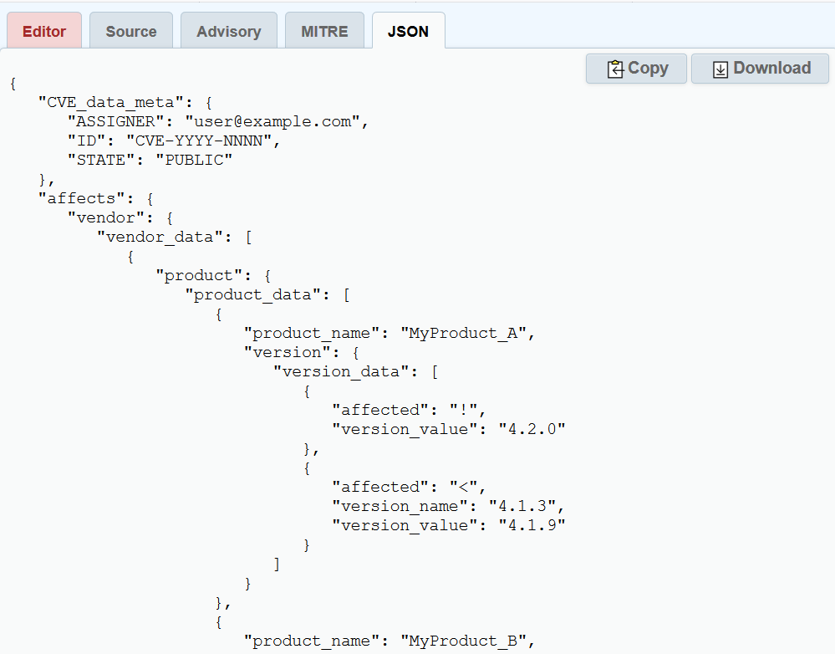
Vulnogram – Access the JSON via the JSON tab

