Slide 1
CVE Entry Creation
CVE Team

Slide 2
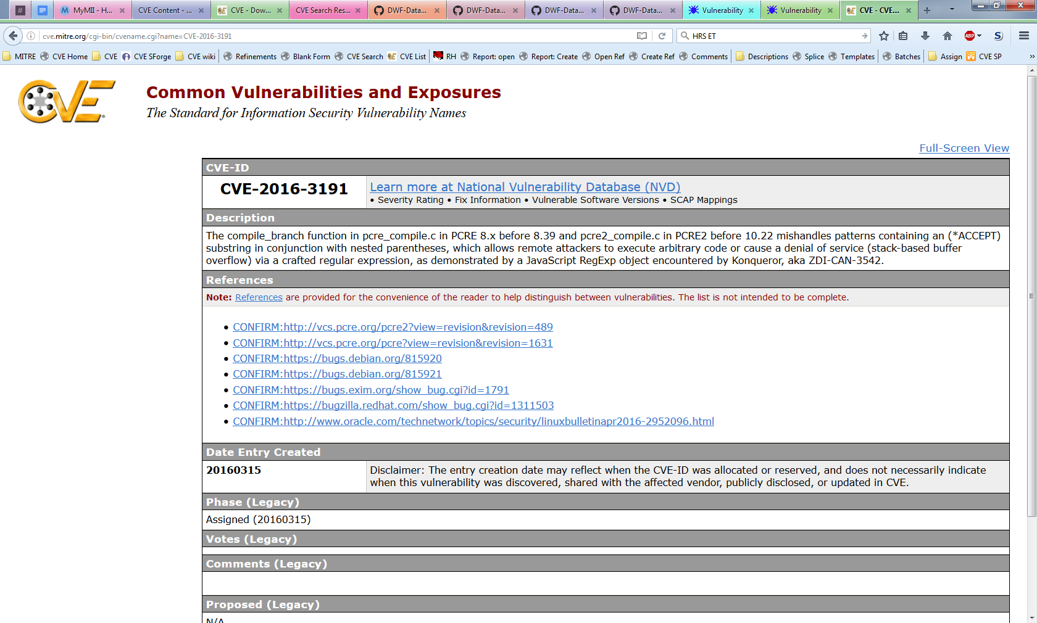
What Is a CVE Entry
The CVE Program Root CNA (currently MITRE) maintains the CVE List, which is a list of CVE Entries
A CVE Entry contains:
CVE ID
Description
References
Notes:
Discuss possibility of changing this and what the impact might be.

Slide 3
Purpose of a CVE Entry
Tell CVE users which vulnerability the CVE ID is assigned to
Explain why the vulnerabilities in the CVE List are different
Inform users when a new CVE Entry is made public
Justify the counting decisions that were made
Create a historical log CVE ID assignments

Slide 4
Minimum Requirements
Defined by Appendix B of the CNA Rules:
CVE ID
Product name
Version (affected and/or fixed)
Problem type (vulnerability type, root cause, and/or impact)
Description
Reference (one or more)
Accept the CVE Program’s Terms of Use
https://cve.mitre.org/about/termsofuse.html
Acceptance is required so that the CVE Program Root CNA can make the CVE List freely available to anyone who wants to use it

Slide 5
Minimum Description Requirements
Must contain the product, version, and problem type information
The product, version, and problem type are also submitted as separate fields
They need to be in both locations because the separate fields are not currently included in the CVE List used by downstream users
Only information in the provided References can be included in the Description
The CVE Program needs to be trusted not to leak the privileged information reporters share with it. Requiring that every detail be backed up by another source helps keep this trust
Only relevant information about the vulnerability should be included
Must be in English (when sent to the Program Root CNA)

Slide 6
Additional Information Often Included
Distinguishing Details
Component names
Attack vectors
Root cause
Threat Details
Attacker
Impact
Remediation Details*
Conditions
Proof of Concepts (PoC)*
Credits*
* Not traditionally included (by Program Root CNA) in CVE Entry Descriptions

Slide 7
Goldilocks Entries
Writing good Descriptions is as much art as it is science
Too few details result in:
Users not being able to tell which vulnerability the ID is assigned to
Duplicate assignments
Too many details result in:
Makes the Description more difficult to read
Increases the chance of errors
The perfect CVE Entry gives just enough information to identify and distinguish the vulnerability from others, and nothing else

Slide 8
Why Include More than the Minimum?
Entries with the minimum details do not always meet the goals of a CVE Entry:
Tell CVE users which vulnerability the CVE ID is assigned to
Explain why the vulnerabilities in the CVE List are different
Inform users when a new CVE Entry is made public
Justify the counting decisions that were made
Including more information will help downstream users

Slide 9
Example 1: Minimum Information Comparison
CVE-2016-7280
Cross-site scripting (XSS) vulnerability in Microsoft Edge allows remote attackers to inject arbitrary web script or HTML via unspecified vectors, aka “Microsoft Edge Information Disclosure Vulnerability,” a different vulnerability than CVE-2016-7206.
CVE-2016-7206
Cross-site scripting (XSS) vulnerability in Microsoft Edge allows remote attackers to inject arbitrary web script or HTML via unspecified vectors, aka “Microsoft Edge Information Disclosure Vulnerability,” a different vulnerability than CVE-2016-7280.
These two entries are identical. As far as the outside world is concerned, they might as well be the same entry
Notes:
* The issue described here is not specific to Microsoft. Microsoft has a long history as a CNA, which made it easier to have consistency across the examples.

Slide 10
Example 2: Distinguishable Through the Component
CVE-2016-7239
The RegEx class in the XSS filter in Microsoft Internet Explorer 9 through 11 and Microsoft Edge allows remote attackers to conduct cross-site scripting (XSS) attacks and obtain sensitive information via unspecified vectors, aka “Microsoft Browser Information Disclosure Vulnerability.”
CVE-2016-3273
The XSS Filter in Microsoft Internet Explorer 9 through 11 and Microsoft Edge does not properly restrict JavaScript code, which allows remote attackers to obtain sensitive information via a crafted web site, aka “Microsoft Browser Information Disclosure Vulnerability.”
You can now tell the two entries apart, but it would still be difficult to tell if the vulnerability you just discovered is the same vulnerability as CVE-2016-7239 or CVE-2016-3273
Notes:
* The issue described here is not specific to Microsoft. Microsoft has a long history as a CNA, which made it easier to have consistency across the examples.

Slide 11
Example 3: Descriptive Root Cause
CVE-2010-1489
The XSS Filter in Microsoft Internet Explorer 8 does not properly perform neutering for the SCRIPT tag, which allows remote attackers to conduct cross-site scripting (XSS) attacks against web sites that have no inherent XSS vulnerabilities, a different issue than CVE-2009-4074.
CVE-2009-4074
The XSS Filter in Microsoft Internet Explorer 8 allows remote attackers to leverage the “response-changing mechanism” to conduct cross-site scripting (XSS) attacks against web sites that have no inherent XSS vulnerabilities, related to the details of output encoding and improper modification of an HTML attribute, aka “XSS Filter Script Handling Vulnerability.”
The more specific root cause descriptions provide enough details to tell the two vulnerabilities apart and maybe enough to identify if the CVE ID applies to a vulnerability
Notes:
* The issue described here is not specific to Microsoft. Microsoft has a long history as a CNA, which made it easier to have consistency across the examples.

Slide 12
Example 4: Too Specific
CVE-2016-9112
Description
Floating Point Exception (aka FPE or divide by zero) in opj_pi_next_cprl function in openjp2/pi.c:523 in OpenJPEG 2.1.2.
The description contains a line number where the fault happens. However, it was later shown that the vulnerability could cause faults in multiple locations of the code
CVE-2016-9633
Description
An issue was discovered in the Tatsuya Kinoshita w3m fork before 0.5.3-33. w3m allows remote attackers to cause a denial of service (infinite loop and resource consumption) via a crafted HTML page.
The description is written for a specific fork of w3m, which was correct given the information at the time. However, it was later shown that the same vulnerability affects the main branch of w3m

Slide 13
What Should You Do
There is no perfect answer
If there were, we would have included in the CNA Rules
If you already have a process for writing Descriptions and publishing advisories, we do not expect you change them
Unless they do not contain the required information
Unfortunately, due to the way most CNAs structure their advisories, they have to write new Descriptions for the CVE Entries
The information in the entry is always limited by the details that are made public

Slide 14
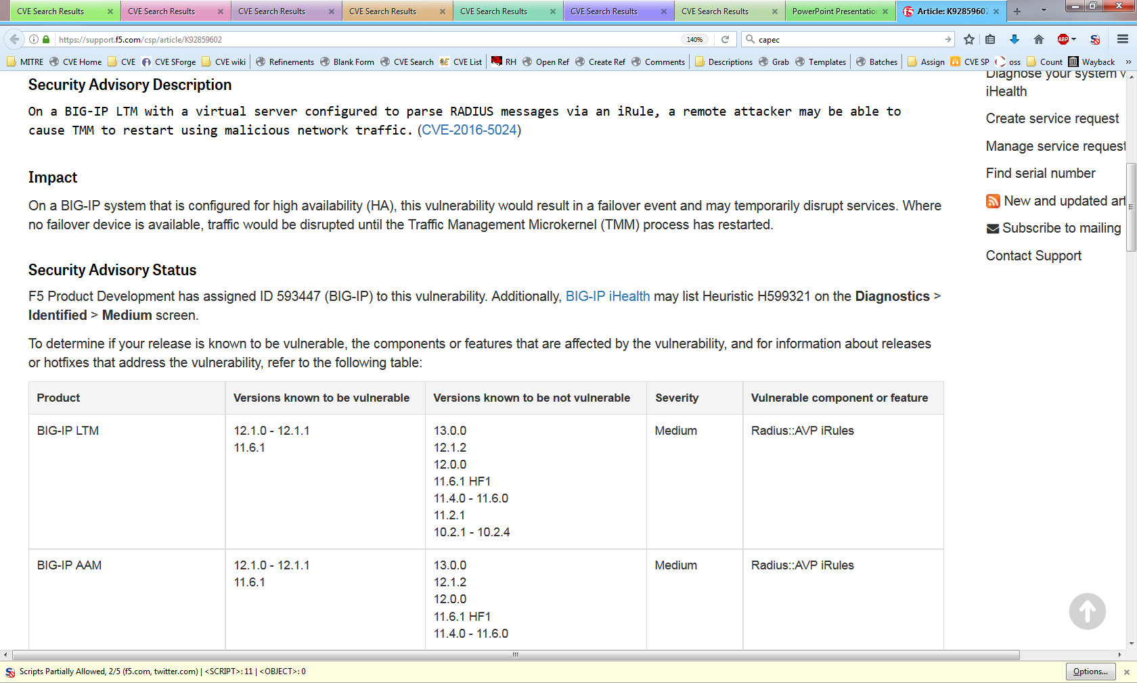
Example: Formatting Requires Description Change for CVE Entry Submission
The description is missing the version information
Source: https://support.f5.com/csp/#/article/K92859602

Slide 15
How Program Root CNA Does It
If you don’t already have a style that works for CVE Entries, you can borrow the Program Root CNA’s template format
[VULNTYPE] in [COMPONENT] in [VENDOR][PRODUCT] [VERSION] allows [ATTACKER] to [IMPACT] via [VECTOR].
[COMPONENT] in [VENDOR] [PRODUCT] [VERSION] [ROOT CAUSE], which allows [ATTACKER] to [IMPACT] via [VECTOR].
For more information on the Program Root CNA’s style see the CVE GitHub website
http://cveproject.github.io/docs/content/key-details-phrasing.pdf
Notes:
The templates are meant to:
Make the description unique
Justify counting decisions
Be short and to the point
Easy to scan
Generate reproducible results
The template has trouble with vulnerabilities affect many products and/or versions.

Slide 16
What Shouldn’t Be in a CVE Entry
Advertising
Code excerpts/diffs
Exploits/Proof of Concepts
Inappropriate language

Slide 17
Entry Creation Tips

Slide 18
Avoid Using Commit IDs as Versions
Sometimes it is unavoidable because the product has no other versioning scheme
However, commit IDs present a number of problems:
There isn’t a good way to tell if your version of the product has the commit.
It’s hard to tell which version contains the commit.
Commit IDs change when moved to a new system, e.g., git to SVN
CVE-2016-7504
A use-after-free vulnerability was observed in Rp_toString function of Artifex Software, Inc. MuJS before 5c337af4b3df80cf967e4f9f6a21522de84b392a. A successful exploitation of this issue can lead to code execution or denial of service condition.

Slide 19
Avoid Saying All Versions Are Affected
Avoid making statements like “all version” or “version X and later”
People (including security tool vendors) will take you at your word, and won’t always get the update when the vulnerability is fixed
CVE-2017-0341
All versions of the NVIDIA Windows GPU Display Driver contain a vulnerability in the kernel mode layer (nvlddmkm.sys) handler for DxgDdiEscape where user provided input can trigger an access to a pointer that has not been initialized which may lead to denial of service or potential escalation of privileges.
Fixed on May 9, 2017
https://nvidia.custhelp.com/app/answers/detail/a_id/4462

Slide 20
Avoid Live Exploits
We don’t want to accidentally exploit someone
CVE-2016-1283
The pcre_compile2 function in pcre_compile.c in PCRE 8.38 mishandles the /((?:F?+(?:^(?(R)a+\"){99}-))(?J)(?'R'(?'R'<((?'RR'(?'R'\){97)?J)?J)(?'R'(?'R'\){99|(:(?|(?'R')(\k'R')|((?'R')))H'R'R)(H'R))))))/ pattern and related patterns with named subgroups, which allows remote attackers to cause a denial of service (heap-based buffer overflow) or possibly have unspecified other impact via a crafted regular expression, as demonstrated by a JavaScript RegExp object encountered by Konqueror.

Slide 21
Be Clear Which Products Are Affected
If an upstream, bundled product is affected, clearly indicate that it contains the vulnerability
CVE-2017-5047
An integer overflow in FFmpeg in Google Chrome prior to 57.0.2987.98 for Mac, Windows, and Linux and 57.0.2987.108 for Android allowed a remote attacker to perform an out of bounds memory write via a crafted video file, related to ChunkDemuxer.
Readers may think that this vulnerability only affects Chrome, but it really affects any product using FFmpeg
Program Root CNA uses the following phrasing in these cases
[UPSTREAM PRODUCT] [AFFECTED VERSION], as used in [DOWNSTREAM PRODUCT],

Slide 22
Backup Slides

Slide 23
Terms of Use
LICENSE
Submissions: For all materials you submit to the Common Vulnerabilities and Exposures (CVE®), you hereby grant to The MITRE Corporation (MITRE) and all CVE Numbering Authorities (CNAs) a perpetual, worldwide, non-exclusive, no-charge, royalty-free, irrevocable copyright license to reproduce, prepare derivative works of, publicly display, publicly perform, sublicense, and distribute such materials and derivative works. Unless required by applicable law or agreed to in writing, you provide such materials on an "AS IS" BASIS, WITHOUT WARRANTIES OR CONDITIONS OF ANY KIND, either express or implied, including, without limitation, any warranties or conditions of TITLE, NON-INFRINGEMENT, MERCHANTABILITY, or FITNESS FOR A PARTICULAR PURPOSE.
CVE Usage: MITRE hereby grants you a perpetual, worldwide, non-exclusive, no-charge, royalty-free, irrevocable copyright license to reproduce, prepare derivative works of, publicly display, publicly perform, sublicense, and distribute Common Vulnerabilities and Exposures (CVE®). Any copy you make for such purposes is authorized provided that you reproduce MITRE's copyright designation and this license in any such copy.
DISCLAIMERS
ALL DOCUMENTS AND THE INFORMATION CONTAINED THEREIN PROVIDED BY MITRE ARE PROVIDED ON AN "AS IS" BASIS AND THE CONTRIBUTOR, THE ORGANIZATION HE/SHE REPRESENTS OR IS SPONSORED BY (IF ANY), THE MITRE CORPORATION, ITS BOARD OF TRUSTEES, OFFICERS, AGENTS, AND EMPLOYEES, DISCLAIM ALL WARRANTIES, EXPRESS OR IMPLIED, INCLUDING BUT NOT LIMITED TO ANY WARRANTY THAT THE USE OF THE INFORMATION THEREIN WILL NOT INFRINGE ANY RIGHTS OR ANY IMPLIED WARRANTIES OF MERCHANTABILITY OR FITNESS FOR A PARTICULAR PURPOSE.
Notes:
http://cve.mitre.org/about/termsofuse.html
Copied 2/20/2018

