Slide 1
CVE Entry Creation
CVE Team
Notes:
Voice Track: Once you have assigned the CVE IDs, performed your coordination to get the vulnerability fixed, and published the vulnerability information, you are going to need to populate the CVE entry. In these slides, we will going over how to create a CVE entry.

Slide 2
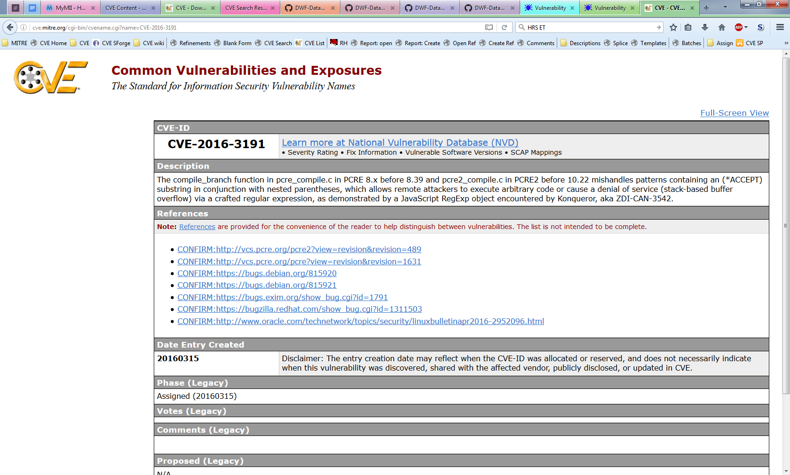
What Is a CVE Entry
The CVE Program Root CNA (currently MITRE) maintains the CVE List, which is a list of CVE Entries
A CVE Entry contains:
CVE ID
Description
References
Notes:
Voice Track: CVE entries are what is put into the CVE master list. CVE Entries contain the CVE ID, a description, references, and other metadata.

Slide 3
Purpose of a CVE Entry
Tell CVE users which vulnerability the CVE ID is assigned to
Explain why the vulnerabilities in the CVE List are different
Inform users when a new CVE Entry is made public
Justify the counting decisions that were made
Create a historical log CVE ID assignments
Notes:
Voice Track: CVE entries inform users when there is a new vulnerability, which ID is associated with the vulnerability and how the vulnerability is different from the other vulnerabilities, etc.

Slide 4
Minimum Requirements
Defined by Appendix B of the CNA Rules:
CVE ID
Product name
Version (affected and/or fixed)
Problem type (vulnerability type, root cause, and/or impact)
Description
Reference (one or more)
Accept the CVE Program’s Terms of Use
https://cve.mitre.org/about/termsofuse.html
Acceptance is required so that the CVE Program Root CNA can make the CVE List freely available to anyone who wants to use it
Notes:
Voice Track: When submitting a CVE entry, it must contain a CVE ID, product name, version information (whether affected or fixed), a problem type (either a vulnerability type, root cause, or impact), a prose description, and one or more references. Lastly, you also have to access the CVE program’s Terms of Use, which basically say that you allow MITRE to republish the information provided and downstream users of CVE can do the same.

Slide 5
Minimum Description Requirements
Must contain the product, version, and problem type information
The product, version, and problem type are also submitted as separate fields
They need to be in both locations because the separate fields are not currently included in the CVE List used by downstream users
Only information in the provided References can be included in the Description
The CVE Program needs to be trusted not to leak the privileged information reporters share with it. Requiring that every detail be backed up by another source helps keep this trust
Only relevant information about the vulnerability should be included
Must be in English (when sent to the Program Root CNA)
Notes:
Voice Track: The description in the CVE entry has additional requirements. First, the product, version, and problem type information must also be in the description. Many of our downstream users only look at the description and will be confused if the product name is not included, for example.
All details in the description must be supported by information in the references. The CVE Program is trusted with embargoed information. We not want to even have the appearance of leaking embargoed information.
All information in the description should be relevant to the vulnerability and the description must be in English. Using the JSON format, you can provide descriptions in multiple languages, but at least one of them has to be in English.
OPTIONAL: Discuss the proposed change to publish without a reference.

Slide 6
Additional Information Often Included
Distinguishing Details
Component names
Attack vectors
Root cause
Threat Details
Attacker
Impact
Remediation Details*
Conditions
Proof of Concepts (PoC)*
Credits*
* Not traditionally included (by Program Root CNA) in CVE Entry Descriptions
Notes:
Voice Track: You can provide more details than those required. For example, you may want to include whether the attacker needs to be authenticated or if the vulnerability can be exploited remotely.

Slide 7
Goldilocks Entries
Writing good Descriptions is as much art as it is science
Too few details result in:
Users not being able to tell which vulnerability the ID is assigned to
Duplicate assignments
Too many details result in:
Makes the Description more difficult to read
Increases the chance of errors
The perfect CVE Entry gives just enough information to identify and distinguish the vulnerability from others, and nothing else
Notes:
Voice Track: Writing a good description is as much an art as it is a science. Every CNA balances providing enough information for users to defend themselves without disclosing too much information.

Slide 8
Why Include More than the Minimum?
Entries with the minimum details do not always meet the goals of a CVE Entry:
Tell CVE users which vulnerability the CVE ID is assigned to
Explain why the vulnerabilities in the CVE List are different
Inform users when a new CVE Entry is made public
Justify the counting decisions that were made
Including more information will help downstream users
Notes:
Voice Track: We ask that you provide more than just the minimum information because it is often not enough to distinguish between vulnerabilities. You can imagine how many buffer overflows there are in a particular version of Windows.

Slide 9
Example 1: Minimum Information Comparison
CVE-2016-7280
Cross-site scripting (XSS) vulnerability in Microsoft Edge allows remote attackers to inject arbitrary web script or HTML via unspecified vectors, aka “Microsoft Edge Information Disclosure Vulnerability,” a different vulnerability than CVE-2016-7206.
CVE-2016-7206
Cross-site scripting (XSS) vulnerability in Microsoft Edge allows remote attackers to inject arbitrary web script or HTML via unspecified vectors, aka “Microsoft Edge Information Disclosure Vulnerability,” a different vulnerability than CVE-2016-7280.
These two entries are identical. As far as the outside world is concerned, they might as well be the same entry
Notes:
Voice Track: And we have an example of this. Here only the minimum information was provided so the descriptions look exactly the same. We kept getting requests to merge these entries from people who believed the were the same vulnerability, which is why we added the phrase at the end of the description saying that they are different. Even with the phrase, we still sometimes get requests to merge the IDs.
* The issue described here is not specific to Microsoft. Microsoft has a long history as a CNA, which made it easier to have consistency across the examples.

Slide 10
Example 2: Distinguishable Through the Component
CVE-2016-7239
The RegEx class in the XSS filter in Microsoft Internet Explorer 9 through 11 and Microsoft Edge allows remote attackers to conduct cross-site scripting (XSS) attacks and obtain sensitive information via unspecified vectors, aka “Microsoft Browser Information Disclosure Vulnerability.”
CVE-2016-3273
The XSS Filter in Microsoft Internet Explorer 9 through 11 and Microsoft Edge does not properly restrict JavaScript code, which allows remote attackers to obtain sensitive information via a crafted web site, aka “Microsoft Browser Information Disclosure Vulnerability.”
You can now tell the two entries apart, but it would still be difficult to tell if the vulnerability you just discovered is the same vulnerability as CVE-2016-7239 or CVE-2016-3273
Notes:
Voice Track: Here is another example, where we were given some additional information and can now distinguish between the two vulnerabilities. However, if I am a researcher and I found a vulnerability, this is probably not enough information for me to determine whether I have rediscovered the vulnerability.
* The issue described here is not specific to Microsoft. Microsoft has a long history as a CNA, which made it easier to have consistency across the examples.

Slide 11
Example 3: Descriptive Root Cause
CVE-2010-1489
The XSS Filter in Microsoft Internet Explorer 8 does not properly perform neutering for the SCRIPT tag, which allows remote attackers to conduct cross-site scripting (XSS) attacks against web sites that have no inherent XSS vulnerabilities, a different issue than CVE-2009-4074.
CVE-2009-4074
The XSS Filter in Microsoft Internet Explorer 8 allows remote attackers to leverage the “response-changing mechanism” to conduct cross-site scripting (XSS) attacks against web sites that have no inherent XSS vulnerabilities, related to the details of output encoding and improper modification of an HTML attribute, aka “XSS Filter Script Handling Vulnerability.”
The more specific root cause descriptions provide enough details to tell the two vulnerabilities apart and maybe enough to identify if the CVE ID applies to a vulnerability
Notes:
Voice Track: Providing some additional information, like the root causes in this case, may allow researchers to do that mapping and reduce duplicate requests.
* The issue described here is not specific to Microsoft. Microsoft has a long history as a CNA, which made it easier to have consistency across the examples.

Slide 12
Example 4: Too Specific
CVE-2016-9112
Description
Floating Point Exception (aka FPE or divide by zero) in opj_pi_next_cprl function in openjp2/pi.c:523 in OpenJPEG 2.1.2.
The description contains a line number where the fault happens. However, it was later shown that the vulnerability could cause faults in multiple locations of the code
CVE-2016-9633
Description
An issue was discovered in the Tatsuya Kinoshita w3m fork before 0.5.3-33. w3m allows remote attackers to cause a denial of service (infinite loop and resource consumption) via a crafted HTML page.
The description is written for a specific fork of w3m, which was correct given the information at the time. However, it was later shown that the same vulnerability affects the main branch of w3m
Notes:
Voice Track: However, you can also get too specific. In the top example, the description says that the vulnerability originates on line 523 of pi.c. However, the vulnerability is really a chain of bug in multiple locations. The requester tried to get a CVE per bug using this description as a reason why more CVE IDs should be assigned.
The description in the bottom example, says the vulnerability is in the Tatsuya Kinoshita w3m for, when in reality the vulnerability was inherited from the main w3m branch and thus all w3m branches are affected.
So be careful with what you put in a description.

Slide 13
What Should You Do
There is no perfect answer
If there were, we would have included in the CNA Rules
If you already have a process for writing Descriptions and publishing advisories, we do not expect you change them
Unless they do not contain the required information
Unfortunately, due to the way most CNAs structure their advisories, they have to write new Descriptions for the CVE Entries
The information in the entry is always limited by the details that are made public
Notes:
Voice Track: So, what should you do? Again, there is not perfect answer. If you are already writing a description and they meet our requirements, then go ahead and use it. Unfortunately, due to the way most CNAs structure their advisories, they have to make modifications before they can submit the description to MITRE.

Slide 14
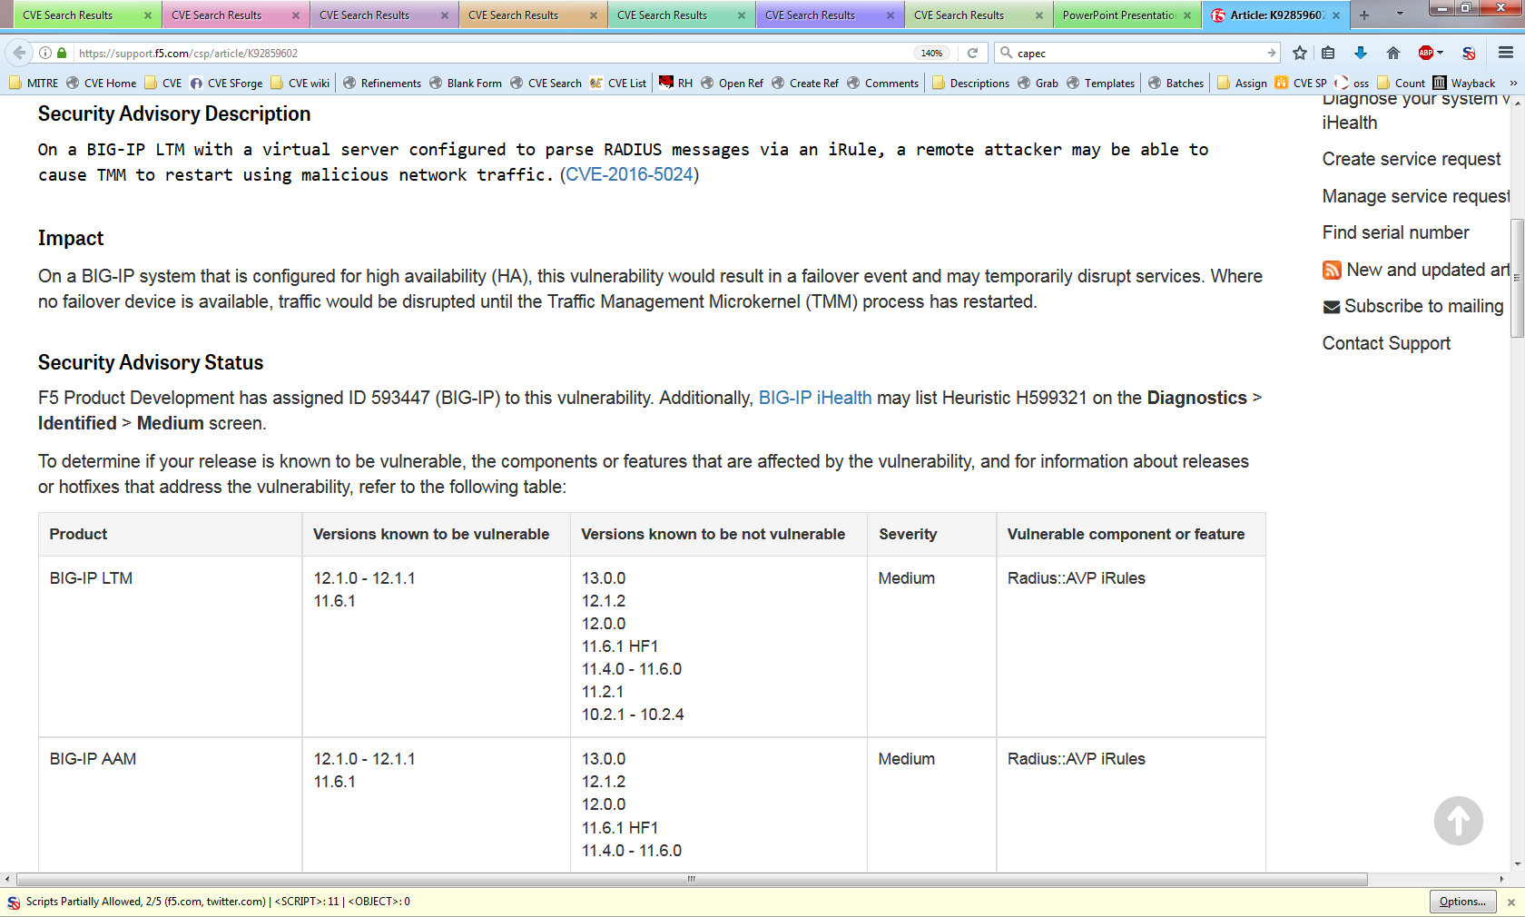
Example: Formatting Requires Description Change for CVE Entry Submission
The description is missing the version information
Source: https://support.f5.com/csp/#/article/K92859602
Notes:
Voice Track: Here we have an example from F5 where the description for their advisory is almost exactly what is required, but the version information is in a separate table. When they submit the CVE entry, they should add the version information to the description.

Slide 15
How Program Root CNA Does It
If you don’t already have a style that works for CVE Entries, you can borrow the Program Root CNA’s template format
[VULNTYPE] in [COMPONENT] in [VENDOR][PRODUCT] [VERSION] allows [ATTACKER] to [IMPACT] via [VECTOR].
[COMPONENT] in [VENDOR] [PRODUCT] [VERSION] [ROOT CAUSE], which allows [ATTACKER] to [IMPACT] via [VECTOR].
For more information on the Program Root CNA’s style see the CVE GitHub website
http://cveproject.github.io/docs/content/key-details-phrasing.pdf
Notes:
Voice Track: If you don’t have your own description style, you can use MITER’s. It is a simple fill in the blank sentence. We have document up on GitHub on how we fill in those blanks if you want more information.

Slide 16
What Shouldn’t Be in a CVE Entry
Advertising
Code excerpts/diffs
Exploits/Proof of Concepts
Inappropriate language
Notes:
Voice Track: There are certain things that should not be in a CVE entry. No advertising or inappropriate language. No Code excerpts, diffs, exploits, or proofs of concepts. All of the CVE entries go through transforms and none of the formatting will be preserved, so even if you do put them in there, they will look ugly.

Slide 17
Entry Creation Tips
Notes:
Voice Track: Here are some additional tips for creating a CVE entry.

Slide 18
Avoid Using Commit IDs as Versions
Sometimes it is unavoidable because the product has no other versioning scheme
However, commit IDs present a number of problems:
There isn’t a good way to tell if your version of the product has the commit
It’s hard to tell which version contains the commit
Commit IDs change when moved to a new system, e.g., git to SVN
CVE-2016-7504
A use-after-free vulnerability was observed in Rp_toString function of Artifex Software, Inc. MuJS before 5c337af4b3df80cf967e4f9f6a21522de84b392a. A successful exploitation of this issue can lead to code execution or denial of service condition.
Notes:
Voice Track: Avoid using commit IDs as versions. Downstream users will rarely know if the version they are using has that commit. We have also run into instances where the commit ID changes. However, sometimes that is all you have so that is what you use.

Slide 19
Avoid Saying All Versions Are Affected
Avoid making statements like “all version” or “version X and later”
People (including security tool vendors) will take you at your word, and won’t always get the update when the vulnerability is fixed
CVE-2017-0341
All versions of the NVIDIA Windows GPU Display Driver contain a vulnerability in the kernel mode layer (nvlddmkm.sys) handler for DxgDdiEscape where user provided input can trigger an access to a pointer that has not been initialized which may lead to denial of service or potential escalation of privileges.
Fixed on May 9, 2017
https://nvidia.custhelp.com/app/answers/detail/a_id/4462
Notes:
Voice Track: Avoid saying “all versions” or “versions X and later” are affected. People will take you at your word (including vulnerability scanners) and they won’t always look for an update.

Slide 20
Avoid Live Exploits
We don’t want to accidentally exploit someone
CVE-2016-1283
The pcre_compile2 function in pcre_compile.c in PCRE 8.38 mishandles the /((?:F?+(?:^(?(R)a+\"){99}-))(?J)(?'R'(?'R'<((?'RR'(?'R'\){97)?J)?J)(?'R'(?'R'\){99|(:(?|(?'R')(\k'R')|((?'R')))H'R'R)(H'R))))))/ pattern and related patterns with named subgroups, which allows remote attackers to cause a denial of service (heap-based buffer overflow) or possibly have unspecified other impact via a crafted regular expression, as demonstrated by a JavaScript RegExp object encountered by Konqueror.
Notes:
Voice Track: Again, avoid including exploits. Here is an example where MITRE wasn’t entirely sure what was going on so we wrote that PCRE mishandles this pattern. If you aren’t familiar with PCRE, it is a library used to process regular expressions and is often used parse data. It turns out that there were a number of people where using PCRE to parse the CVE List and we exploited them. We received a few angry emails.

Slide 21
Be Clear Which Products Are Affected
If an upstream, bundled product is affected, clearly indicate that it contains the vulnerability
CVE-2017-5047
An integer overflow in FFmpeg in Google Chrome prior to 57.0.2987.98 for Mac, Windows, and Linux and 57.0.2987.108 for Android allowed a remote attacker to perform an out of bounds memory write via a crafted video file, related to ChunkDemuxer.
Readers may think that this vulnerability only affects Chrome, but it really affects any product using FFmpeg
Program Root CNA uses the following phrasing in these cases
[UPSTREAM PRODUCT] [AFFECTED VERSION], as used in [DOWNSTREAM PRODUCT]
Notes:
Voice Track: If you assign a CVE ID to a third-party product, please make it clear that it is the origin of the vulnerability. In the example, the description reads as if only Google Chrome is affected, when in reality, Ffmpeg and any other product using Ffmpeg are affected.

Slide 22
Backup Slides

Slide 23
Terms of Use
LICENSE
Submissions: For all materials you submit to the Common Vulnerabilities and Exposures (CVE®), you hereby grant to The MITRE Corporation (MITRE) and all CVE Numbering Authorities (CNAs) a perpetual, worldwide, non-exclusive, no-charge, royalty-free, irrevocable copyright license to reproduce, prepare derivative works of, publicly display, publicly perform, sublicense, and distribute such materials and derivative works. Unless required by applicable law or agreed to in writing, you provide such materials on an "AS IS" BASIS, WITHOUT WARRANTIES OR CONDITIONS OF ANY KIND, either express or implied, including, without limitation, any warranties or conditions of TITLE, NON-INFRINGEMENT, MERCHANTABILITY, or FITNESS FOR A PARTICULAR PURPOSE.
CVE Usage: MITRE hereby grants you a perpetual, worldwide, non-exclusive, no-charge, royalty-free, irrevocable copyright license to reproduce, prepare derivative works of, publicly display, publicly perform, sublicense, and distribute Common Vulnerabilities and Exposures (CVE®). Any copy you make for such purposes is authorized provided that you reproduce MITRE's copyright designation and this license in any such copy.
DISCLAIMERS
ALL DOCUMENTS AND THE INFORMATION CONTAINED THEREIN PROVIDED BY MITRE ARE PROVIDED ON AN "AS IS" BASIS AND THE CONTRIBUTOR, THE ORGANIZATION HE/SHE REPRESENTS OR IS SPONSORED BY (IF ANY), THE MITRE CORPORATION, ITS BOARD OF TRUSTEES, OFFICERS, AGENTS, AND EMPLOYEES, DISCLAIM ALL WARRANTIES, EXPRESS OR IMPLIED, INCLUDING BUT NOT LIMITED TO ANY WARRANTY THAT THE USE OF THE INFORMATION THEREIN WILL NOT INFRINGE ANY RIGHTS OR ANY IMPLIED WARRANTIES OF MERCHANTABILITY OR FITNESS FOR A PARTICULAR PURPOSE.
Notes:
http://cve.mitre.org/about/termsofuse.html
Copied 2/20/2018

