Slide 1
Submissions through GitHub
Notes:
Voice Track: Submitting through the GitHub.

Slide 2
Git Submission (Initial Setup)
Create a GitHub.com account
Inform your parent CNA of the account you will be using
Fork your parent’s repository
E.g., child CNAs of Program Root CNA’s fork CVEProject/cvelist, but child CNAs of DWF for distributedweaknessfiling/cvelist
You can use your personal account or an organization account for the fork
GitHub provides a web interface for organization forks
Clone your fork to a local repository
Set the upstream git repo
git remote add upstream git@github.com:[PARENT REPO]
[PARENT REPO] is the path to your parent’s repo, e.g., CVEProject/cvelist

Slide 3
Git Submission, Part 1
Ensure your fork is up to date
git fetch upstream
git checkout master
git merge upstream/master
Optionally push any updates from the upstream CVEProject/cvelist master back to you fork on GitHub.com:
git push
Create a new branch, separate from master, for each submission
git branch $YOUR_BRANCH master
Include multiple, related updates when possible
If you are working on multiple branches make sure you explicitly branch against master otherwise future branches may include work from other local branches

Slide 4
Git Submission, Part 2
Make changes to your branch
git checkout $YOUR_BRANCH
Edit the files you want to change in your branch
Limit your changes to only the portions of the JSON that needs updating. Otherwise, you may accidentally overwrite information
Validate the changes against the JSON schema
python -m json.tool < $CHANGED_FILE.json
jsonschema -i $CHANGED_FILE.json CVE_JSON_4.0_min_public.schema
The schema file is available in the CVE Automation Working Group and version 4 is currently in use

Slide 5
Git Submission, Part 3
Review the updates
Make sure that only information intend to make public is included
For example, check that every CVE ID is mentioned in one of the references associated with it to avoid making public information about a vulnerability ahead of schedule
Also, review the details in the Description. Do they agree with information in the associated References?
Commit the changes
git commit –av
If necessary, push your branch to GitHub.com
Git push origin $YOUR_BRANCH

Slide 6
Git Submission, Part 4
Create a pull request
Browse to https://github.com/$YOUR_FORK/cvelist/pull/new/master
Fill in the form
Important fields:
base fork is the upstream repo in which you want your updates merged - CVEProject/cvelist
base is the branch in the upstream repo in which the changes should be placed – master
head fork is your repo from which the updates should be taken; e.g., /$YOUR_FORK /cvelist
compare is the branch in your repo where the changes are; e.g., $YOUR_BRANCH
Make sure that GitHub reports that the branches can be merged
Resolve any conflicts before you merge

Slide 7
Notes on Git Usage
Only submit information to the Program Root CNA cvelist repo that is intended to become public immediately. There is no support for embargoed submissions!!
GitHub is a PILOT - it could be changed significantly or even halted
Submissions are subject to the CVE Submissions License Terms of Use
https://cve.mitre.org/about/termsofuse.html
Strongly recommended submissions use signed commits. NOTE: some hierarchies may require all submissions to be signed

Slide 8
Resources and Tools
Notes:
Voice Track: Resources available to assist you with CVE submissions.

Slide 9
Resources
CVEProject GIT Project (https://github.com/CVEProject)
- automation-working-group/tree/master/tools repo
cmdlinejsonvalidator.py - Python script to validate JSON files. Requires a valid schema file
automation-working-group/tree/master/cve_json_schema repo
CVE_JSON_4.0_min.schema - Schema for validating a JSON file against the minimal CVE structure
DRAFT-JSON-file-format-v4.md - 4.0 CVE JSON spec
Vulnogram - tool for creating and editing CVE information in CVE JSON format
https://github.com/Vulnogram/Vulnogram
https://vulnogram.github.io/
Created by Chandan Nandakumaraiah
CVE Request Form (https://cveform.mitre.org/)
Notes:
Voice Track: There are some tools available to help you with your submissions. We have a JSON validator on the automation working group GitHub repository, along with the JSON schema. Also, Chandan from PaloAltoNetworks was kind enough to open source the Vulnogram tool he created. Vulnogram provides a form that you can fill out and it will generate the JSON for you.

Slide 10
Vulnogram (example slides)

Slide 11
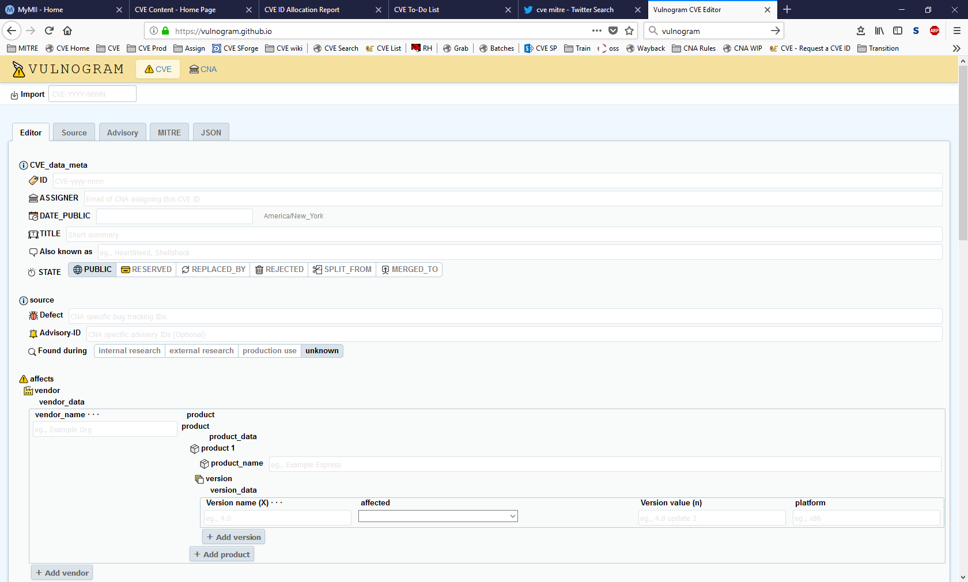
Vulnogram

Slide 12
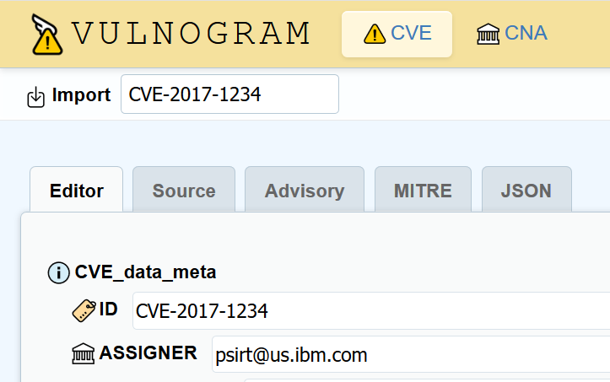
Vulnogram – Choose the CVE ID to Edit
Input the ID you want to update

Slide 13
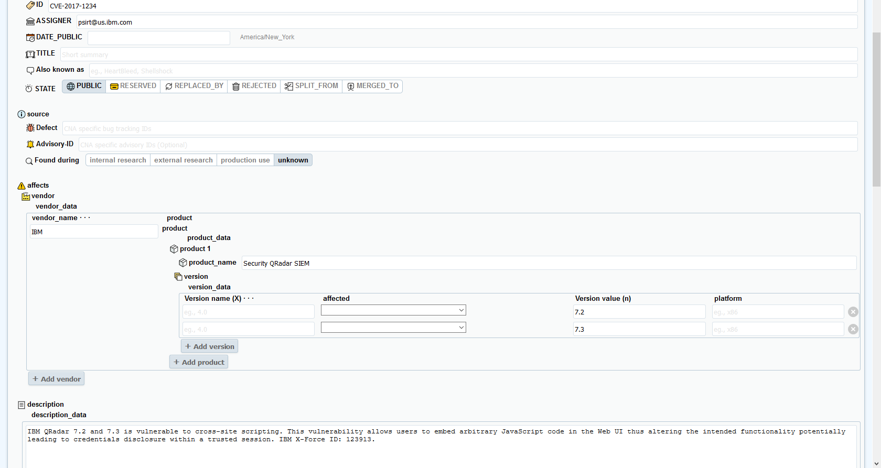
Vulnograms – CVE Information Is Imported from the Official CVE List

Slide 14
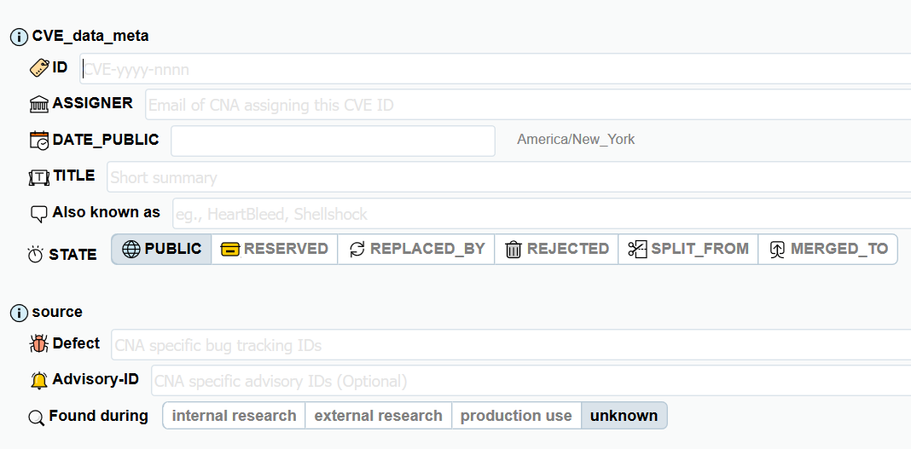
Vulnogram – Fill in Metadata
Required Fields

Slide 15
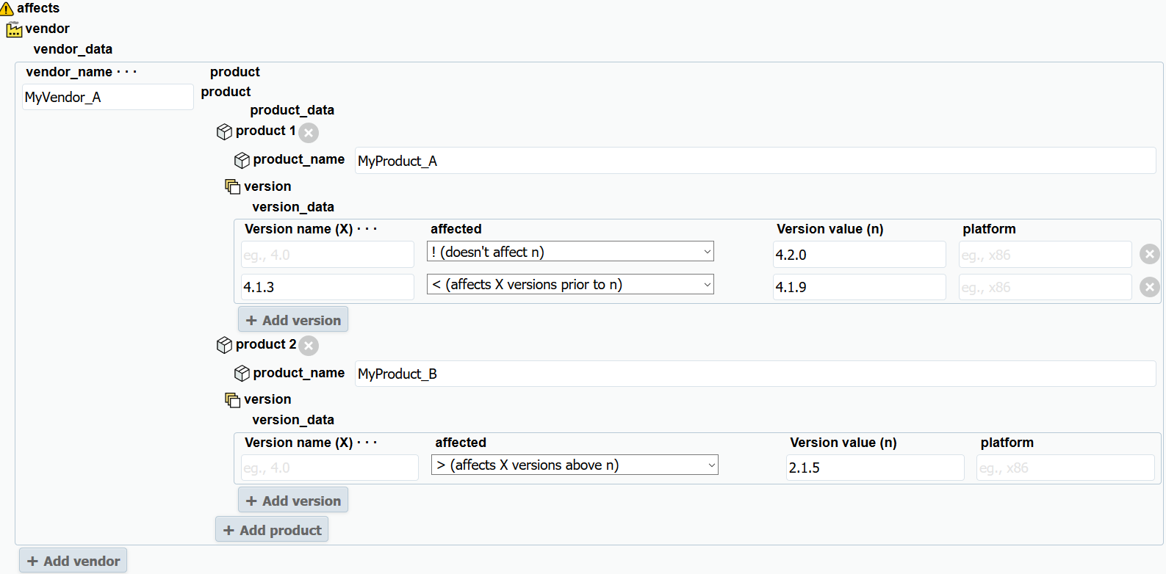
Vulnogram – Fill in Product/Version Information
At least one vendor/product/version group is required
Optional
Required

Slide 16
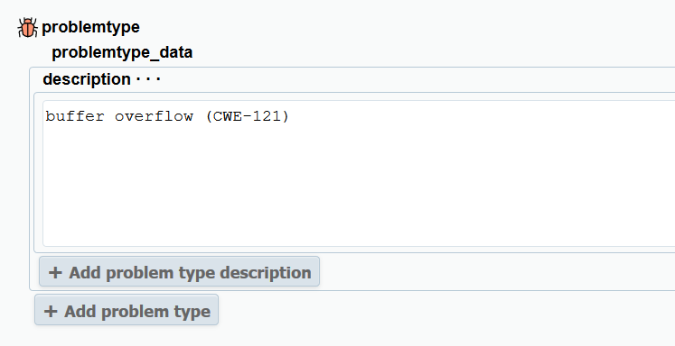
Vulnogram – Fill in Problem Type

Slide 17
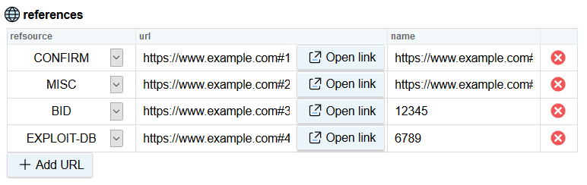
Vulnogram – Add Reference(s)
Refsource and name aren’t required by the standard. However, Vulnogram requires the refsource and if you use refsource, you have to a name.
Required

Slide 18
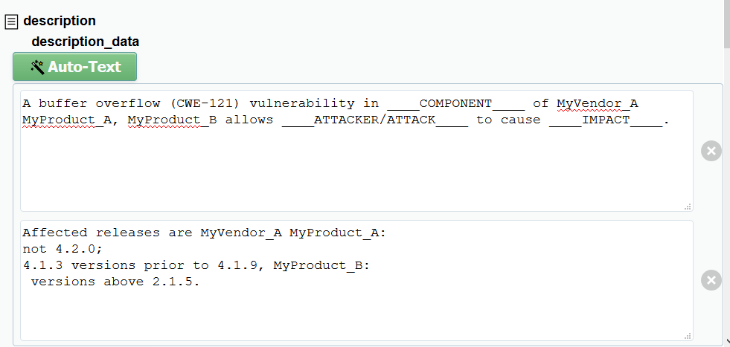
Vulnogram – Use the Auto-Text Feature to Start the Description
Must be moved to the top box for Vulnogram to generate proper JSON

Slide 19
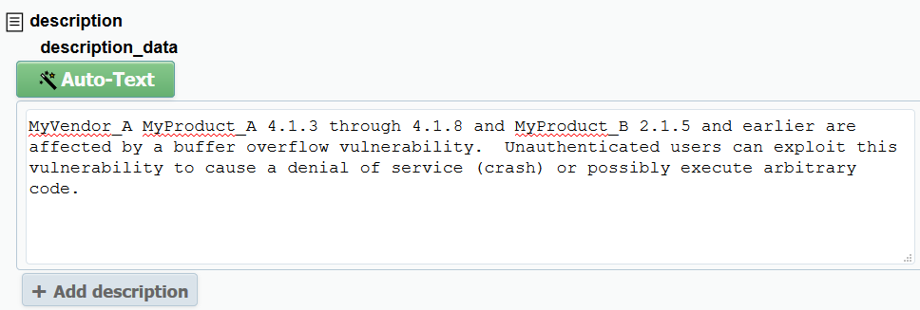
Vulnogram – Or Start the Description from Scratch
Product, version, and problem type information must be in the description section. There are no restrictions on how they are phrased in the description section.

Slide 20
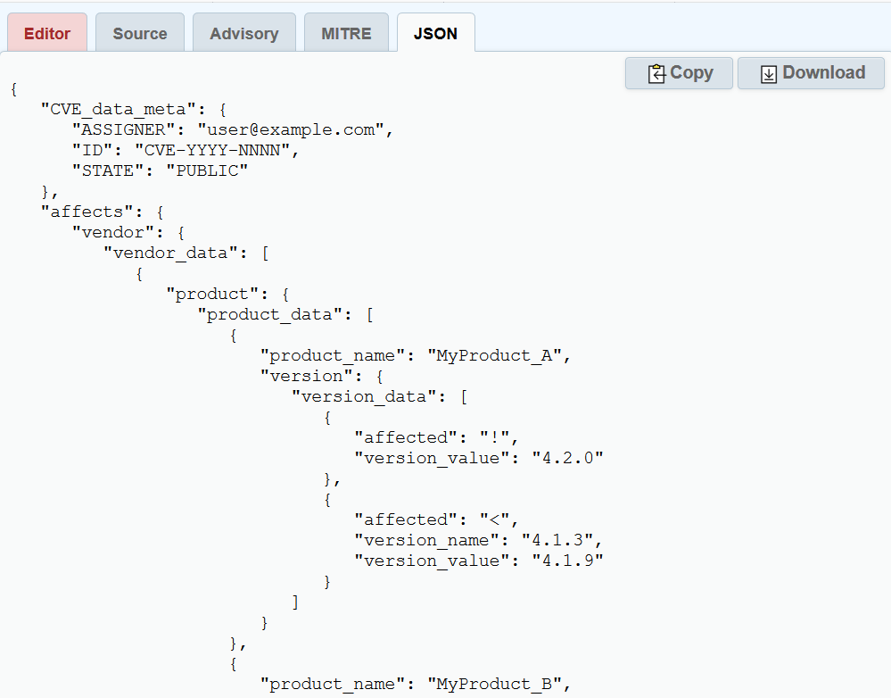
Vulnogram – Access the JSON via the JSON Tab

