Slide 1
CVE Submission Process for Submissions to CVE Program Root CNA Only
CVE Team
Notes:
Voice Track: So now that you know how to create CVE entries, how to get them to MITRE?

Slide 2
Disclaimers
These slides assume that the information needed for the CVE Entry is already generated.
These processes are specific to the CVE Program Root CNA (currently MITRE). Other Root CNAs may have other processes that CNAs need to follow.
Notes:
SKIP

Slide 3
Outline
Information Requirements
Approved Formats
Flat File
CSV
JSON (preferred)
Approved Submission Channels
GitHub (preferred)
Web Form
Submission Process
Tools
Notes:
Voice Track: In this presentation, we will go over the required information, what formats you need to use for the submissions, how to send the information to MITRE, what MITRE does on our end when we receive a request, and some tools that can help you with the formatting.

Slide 4
Where to Send the Information?
Root CNA
CVE Program Root CNA
Notes:
Voice Track: Send your submissions to MITRE.

Slide 5
Required Information
CVE ID
Products
Versions
Problem Type (Vulnerability Type or Impact)
References
Description
This should include product/version information as well as the problem type as it will be used to populate the entry in the CVE List
Assigning CNA
Cautions
ASCII Only – no UTF or Unicode
Plain text only – no HTML or proprietary document formats
Avoid MS-DOS style line endings (CR/LF)
Notes:
Voice Track: The required information is a CVE ID, products, versions, problem type, references, a descriptions, and the assigning CNA.

Slide 6
Submission Formats
Notes:
Voice Track: Each CVE ID submission needs to be in one of the approved formats

Slide 7
Approved Formats
Flat File
Comma-Separated Values (CSV)
CVE JSON
Notes:
Voice Track: The approved formats are the flat file format, comma-separated values, and JSON. The JSON format is the preferred format because it has a lot more flexibility than the other formats.

Slide 8
Flat File
[CVEID]:
[PRODUCT]:
[VERSION]:
[PROBLEMTYPE]:
[REFERENCES]:
[DESCRIPTION]:
[ASSIGNINGCNA]:
On CVE ID per [CVEID] field
Field order should be maintained
A single field should not span multiple lines
https://cve.mitre.org/cve/list_rules_and_guidance/cve_assignment_information_format.html#format
Notes:
Voice Track: The flat file format looks like this. Each field name is enclosed in brackets and the field name is separated from the value by a colon. You can only have one CVE ID per set of fields. The field order needs to be maintained. And fields cannot span multiple lines.

Slide 9
Flat File – Handling Multiples
Multiple CVE Entries
Concatenate entries, optionally separated by a blank line
Multiple Products/Versions
Separate products, and correspondingly versions, by a semicolon followed by a space and, to separate multiple versions for a given product by a comma followed by a space; e.g.,
[PRODUCT]:IOS; IOS XE
[VERSION]:12.2, 15.0 through 15.6; 3.2 through 3.18
[DESCRIPTION]:... IOS 12.2 and 15.0 through 15.6 and IOS EX 3.2 through 3.18 …
Multiple References
Separate references by a space; e.g.,
[REFERENCES]: https://tomcat.apache.org/security-9.html#Fixed_in_Apache_Tomcat_9.0.0.M13 https://tomcat.apache.org/security-8.html#Fixed_in_Apache_Tomcat_8.5.8 https://tomcat.apache.org/security-8.html#Fixed_in_Apache_Tomcat_8.0.39 https://tomcat.apache.org/security-7.html#Fixed_in_Apache_Tomcat_7.0.73 https://tomcat.apache.org/security-6.html#Fixed_in_Apache_Tomcat_6.0.48
Notes:
Voice Track: To submit multiple vulnerabilities at the same time, you can put them in the same file and separate them with a blank line. If there are multiple affected products and versions of those products, then separate them with a semicolon. In the example here, versions 12.2 and 15.0 through 15.6 of IOS are affected and versions 3.2 through 3.18 of IOS XE are affected. If you want to provide multiple references, separate them via a space.

Slide 10
Flat File Example
[CVEID]:CVE-2017-1194
[PRODUCT]:IBM WebSphere Application Server
[VERSION]:7.0, 8.0, 8.5, 9.0
[PROBLEMTYPE]:Cross-site request forgery
[REFERENCES]:http://www.ibm.com/support/docview.wss?uid=swg22001226
[DESCRIPTION]:IBM WebSphere Application Server 7.0, 8.0, 8.5, and 9.0 is vulnerable to cross-site request forgery which could allow an attacker to execute malicious and unauthorized actions transmitted from a user that the website trusts. IBM X-Force ID: 123669.
[ASSIGNINGCNA]:IBM
Notes:
Voice Track: Here is an example of a flat file submission.

Slide 11
Comma-Separated Values (CSV)
Fields:
CVE ID
Product
Version
Problem type
Description
Assigning CNA
Omit field headers
Use double-quotes if fields contain commas or quote characters
Do not use embedded line-breaks
Write any double-quote characters in a field as two double-quote characters
On CVE ID per line
Notes:
Voice Track: The comma-separated values format is very similar to flat file format, except the field headers are no longer needed and everything is on a single line separated by a comma. If there is a comma or quote character in the field value, then enclose the field in double quotes. If there is a double quote character in the field value, use two double-quote characters and please do not use embedded line-breaks.

Slide 12
CSV – Handling Multiples
Multiple CVE Entries
Multiple lines, one per entry
Multiple Products/Versions
Separate products, and correspondingly versions, by a semicolon followed by a space and, to separate multiple versions for a given product by a comma followed by a space; e.g.,
CVE-2017-3862,”IOS; IOS XE”,”12.2, 15.0 through 15.6; 3.2 through 3.18”,…
Multiple References
Separate references by a space; e.g.,
CVE-2016-6816,…,”https://tomcat.apache.org/security-9.html#Fixed_in_Apache_Tomcat_9.0.0.M13 https://tomcat.apache.org/security-8.html#Fixed_in_Apache_Tomcat_8.5.8 https://tomcat.apache.org/security-8.html#Fixed_in_Apache_Tomcat_8.0.39 https://tomcat.apache.org/security-7.html#Fixed_in_Apache_Tomcat_7.0.73 https://tomcat.apache.org/security-6.html#Fixed_in_Apache_Tomcat_6.0.48”,…
Notes:
Voice Track: To submit multiple entries, put them in the same file, each on their own line. Again, if there are multiple product and versions, separate them by a semicolon, and if there are multiple references, separate them by a space.

Slide 13
CSV Example
"CVE-2017-1194","IBM WebSphere Application Server"," 7.0, 8.0, 8.5, 9.0",“Cross-site request forgery","http://www.ibm.com/support/docview.wss?uid=swg22001226","IBM WebSphere Application Server 7.0, 8.0, 8.5, and 9.0 is vulnerable to cross-site request forgery which could allow an attacker to execute malicious and unauthorized actions transmitted from a user that the website trusts. IBM X-Force ID: 123669.","IBM"
Notes:
Voice Track: Here is an example of the CSV submission.

Slide 14
CVE JSON 4.0
Required Data Strings
Data_type - CVE
Data_format - MITRE
Data_version – 4.0
Required Data Objects
CVE_data_meta
CVE ID
ASSIGNER
Affects
Vendor
Product
Version
Description
References
Problemtype
Additional optional objects can be included. For a full list see:
https://github.com/CVEProject/automation-working-group/blob/master/cve_json_schema/DRAFT-JSON-file-format-v4.md
Notes:
Voice Track: The JSON is a little different. It handles product and version information in a more structured way. It also supports more fields than just the minimum, such as CVSS vectors, impact, and credits. The full list of the supported fields in the format specification on the automation working group’s GitHub repo.

Slide 15
CVE JSON Example
{
"data_type": "CVE",
"data_format": "MITRE",
"data_version": "4.0",
"CVE_data_meta": { "ASSIGNER": "psirt@us.ibm.com", "ID": "CVE-2017-1194" },
"affects": { "vendor": { "vendor_data": [ { "vendor_name": "IBM", "product": { "product_data": [ { "product_name": "WebSphere Application Server", "version": { "version_data": [ { "version_value": "7.0, 8.0, 8.5, 9.0" } ] } } ] } } ] } },
"problemtype": { "problemtype_data": [ { "description": [ { "lang": "eng", "value": "Cross-site request forgery" } ] } ] },
"references": { "reference_data": [ { "url": "http://www.ibm.com/support/docview.wss?uid=swg22001226" } ] },
"description": { "description_data": [ { "lang": "eng", "value": "IBM WebSphere Application Server 7.0, 8.0, 8.5, and 9.0 is vulnerable to cross-site request forgery which could allow an attacker to execute malicious and unauthorized actions transmitted from a user that the website trusts. IBM X-Force ID: 123669." } ] }
}
Note that whitespace, including line breaks, can be included to improve readability
Notes:
Voice Track: Here is an example of a JSON submission. You can see that there can be multiple vendors, which can have multiple products, which can have multiple versions. Another thing to note here is that you can provide multiple descriptions if you want to provide translations to languages other than English.

Slide 16
Submission Channels
Notes:
Voice Track: So once you have formatted the entries, you are ready send it to MITRE. How do you do that?

Slide 17
Approved Submission Channels
Web Form
Supports all three file types
Suited to new submissions only
Has limits on form field sizes!
GitHub
Supports CVE JSON only!
Avoid files with MS-DOS style line endings (CR/LF)
Suited to both new and updated submissions
Notes:
Voice Track: There are two submission options. You can submit through the web form or through a pull request to our GitHub repository. You can use any of the formats when submitting through the web form, but you have to use the JSON format when submitting through GitHub.

Slide 18
Submissions through the Web Form
Notes:
Voice Track: Submitting through the web form.

Slide 19
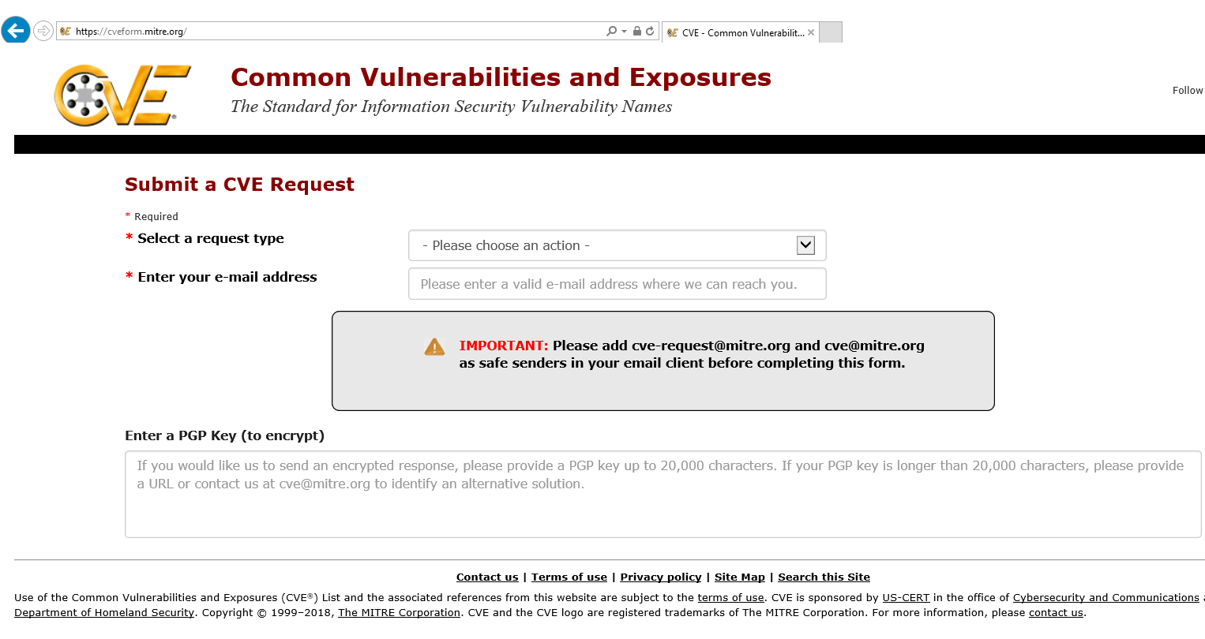
Go to https://cveform.mitre.org/
Notes:
Voice Track: Go to cveform.mitre.org

Slide 20
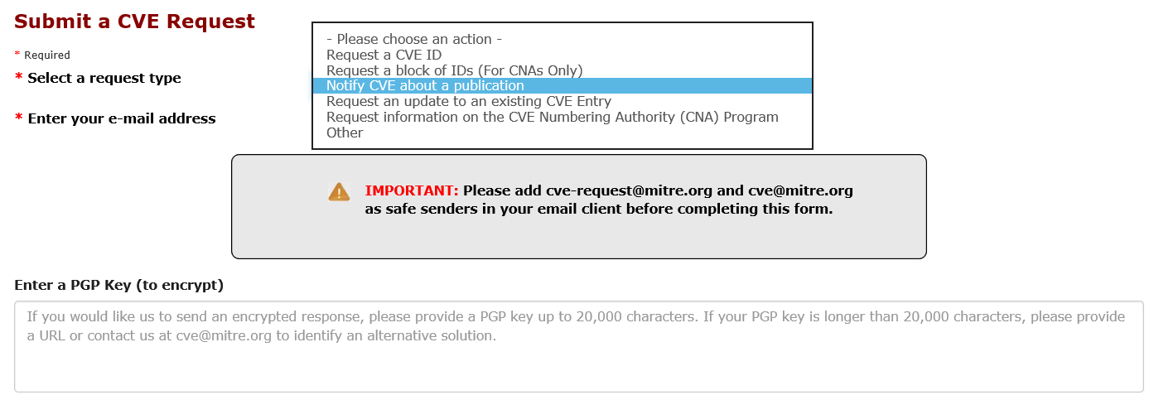
Select the “Notify CVE about a publication” Request Type
Notes:
Voice Track: Select “Notify CVE about a publication”

Slide 21
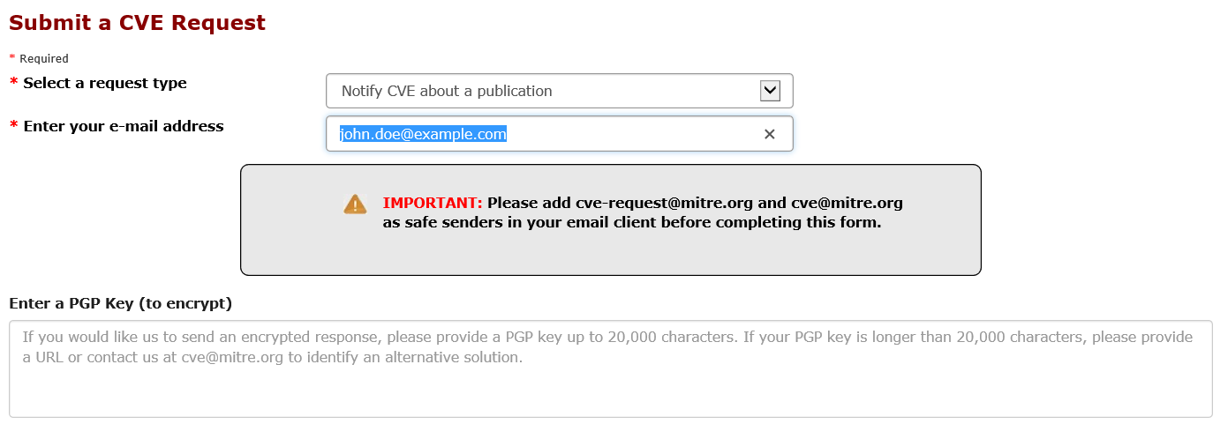
Fill in Contact Information
Notes:
Voice Track: Fill in your contact information

Slide 22
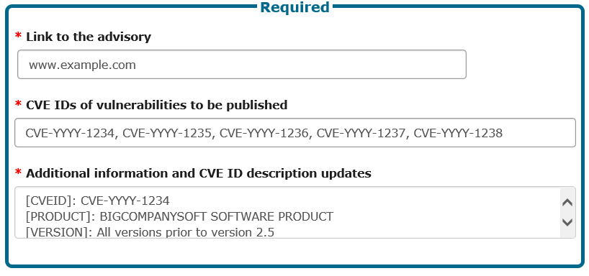
Fill in the Submission Information
Instructions for submissions greater than 2000 characters in size are at the end of the slides.
Notes:
Voice Track: Fill in the form. Put the formatted information in the “Additional information and CVE ID description updates” field.

Slide 23
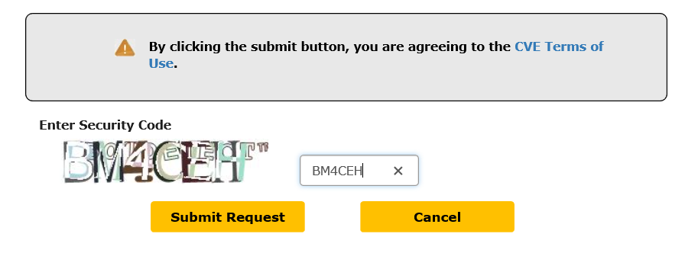
Fill in the Captcha and Select the Submit Request Button
Notes:
Voice Track: Fill in the security code and press submit.

Slide 24
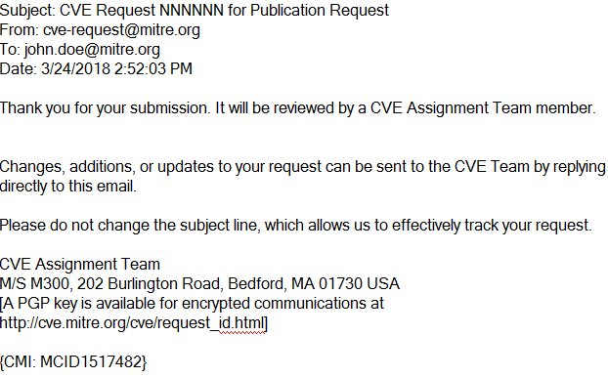
A Ticket Will Be Created and Email Acknowledgement Sent
Notes:
Voice Track: The request will go into our ticketing system and you will receive an automated email saying that we received the request.

Slide 25
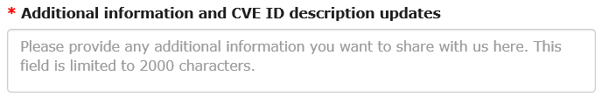
The Description Field Is Character Limited
Notes:
Voice Track: It is important to note that the “Additional information” is limited to 2,000 characters. CNAs have run into this limit.

Slide 26
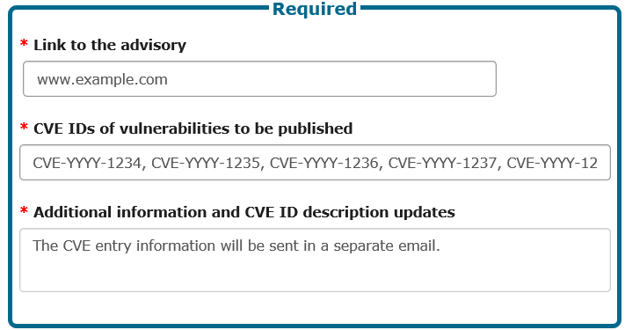
If You Need More Characters, Use Email …
Notes:
Voice Track: For now, the work around is to fill in the form like normal, except in the “Additional information” field, state that a separate email providing the information is forthcoming.

Slide 27
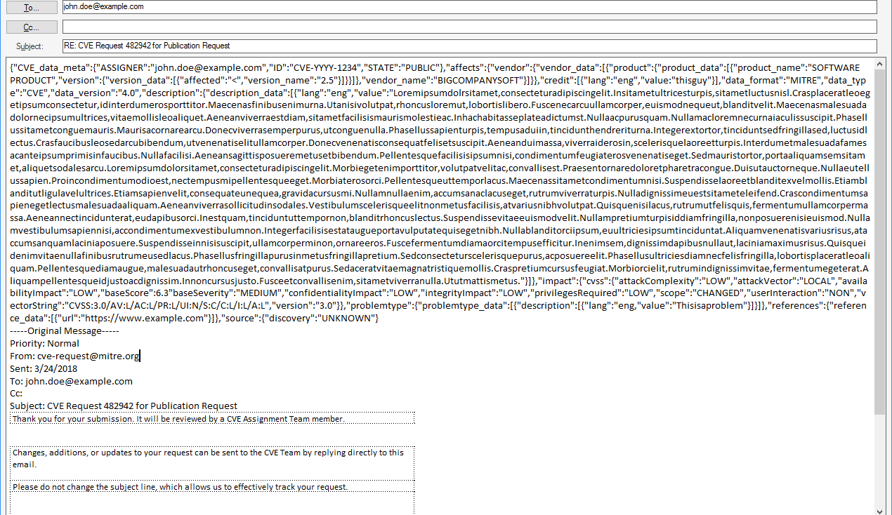
By Replying to the Acknowledgement Email
Notes:
Voice Track: Next, reply to the automated email with the formatted information either in the body of the email or as an attachment.

Slide 28
Submissions through GitHub

Slide 29
Git Submission (Initial Setup)
Create a GitHub.com account
Inform your parent CNA of the account you will be using
Fork your parent’s repository
E.g., child CNAs of Program Root CNA’s fork CVEProject/cvelist, but child CNAs of DWF for distributedweaknessfiling/cvelist
You can use your personal account or an organization account for the fork
GitHub provides a web interface for organization forks
Clone the your fork to a local repository
Set the upstream git repo
git remote add upstream git@github.com:[PARENT REPO]
[PARENT REPO] is the path to your parent’s repo, e.g., CVEProject/cvelist
Notes:
Voice Track: For the GitHub submissions, go to our CVEProject/cvelist repo on GitHub and create a fork of it. The cvelist repo is broken down into folders for each year and further broken down into folder per thousand vulnerabilities. In these folders, each CVE ID has its own JSON file. To submit CVE entries, you will change the appropriate JSON files on your own branch and create a pull request to the CVEProject repo. Further in guidance developed by the CNAs through the CNA Collaboration Working Group can be found on our GitHub.io site (http://cveproject.github.io/docs/cna/processes_documentation/index.html).
You will need to register your GitHub username before you create the pull request. You can do this by making an “Other” request through the CVE web form.
It is also important to note that once the submission is on GitHub, it will immediately become public.

Slide 30
Git Submission, Part 1
Ensure your fork is up to date
git fetch upstream
git checkout master
git merge upstream/master
Optionally push any updates from the upstream CVEProject/cvelist master back to you fork on GitHub.com:
git push
Create a new branch, separate from master, for each submission
git branch $YOUR_BRANCH master
Include multiple, related updates when possible
If you are working on multiple branches make sure you explicitly branch against master otherwise future branches may include work from other local branches
Notes:
Voice Track: These slides go through each commandline instruction needed to perform and create a pull request. That is a bit too much for this presentation so I am going to skip them.

Slide 31
Git Submission, Part 2
Make changes to your branch
git checkout $YOUR_BRANCH
Edit the files you want to change in your branch
Limit your changes to only the portions of the JSON that needs updating. Otherwise, you may accidentally overwrite information
Validate the changes against the JSON schema
python -m json.tool < $CHANGED_FILE.json
jsonschema -i $CHANGED_FILE.json CVE_JSON_4.0_min_public.schema
The schema file is available in the CVE Automation Working Group and version 4 is currently in use
Notes:
SKIP

Slide 32
Git Submission, Part 3
Review the updates
Make sure that only information intend to make public is included
For example, check that every CVE ID is mentioned in one of the references associated with it to avoid making public information about a vulnerability ahead of schedule
Also, review the details in the Description. Do they agree with information in the associated References?
Commit the changes
git commit –av
If necessary, push your branch to GitHub.com
Git push origin $YOUR_BRANCH
Notes:
SKIP

Slide 33
Git Submission, Part 4
Create a pull request
Browse to https://github.com/$YOUR_FORK/cvelist/pull/new/master
Fill in the form
Important fields:
base fork is the upstream repo in which you want your updates merged - CVEProject/cvelist
base is the branch in the upstream repo in which the changes should be placed – master
head fork is your repo from which the updates should be taken; e.g., /$YOUR_FORK /cvelist
compare is the branch in your repo where the changes are; e.g., $YOUR_BRANCH
Make sure that GitHub reports that the branches can be merged
Resolve any conflicts before you merge
Notes:
SKIP

Slide 34
Notes on Git Usage
Only submit information to the Program Root CNA cvelist repo that is intended to become public immediately. There is no support for embargoed submissions!!
Understand that this is only a pilot - it could be changed significantly or even halted
Submissions should be made subject to the CVE Submissions License Terms of Use
It is strongly recommended that submissions use signed commits. Please note that some hierarchies may require all submissions to be signed
Notes:
SKIP

Slide 35
What Happens on Program Root CNA’s End of Process
Review
Is the assignment data for IDs assigned to the CNA?
Do the IDs exist in the CVE List as “RESERVED”?
Do the references exist and are they public?
Does the assignment data agree with the associated references?
Submission Processing
Resolve with CNA any issues uncovered during review
Incorporate assignment data into the cvelist git repo
Populate associated entries in the master CVE List
Other processing
Announce “new” CVE Entries
Publish master CVE List on cve.mitre.org
https://cve.mitre.org/data/downloads/index.html
Notes:
Voice Track: So what does MITRE do when we receive a submission? We make sure that the CVE ID is assigned to you; that the ID is in the reserved state; the reference(s) are public; and that the information in the entry matches what is in the references.
If all of that looks good, we add the submission to the CVE list. That gets updated on our website, put up on GitHub, and sent out through our announcement channels, like our Twitter feed.

Slide 36
Resources
CVEProject GIT Project (https://github.com/CVEProject)
- automation-working-group/tree/master/tools repo
cmdlinejsonvalidator.py - Python script to validate JSON files. Requires a valid schema file
automation-working-group/tree/master/cve_json_schema repo
CVE_JSON_4.0_min.schema - Schema for validating a JSON file against the minimal CVE structure
DRAFT-JSON-file-format-v4.md - 4.0 CVE JSON spec
Vulnogram - tool for creating and editing CVE information in CVE JSON format
https://github.com/Vulnogram/Vulnogram
https://vulnogram.github.io/
Created by Chandan Nandakumaraiah
CVE Request Form (https://cveform.mitre.org/)
Notes:
Voice Track: There are some tools available to help you with your submissions. We have a JSON validator on the automation working group GitHub repository, along with the JSON schema. Also, Chandan from Juniper was kind enough to open source the Vulnogram tool he created. Vulnogram provide a form that you can fill out and it will generate the JSON for you. (an example is in later slides).

Slide 37
Backup Slides

Slide 38
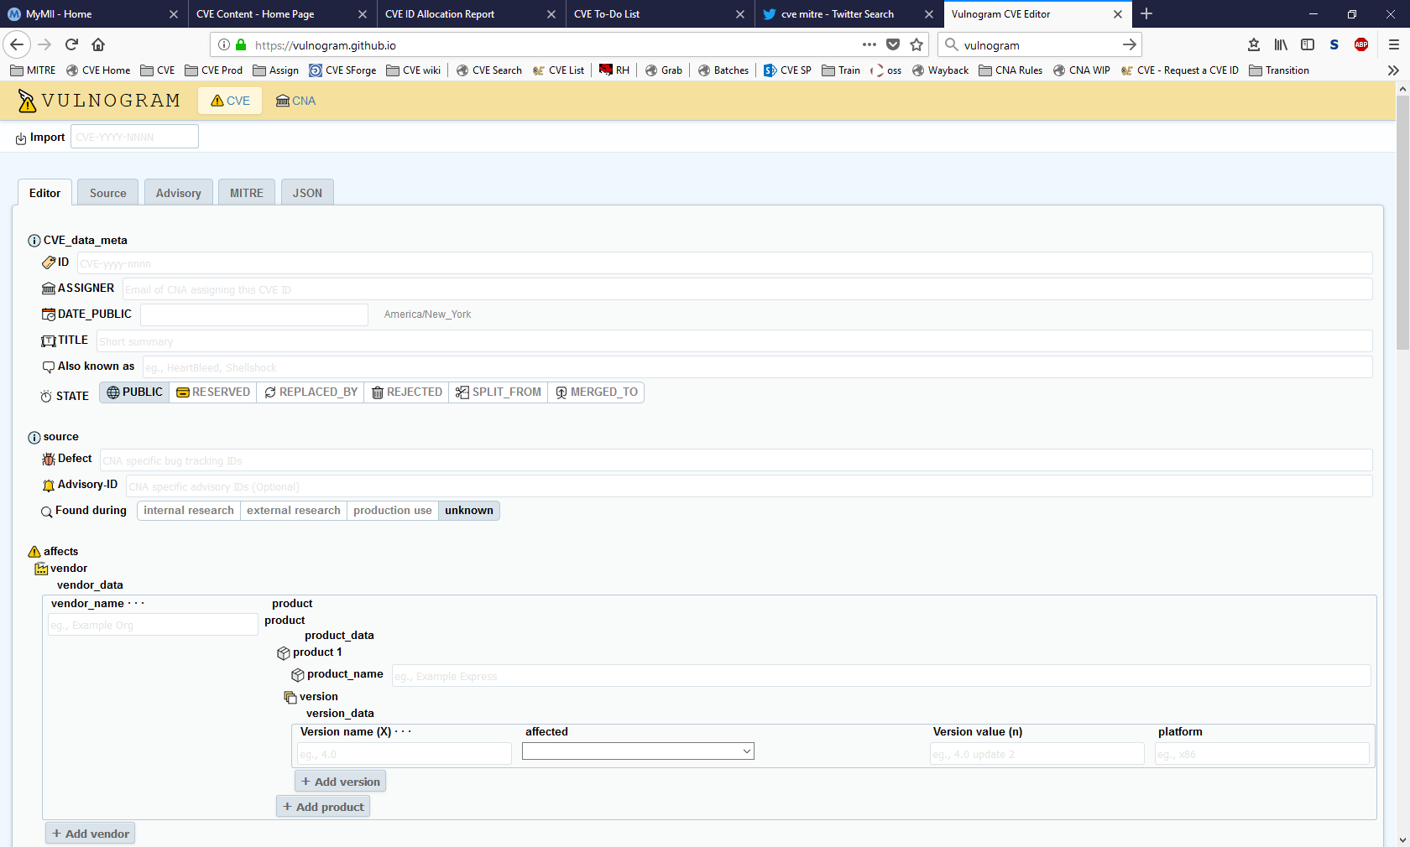
Vulnogram

Slide 39
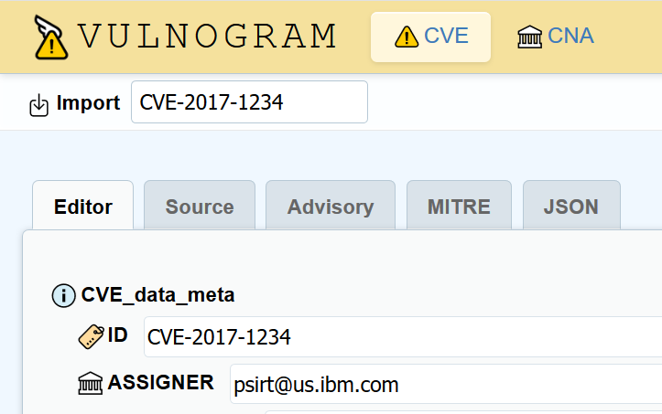
Vulnogram – Choose the CVE ID to Edit
Input the ID you want to update

Slide 40
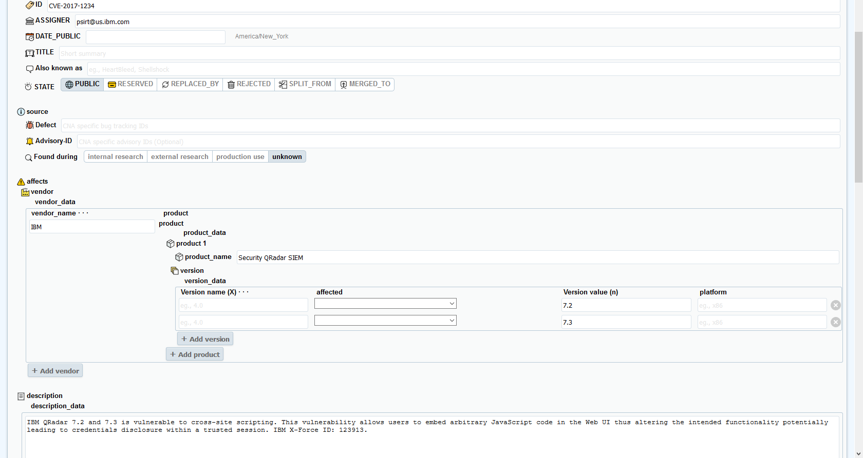
Vulnograms – CVE Information Is Imported from the Official CVE List

Slide 41
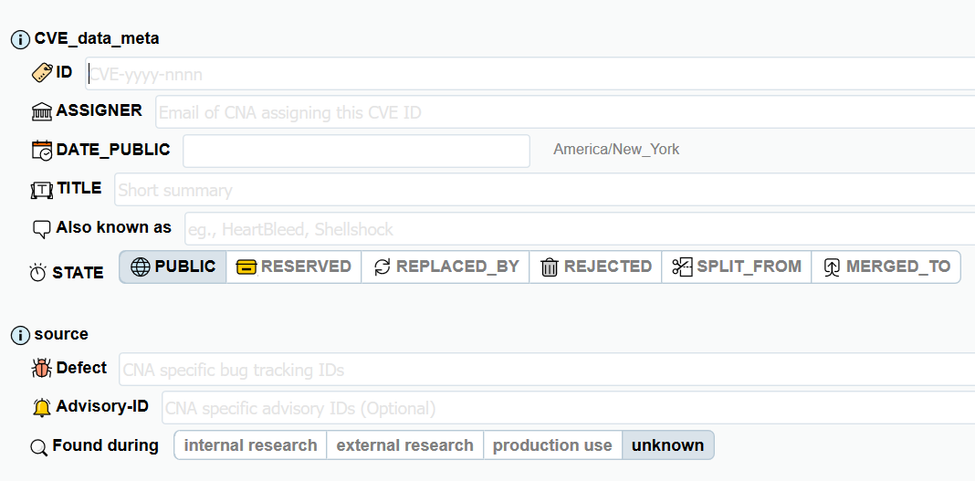
Vulnogram – Fill in Metadata
Required Fields

Slide 42
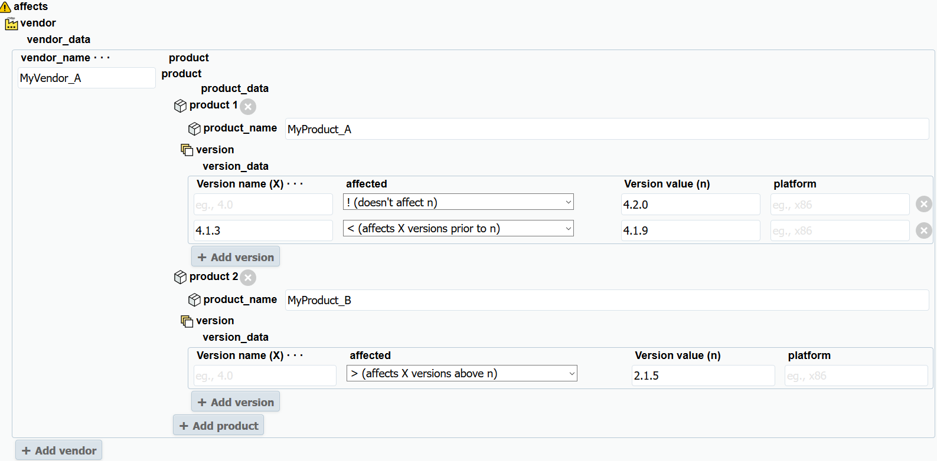
Vulnogram – Fill in Product/Version Information
At least one vendor/product/version group is required
Optional
Required

Slide 43
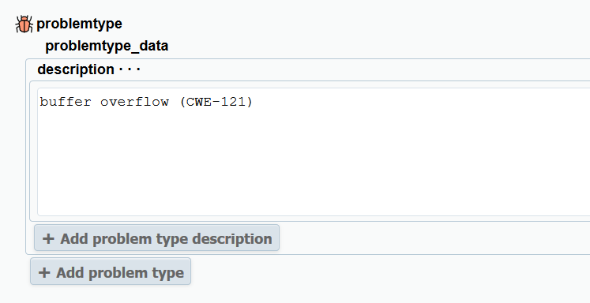
Vulnogram – Fill in Problem Type

Slide 44
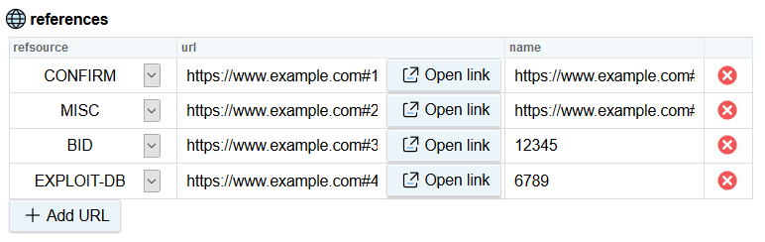
Vulnogram – Add Reference(s)
Refsource and name aren’t required by the standard. However, Vulnogram requires the refsource and if you use refsource, you have to a name.
Required

Slide 45
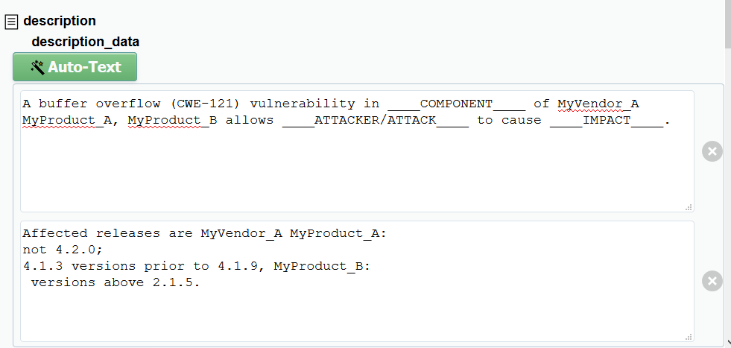
Vulnogram – Use the Auto-Text Feature to Start the Description
Must be moved to the top box for Vulnogram to generate proper JSON

Slide 46
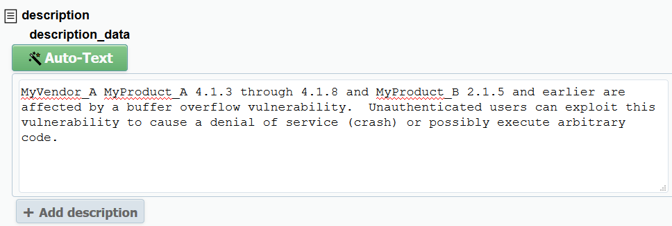
Vulnogram – Or Start the Description from Scratch
Product, version, and problem type information must be in the description section. There are no restrictions on how they are phrased in the description section.

Slide 47
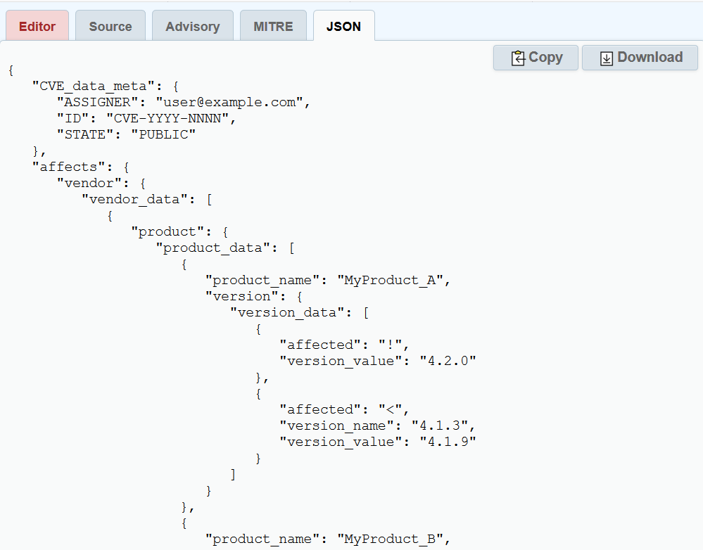
Vulnogram – Access the JSON via the JSON Tab

