Slide 1
Program Root CNA Web Form CVE Entry Submission Process
CVE Team

Slide 2
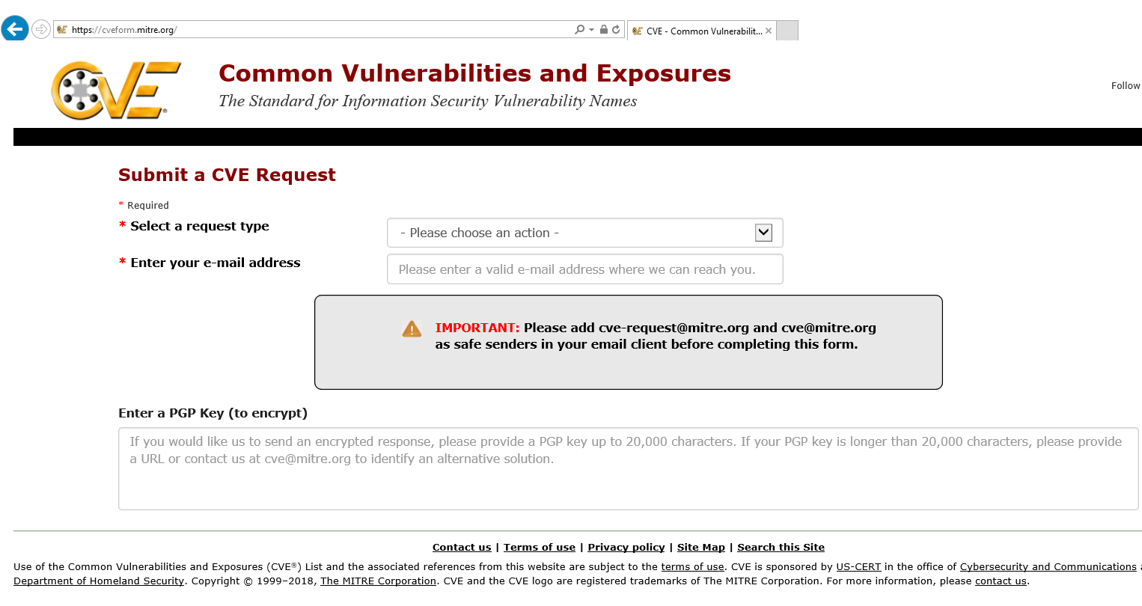
Go to https://cveform.mitre.org/

Slide 3
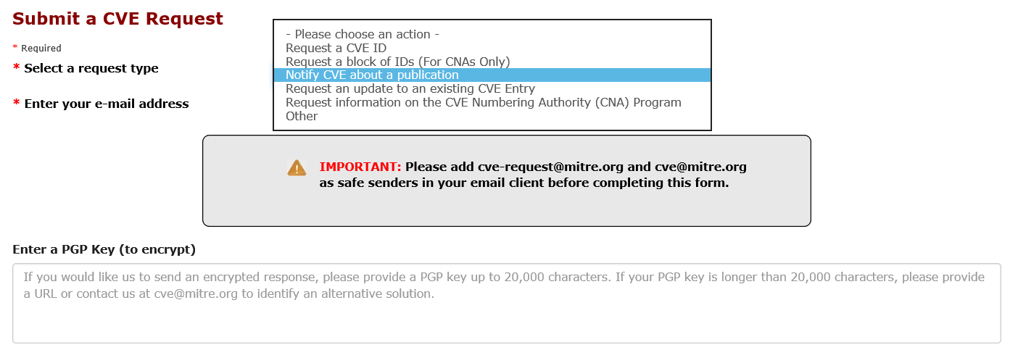
Select the “Notify CVE about a publication” Request Type

Slide 4
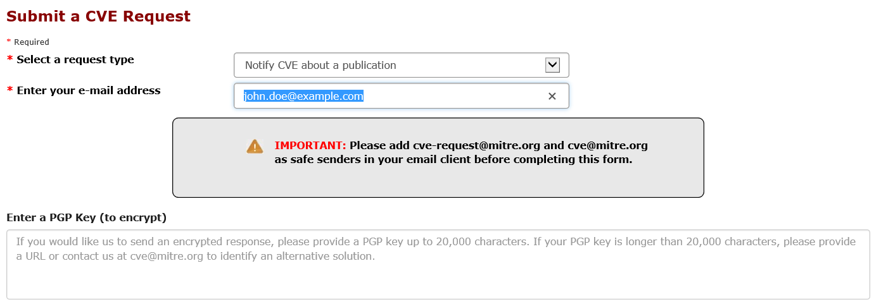
Fill in Contact Information

Slide 5
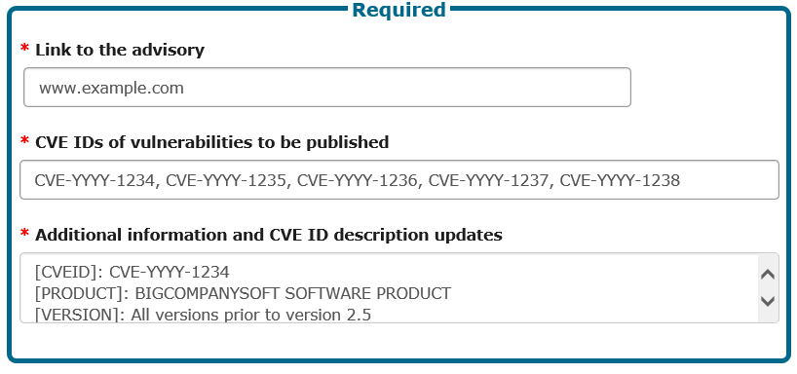
Fill in the Submission Information
Instructions for submissions greater than 2000 characters in size are at the end of the slides.

Slide 6
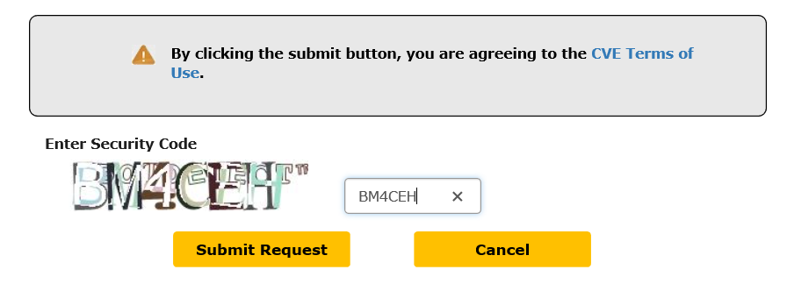
Fill in the Captcha and Select the Submit Request Button

Slide 7
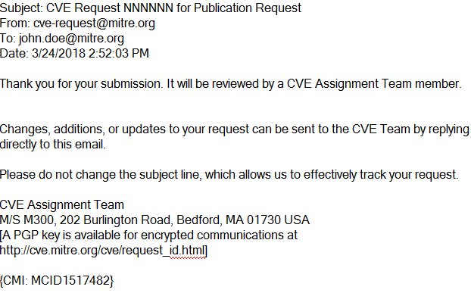
A Ticket Will Be Created and Email Acknowledgement Sent

Slide 8
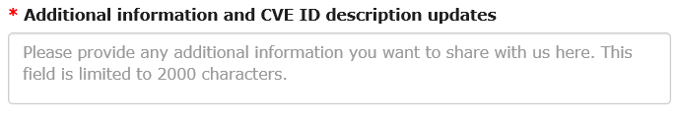
The Description Field Is Character Limited

Slide 9
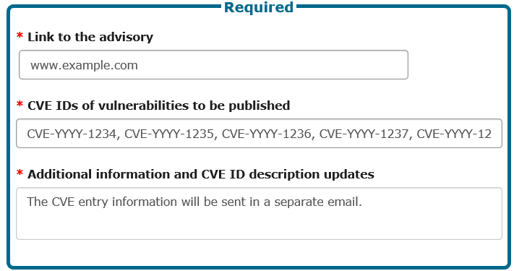
If You Need More Characters, Use Email …

Slide 10
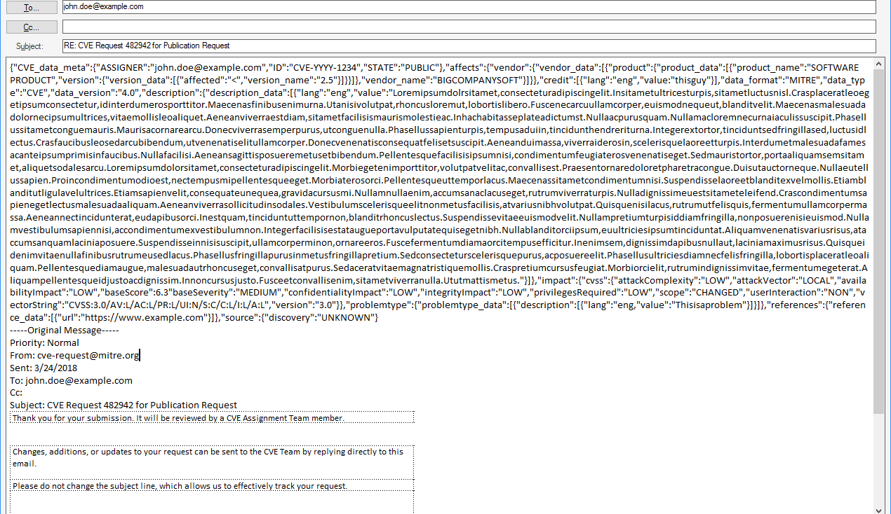
By Replying to the Acknowledgement Email

