Slide 1
CNA Processes
CVE Team
Notes:
Voice Track:
Hello and welcome to CNA Processes presentation, presented by the MITRE CVE team.

Slide 2
Outline
Getting a CVE ID Block
Assigning CVE IDs
Submitting CVE Entries
Updating CVE Entries
Escalating Issues
Rejecting CVE IDs
Disputing CVE IDs
CVE ID Expiration
Notes:
Voice Track: The next set of slides will tell you what they do…
CNAs obtain CVE IDs, they assign vulnerabilities to the CVE IDs, they submit the CVE ID’s to the master list, they update those entries when necessary, they escalate issues where there is a dispute, they reject CVE ID’s when needed, they dispute a CVE ID and sometimes they expire CVE ID’s.

Slide 3
Terms
CVE ID Block – A set of sequential CVE IDs given to a CNA for later assignment to vulnerabilities
CVE Entry - An item in the CVE List. CVE Entries contain the CVE ID, a description of the vulnerability, and references to public disclosure sources
Populate – The act of filling in the details for a previously reserved CVE ID into the CVE List
Reserved CVE ID – A CVE ID that has been give to a CNA for assignment and has not had the vulnerabilities details populated in the CVE List
CVE List - A collection of common names (CVE IDs) for publicly known cybersecurity vulnerabilities
Notes:
Voice Track: Terms to be familiar with should be referenced here.

Slide 4
Getting a CVE ID Block

Slide 5
Root CNA Asks the Program Root CNA for CVE IDs
Root CNA
10 2017 CVE IDs please!
Program Root CNA

Slide 6
Program Root CNA Provide the IDs
CVE-2017-0001
CVE-2017-0002
CVE-2017-0003
CVE-2017-0004
CVE-2017-0005
CVE-2017-0006
CVE-2017-0007
CVE-2017-0008
CVE-2017-0009
CVE-2017-0010
Root CNA
Program Root CNA

Slide 7
Sub-CNAs Ask the Root CNA for CVE IDs
CVE-2017-0001
CVE-2017-0002
CVE-2017-0003
CVE-2017-0004
CVE-2017-0005
CVE-2017-0006
CVE-2017-0007
CVE-2017-0008
CVE-2017-0009
CVE-2017-0010
Sub-CNA
Sub-CNA
Root CNA
3 2017 CVE IDs please!
Sub-CNA

Slide 8
Root CNA Provides the IDs to the Sub-CNAs
CVE-2017-0001
CVE-2017-0002
CVE-2017-0003
CVE-2017-0004
CVE-2017-0005
CVE-2017-0006
CVE-2017-0007
CVE-2017-0008
CVE-2017-0009
CVE-2017-0010
Sub-CNA
Sub-CNA
Root CNA
Sub-CNA

Slide 9
Sub-CNAs Have Their IDs to Assign
Sub-CNA
CVE-2017-0001
CVE-2017-0002
CVE-2017-0003
CVE-2017-0010
Sub-CNA
Root CNA
CVE-2017-0004
CVE-2017-0005
CVE-2017-0006
Sub-CNA
CVE-2017-0007
CVE-2017-0008
CVE-2017-0009

Slide 10
Root CNA Needs More IDs
CVE-2017-0010
Root CNA
Program Root CNA
10 2017 CVE IDs please!

Slide 11
Program Root CNA Provides More IDs
CVE-2017-0651
CVE-2017-0652
CVE-2017-0653
CVE-2017-0654
CVE-2017-0655
CVE-2017-0656
CVE-2017-0657
CVE-2017-0658
CVE-2017-0659
CVE-2017-0660
CVE-2017-0010
Root CNA
Program Root CNA

Slide 12
What to Consider When Making a Request for a CVE ID
How many CVE IDs to request
This should be negotiated with your parent CNA
In most cases, CNAs should enough IDs to last the entire year
When to request for more CVE IDs
When your running low
When the end of the year is nearing (get IDs for next year)
A new CNA
What year to ask for CVE IDs
Most of the time it will be for the current year
IDs for the next year are normally requested in the last quarter of the year

Slide 13
Contact Details Vary by CNA
Each parent CNA will have their own method of receiving and processing block requests
Your parent CNA should provide you with information on how to requests blocks from it
For example, if your CNA is the Program Root CNA (currently MITRE), there is web form for these requests
https://cveform.mitre.org/

Slide 14
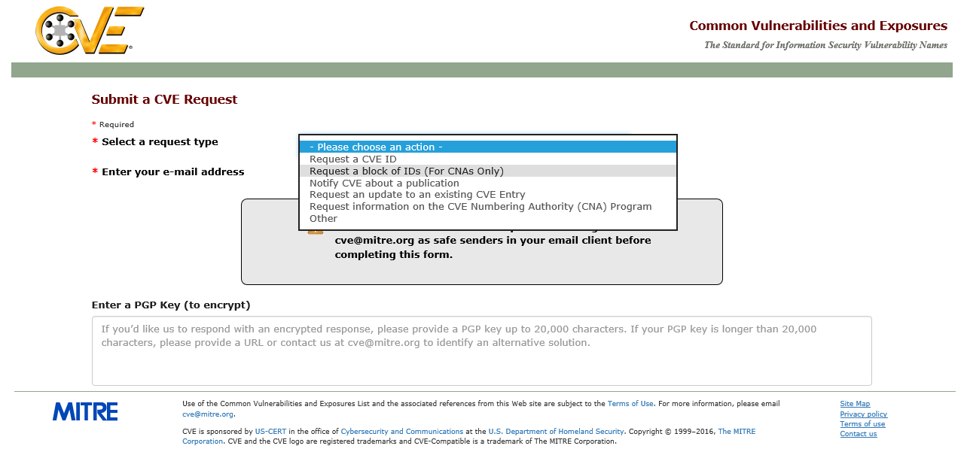
MITRE Form: Select Block ID Request

Slide 15
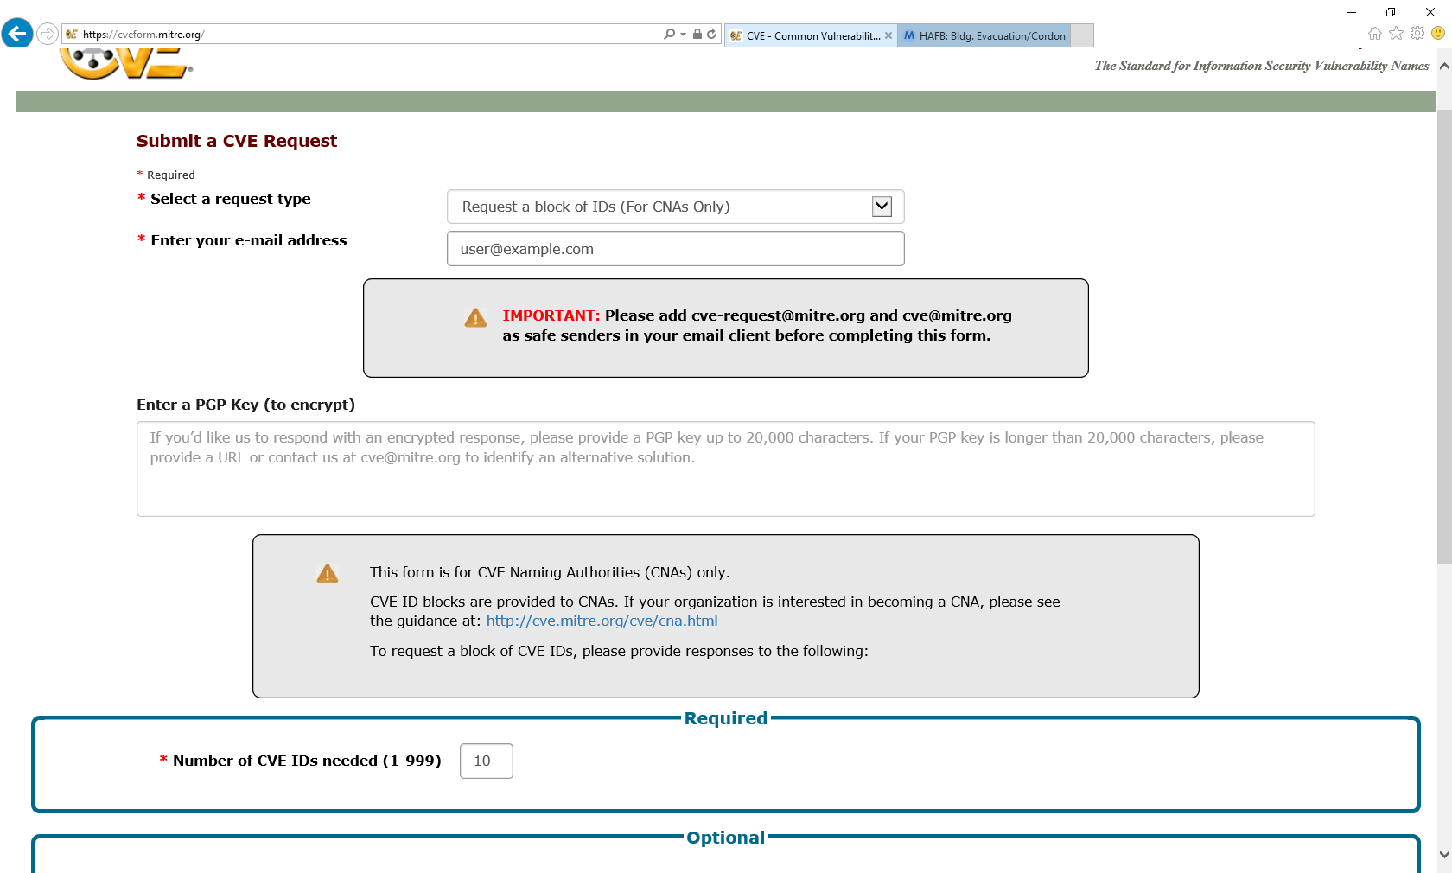
MITRE Form: Fill in Contact Details

Slide 16
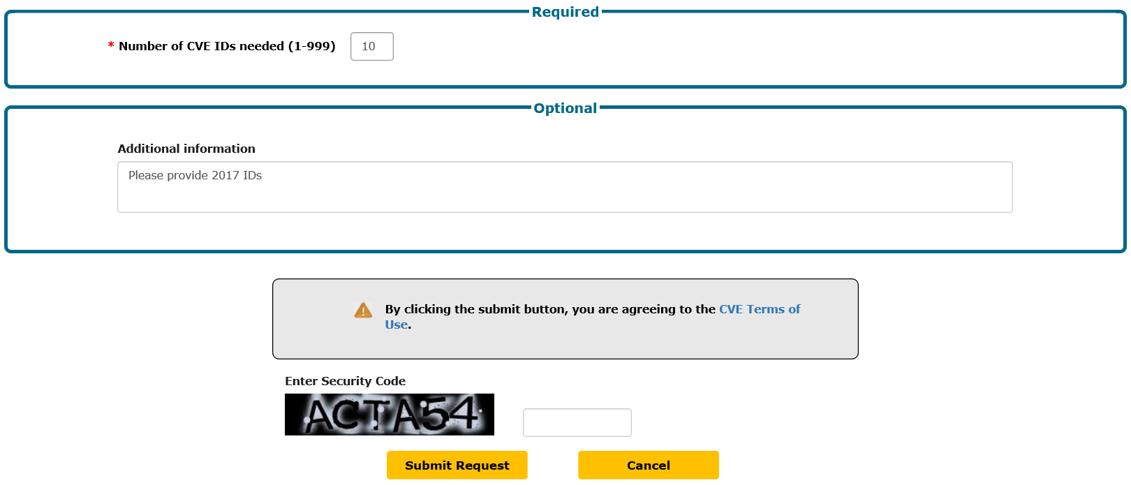
MITRE Form: Fill in Request Details

Slide 17
CVE ID Assignment

Slide 18
Reporter Sends Vulnerability Information
I found some vulnerabilities in
your product…
Reporter
CNA

Slide 19
CNA Acknowledges Receipt
Thank you for the report. We will
look into it and get back to you
within 7 days.
Reporter
CNA

Slide 20
CNA Counts the Number of Vulnerabilities
CNT1: Independently
Fixable Issue
CNT2: Determine if
a Vulnerability
CNT3: Determine is
Results from Shared
Code, Library, or
Standard
Issue 1
I found some vulnerabilities in
your product…
Vuln. 1
Issue 2
Vuln. 1
Vuln. 2
Issue 3
Vuln. 2
Issue 4
Vuln. 3
Vuln. 5
Vuln. 6
Issue 5
Vuln. 4
Notes:
Voice Track: The next step is to count the number of vulnerabilities. To do that, the first step: Take the report and break it down into independently fixable issues and then the next step, is to determine if those issues are vulnerabilities, if they are, then you determine what set of products those vulnerabilities effect.

Slide 21
CNA Decides Whether to Assign an ID
INC1: In
Scope
INC2: Make
Public
INC3:
Customer
Controlled
INC4: Publicly
Available
Software
INC5:
Avoid
Duplicates
Vuln. 1
Vuln. 1
Vuln. 1
Vuln. 1
Vuln. 2
Vuln. 2
Vuln. 2
Vuln. 2
Vuln. 2
Vuln. 2
Vuln. 5
Vuln. 5
Vuln. 6
Vuln. 6
Vuln. 6
Vuln. 6
Vuln. 6
Vuln. 6
Notes:
Voice Track: Once you know the effected products, then determine if the vulnerabilities are within your scope. If the vulnerabilities are within your scope, next you determine if you are going to make the vulnerability public. Next, you determine if the product is in customer controlled and if the software is publicly available. Lastly, you need to determine is there is a CVE ID already assigned to the vulnerability.

Slide 22
CNA Records Assignments
CVE ID Assignment Records
Vuln. A | CVE-YYYY-1024
Vuln. B | CVE-YYYY-1025
Vuln. 2 | CVE-YYYY-1026
Vuln. 6 | CVE-YYYY-1027
CVE-YYYY-1024
CVE-YYYY-1025
CVE-YYYY-1026
CVE-YYYY-1027
CVE-YYYY-1028
CVE-YYYY-1029
CVE-YYYY-1030
CVE-YYYY-1031
CVE-YYYY-1032
CVE-YYYY-1033
Vuln. 2
Vuln. 6
Notes:
Voice Track: Next, you assign CVE ID’s to each vulnerability, for your own records.

Slide 23
CNA Informs Reporter of Assignments
…
Vuln. 2 is assigned
CVE-YYYY-1026 and
Vuln. 6 is assigned
CVE-YYYY-1027
…
Reporter
CNA

Slide 24
Submitting CVE Entries
Notes:
Voice track: Once you have assigned the CVE IDs, performed your coordination to get the vulnerability fixed, and published the vulnerability information, you are going to need to submit the CVE entry.

Slide 25
CNA Publishes Advisory with CVE Details
www.example.com/security-advisory-1
Fixed Vuln. 2 (CVE-YYYY-1026)
Fixed Vuln. 6 (CVE-YYYY-1027)
CNA
Publish advisory

Slide 26
CNA Formats Details as Required
[CVEID]: CVE-YYYY-1026
[PRODUCT]: MY-PRODUCT
[VERSION]: 1.2.3
[PROBLEMTYPE]: Buffer overflow
[REFERENCES]: www.example.com/security-advisory-1
[DESCRIPTION ]: Buffer overflow in MY-PRODUCT 1.2.3
[CVEID]: CVE-YYYY-1027
….
CNA

Slide 27
CNA Sends Formatted Details to Root CNA
[CVEID]: CVE-YYYY-1026
…
[CVEID]: CVE-YYYY-1027
…
CNA
Root CNA

Slide 28
Root CNA Sends the Details to the Program Root CNA
[CVEID]: CVE-YYYY-1026
…
[CVEID]: CVE-YYYY-1027
…
Root CNA
Program Root CNA

Slide 29
Program Root CNA Updates the Official CVE List
Submission
CVE List
[CVEID]: CVE-YYYY-1026
[PRODUCT]: MY-PRODUCT
[VERSION]: 1.2.3
[PROBLEMTYPE]: Buffer overflow
[REFERENCES]: www.example.com/security-advisory-1
[DESCRIPTION ]: Buffer overflow in MY-PRODUCT 1.2.3
[CVEID]: CVE-YYYY-1027
….
Name: CVE-YYYY-1026
Status: Candidate
URL: http://cve.mitre.org/cgi-bin/cvename.cgi?name=CVE-YYYY-1026
Phase: Assigned (YYYYMMDD)
Category:
** RESERVED **
This candidate has been reserved by an organization or individual that will use it when announcing a new security problem. When the candidate has been publicized, the details for this candidate will be provided.

Slide 30
Program Root CNA Publishes Updated CVE List
Name: CVE-YYYY-1026
Status: Candidate
URL: http://cve.mitre.org/cgi-bin/cvename.cgi?name=CVE-YYYY-1026
Phase: Assigned (YYYYMMDD)
Category:
Reference: CONFIRM: www.example.com/security-advisory-1
Buffer overflow in MY-PRODUCT 1.2.3
Current Votes:
None (candidate not yet proposed)
=================================
Name: CVE-2016-6260
…

Slide 31

Reserved by Public (RBP) Policy
What happens if a CNA doesn’t populate an entry after they publish the CVE ID in their advisory?
People complain (often to MITRE)
MITRE keeps track of requests to populate CVE entries
MITRE also monitors several sources for vulnerabilities
If the percentage of reserved CVE ID’s assigned by a CNA is greater than the total number of public CVE ID’s for the CNA in the last 12 months, then the CNA will not longer receive new CVE IDs until the percentage is below 5%.
Notes:
Voice Track: The RBP policy was created to ensure that CNA populate their CVE ID’s. If the CVE IDs are not populated soon after the advisory is published, the user community will complain to MITRE. MITRE tracks request to populate as well as monitors various sources for vulnerabilities that are made public. The RBP policy states that the total RBP for a given CNA must be below 5%, this is calculated by taking the total RBPs CVE IDs and divided by the public CVE ID’s with the last 12 months. If the percentage of reserved CVE ID’s assigned by a CNA is greater than the total number of public CVE ID’s for the CNA in the last 12 months, then the CNA will not longer receive new CVE IDs until the percentage is below 5%.

Slide 32
Update CVE Entries

Slide 33
CNA Is Asked to Update a CVE Entry
Please update CVE-YYYY-NNNN
….
Reporter
CNA

Slide 34
Determine Responsible CNA
Reporter/CNA
https://cve.mitre.org/cve/
CVE-YYYY-NNNN
Vulnerability in Product A allows attacker to do something bad.
http://cve.mitre.org/cna.html
CNA | Scope | Contact
CNA 1 | Scope 1 | Email 1
CNA 2 | Scope 2 | Form 1
CNA 3 | Product A… | Email 2
CNA 4 | Scope 4 | Email 3
CNA 5 | Scope 5 | Form 2

Slide 35
Responsible CNA Is Asked to Make the Change
Please update CVE-YYYY-NNNN
….
Reporter/CNA
Responsible CNA

Slide 36
Responsible CNA Decides Whether to Change the Entry
Should the entry be updated?
Please update
CVE-YYYY-NNNN
…
Responsible CNA
Program Root CNA
Yes
Unfortunately, we do not believe
…
No
Reporter

Slide 37
Updating CVE Entries with Counting Issues
Notes:
Voice Track: Some times you can make mistake when assigning CVE IDs, so how do you manage it?

Slide 38
Updating CVE Entries with Counting Issues
The processes for updating entries with counting issues are in Appendix E of the CNA Rules v2.0
Rejecting CVE Entries
Merging CVE Entries
Splitting CVE Entries
Disputing CVE Entries
Notes:
Rejecting: When you assign a CVE ID that shouldn’t have been assigned
Merging: Assign the same vulnerability to multiple CVE ID’s
Splitting: Assign single CVE ID to multiple vulnerabilities
Disputing: Disagree if it’s a vulnerability

Slide 39
Rejecting a CVE ID Outright
Reasons
The issue is not a vulnerability (fails CNT2)
You decide not to make the vulnerability public (fails INC2)
The product isn’t customer controlled (fails INC3)
The product isn’t generally available (fails INC4)
Notes:
Voice Track: CVE IDs get rejected when an issue is not a vulnerability, or the issue should have not received a CVE ID.

Slide 40
Outright Reject Process
Rejection Process:
Update the Description saying that the CVE ID has been rejected
Remove the References
Both populated and unpopulated entries can be rejected
The Merging process also results in rejected CVE Entries

Slide 41
Rejection Description Template
** REJECT **
DO NOT USE THIS CANDIDATE NUMBER.
ConsultIDs:
Reason:
Notes:

Slide 42
Why Not Remove the Entry from the CVE List
CVE IDs remain on the CVE List to reduce confusion
CVE IDs are used by many sources
Not all sources change the CVE ID they use
Having an entry explaining why the ID should not be used reduces confusion

Slide 43
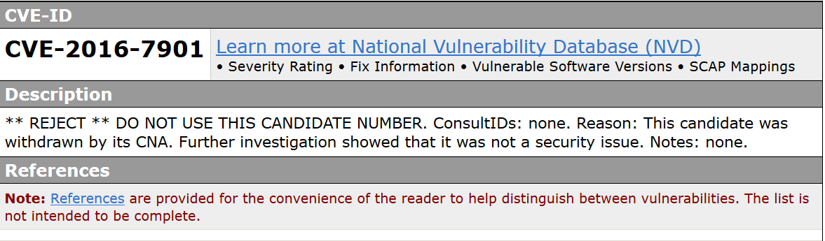
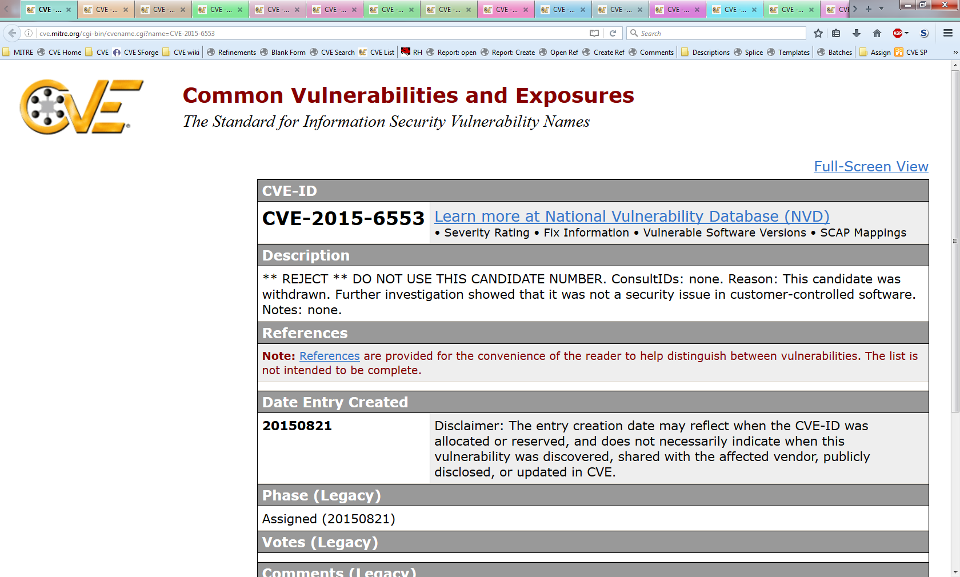
Examples of CVE IDs that Have Been Rejected

Slide 44
Merging CVE Entries
Not independently fixable (fails CNT1)
Result of shared codebase, library, protocol, etc. (fails CNT3)
Duplicate assignment (fails INC5)
A typo in an advisory causes a duplicate assignment (fails INC5)
Notes:
Voice Track: Merging of CVE ID’s occur when vulnerabilities' have received several CVE IDs.

Slide 45
Process for Merging CVE Entries
Determine which CVE ID to associate with the issue
Merge the information from the other CVE IDs into chosen CVE ID
Update the CVE IDs that were not chosen with a REJECT Description that points to the chosen CVE ID as the correct one to use

Slide 46
Process for Deciding which CVE ID to Keep
Most commonly referenced identifier
Most authoritative source
Roughly prioritized as: vendor, coordinator, researcher
Longest public
Smallest numeric portion

Slide 47
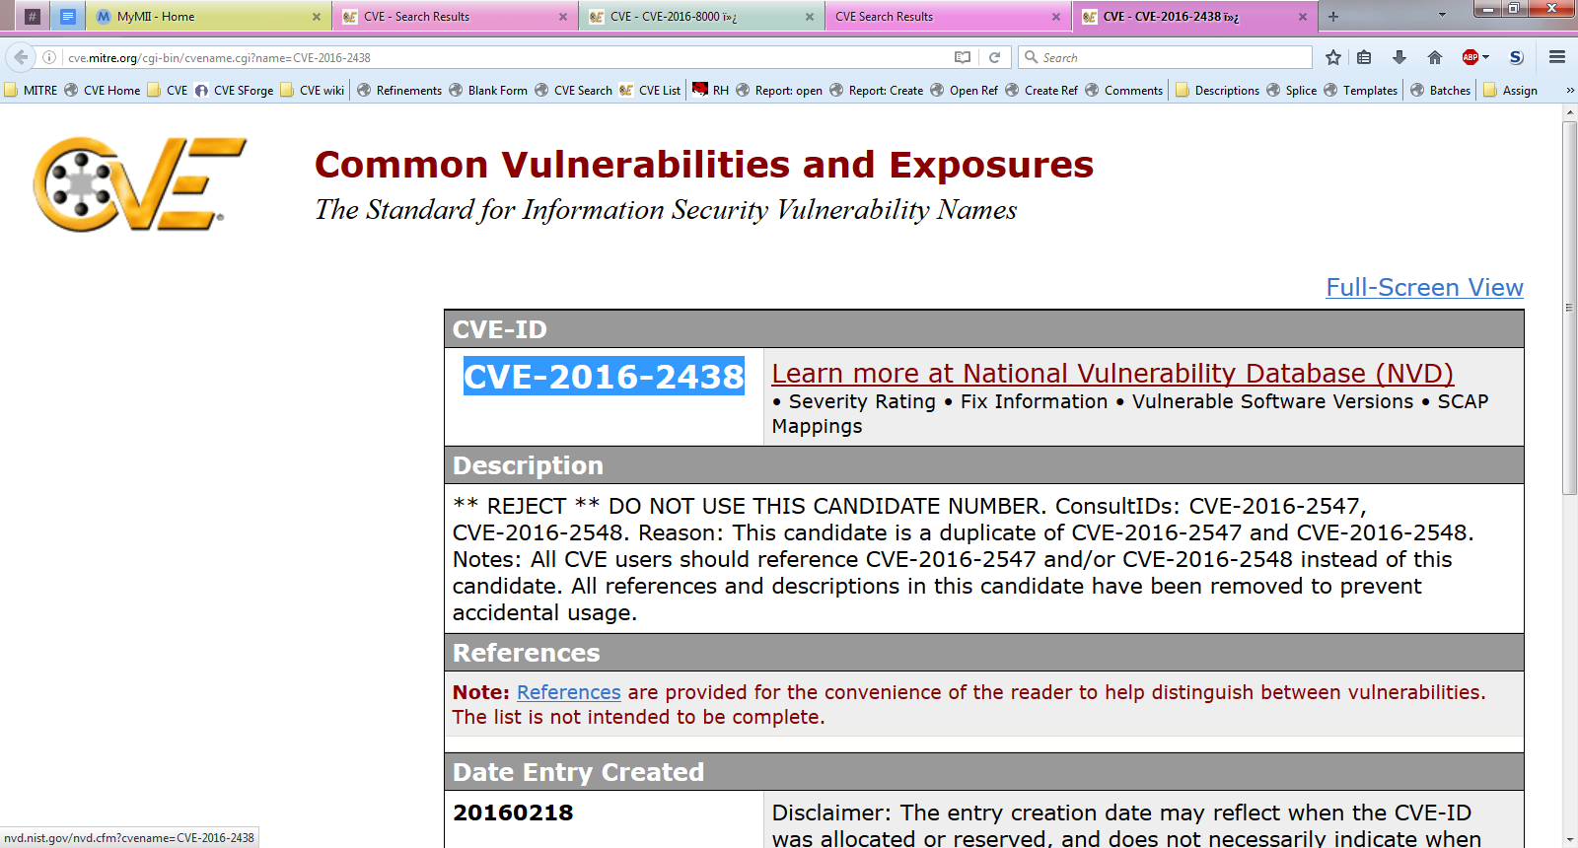
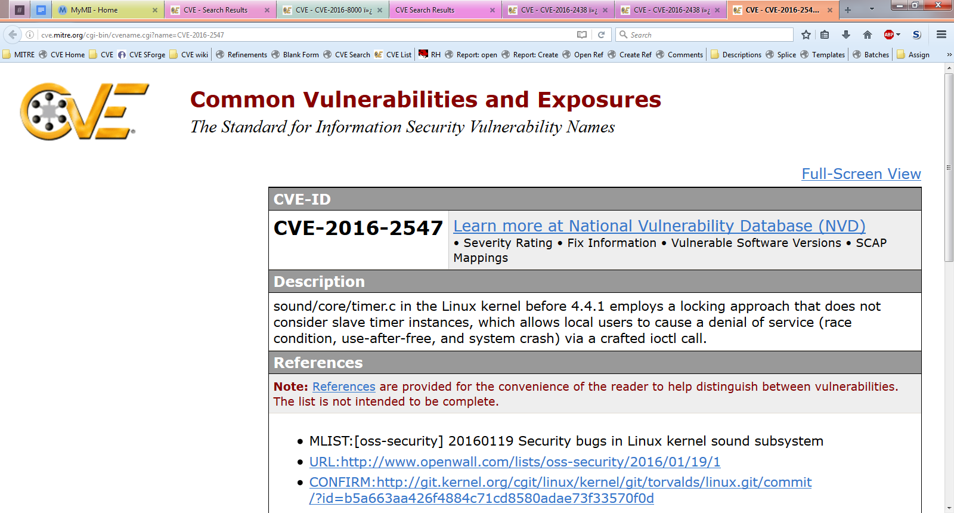
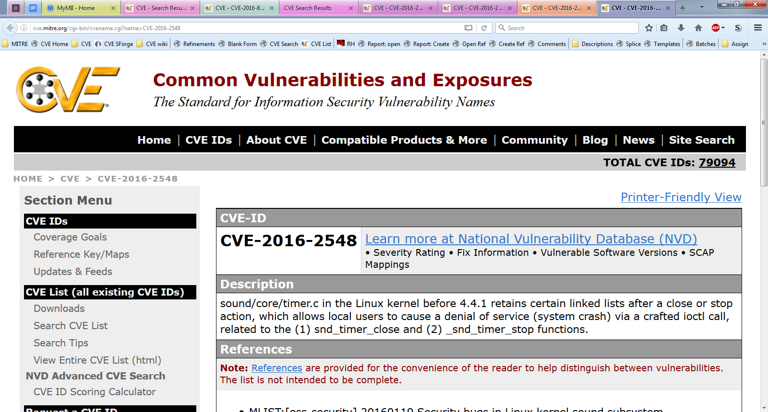
Example of a Merged CVE ID
Notes:
Note that a merge and a split happened

Slide 48
Splitting CVE Entries
Contains interpedently fixable bugs (passes CNT1)
Does not share a codebase (fails CNT3)
Determined to be implementation specific (fails CNT3)
Notes:
Voice track: Splitting occurs with a single CVE ID is assigned for multiple vulnerabilities.

Slide 49
Splitting CVE IDs
Process for splitting
Determine which vulnerability should be associated with the original CVE ID
Assign CVE IDs to the additional vulnerabilities
Include a NOTE pointing to the original CVE ID in the descriptions of the CVE Entries for the new CVE IDs
Update Description of the CVE Entry for the original CVE ID with a NOTE saying that the entry has been split and point to the additional CVE IDs
Process for determining which vulnerability gets the original ID
Most commonly associated vulnerability
Most severe risk
Broadest range of affected versions
Described first in initial publication

Slide 50
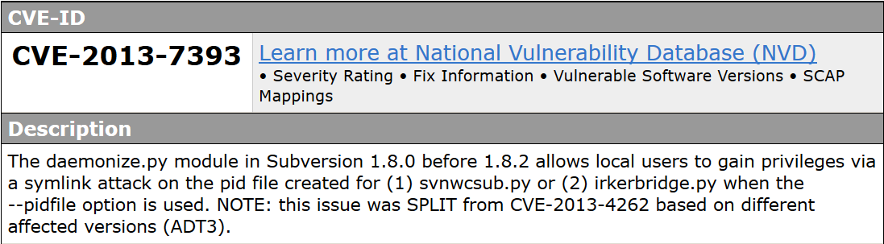
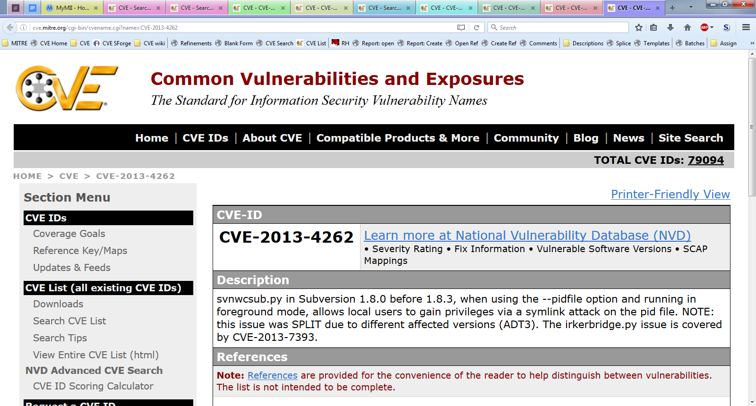
Split CVE ID Example

Slide 51
Disputed CVE Entries
Use a dispute when:
The CVE ID was assigned correctly using the CNA Rules, but
An authoritative source questions the validity of the vulnerability
Process creating a dispute
Add “** DISPUTE **” to the beginning of the Description
Add a NOTE to the end of the Description explaining why the vulnerability is disputed

Slide 52
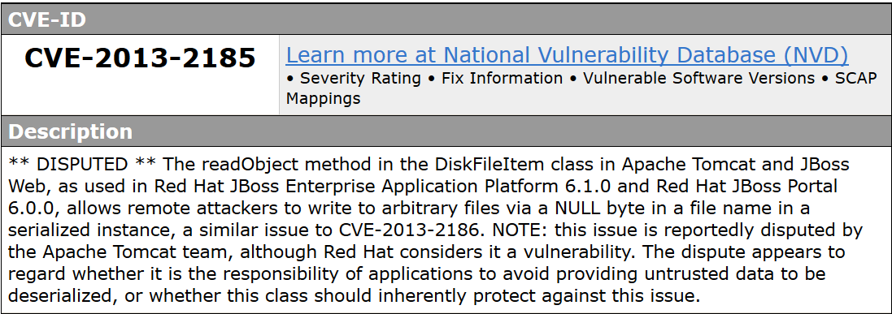
Dispute Example
Notes:
Voice Track:
Redhat has Apache Tomcat in Redhat Jboss product
Redhat thinks there is a vulnerability in Apache Tomcat
Apache thinks there is NOT a vulnerability
Redhat still needs a CVE ID for coordination, hence we mark the CVE as disputed

Slide 53
Escalation
Notes:
Voice Track: How do CVE ID’s get disputed, they get escalated.

Slide 54
Escalation Process
If the author CNA rejects the change or is unresponsive:
The requester can escalate to the appropriate Root CNA
The Root CNA requests the reasoning behind the Sub-CNA’s decision
The Root CNA determines which action is appropriate
The Root CNA informs the requester and the Sub-CNA of its decision

Slide 55
CVE ID Expiration

Slide 56
CVE ID Expiration
CVE IDs contain a year in the ID
Unassigned CVE IDs for a give year expire at the end of the year
Each CNA is expected to tell their parent CNA which CVE IDs they did not use
The Program Root CNA will reject the CVE IDs that were not used

Slide 57
CNA Records Assignments
CVE ID Assignment Records
Vuln. A | CVE-YYYY-1024 | Populated
Vuln. B | CVE-YYYY-1025 | Populated
Vuln. 2 | CVE-YYYY-1026 | Populated
Vuln. 6 | CVE-YYYY-1027 | Populated
Vuln. X | CVE-YYYY-1028 | Waiting for Publication
Vuln. Y | CVE-YYYY-1029 | Waiting for Publication
 | CVE-YYYY-1030 | Unassigned
 | CVE-YYYY-1031 | Unassigned
 | CVE-YYYY-1032 | Unassigned
 | CVE-YYYY-1033 | Unassigned
Notes:
Voice Track: CVE ID’s not assigned to vulnerabilities expire at year end.

Slide 58
CNA returns unused CVE IDs
CVE IDs unused in YYYY:
CVE-YYYY-1030
CVE-YYYY-1031
CVE-YYYY-1032
CVE-YYYY-1033
CNA
Program Root CNA

Slide 59
Program Root CNA Updates the Master CVE List
Before
After
Name: CVE-YYYY-10230Status: Candidate
URL: http://cve.mitre.org/cgi-bin/cvename.cgi?name=CVE-YYYY-1030
Phase: Assigned (YYYYMMDD)
Category:
** RESERVED **
This candidate has been reserved by an organization or individual that will use it when announcing a new security problem. When the candidate has been publicized, the details for this candidate will be provided.
Name: CVE-YYYY-10230Status: Candidate
URL: http://cve.mitre.org/cgi-bin/cvename.cgi?name=CVE-YYYY-1030
Phase: Assigned (YYYYMMDD)
Category:
** REJECT **
DO NOT USE THIS CANDIDATE NUMBER. Consult: none. Reason: The CNA or individual who requested this did not associated with any vulnerability during YYYY. Notes: none.

Slide 60
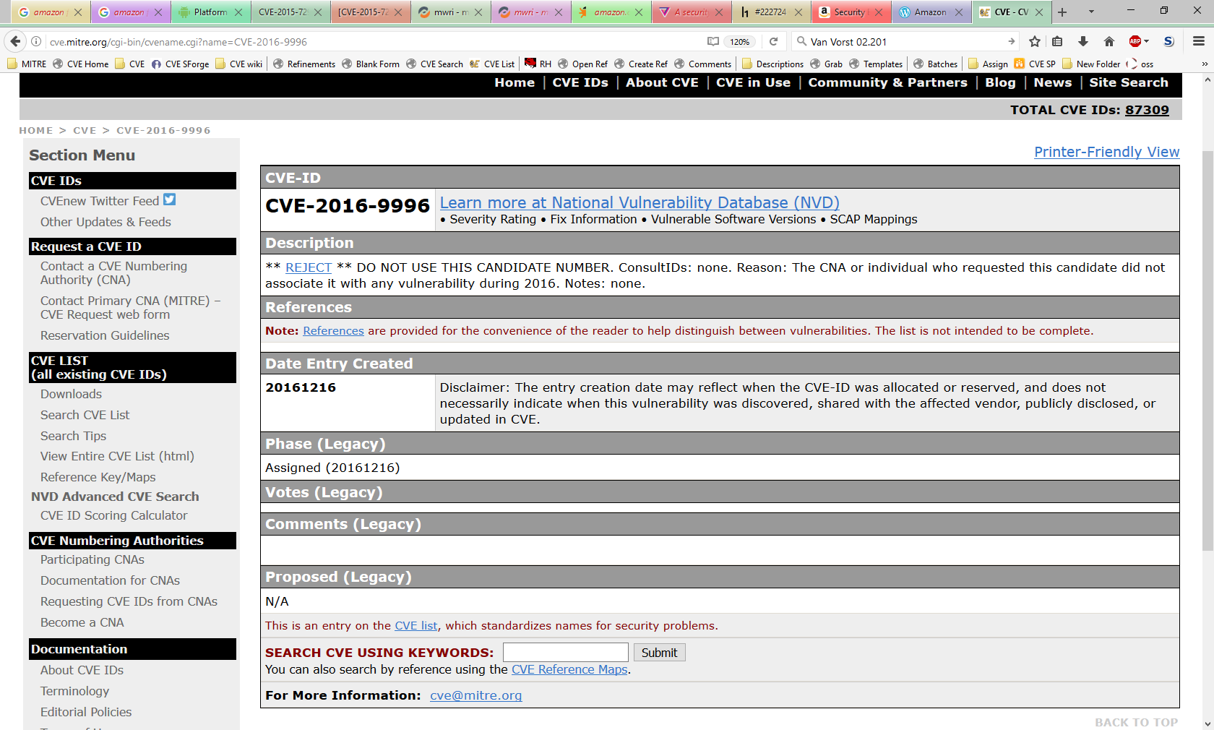
Unused CVE ID is marked Rejected

Slide 61
Questions?

