Slide 1
Bulk download: Reserved records
Notes:
Greeting, thanks, and intro needed?
Thank intro
Hi everyone, I am noah and I have been on the CVE project for 4 years as an analyst and developer.
In this presentation, I aim to propose solutions for incorporating reserved CVE ID data into the bulk download capabilities.

Slide 2
User stories
As an unauthenticated user…
I want to find out if a specific CVE ID is reserved.
I want to find all currently reserved CVE IDs.
Notes:
Some user stories we are currently trying to solve for are:
As an unauthenticated user, I want to find out if a specific CVE ID is reserved.
As an unauthenticated user, I want to find all currently reserved CVE IDs.

Slide 3
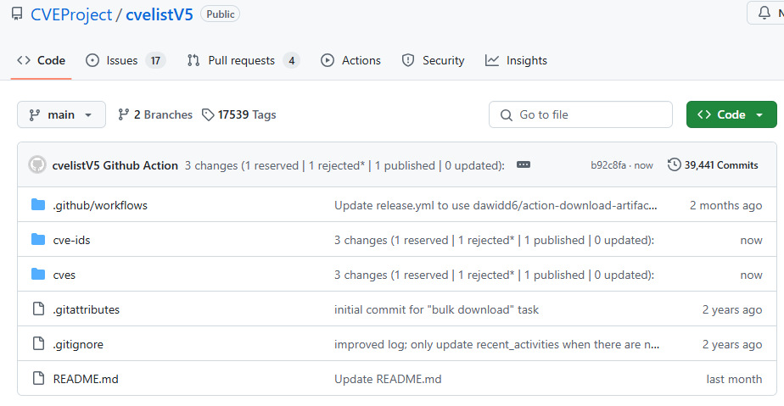
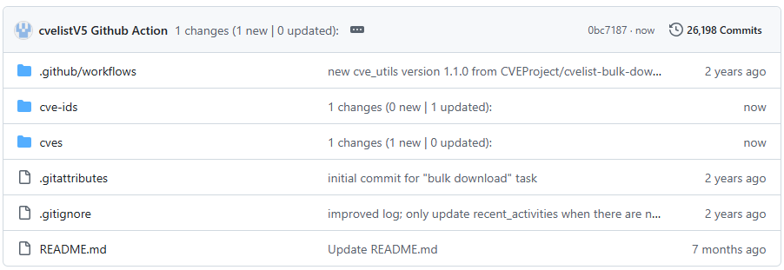
CVEProject/cvelistV5
Notes:
So for all of the solutions we are about to propose, we would like to apply them to the existing cvelistV5 repository.

Slide 4
Proposal: new independent component
NEW
Or, new repo*
Notes:
Specifically, we would like to make any changes in a new independent component which could be a new directory in cvelistV5.
Alternatively, if the community strongly feels that this can be put into a new repo, we can make that happen as well.
We can revisit naming conventions at the end of the presentation.

Slide 5
Proposed new bulk download features:
In the CvelistV5 repo
New independent directory: “cvelistV5/cve-ids”
Single file per missing data
One json file for all reserved CVE IDs
One json file for rejected* CVE IDs
*Rejected and never published
CVE Services /cve-id cache
Similar to cvelistV5/cves
/cve-ids/YYYY/#xxx/CVE-YYYY-####.json
Notes:
https://github.com/M-nj/cvelistV5-mockup-summary-json-only
So in this new independent /cve-ids directory, we are proposing two solutions that could - both be implemented.
We will do a quick overview of the two proposals before diving into the specifics.
The first solution we propose takes a “minimalistic approach”.
This would be a single json file containing a list of the reserved CVE IDs.
It would also contain another json file containing a list of the rejected cve ids that were never published.
The second solution we propose is more of a self-service approach. We would like to simply cache the CVE Services /cve-id endpoint. This is the endpoint that contains some additional information of all CVE IDs which includes the CVE IDs in a reserved state.
Now that we have a brief overview of the two proposals, lets dive into the specifics.

Slide 6
Observations from 1/21 discussion
2 solutions offered
Simple list of CVE IDs in the Reserved State and Rejected State (that are not published)
Full copy of CVE List with Reserved CVE IDs integrated into the list
No strong consensus for either solution really reached
Key Point
The recommended ideal size of Github repository is less than 1 GB with a strong recommendation of less than 5 GB
CVE V5 repository is growing (currently .9 GB) cache will double the size of the repository (if we place this cache in the current cvelistV5 repository

Slide 7
Observations 1/21
Proposal consideration
Given that there seemed to be no strong consensus and the concerns associated with size/growth
Suggest going with option 1 (simple file)
1 file for reserved IDs
1 file for reserved/rejected (but not published)

Slide 8
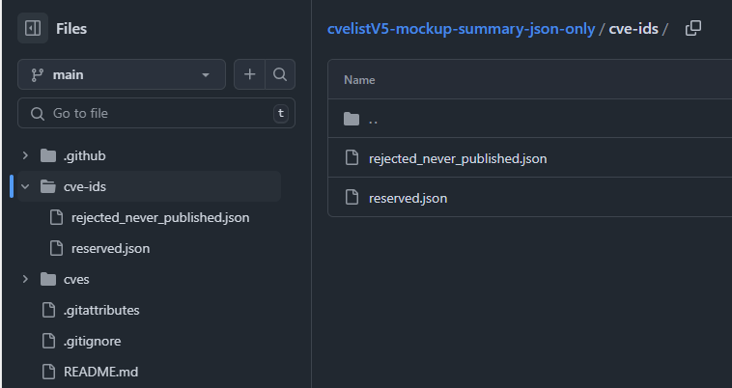
Summary json file(s)
Mock up:
https://github.com/M-nj/cvelistV5-mockup-summary-json-only
Based on a snapshot of CVE Services from June 28, 2024
Single file for:
Reserved IDs
/cve-ids/reserved.json
Rejected IDs (non-published)
/cve-ids/rejected_never_published.json
Notes:
So the first proposed solution is making json files with the list of reserved CVE IDs, as well as rejected ids that never got published. We actually have a mock up repository for what that might look like.
I am going to post a link in chat here so that you can follow along if you wish:
“Summary json files”, the single file for all reserved CVE IDs.
https://github.com/M-nj/cvelistV5-mockup-summary-json-only
A quick background this mockup repo:
- It is based on a snapshot of CVE Services from June 28, 2024.
- It has the new cve-ids independent directory (lazer pointer), and inside this directory you can find
- reserved.json (lazer pointer), which contains all reserved CVE IDs
- rejected_never_published.json (lazer pointer), which contains all CVE IDs that were rejected but never published.
When an ID gets reserved, it gets added to the reserved list.
When an ID leaves the reserved state, it is removed from the reserved list.
If an ID changes from reserved to rejected without getting published, it is added to the rejected_never_published list.
We included the rejected_never_published list because we didn’t want to have CVE IDs that appear in the reserved list and then mysteriously go missing. This would mean that between the two list of IDs and the existing cves directory, all existing CVE IDs would be accounted for in some manner.
(demo search?)
Published: CVE-1999-0001
Reserved: CVE-2000-1253
Reject_never_published: CVE-2016-1604

Slide 9
CVE Services /cve-id cache
Notes:
Lets get into the specifics of the second proposed solution, which is a cache of the CVE Services /cve-id endpoint

Slide 10
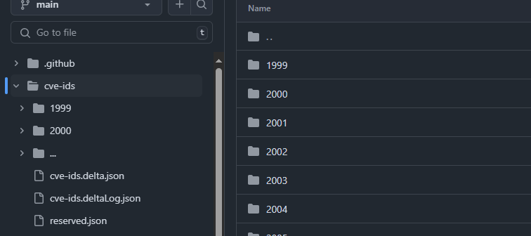
Mock up for: CVE Services /cve-id cache
https://github.com/M-nj/cvelistV5-mockup-cve-ids-cache
Based on a snapshot of CVE Services from June 28, 2024
Single file for all reserved IDs: /cve-ids/reserved.json
cache of CVE Services /cve-id*
Notes:
So I’m going to paste a link in the chat to a mock up repository for this solution so that you can follow along.
“CVE Services /cve-id cache”, mock up sample repo.
https://github.com/M-nj/cvelistV5-mockup-cve-ids-cache
A quick background for this mockup repo:
- It is based on the same snapshot of CVE Services from June 28, 2024.
- It has the new cve-ids independent directory (lazer pointer), and inside it includes
- The first proposed solution of reserved.json (lazer pointer), which contains all reserved CVE IDs.
- it also includes A cache of CVE Services /cve-id data (lazer pointer) with one file per CVE ID.
in theory this solution could also have a rejected_never_published.json list if we choose to do so, there just isn’t one in the demo repo.
Side note, that mocked activity is mirrored across both mock repos for consistency.
So why cache the entire /cve-ids endpoint?

Slide 11
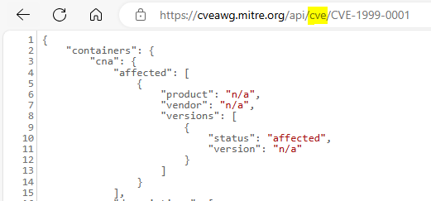
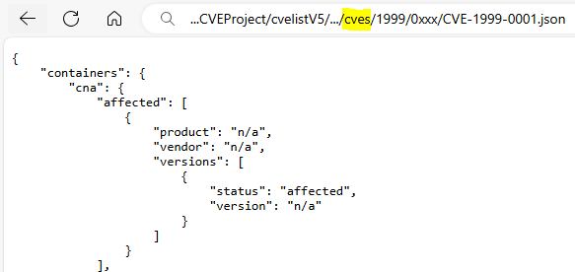
Existing Cve Services /cve -> cvelistV5/cves
Notes:
To stay in the spirit that cvelistV5/cves is a cache of cve services cve content…

Slide 12
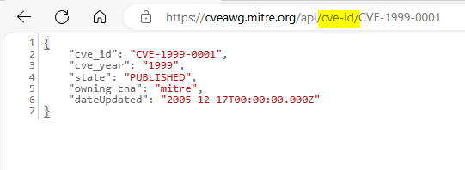
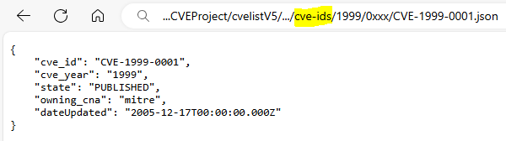
Proposed Cve Services /cve-id -> cvelistV5/cve-ids
/cve-ids/YYYY/#xxx/CVE-YYYY-####.json
Notes:
We propose that we do the same for /cve-id.
The data here would be one file per CVE ID, and it would follow the same directory structure where you can drill down from year, to thousands group, to the cve id file.
The contents of these files would be the values that cve services gives us, there would be no special format for this repo.

Slide 13
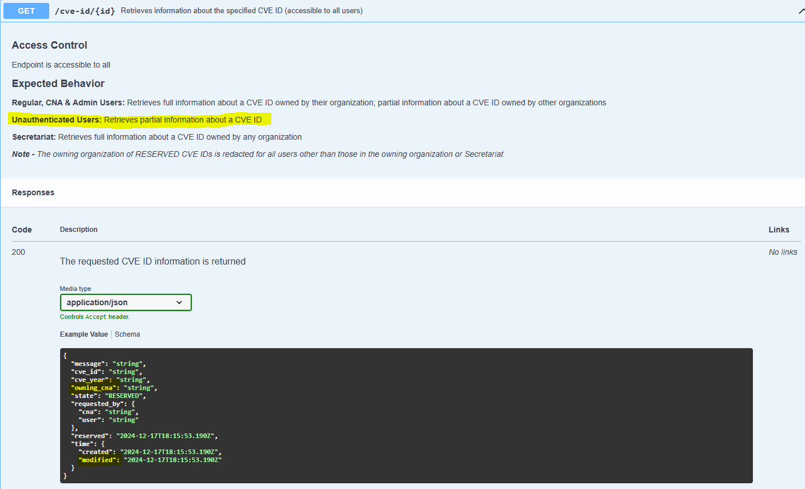
New data
Reserved CVE IDs
Rejected but never published IDs
Owning CNA
Modification dates
Notes:
The CVE Services /cve-id data does contain some information that we don’t currently have available in the /cves directory.
Some new information that we would get from this endpoint includes:
1. CVE IDs that are in a reserved state
2. CVE IDs that were rejected but never published. (we would not get this data just from solution #1)
3. The currently owning CNA (with some exceptions for authentication reasons)
4. And Modification dates which can occasionally differ from the reported dateUpdated field in a cve record. (for example, transferring ownership of a CVE ID, that information would only be found in the /cve-id data and nowhere in the current /cve data).

Slide 14
No privileged data
Notes:
So in the bulk download repo we don’t want to be leaking information, therefore we would only be publishing data that is accessible to an unauthenticated user
Note that some data claimed to be returned by CVE Services is privileged, and may not be available to an unauthorized user.

Slide 15
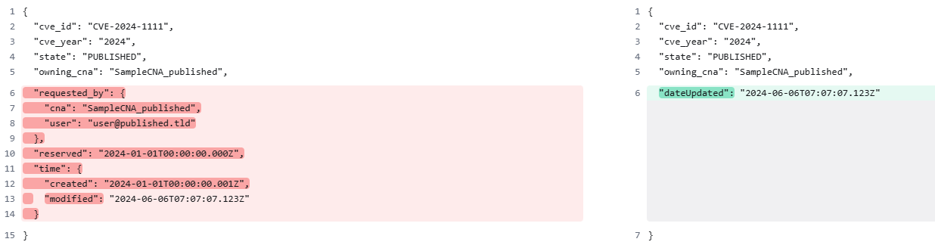
CVE Services GET /cve-id/{id} PUBLISHED contents
(as authorized user)
(as unauthorized user)
Notes:
For example, we will start with published CVE IDs,
As an authorized user, you could get all of the data on the left hand side
Which includes, cve id, year, state, the owner, some requester info, and timestamps for reserved, created, and last modified.
, however UNauthorized users are restricted to the data on the RIGHT hand side,
Which redacts requester info and some timestamps.
The data in the cve-id repo would look like the data on the right hand side.

Slide 16
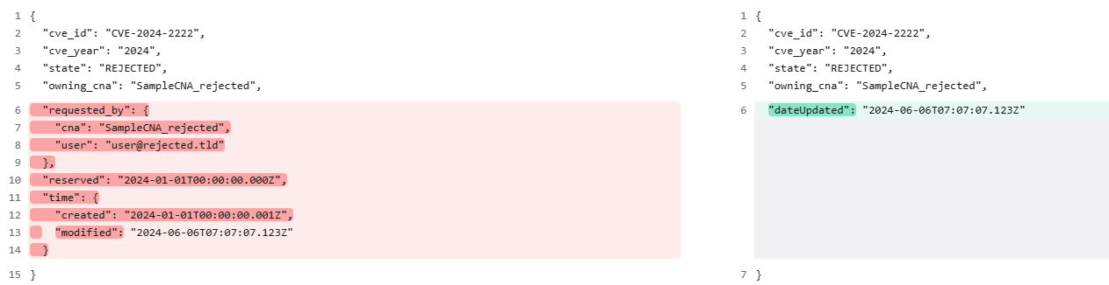
CVE Services GET /cve-id/{id} REJECTED contents
(as authorized user)
(as unauthorized user)
Notes:
Rejected CVE IDs follow the same pattern. Where, as an authorized user, you could get all of the data on the LEFT side which is the same as the published,
however UNauthorized users could only get what is on the RIGHT side, the same as the published.

Slide 17
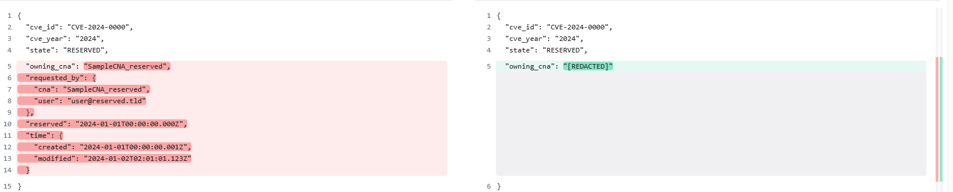
CVE Services GET /cve-id/{id} RESERVED contents
(as authorized user)
(as unauthorized user)
Notes:
As for Reserved CVE IDs, authorized users could get the data that is on the LEFT side which is the same as the previous two,
but UNauthenticated users can only get the cve id, year, and state as the rest is privileged.

Slide 18
Feedback
One file for all reserved CVE IDs
Cache of /cve-id
Something else?
Notes:
How do we feel about this proposed solution?
Pros of cache:
Available now, rather than a slow schema change.
It addresses potential future issues such as accurate CNA owners.
More cached history :D
Lets hear some yay or nays about the single reserved.json file, or the unprivileged data cache.
Do we want something else?
Kris, idk how you want to do this but I think we can open the floor here

Slide 23
Mocked activity
TIMESTEP | ACTIVITY
-1 | Last prod activity before mock begins: Publish reserved IDs: CVE-2024-3801, CVE-2024-3816
0 | Sync /cve-ids directory data with /cves: UPDATE /cve-ids & /cves
1 | Reserve new IDs: CVE-2025-0001
2 | UPDATE /cve-ids & /cves
3 | Reserve new IDs: CVE-2025-0002, CVE-2025-0003, CVE-2025-0004, CVE-2025-0005 Publish reserved IDs: CVE-2025-0001
4 | UPDATE /cve-ids & /cves
5 | Reject reserved IDs: CVE-2025-0003 Publish reserved IDs: CVE-2025-0004 Reserve new IDs: CVE-2025-0006
6 | UPDATE /cve-ids & /cves
7 | Reserve new IDs: CVE-2025-0007
8 | START UPDATE PROCESS… UPDATE PROC reads CVE Service /cve-id (reads CVE-2025-0007 reserved) Publish reserved IDs: CVE-2025-0007 UPDATE PROC reads CVE Service /cve (reads CVE-2025-0007 published) Finish UPDATE PROCESS…
Notes:
This is the mocked activity that you can find in the repo
We start with the last activity that we forked off of the prod database with…
Please note that the last timestep, number 8, demonstrates a potential edge case that shows why the two directories need to be seen as independent.

Slide 24
git log delta messages:
Combined
1 changes (1 reserved | 0 published | 0 updated):
- 1 Newly Reserved CVEs: CVE-2025-0001
- 0 Rejected Reserved CVEs:
- 0 Published CVEs:
- 0 Updated Published CVEs:
5 changes (4 reserved | 1 published | 0 updated):
- 4 Newly Reserved CVEs: CVE-2025-0002, CVE-2025-0003, CVE-2025-0004, CVE-2025-0005
- 0 Rejected Reserved CVEs:
- 1 Published CVEs: CVE-2025-0001
- 0 Updated Published CVEs:
3 changes (1 reserved | 1 published | 1 updated):
- 1 Newly Reserved CVEs: CVE-2025-0006
- 1 Rejected Reserved CVEs: CVE-2025-0003
- 1 Published CVEs: CVE-2025-0004
- 0 Updated Published CVEs:
2 changes (1 reserved | 1 published | 0 updated):
- 1 Newly Reserved CVEs: CVE-2025-0007
- 0 Rejected Reserved CVEs:
- 1 Published CVEs: CVE-2025-0007
- 0 Updated Published CVEs:
Notes:
Combined delta messages, all in one.

Slide 25
git log delta messages:
Separated
1 changes (1 new | 0 updated):
- 1 new CVE-IDs: CVE-2025-0001
- 0 updated CVE-IDs:
5 changes (4 new | 1 updated):
- 4 new CVE-IDs: CVE-2025-0002, CVE-2025-0003, CVE-2025-0004, CVE-2025-0005
- 1 updated CVE-IDs: CVE-2025-0001
3 changes (1 new | 2 updated):
- 1 new CVE-IDs: CVE-2025-0006
- 2 updated CVE-IDs: CVE-2025-0003, CVE-2025-0004
1 changes (1 new | 0 updated):
- 1 new CVEs: CVE-2025-0004
- 0 updated CVEs:
1 changes (1 new | 0 updated):
- 1 new CVE-IDs: CVE-2025-0007
- 0 updated CVE-IDs:
1 changes (0 new | 1 updated):
- 0 new CVE-IDs:
- 1 updated CVE-IDs: CVE-2025-0007
1 changes (1 new | 0 updated):
- 1 new CVEs: CVE-2025-0007
- 0 updated CVEs:
Notes:
Separate commits, one per directory
Note the similarities, but unique keys for CVE-ID vs CVE.

