Slide 2
Cognitive Systems Amplify the Human Experience

Slide 3

Cognitive computing enables systems to process and act on data, like humans
Understand
Reason
Interact
Learn
They understand
Intent, tone, personality
Submissions, contracts, claims
Legal & regulatory obligations, guidelines
News, market data…
like humans do
They can
Identify similar risks and claims
Assess risk
Check for compliance
Spot new sales opportunities, …
infer and extract ideas
With abilities to see, talk
and hear they can support
Clients, agents & broker
Contact center agents
Underwriter
Claims handler
and many others
in a natural way
They learn from every interaction and
Extract and improve best practices
Digest new regulatory requirements, guidelines…
and never stop learning
Notes:
A COGNITIVE BUSINESS HAS SYSTEMS THAT CAN ENHANCE DIGITAL INTELLIGENCE EXPONENTIALLY.
Key to attaining a richer digital intelligence are cognitive systems.
With analytics, we get key insights from data, but with cognitive systems, we can turn those key insights into knowledge.
Traditional computing is programmed (rules-based, logic-driven, dependent on organized information), but cognitive systems are probabilistic (they learn systematically, they are not dependent on rules, they handle disparate and varied data).
Cognitive systems can understand unstructured information such as the imagery, natural language and sounds in books, emails, tweets, journals, blogs, images, sound and videos.
They unlock meaning because they can reason through it, giving us new contexts to weigh and consider.
Cognitive systems also learn continually, honing our own expertise so we can immediately take more informed actions.
And they interact with us and with our customers, dissolving barriers between humans and machine, fueling unique, essential user experiences.

Slide 4
Artificial Intelligence and Sub Categories
Artificial Intelligence
Cognitive
Machine Learning
Deep Learning
the study of "intelligent agents": any device that perceives its environment and takes actions that maximize its chance of success at some goal
Systems that learn at scale, reason with purpose and interact with humans naturally.
Computers the ability to learn without being explicitly programmed.
Sometimes called neural networks, uses a cascade of many layers of nonlinear processing units for feature extraction and transformation.
Notes:
AI is the field of study that focuses on enabling machines, devices, systems to come more intelligent, by sensing or perceiving the environment and taking action for the purpose of maximizing success in achieving a goal.
AI Draw upon Comp-Sci, Math, Psychology, linguistics, Philosophy, Neuro Science
Goals: Reasoning, Knowledge, Planning, Learning, NLP, Perception, Robotics
Supervised: Supervised learning is the machine learning task of inferring a function from labeled training data.^{[1]} The training data consist of a set of training examples. In supervised learning, each example is a pair consisting of an input object (typically a vector) and a desired output value (also called the supervisory signal).
Pattern Matching
Regression
Unsupervised: Unsupervised machine learning is the machine learning task of inferring a function to describe hidden structure from "unlabeled" data
Estimation Problems
Clustering, Compression Filtering
Reinforcement Learning: longer running scenarios
Games
Sequential decision making
Artificial Neural Networks
Bayesian structural time series (BSTS)
Ensambles
Clustering

Slide 5

Cognitive solutions create a new partnership
between humans and technology
Cognitive Solutions
excel at:
Humans excel at:
Locating knowledge
Common sense
Identifying Patterns
Morals
Natural language
Imagination
Machine Learning
Compassion
Eliminating bias
Abstraction
Offering Endless capacity
Dilemmas
Dreaming
Generalization
Notes:
Humans are inherently capable of a set of skills that help us learn, discover and make decisions:
We can apply common sense, morals, and reason through dilemmas; we can dream up new ideas and make generalizations when essential clues and pieces of information are missing.
But we’re restricted by the time it takes to learn, process, and absorb new information and limited by the unconscious biases we all possess that influence the decisions we make.
Cognitive systems, like Watson, are systems that:
Understand: They understand data – structured and unstructured, text-based or sensory – in context and meaning, at astonishing speeds and volumes. In fact, Watson reads 800 million pages per second.
With one client, Watson initially ingested 80 million documents and incrementally adds 30,000 additional documents every day.
Reason: They have the ability to form hypotheses, make considered arguments, and prioritize recommendations to help humans make better decisions.
Learn: They ingest and accumulate data and insight from every interaction, continuously. And they’re trained, not programmed, by experts who enhance, scale, and accelerate their expertise, and therefore get better over time. They never stop learning. It’s the difference between the strategies we used as children to solve mathematical problems, and the strategies we developed when we got into advanced strategies like geometry, algebra and calculus.
And working together with systems like Watson, we can achieve the kinds of outcomes that would never have been possible otherwise:
For instance, a Baylor Medical School retrospective study focused on a particular protein, called p53 -- a protein that inhibits tumor growth in cancer patients.
Holding constant all the research and insights that had been done prior to 2003, and testing Watson's capabilities against it, Watson was able to extract from the over 23M Medline articles it read, a 100% of the known proteins that affect p53. It compressed what had been a decade of research to a matter of weeks.
Watson was also able to identify the 7 new proteins that have been discovered since 2003 as well as 6 new phosphates that appear to impact p53, all of which are now being investigated.
But this is just one example; oil pipeline analysts are using Watson to trim years off of production timelines; SwissRe -- one of the world’s largest reinsurance companies -- is using Watson to reimagine the practice of insurance underwriting.

Slide 6
A Continuum of Capabilities
Research
New Algorithms
Chips
Core Technologies
ML/Deep Learning
Neural Networks
Platforms
Watson API's
General Solutions
Industry Solutions
Hardware
Analytics
Data Management
PowerAI
Data Science Experience
Watson Conversation
Watson Discovery
Knowledge Studio
Watson Explorer
Security
Healthcare
Internet of Things
Surveillance Insight
Customer Insight

Slide 7



The cognitive APIs are part of ONE architecture for cognitive and cloud
Highly scalable and flexible, enabled with security, to meet our client's most aggressive needs
Applications
Finished products for clients
Watson Oncology
Watson Cyber Security
Weather
GBS/GTS Ind. Solutions
Watson Virtual Agent
Watson Company Profiler
IBM Risk
& Compliance
Asset Mgmt.
(Maximo)
+ more
AI
Building blocks for developers
Conversation
Discovery
Compare/
Comply
DLaaS
Tone Analyzer
Personality Insight
API
API
API
API
API
API
API
Visual Recognition
API
Speech
API
IoT
API
NLU
API
NLC
API
Knowledge Query
Data
Tools to prepare data for cognitive
Crawl
Cleanse
Enrich
Store
Cloud
A highly scalable, security enabled foundation
Developer Services – IAM, Billing, Logging, Monitoring, + more
Firewall/
Reverse Proxy
Object Storage
DNS
Dedicated Machines
Virtual
Machines
Networking
File Storage

Slide 8
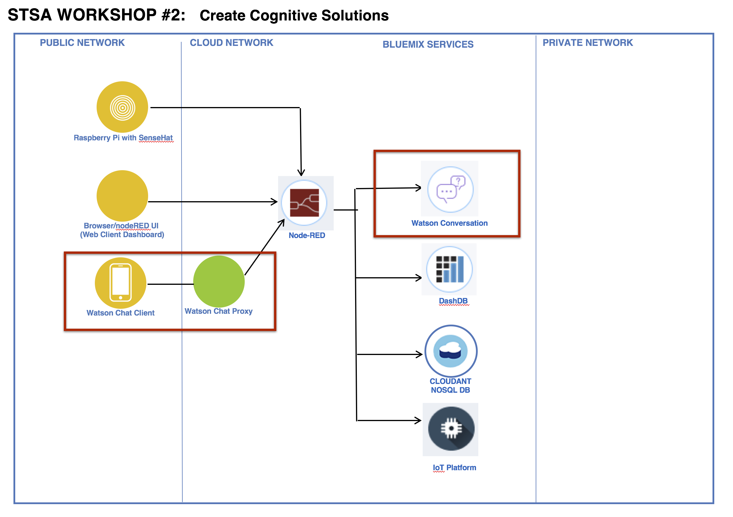
Watson Conversation in the Cloud Reference Architecture

Slide 9




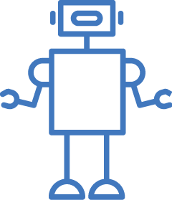
Uses for Conversational Agents
Customer Service Add a chatbot to your website that automatically responds to your customers’ most frequently asked question | Mobile Apps Allow your customers to control your mobile app using natural language virtual agents | Messaging Channels Build Twitter, Slack, Facebook Messenger, and other messaging platform chatbots that interact instantly with channel users | Internet-of-Things Power connected devices to understand language and respond to your users’ commands | Robots Power your robots with natural language understanding and conversational capabilities

Slide 10






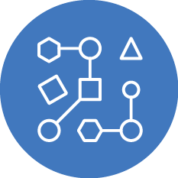
Watson as the Center of Customer Engagement
Flexible, cost-effective solutions for building chat bots and virtual agents
Build from the ground up or buy pre-built capabilities
Build once, deploy across multiple platforms
Create natural language interactions with your end-users, including Q&A and onboarding
Detect emotional states* and responds in appropriate ways
Create an omni-channel experience for better user engagement
Walk customers through business processes like application forms or resetting a password
Advanced Machine Learning capabilities
*Leveraging Watson Tone Analyzer

